Slide 1


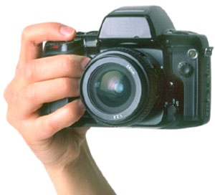
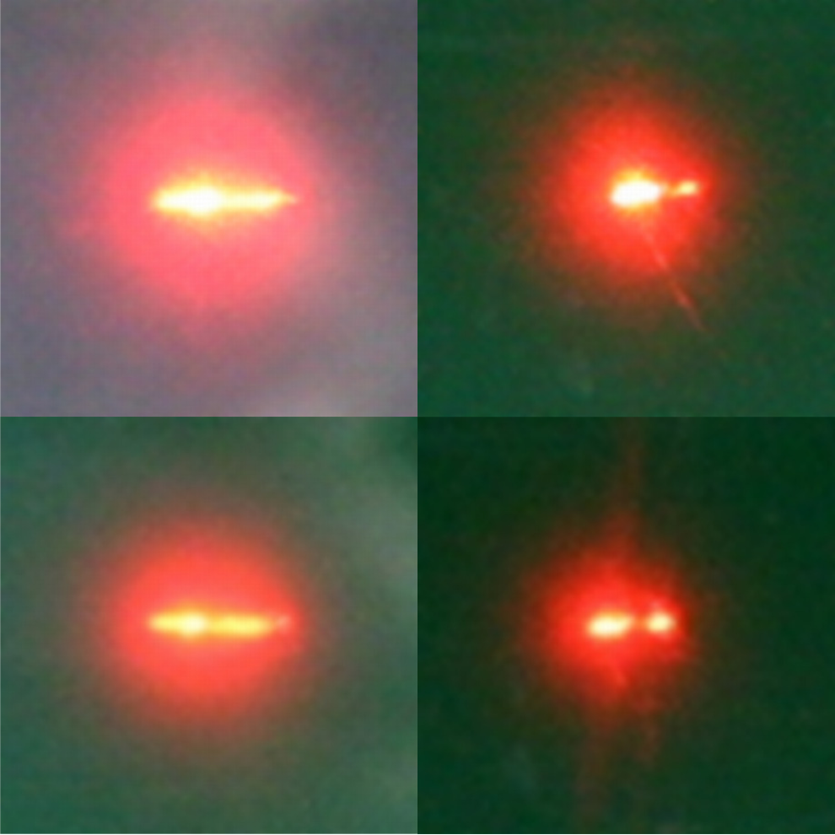

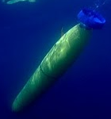


A novel concept for measuring
seawater inherent optical properties in and out of the water
Alina Gainusa Bogdan and Emmanuel Boss
School of Marine Sciences, University of Maine, Orono, ME, 04469, US
Aim: Test sensor concept inspired by atmospheric THOR instrument (Cahalan et al., 2005), to simultaneously measure the absorption (a) and backscattering (b_{b}) coefficients of seawater.
Applications: water quality assessment - turbidity measurements; oceanography and ecology - characterization of algal blooms and biogeochemical processes; calibration of satellite ocean color.
Idea
Shine laser in water samples with different IOPs → observe the intensity and geometry of the backscattering spot.
Emerging ideas
a₀
b₀
a₁> a₀
b₀
Side view
Top view
Typical signal
Hand-held in-water instrument
Long instrument mounted on AUVs
photon detected
photon emitted
3D profiling of a and b_{b}
Plausible:
Adaptations to optical model
photon absorbed
Out-of-water instrument
a₁
b₁> b₀
a₂> a₁
b₁
Long-term deployment
on dry platforms
Interpret in terms of beam attenuation with path length.
Figure 1. Photographs of the backscattering spot for a series of solutions with increasing concentrations of absorbing (green die) and scattering (Maalox) agents. The camera sensitivity and exposure time were held constant.
photon scattered
R = 3.1 cm
Δr = 1 cm
Discussion
D (Intensity)
α (Geometry)
Test inversion on data
obtained using the
Petzold scattering
phase function
=> inversion algorithm
not sensitive to volume
scattering function (VSF),
at least within the range
shown in Figure 6.
Quality of b_{b} inversion does not depend on the instrument size; larger instrument => better a inversion
Increasing the detector resolution does NOT improve the quality of IOP inversions
Radial symmetry of backscattering spot => other instrument shapes possible (keeping symmetry with respect to the center of illumination)
IOP change | Effect on backscattering spot
Scattering | Intensity
 | Lateral spread
Absorption | Intensity
 | Lateral spread
D
Cumulative photon count
(Detected/incident) photon count
Scattering
Absorption
α
Figure 6. Range of VSF shapes (in the back direction) used in this study.
‘FF’ stands for ‘Fournier-Forand’.
^{dIntensity}/_{dScattering}
^{dGeometry}/_{dScattering}
r [m]
r [m]
IF
≠
Figure 3. Sketch of the proposed sensor, with typical modeled measurement. A collimated light beam is shone into the water and the backscattered light intensity is retrieved as a function of distance from the center of illumination by three concentric photodetector rings. The signal is described by the integrated detected photon count within each ring as a function of the distance from the center. The final signal descriptors are calculated on the basis of the cumulative photon count within each radius.
The total detected photon count, D, is an indicator of the retrieved intensity; the geometry parameter, α, is a measure of the lateral spread of detected light.
^{dIntensity}/_{dAbsorption}
^{dGeometry}/_{dAbsorption}
THEN
Intensity
Geometry
Scattering
Absorption
Methodology
Use Monte Carlo modeling of light propagation to simulate the instrument response to different IOP combinations
Results
b_{b} = 10^{1.048log10(α)+0.341} (1)
Identify robust mathematical relationships between the known, imposed IOPs and some descriptors of the modeled instrument signal
b_{b}
= 10-0.074log102(D)+0.353log10(D)+0.656 (2)
a
Figure 2. Particulate absorption and scattering values chosen to drive the optical simulations.
These equations can be used to obtain a and b_{b} from a given measurement described by D and α. The maximum relative errors when this inversion is applied to the original modeled data set are 13.4% for the inversion of b_{b} and 56.9% for a. 90% of the errors fall below 6.9% for b_{b} and below 29.7% for a.
The signal retrieved by the instrument is determined mainly by a and b_{b}, with little or no added effect from the backscattering ratio, B_{p}.
Invert relationships to obtain the algorithm that the actual instrument would use to convert a measured signal into estimates of the water IOPs
+
B_{p} ≡b_{bp}/b_{p}= [0.5%,1%,1.5%,2%,2.5%]
Low B_{p} values are typical of organic particles (e.g., phytoplankton); high values are typical of inorganic particles (e.g., suspended sediments).
Particle scattering is modeled using the Fournier-Forand phase function (Fournier & Jonasz, 1999)
Figure 4. Water IOPs plotted against resulting signal descriptors. b_{b} - backscattering coef.; a - absorption coef.; α - geometry parameter.; D - intensity.
Figure 5. Histograms of the relative errors in inverting b_{b} and a from the modeled instrument response to the full range of IOPs
References: R F Cahalan, M McGill, J Kolasinski, T Várnai, and K Yetzer. THOR – Cloud thickness from off beam LIDAR returns. Journal of Atmospheric and Oceanic Technology, 22:605-627, 2005
G R Fournier and M Jonasz. Computer-based underwater imaging analysis. Airborne and In-Water Underwater Imaging, 3761(1):62-70, July 1999
Acknowledgements:

