Slide 1
Welcome to 2011 Ocean Optics Class SMS 598: Calibration and Validation for Ocean Color Remote Sensing, 11-29 July 2011
Instructors: Emmanuel Boss, Mary Jane Perry – UMaine
Curt Mobley – Sequoia Scientific (Wed. night)
Collin Roesler – Bowdoin College
Ken Voss – U. Miami (week 2)
Jeremy Werdell – NASA Goddard
TA: Meg Estapa – UMaine
Help from: Emily Kallin, Ivona Cetinic – UMaine

Slide 2
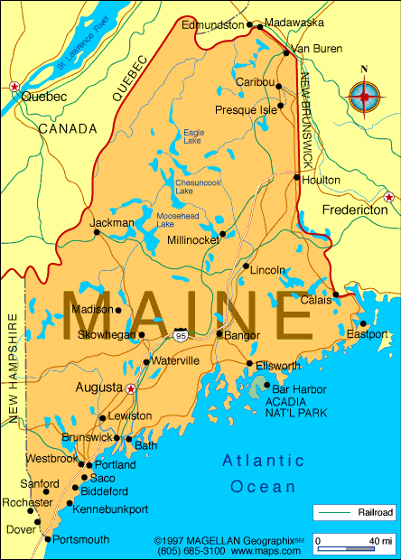
Welcome to Maine
Maine facts:
Population (2009): 1,318,301
Coastline: 5300 miles
Area: 35,387 miles² + 4,523 miles² of inland waters.
Seasons: Tourist, Foliage, Ski, & Mud (some further subdivide it according to pests).
Welcome to Maine

Slide 3
History of the Ocean Optics class
1985, 1987, 1989, 1995, 1998, 2001, 2004, 2007 and now 201. This is 9th class!
MJP started it; CR was student that year. EB was student 1995. CM joined in 1995.
O(130) graduates, including Paula Bontempi at NASA
Many graduates are leaders in their fields: Ray Najjar, Dennis McGillicuddy, Heidi Sosik, to name a few.
Evolution and highlights:
1985: 1 Spec, 1 PAR sensor, a spectral transmissometer, turner.
1987: 1 computer, FCM
1989: symposium + book
1995: Hydrolight
1998: hyper-spectral overflights. Special Ocean Sciences session.
2001: Maine.

Slide 4
Logistics: safety, meals, linen, Maine activities, etcetera
Requirement for team work, each member with his/her own focus. Collaborative environment. Learning community. Network. Contribute to advancement of ocean sciences, through ocean optics.
Course schedule and Syllabus
SIDE BOX

Slide 5
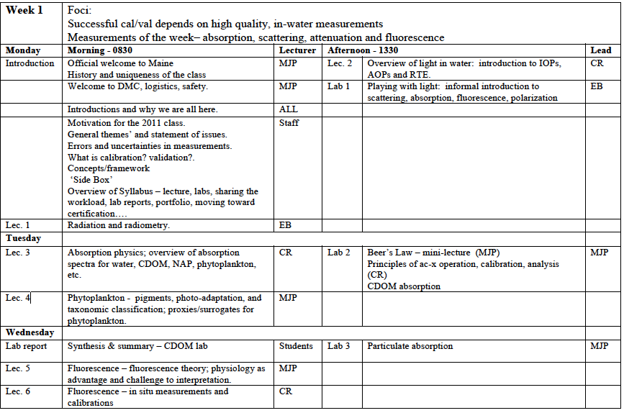
Saturday class this week only - 0900

Slide 6
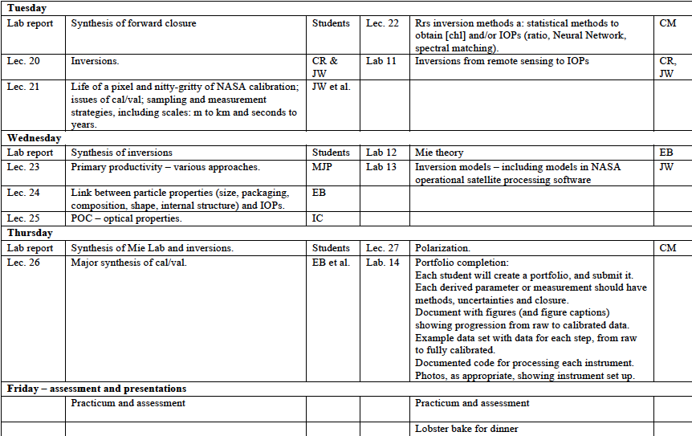

Slide 7
INTRODUCTIONS NAME of person you are introducing: WHERE she or he comes from (state/country and school or institution): THE PAST – something about the person’s background that resulted in him/her being in this course: THE FUTURE – something about her/his future plans, that he/she hopes the course will help in achieving: THE PRESENT – something that she/he wants to get of this course and how everyone else can contribute to this experience (it might be asking for help in something challenging): THE UNEXPECTED – something that we would never guess about the person’s activities, skills, or interests:

Slide 8
Sampling strategy must include appropriate spatial/temporal scales.
Understanding
marine biogeochemical cycles and ecosystems
on regional-to-global scales requires calibrated, validated satellite ocean color data.
Successful cal/val depends on high quality, in-water measurements.
Measurement – measurement closure and measurements – model closure reduce uncertainty.

Slide 9
satellite
radiometry
The motivation
In-water
optical
properties;
surrogates
real entity
(cell, POC, etc.)
The optics problem
ecosystem;
carbon cycle;
climate system;
fisheries;
HABs; etc.

