Slide 1

Atmospheric Correction and Adjacency effect (a little)
Ken Voss, Ocean Optics Class, Darling Center, Maine, Summer 2011

Slide 2
Introduction
Outline:
Introduce the problem
Discuss standard atmospheric correction algorithm
Discuss some of the more standard augmentations to this algorithm
Discuss coupled models
Adjacency effect, what is it?

Slide 3
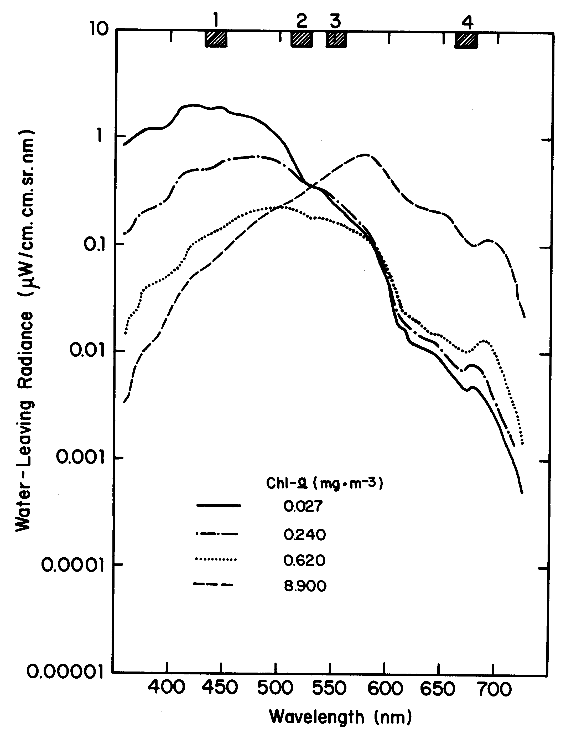
Introduction
What is the primary object of ocean color imaging? (note, not without controversy)

Slide 4
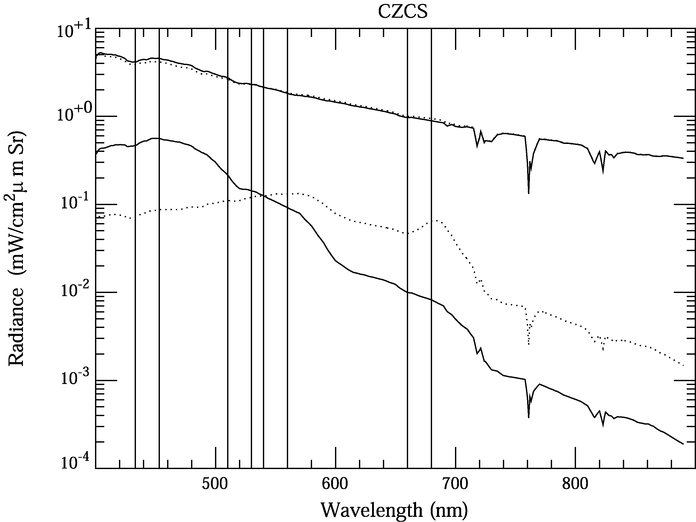
Introduction
What does a satellite see from space?
Note this is where the rule of thumb statement: 10% accuracy requires 1% TOA
comes from, 90% of signal is atmosphere.

Slide 5
Examples of Atmospheric Effects
The MODTRAN atmospheric model was used to compute the radiance incident onto the sea surface.
HydroLight was used with the MODTRAN incident radiance to compute the water-leaving and surface-reflected radiances.
MODTRAN was then used to propagate the water-leaving and surface-reflected radiances to the sensor, and to compute the atmospheric path radiance contribution to the measured total radiance at the sensor.
(The combined HydroLight-MODTRAN code was developed for Northrop-Grumman for design of the NPOESS-VIIRS sensor and is proprietary. I can show you results but not the code or algorithms. NPOESS-VIIRS is National Polar-Orbiting Environmental Satellite System-Visible Infrared Imager Radiometer Suite, now called JPSS-VIIRS, Joint Polar Satellite System, to be launched in a few years, maybe, with luck….)
From Curt M.

Slide 6
Simulated Atmosphere and Water
MODTRAN was run with typical atmospheric conditions for mid-latitude summer, marine aerosols, sun at 50 deg, cloudless sky, 6 m/s wind speed, etc. These conditions were typical of excellent remote-sensing conditions (63 km horizontal visibility at sea level)
HydroLight v5 was run for homogeneous, infinitely deep, Case 1 or 2 water.
  --Case 1: used the “new” Case 1 IOP model with Chl = 1
  --Case 2: used Chl = 1 plus calcareous sand mineral particles with a concentration of 2 gm/m³
From Curt M.

Slide 7
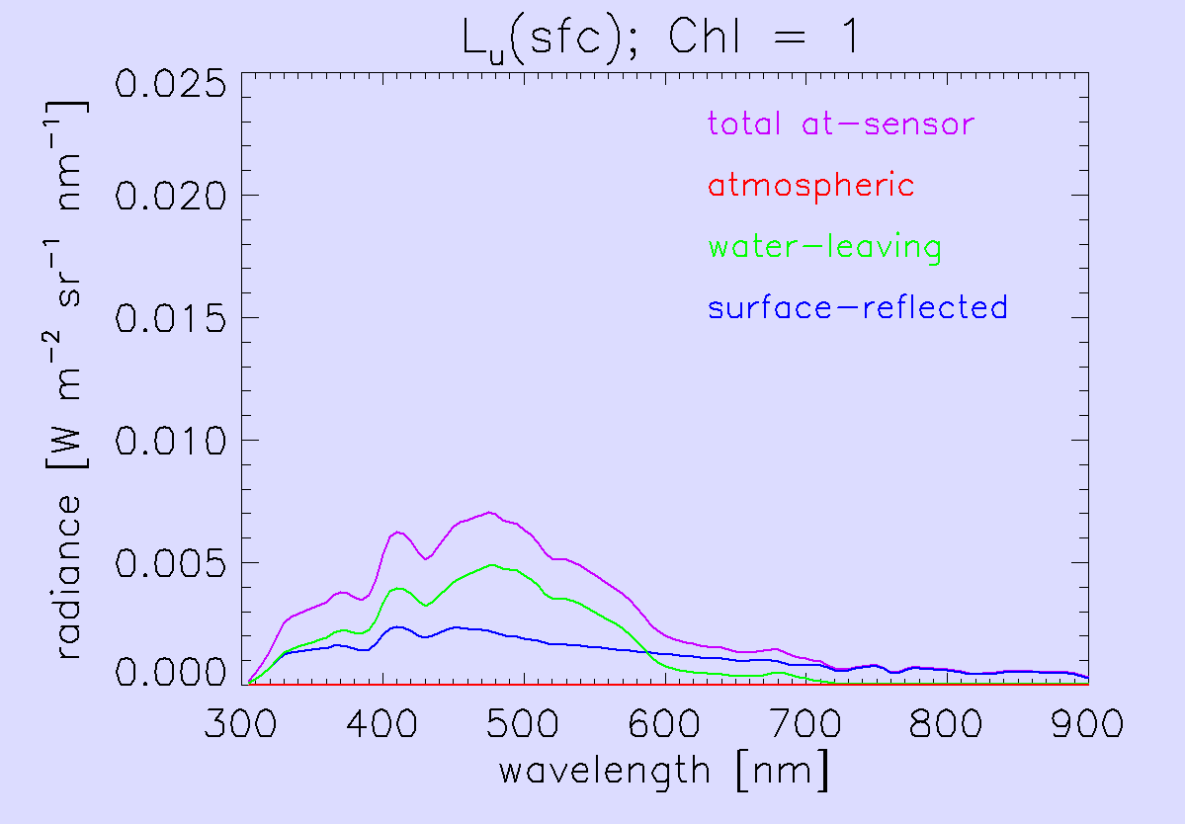
Example for Case 1 Water
Upwelling (nadir-viewing) radiance measured just above the sea surface.
From Curt M.

Slide 8
Example for Case 1 Water
Upwelling (nadir-viewing) radiances just above the sea surface
L_{u}: this is what the sensor measures
From Curt M.

Slide 9
Example for Case 1 Water
Upwelling (nadir-viewing) radiances just above the sea surface
L_{w}: this is what you want
Note that L_{w} ≈ 0 for λ > 750 nm
From Curt M.

Slide 10
Example for Case 1 Water
Upwelling (nadir-viewing) radiances just above the sea surface
L_{sr}: this is noise (reflected sky radiance and sun glint)
From Curt M.

Slide 11
Example for Case 1 Water
Upwelling (nadir-viewing) radiances just above the sea surface
L_{atm}: there is no atmospheric path radiance at 0 altitude
From Curt

Slide 12
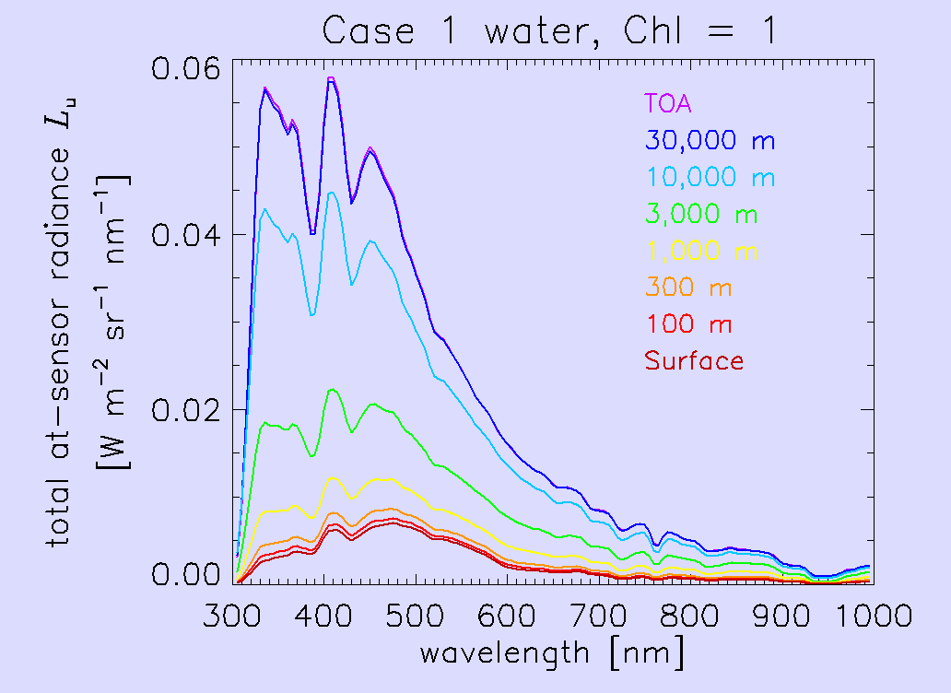
Total At-sensor Radiances at Various Altitudes
Most airborne remote sensing is done from altitudes of 1,000 to 10,000 m. Atmospheric path radiance is very important
From Curt

Slide 13
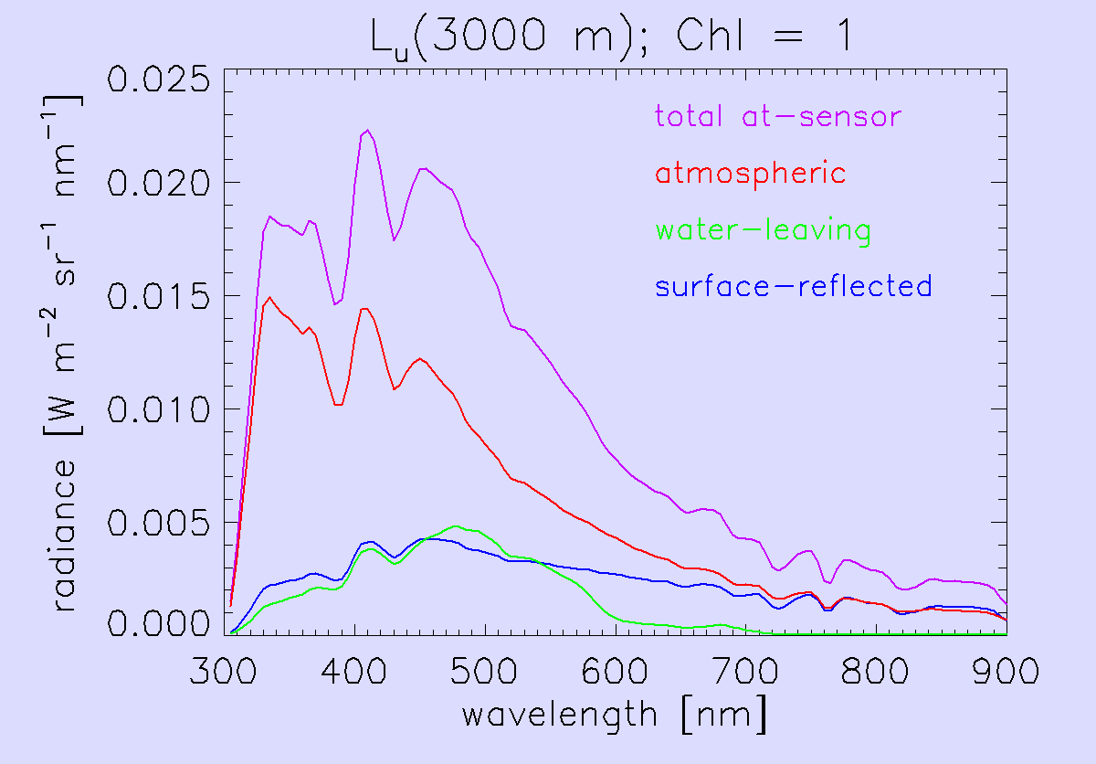
Radiances at 3,000 m Altitude
This is the altitude of the PHILLS/SAMPSON sensor by Curt’s work
Atmospheric path radiance is now most of the measured total
From Curt M.

Slide 14
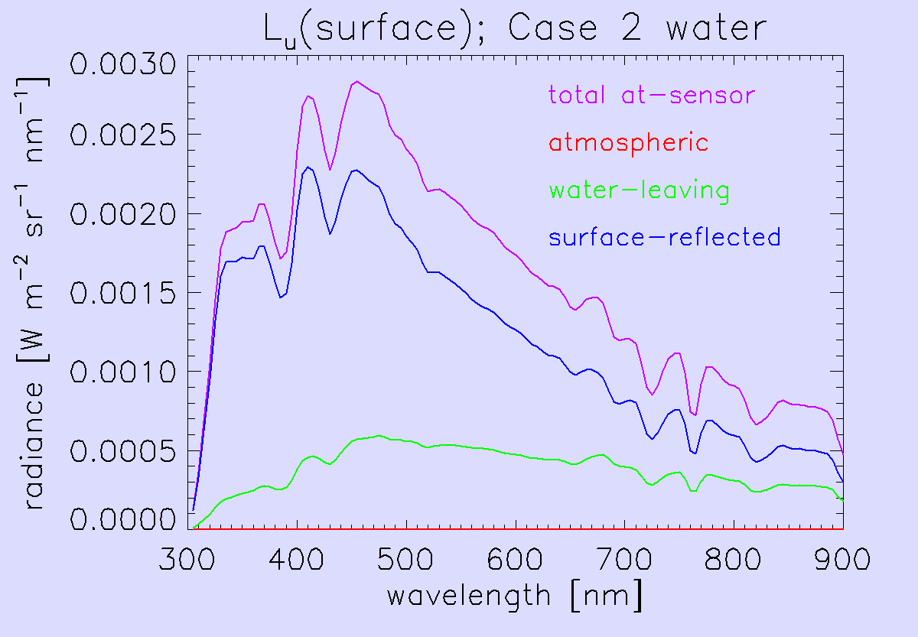
Example for Case 2 Water
Upwelling (nadir-viewing) radiances just above the sea surface
Now L_{w} > 0 for
λ > 750 nm
From Curt

Slide 15
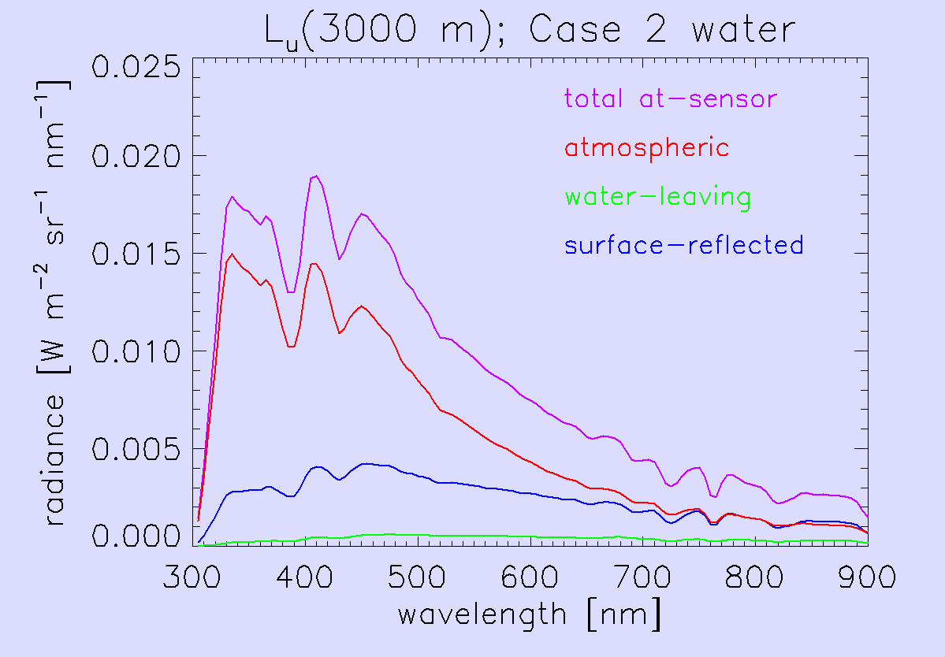
Example for Case 2 Water
Upwelling (nadir-viewing) radiances at 3,000 m altitude
From Curt M.

Slide 16
Introduction
Algebraically (and simply) what is the signal at the top of the atmosphere (TOA)?
L_{toa} = L_{rayleigh} + L_{aerosol} + tL_{glitter} + tL_{w} + complications
L_{toa}: Top of the atmosphere signal
L_{rayleigh}: Radiance at TOA due to Rayleigh (molecular) scattering
L_{aerosol}: Radiance at TOA due to aerosols
L_{glitter}: Radiance at surface due to reflection of direct and sky radiance off of surface
L_{w}: Radiance at surface (above) from light scattered in the water column
t: diffuse transmittance through atmosphere of signal at surface

Slide 17
Introduction
L_{toa} = L_{rayleigh} + L_{aerosol} + tL_{glitter} + tL_{w} + complications
1 and 2 are tLglitter
3 is L_{aerosol} and L_{rayleigh}
4 is tL_{w}
2
3
1
4

Slide 18
Standard algorithm, in simplest form
L_{toa} = L_{rayleigh} + L_{aerosol} + tL_{glitter} + tL_{w} + complications
Note: remember these all depend on wavelength and geometry (incident sun angle, viewing geometries), complications include whitecaps, aerosol-rayleigh interaction…
Lets change the notation slightly and instead of using L, use reflectance ρ:
ρ=πL/(E_{o} μ_{o}) where E_{o} is extra terrestrial solar irradiance, and μ_{o} is the cosine of the solar zenith angle

Slide 19
Standard algorithm, in simplest form
Can calculate ρ_{rayleigh} so:
ρ_{toa}-ρ_{rayleigh} = ρ_{aerosol} +tρ_{glitter} +tρ_{w}
Group terms:
ρ_{toa}-ρ_{rayleigh} = (ρ_{aerosol} +tρ_{glitter}) +tρ_{w}

Slide 20
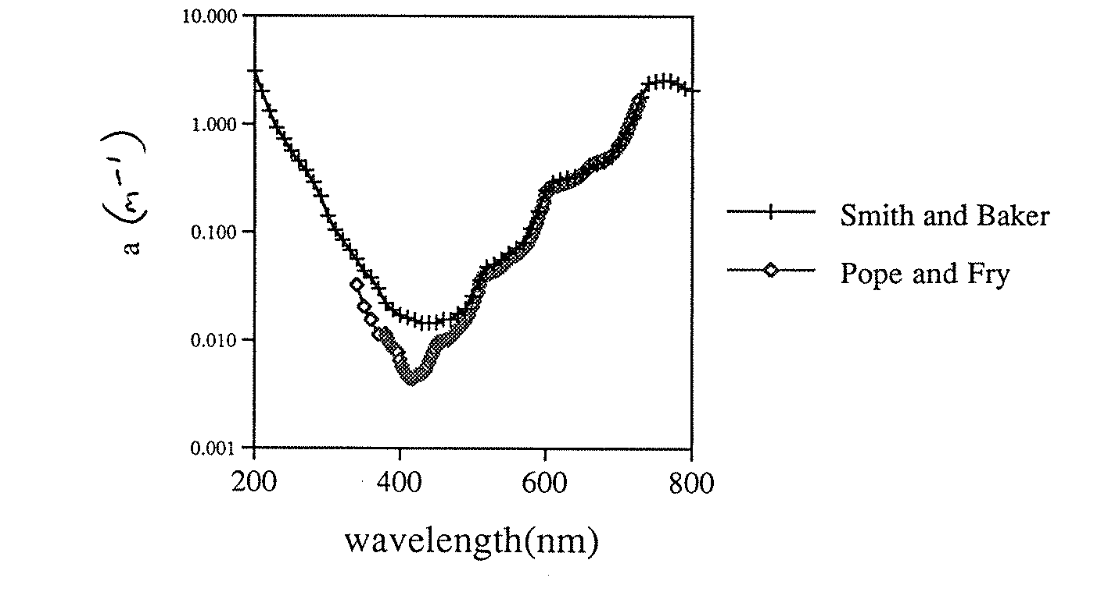
Standard algorithm, in simplest form
Take advantage of very high absorption in infrared wavelengths:

Slide 21
Standard algorithm, in simplest form
Which causes very little light
To come out of the ocean above
650 nm or so.
Note problem (discussed later)
In very productive, or coastal
Waters.

Slide 22
Standard algorithm, in simplest form
So go into infrared where we assume ρ_{w}(λ) = 0
Then:
ρ_{toa} -ρ_{rayleigh} (λ) = ρ_{aerosol}(λ) +tρ_{glitter}(λ)
Assume ρ_{glitter} = 0, so left with ρ_{aerosol}
Next step is to define a term ε, such that
ε(λ_{1,} λ₂)= ρ_{aerosol}(λ₁)/ρ_{aerosol}(λ₂)
Use two wavelengths in the near infrared and find this
ε.

Slide 23
Standard algorithm, in simplest form
Now ε can be shown to be:
ω is single scattering albedo (b/c), =1 for non-absorbing aerosol
P is phase function (angular scattering of light) for aerosols,
not strongly varying with wavelength, α₊ is scattering angle for
direct scattering (incoming to outgoing),
α₋ is angle for scattering and a reflection from the surface
μ is cosine of the angle, either incoming (μ_{o}) or outgoing (μ)
Now only factor that varies strongly with wavelength is τ, so

Slide 24
Standard algorithm, in simplest form
So, we either assume:
Angstrom law
Or match ε(λ₁,λ₂) to an aerosol model, and use this model to
propagate to other λ: ε(λ,λ₂)
SeaWiFS/MODIS algorithms basically do this. Models must be selected
to contain a wide range of ε and τ, but not so wide that the lookup
tables are too multivalued.
Note: this routine is aimed at accurately correcting ocean color data, not
necessarily retrieving an atmospheric τ(an important parameter for the
atmosphere), since we are using backscattering to do determine it, and
τis mostly a forward scattering parameter. Can do an excellent job at
atmospheric correction, without getting τ right.

Slide 25
Standard algorithm, in simplest form, examples

Slide 26
Standard algorithm, in simplest form

Slide 27
Standard algorithm, in simplest form

Slide 28
Standard algorithm, in simplest form

Slide 29
Standard algorithm, in simplest form, epsilon

Slide 30
Standard algorithm, augmentations
Problems with standard algorithm:
Assume “black pixels” at two wavelengths (SeaWiFS and MODIS) in first order.
Doesn’t deal well with absorbing aerosols, which often have a spectral
dependence and the correction varies with altitude of the aerosol….
Ignores multiple scattering, but this can be addressed by calculating
Rayleigh scattering with multiple scattering tables.

Slide 31
Standard algorithm, augmentations
Deal with first problem, “black pixel assumption”
At least two options:
First move farther out (1100-2100 nm) where water
is truly black….often hear Menghua Wang talking about
this.
Second, an iterative algorithm based on some water model
this is done now for SeaWiFS and MODIS…basically using some
form of the Garver Siegel model (GSM). Here use first guess
(black pixel) to get guess of water optical properties, then use water
optical properties to get ρ(λ) for water….then do correction again..
Jeremy covered this last week…

Slide 32
More advanced algorithms….some examples
A class of more advanced atmospheric corrections is the coupled atmosphere-ocean model.
Basic idea is to take L_{toa} and try to simultaneously find atmosphere and ocean components. In the end, requires models of ocean and models of atmosphere….basically vary inputs to ocean and atmosphere models until total matches measured total.
Need to worry about multivalued results….among other issues.

Slide 33
More advanced algorithms….some examples
Stamnes et al. (Applied Optics, pg 939, 2003)
COA-DISORT: coupled ocean atmosphere – discrete ordinate radiative transfer
Divides atmosphere and ocean into two plane parallel slabs, which are separated into
enough layers to resolve any variations you want to put in
Interface is flat surface
Paper above uses Shettle and Fenn models or more complicated aerosol models
Use their own model for water properties.

Slide 34
More advanced algorithms….coupled models

Slide 35
More advanced algorithms….some examples
So much for balanced view….honestly many coupled models out there, but
here are two more examples;
Spectral Optimization Model (SOA, Kuchinke et al. 2009, RSE,pg 610)
Atmospheric model: 72 input aerosol models, including absorption.
Water model: choose a*_{ph}, S_{cdm}, and η before hand.
a_{ph}(λ) = C a*_{ph} (λ)
a_{cdm}(λ)= a_{cdm}(443) exp(-S_{cdm}(λ-443)
b_{bp}(λ) = b_{pb}(443) (443/λ)^{η}
So water model can be represented as:
ρ_{w}(λ) = ρ_{w}(λ, C, a_{cdm}, b_{bp})
Vary these parameters until the remote sensing signal matches the model

Slide 36
More advanced algorithms….SMA
Spectral Matching Algorithm: tuned for specific aerosols, for example dust.
Banzon et al (RSE, pg 2689, 2009)
SMA uses aerosol models characterized by ω_{o} and P_{a}(θ). And then uses
a water model based on Chl and particle backscattering, bº.
Keeps varying these parameters until spectrum is matched within a certain value.
Works really well in Dust, when dust is dominant, but standard model works better in
general case….

Slide 37
More advanced algorithms….future algorithms
Standard algorithms work very well in case I and non-absorbing aerosols.
Need improvement in Case II and absorbing aerosols
Coupled models depend on accurate model of water reflectance and
Atmosphere….really depend on models.
Future will bring (hopefully) coupled Ocean color and lidar systems so
vertical distribution can be figured out, important for absorbing aerosols…
Channels in the infrared for better “black” pixel
Channels in UV (for coastal waters, also black) to constrain the blue side….

Slide 38
Adjacency effect
Adjacency effect is basically the effect a bright object (cloud, land, etc) has on
neighboring pixels. Can be characterized by the Point Spread Function:
Meister et al.
2005

Slide 39
Adjacency effect
Effect of small (3 x 3 pixel cloud), as this is TOA effect, 1% is a large problem.
I think for MODIS, OBPG applies 5x7 cloud mask(?), but limits work in coastal water.
Meister et al.
2005

Slide 40
Conclusion
Standard model works well in Case 1 waters, without absorbing aerosols
Add absorbing aerosols, then altitude of aerosols matters…need this information
(lidar, ancillary data?)
Coupled models are interesting, could help, but also are very dependent on water
model and atmosphere model used.
All atmospheric corrections dependent on good calibration of sensor, and calibration of sensor. Is atmospheric correction dependent…..

Slide 41
Standard algorithm, in simplest form
Question the other day on where does πcome from?
A surface with reflectivity,ρ, has ρFlux_{on} = Flux_{off}
So:
And for a lambertian surface, radiance from a unit area is:
So:

