Slide 1
Light and Radiometry
*Based on lectures by Mobley, Roesler & Lewis
How to quantitatively describe “how much” light there is, where it is going, etc.?
Different ways to quantify light:
Energy [W m⁻²]. Useful when we are interested in heating rates.
Number of photons [Einstein= Mol (6.023.10²³) photons m⁻² s⁻¹]. Useful for photosynthesis, photochemistry.
At what wavelength?

Slide 2
Radiometry
The science of measuring electromagnetic energy.
Detectors:
Thermal-instrument response is proportional to energy (absorbed and converted to heat)
Quantum-response is proportional to number of photons (photoelectric devices).
Calibration of radiometric instrument is non trivial (~2-3% accuracy (1% @ NIST), precision ~0.1%).
How do we measure spectrally resolved radiation?
→ For years it was easier to define the euphotic depth by a % of surface light rather than a constantisolume.

Slide 3
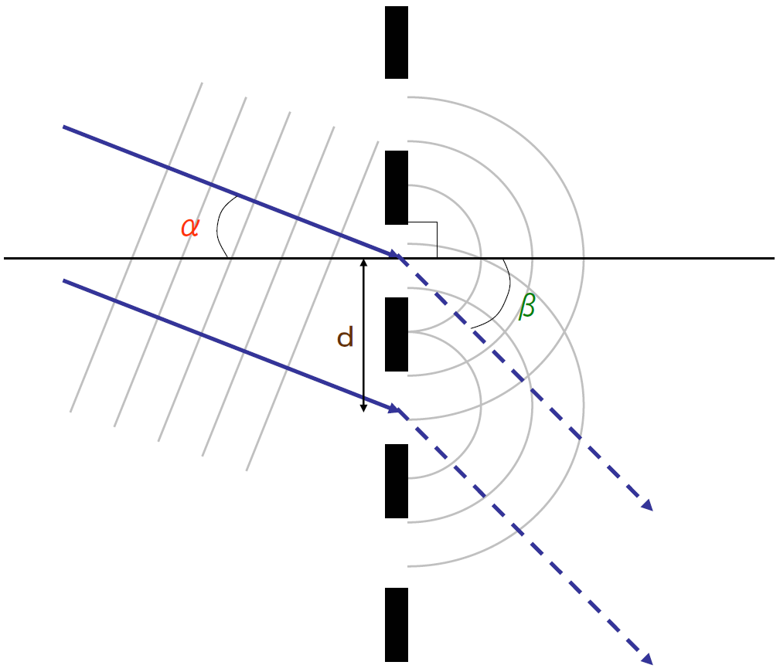
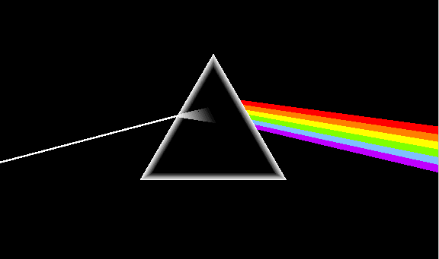
Separating light into its spectral components:
Spectrometers
Diffraction grating:
Prism:
http://commons.wikimedia.org/wiki/Image:Diffraction_grating_principle.png
http://www.abdn.ac.uk/~u20lm5/px2013/app2.htm

Slide 4
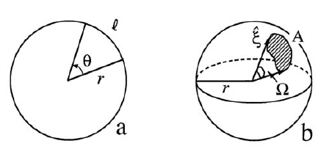
Geometrical foundation
Angle and solid angle review:
= arc-length/radius
or
l = θr
Ω= Area/radius²
or
A = Ωr²
Units ?

Slide 5
Computing solid angles:
r dθ
r sinθ dφ
dθ
dφ
θ
r
dΩ = dA/r²
φ
dΩ = r² sinθ dθ dφ/r²
θ-zenith angle
φ-azimuthal angle

Slide 6
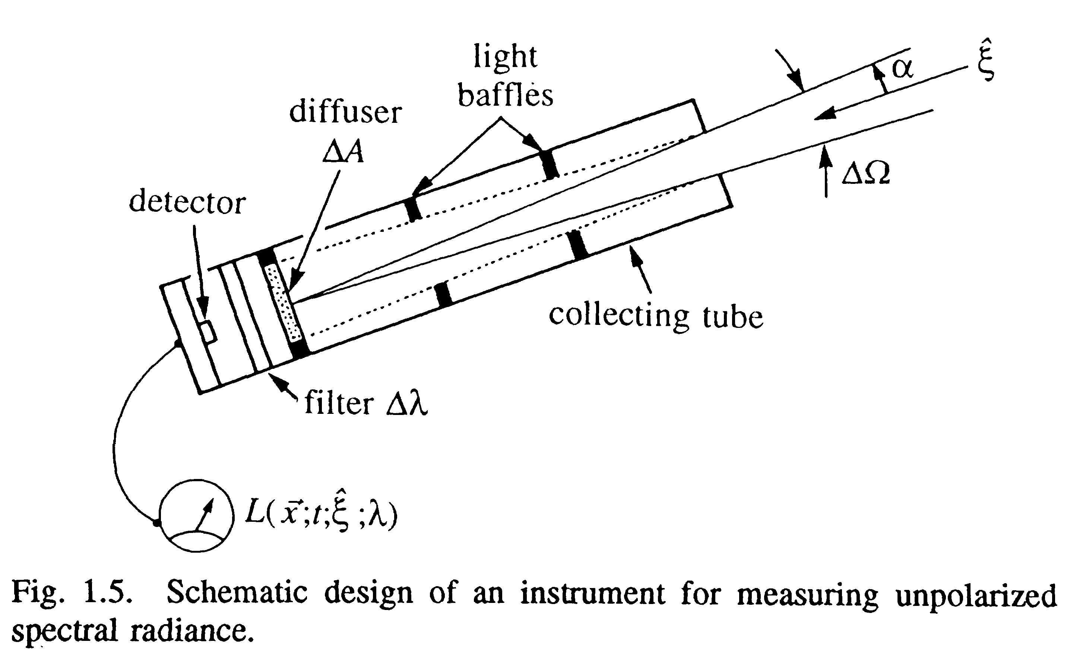
Radiance
Gershun’s tube
[L]=(W m⁻² sr⁻¹ nm⁻¹)
All other radiometric quantities can be derived
from L.

Slide 7
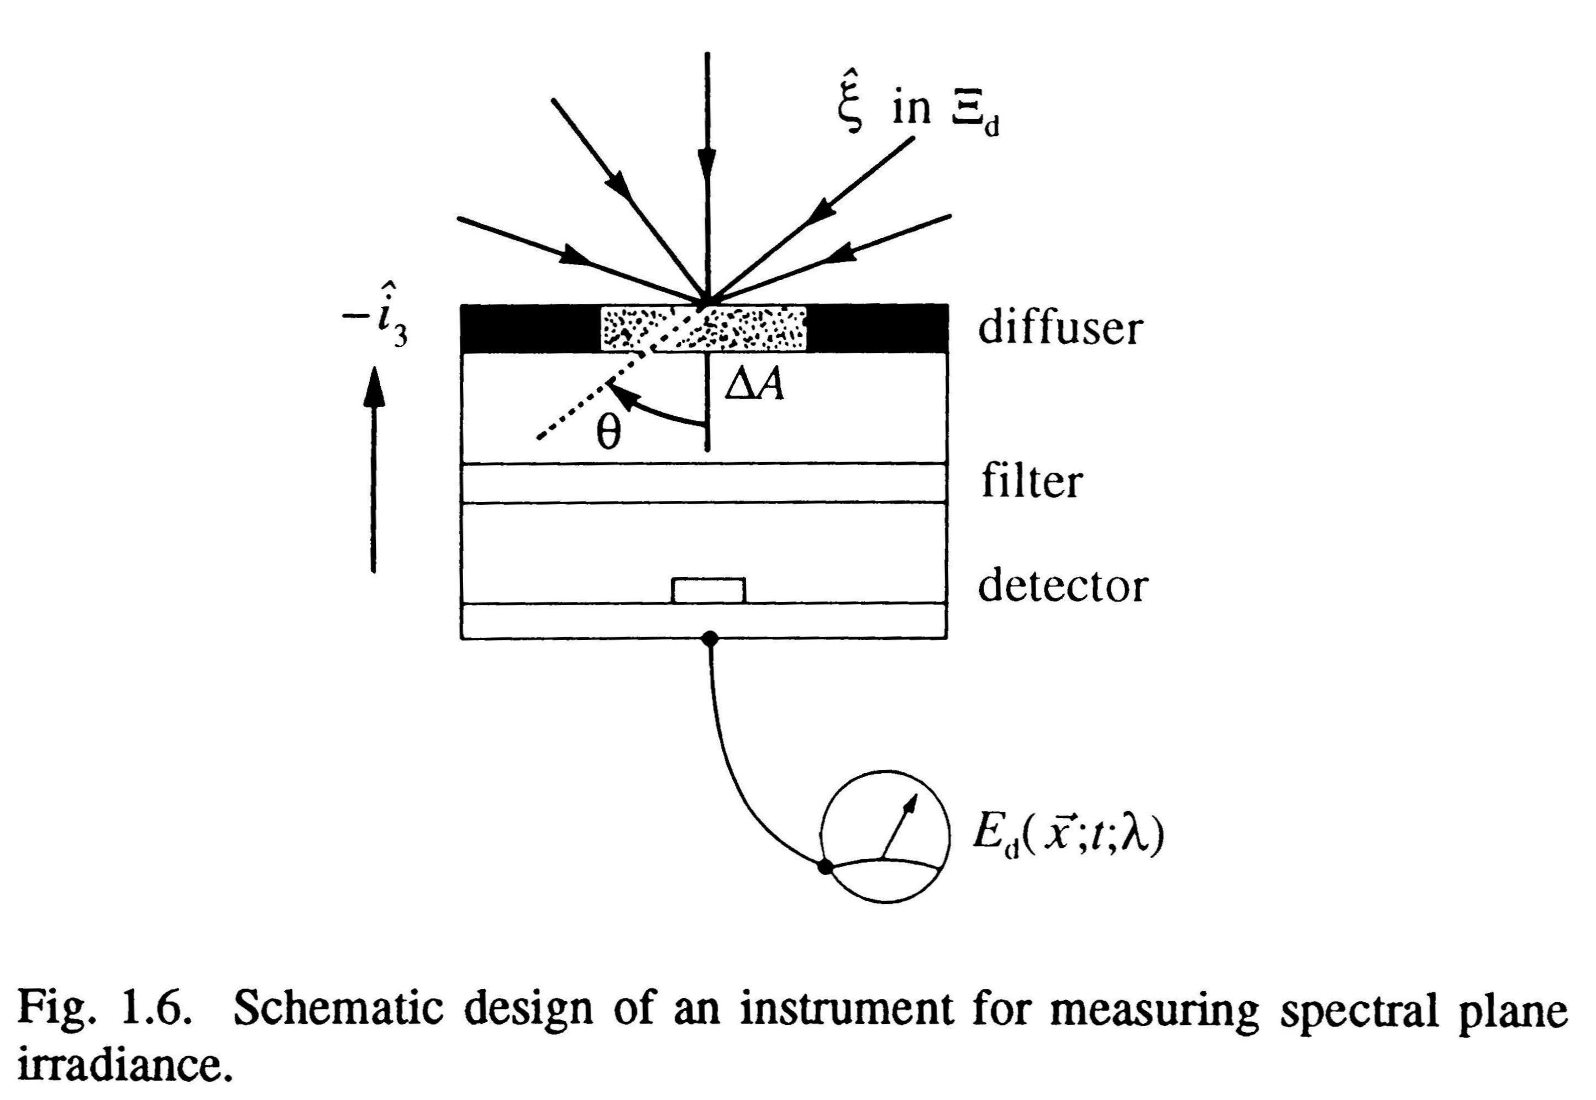
(plane) Irradiance
Downward irradiance is the downward component of the L vector, weighted by its angle to the detector (effective area over which the light is spread).
Cosine response to wide vs. narrow beams.

Slide 8
Net (vector) irradiance
E = E_{d} - E_{u}
Describes net flux
When will we use it?

Slide 9
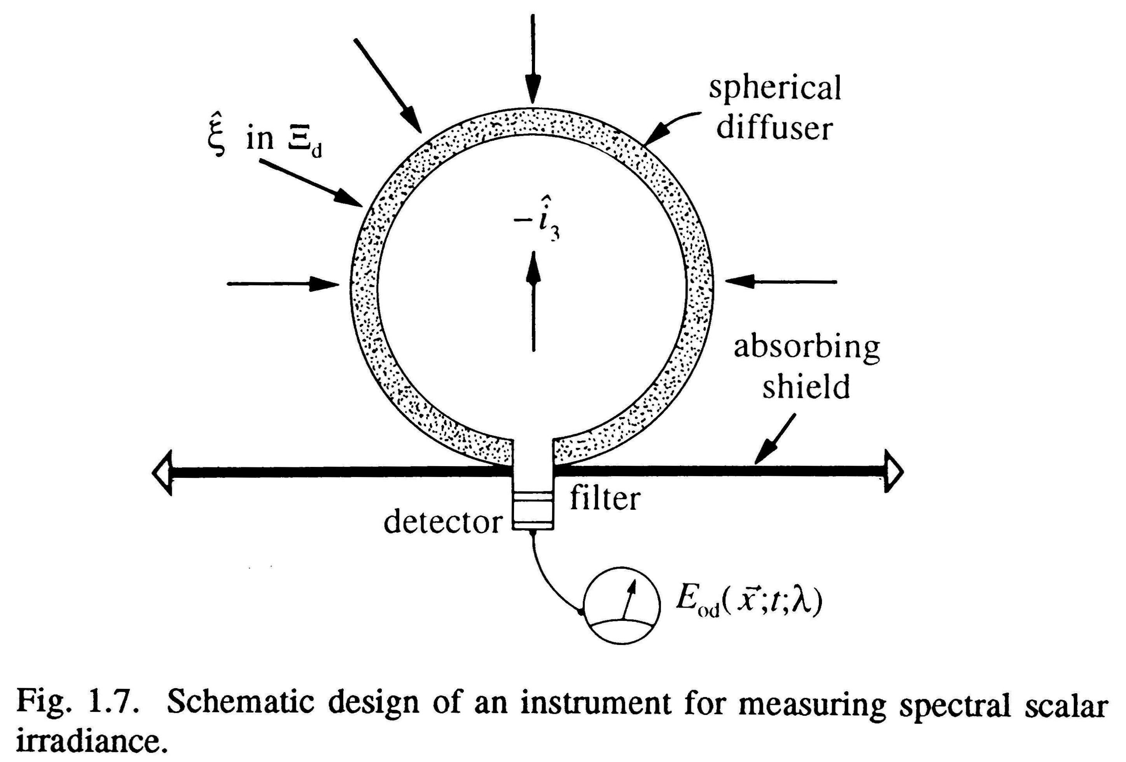
Scalar irradiance
Downward scalar irradiance has the same effective area for L in any direction. No cosθ factor.

Slide 10
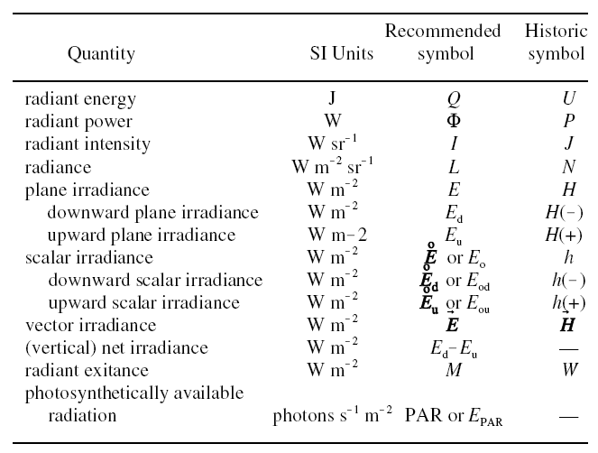
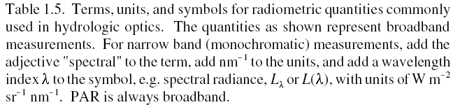
Notation
(intensity)
(I)
(radiant flux)
(F)

Slide 11
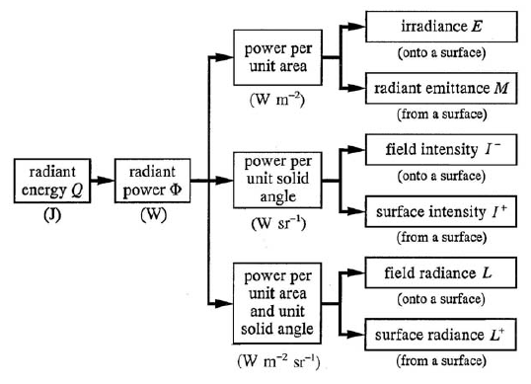
Hierarchy

Slide 12
Things to watch out for:
Spectral normalization are often done without change in notation. Hence E_{d}(PAR) , the integrated irradiance over the photosynthetic band has different units than spectral irradiance yet both are denoted by E_{d}.
Time for light field equilibration to a change in the environment is very rapid (O(10⁻⁶s), why?). Hence most radiative problem omit time changes.
In most environment optical properties vary most in a single direction (e.g. vertical in the ocean and atmosphere). The radiative calculations and measurements are then limited to one direction. This is, off course, not true when dealing with patchy clouds and below gravity waves, and provide, at best, an average light field.

Slide 13
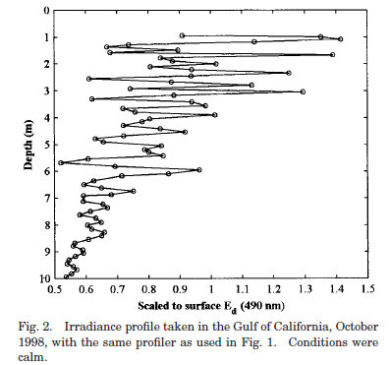
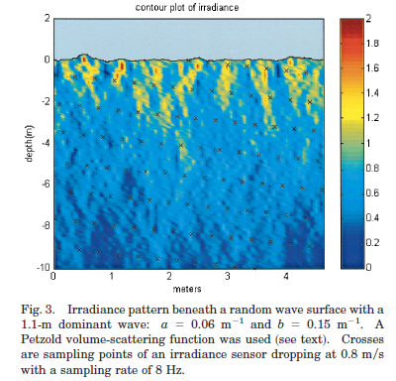
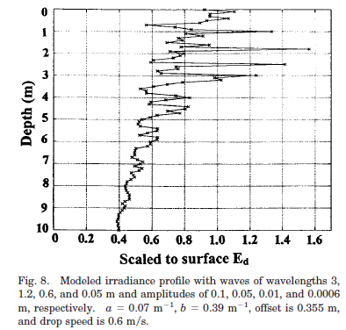
Example: light and waves
Observations:
simulation:
Zaneveld et al., 2001

Slide 14
Inverse square law of for irradiance:
Energy per unit time per unit area (irradiance) decreases away from a point source as 1/R².

Slide 15
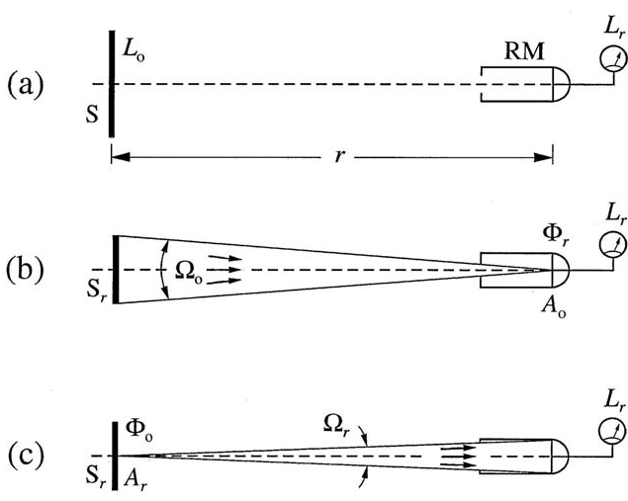
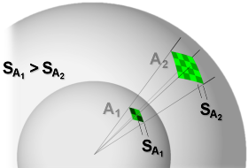
Radiance invariance law
Radiance does not change along a photon-path (ray) in vacuum, L_{o}=L_{r} for all r:
Geometry: Ω_{r}=A_{o}/r², Ω_{o}=A_{r}/r²
Φ_{r}-arrives at detector in direction of source.
Φ_{o}- leaves the source (within field of view of detector).
Both fluxes are equal (conservation of energy).
Since Φ_{o} =L_{o}A _{r} Ω_{r} and Φ_{r} =L_{r}A _{o}Ω_{o} → L_{o}=L_{r}
→ In absence of attenuation, provides for the radiance of a distant object.

Slide 16
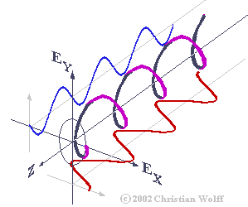
The Physical foundation:
Light can be modeled as varying electrical (E(x,t)) and magnetic (B(x,t)) fields oscillating in time and space related to each other through Maxwell’s equations.
Defining a Poynting vector: S=ExB/μ_{o}
provides the instantaneous power per unit area perpendicular to S (μ_{o} is the permeability).
The time-averaged magnitude of S
is the irradiance.
Light is polarized (what does it mean?).

Slide 17
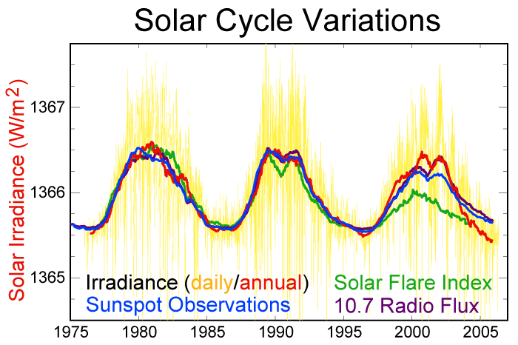
Extraterrestrial Solar Radiation
Fraunhofer lines
(absorption in sun’s atmosphere)
UV
Visible
Infrared
http://rredc.nrel.gov/solar/standards/am0/NewAM0.xls
The Solar ‘Constant’ is 1366.1 Wm⁻².
      Amount of solar radiation on a surface perpendicular to the solar beam, at the outer limit of earth’s atmosphere, at the mean sun-earth distance.
      Yearly fluctuation (sun spot cycle):
http://en.wikipedia.org/wiki/Image:Solar-cycle-data.png

Slide 18
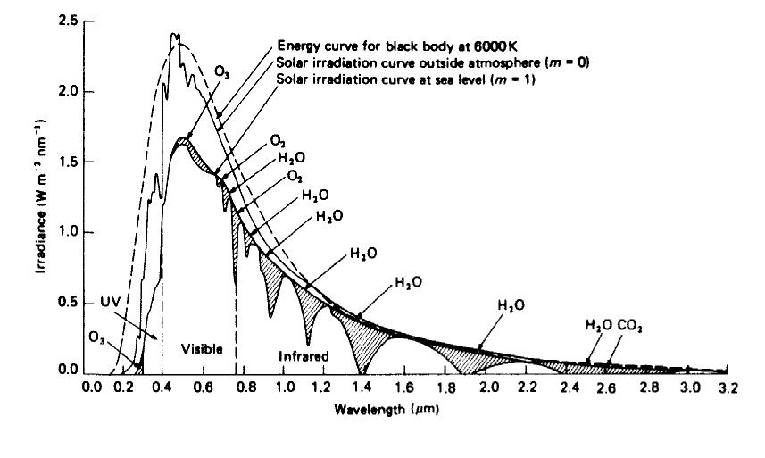
Radiation on the Earth
The atmosphere attenuates the amount of radiation impinging on earth’s surface.
Atmosphere
Kirk 1994, Fig. 2.1, p. 27

Slide 19
Radiation on the Earth
Transmission through the atmosphere depends on:
    Solar zenith angle (latitude, season, time of day) ← why?
    Cloud cover
    Atmospheric pressure (air mass)
    Water vapor
    Atmospheric turbidity (Aerosols)
    Column ozone (important for UV-B)
      Ground albedo (how much light is reflected from the ground) also affects the incident irradiance.
Midsummer Solar Irradiance at 45°N (midday)
    about 400 W m⁻² (PAR, energy units)
    1900 µmol m⁻² s⁻¹ (PAR, quanta)
Midwinter Solar Irradiance at 45°N
    about 130 W m⁻²; 600 µmol m⁻² s⁻¹

Slide 20
Typical E_{d} Spectrum for summer in Halifax
UVB
UVA
Visible or PAR
-Visible: 400 to 700 nm (or PAR)
      About 45% of incident solar radiation is PAR
-Ultraviolet
  UVA 315 (or 320) to 400 nm, UVB 280 to 320 nm, UVC 200 to 280 nm

Slide 21
Examples: Vernal Equinox
Equator — March 21 – noon
2184 µmol m⁻² s⁻¹ PAR
60°N — March 21 — noon
901 µmol m⁻² s⁻¹ PAR
Direct and diffuse light don’t have the same spectra.
Sun angle effects.

Slide 22
Some relations to phytoplankton:
What type of irradiance do phytoplankton experience?
How should the euphotic depth be defined?
How is PAR computed?
Irradiance is often measured in units of energy [w/m²]. Phytoplankton care about number of photons in wavelength they absorb:
h is Plank’s constant, 6.026x10⁻³⁴ m² Kg s⁻¹.
But not all photons are equal. Phytoplankton absorb certain wavelength preferably.

Slide 23
Summary
Light is measured in different ways depending on application (e.g. heating rate vs. photosynthesis).
Definitions, nomenclature, and units insure we compare similar quantities.
Measuring ambient light is not trivial.

