Slide 1
Scattering and attenuation and tracking uncertainties for cal/val

Slide 2
Beam Attenuation
Measurement Reality
c = (-1/x) ln(Φ_{t}/Φ_{o})
source
detector
Φ_{a}
Φ_{b}
Φ_{o}
Φ_{t}
x
Detected flux (Φ_{t}) measurement must exclude scattered flux

Slide 3
Beam Attenuation
Measurement Reality
c = (-1/x) ln(Φ_{t}/Φ_{o})
The size of the detector acceptance angle (FOV) determines the retrieved value of c
source
Φ_{a}
Φ_{b}
Φ_{o}
Φ_{t}
x
The larger the detector acceptance angle, the more scattered flux detected as Φ_{t}, the smaller the estimated value of c

Slide 4
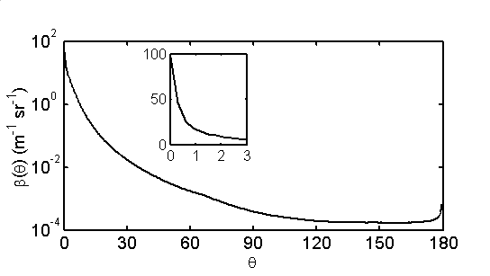
Ex. transmissometer/c-meter
FOV % b detected
0.018º <1
0.7º ~ 5
0.86º ~ 7
1.5º ~14
Large dβ/dθ in near forward angles
Direct impact on accuracy
of measured beam c

Slide 5
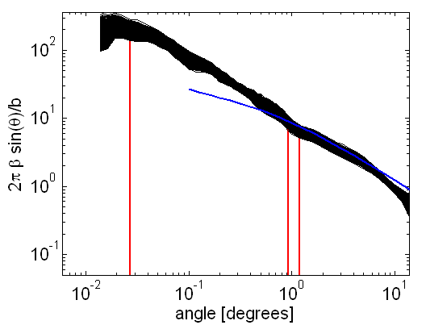
VSF measurements with LISST-Floc:
Boss et al., 2009a

Slide 6
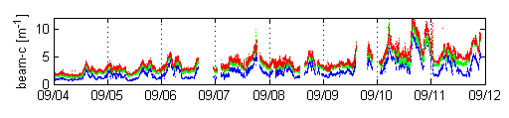
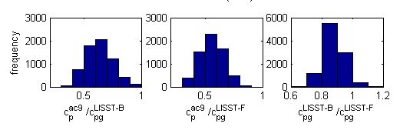
Instrumental and sample considerations affecting our measurements, beam-attenuation acceptance-angle example:
Acceptance
Angles
0.93°
0.0269°
0.0045°
Boss et al., 2009a

Slide 7
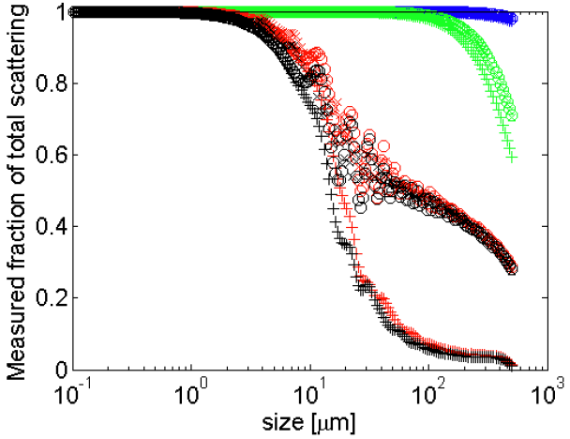
Issues with attenuation:
Magnitude depends on the acceptance angle.
Because of that -> size filter.
Does not need other corrections (+++).
Path-length need to be adjusted to environment.
Recent analysis: Leymarie et al., 2010 (AO)

Slide 8
Scattering Measurement Theory
b = fractional scatterance
per unit distance
Φ_{b} Scattered Radiant Flux
Φ_{a}
Φ_{o}
Φ_{t}
b = (-1/x) ln [Φ_{t} /Φ_{o}] –
(-1/x) ln [Φ_{a} /Φ_{o}]
= c - a

Slide 9
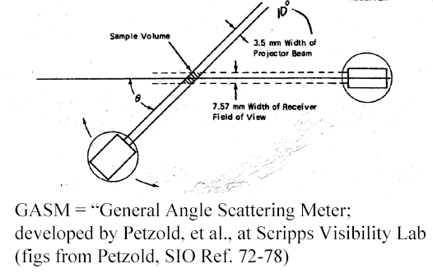
Volume Scattering Function (β)
β(θ) = (-1/x dΩ) ln[Φ_{b}(θ)/Φ_{o}]
b=∫βdΩ
detector
Φ_{b}/ΔΩ
source
Φ_{a}
Φ_{o}

Slide 10
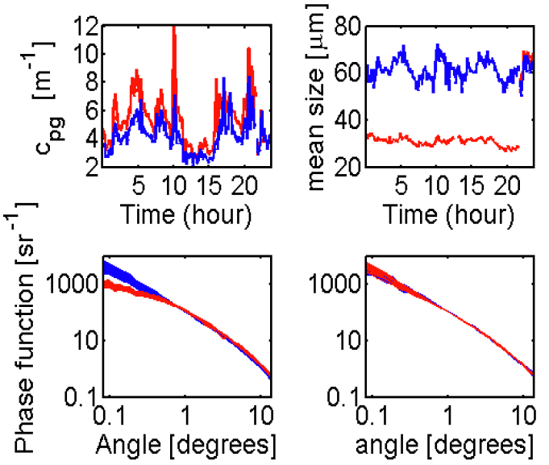
Issues with the VSF:
Fundamental in-situ IOP (as important as absorption!).
No commercial sensor for full (bench-top exist).
Issues of packaging (in-situ undistrubed vs. handled samples)

Slide 11
Volume Scattering Measurements
β(θ) = (-1/x dΩ) ln[Φ_{b}(θ)/Φ_{o}]
Detected flux measurement must correct for attenuated flux along pathlength→ inner-filter effect x
Define shape of detection area
  Calibration with known substance
  mathematically
Φ_{o}
Φ_{b} (θ)
θ
source
detector

Slide 12
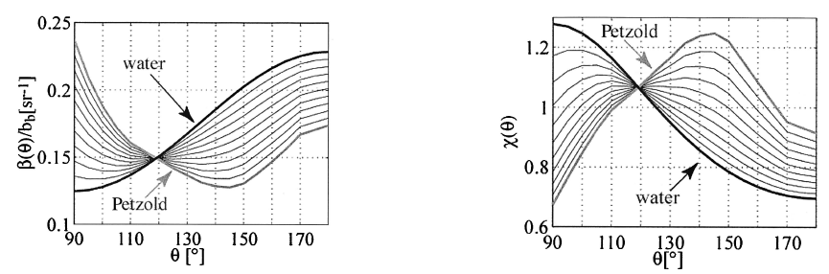

Most often backscattering in inferred from one angle in the back direction. Why:
Boss and Pegau, 2001

Slide 13
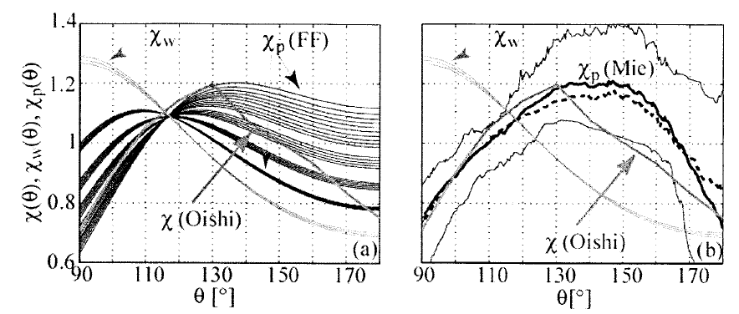
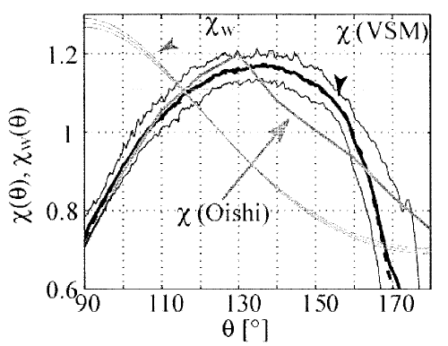
How does it agree with other data and theory?

Slide 14
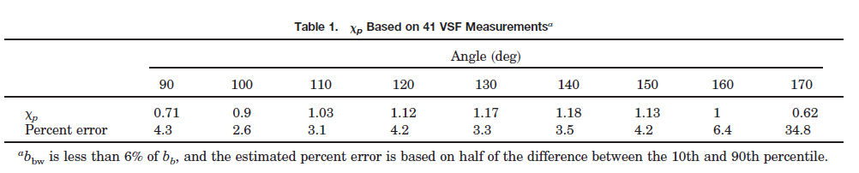
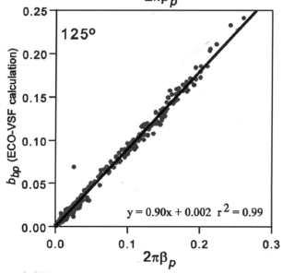
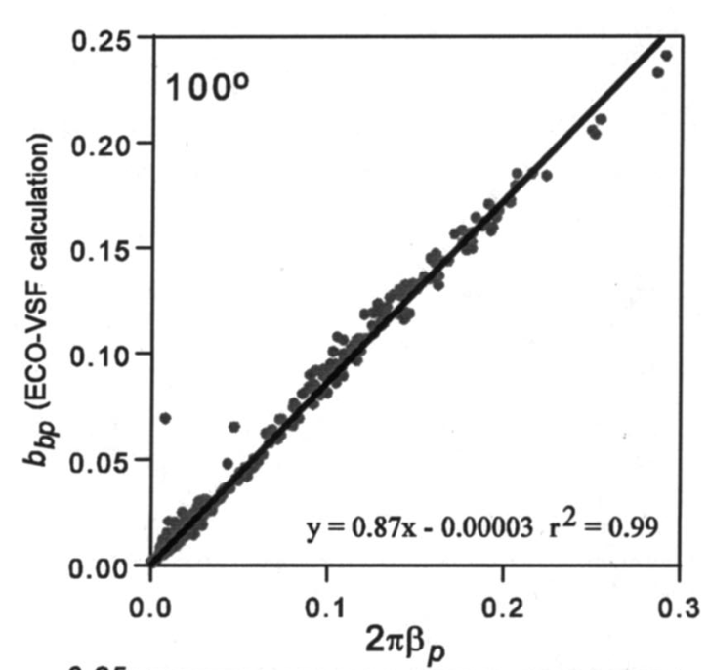
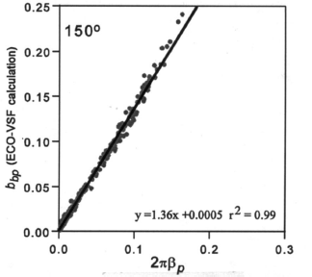
Bottom line:
But (2005):

Slide 15
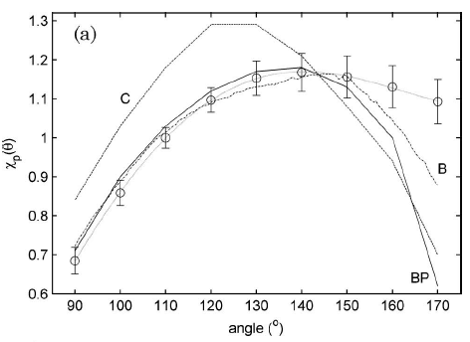
Sullivan and Twardowski (2009):
Consistency from 90->150degrees (except for one study…).

Slide 16
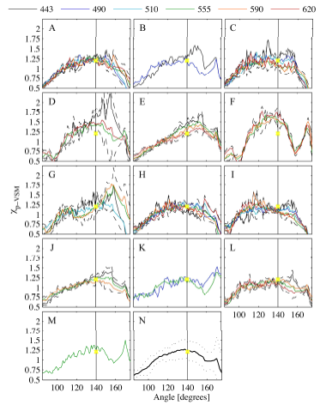
Whitmire et al. (2010):
Phytoplankton cultures (6 λ):

Slide 17
How should we go ahead and characterize the uncertainty in a backscattering sensor?
Signal and Dark values are measured in counts.
The Dark value is system dependent (due to impedance of circuit) .
Current reported uncertainty: slope × 1 count.
Uncertainty in χ_{p} ~10%. Uncertainty in β?

Slide 18
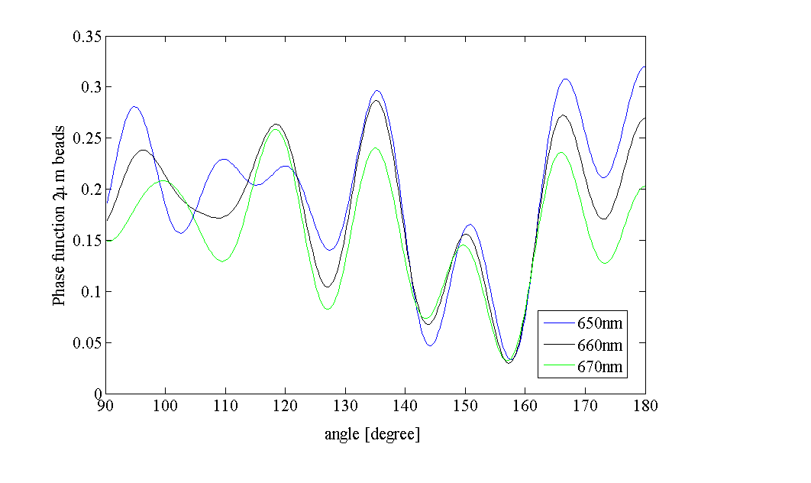
Calibration is done with 2μm NIST traceable
polystyrene beads, whose phase function is:

Slide 19
How is the wavelength distribution for the b_{b} sensors?
Normalized source output for MISC’s bb9 (solid line) vs. that provided by WETLabs (dashed line).
Currently, slope calculations assume wavelength is constant…

Slide 20
How about the angle distribution?
Currently, slope calculations assume angle is constant…

Slide 21
Issues with scattering:
‘Attenuation’ along the path (---).
Knowledge of geometry and wavelength.
calibration.
Conversion from angle(s) to backscattering involve significant uncertainties.

