Slide 1

Radiometric quantities and their measurement
Ken Voss, Ocean Optics Class, Darling Center, Maine
Summer, 2011

Slide 2
Introduction
While the radiance is the fundamental property, for measurements, an irradiance detector is more fundamental, so I will build from irradiance to radiance.
Outline
Spectral resolution of Detectors
Plane irradiance measurements
Scalar irradiance measurements
Radiance and Radiance Distribution measurements

Slide 3
Detectors
Two (maybe three) classes of detectors/instruments if defined by spectral resolution
1) Multi-channel instruments
  2) Hyperspectral instruments
  3) PAR (or other broadband for example UV-A) sensor

Slide 4
Narrow band, multi channel instruments
Detectors
1) Typically channels have spectral bands of 10nm wide.
a) Most ocean optics parameters do not have sharp features.
b) May try to match some other spectral shape (SeaWiFS bands).
2) Spectral channels defined by filters, typically interference filters.
a) Filters have some spectral shape, defined by band center and the width.
b) Have to be careful of out-of-band effects (looking at different “color” sources)

Slide 5
Detectors
FWHM = (λ_{50%+} - λ_{50%-})
Band Center = (λ_{50%+} + λ_{50%-})/2

Slide 6
Detectors

Slide 7
Detectors
Hyperspectral Detectors
1) “continuous spectrum”, really channels every 1-10nm.
2) Typically grating or prism dispersive elements.
3) Can build integrated channels, match satellite sensor channels, etc.
3) Be careful of various effects
a) similar to out-of-band effects, have scattered light effects
b) resolution limits (entrance slitwidth, dispersion, imaging ability)
just because there is a detector every 1 nm, doesn’t mean it tells
you anything.
Pixels
Dispersion: cm/nm
Light
Slit
Dispersive elements

Slide 8
Detectors
From Stephanie Flora
Moby project

Slide 9
Detectors
From Stephanie Flora, MOBY project

Slide 10
Detectors
PAR or other broadband (UVA, UVB, etc.)
PAR:
1) photosynthetically available radiation, try to count photons in the range
from 400-700 nm, equal weight to each photon.
2) Silicon detector through photoelectric effect, should sort of do this:
Each photon generates one photo-electron (perfect quantum efficiency)
3) Problems due to scattering in detector, reabsorption of photo-electrons,
spectrally dependent reflection…break down this relationship which then
causes calibration to be difficult (different colored sources). Physically not
a “nice” measurement, but easy.

Slide 11
Irradiance
Definition of plane Irradiance :
Perfect detector would be a hole, with a detector right behind that collects all the light which passed through the hole:
Problems:
1) Filter, typically interference filter, has
an angle dependence on spectral transmission
2) Detectors also have angular dependence on
their response
3) Invariably need some sort of window in front
of hole, which then has a reflection/transmission
coefficient which varies with incident angle.
Typically 2-3 decrease with increasing incidence
angle.
Hole
Filter
Detector

Slide 12
Irradiance
Real Irradiance detectors try to enhance response to light at large incidence angles. Typical design shown below:
Plastic Diffuser material, raised on edges
to enhance area exposed to large incidence
angles.
hole
Filter, back from diffuser, to reduce variation
In angles
Detector

Slide 13
Irradiance
Note: this is in air, not water, but is typical
Zibordi and Bulgarelli, AO, pg:5529-5538 (2007)

Slide 14
Irradiance
Downwelling
Radiance
distribution
1m
5m
10m
30m

Slide 15
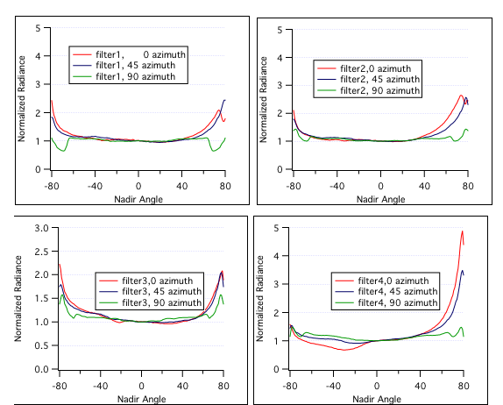
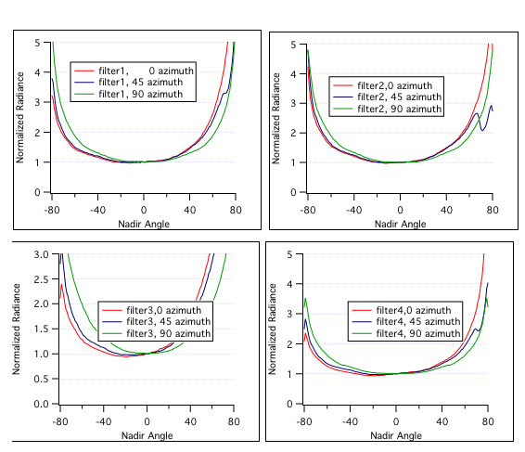
Irradiance
Upwelling Radiance distribution
Low Chl
High Chl
Error due to cosine collector much more significant

Slide 16
Irradiance
Should mention one more factor: Immersion coefficient, 30-40% correction.
Cosine collector efficiency different when operating in air or water
Outside medium
Air or water
Detector (in air, hopefully)
Just drew normal incidence, really all over the place. When in air, larger index of
refraction difference between medium and plastic, harder for light to escape. In water
more light, after being diffused in detector, can escape….so collection efficiency is less.
Immersion factor corrects for this. Is spectrally dependent, and collector
design dependent (including plastic), so must be measured. Paper by Hooker and Zibordi
2005.

Slide 17
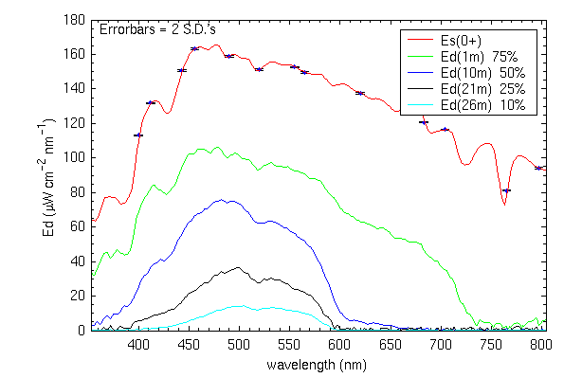
Irradiance
Blue water station (Data from Marlon Lewis, Satlantic)

Slide 18
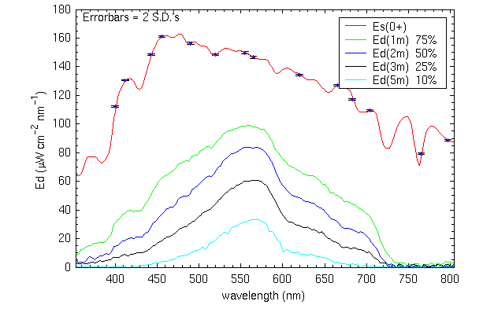
Irradiance
Green water station (Data from Marlon Lewis, Satlantic)

Slide 19
Irradiance
Greatly simplified, but to calibrate this sensor…set up in lab with known source of
irradiance:
Known
Source, typically
NIST lamp
Instrument
Specified distance (typically 50 100 cm)

Slide 20
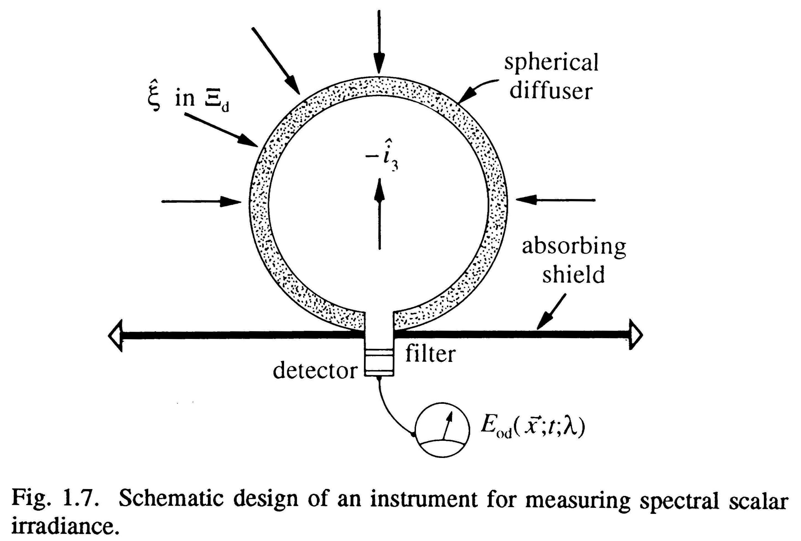
Scalar Irradiance
Definition of Scalar Irradiance:
Want to collect all light coming to a single point, regardless of angle. Perfect collector would be as shown earlier, with the limit of the radius going to zero:
(from Curt’s
Book)

Slide 21
Scalar Irradiance
Problems:
Would like shield below the ball to be zero (to measure total), or infinity, to measure E_{od}. If you want total then how to handle horizon from a combination of E_{od} and E_{ou} in this case?

Slide 22
Scalar irradiance
μ = E_{d} / E_{o}
Depth | E_{d}(z) | E_{od}(z) | E_{u}(z) | E_{ou}(z) | μ_{d}(z) | μ_{u}(z)
20.0 m | 16.7 | 23.1 | 0.488 | 1.29 | 0.72 | 0.38
24.8m | 9.34 | 13.0 | 0.330 | 0.852 | 0.72 | 0.39
29.9m | 6.29 | 8.78 | 0.212 | 0.550 | 0.72 | 0.38
44.8m | 1.73 | 2.31 | 0.0658 | 0.160 | 0.75 | 0.41
49.6 | 1.56 | 2.07 | 0.0512 | 0.129 | 0.75 | 0.40
E_{d}, E_{od}, E_{u}, E_{ou} all in units of μW cm⁻² nm⁻¹
upwelling measurements at 505 nm
Downwelling measurements at 503 nm
Average cosine of downwelling points to 44 deg, while upwelling is 67 deg

Slide 23
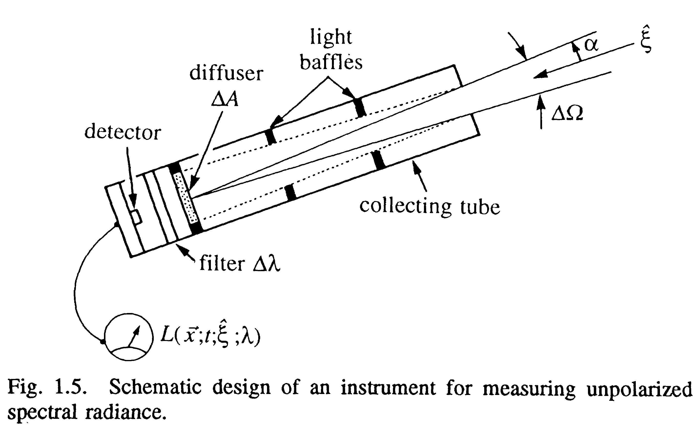
Radiance
Definition of Radiance:
As shown earlier, basic concept for radiometer is a Gershun tube:

Slide 24
Radiance
Most often Radiance measured with some sort of Gershun tube device in a single direction (typically upwelling nadir).
But to use radiance in all the other equations, need radiance distribution. Either measure many individual directions (such as Tyler, 1960) or many directions at once with a camera and lens of some sort (Fisheye, Smith et al. 1970).

Slide 25
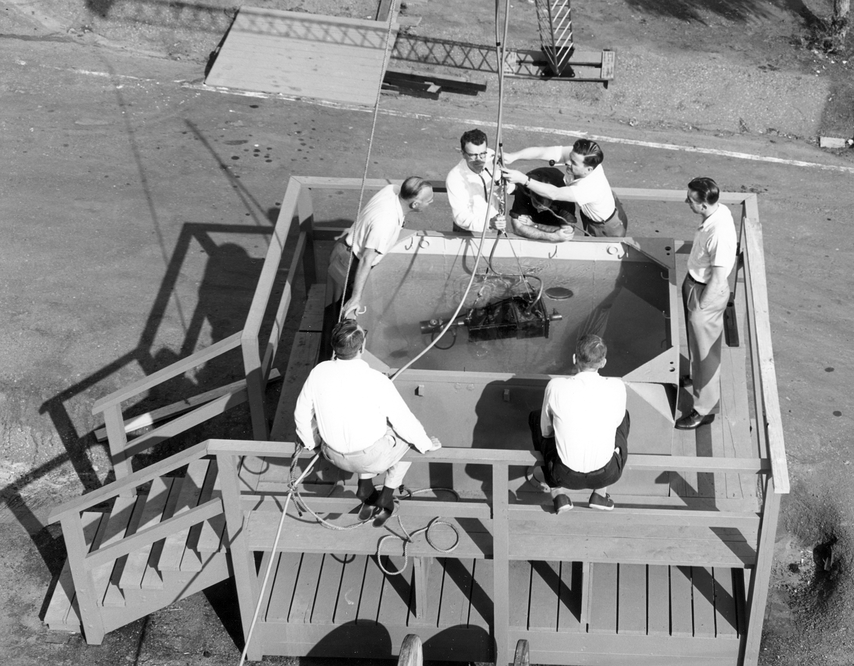
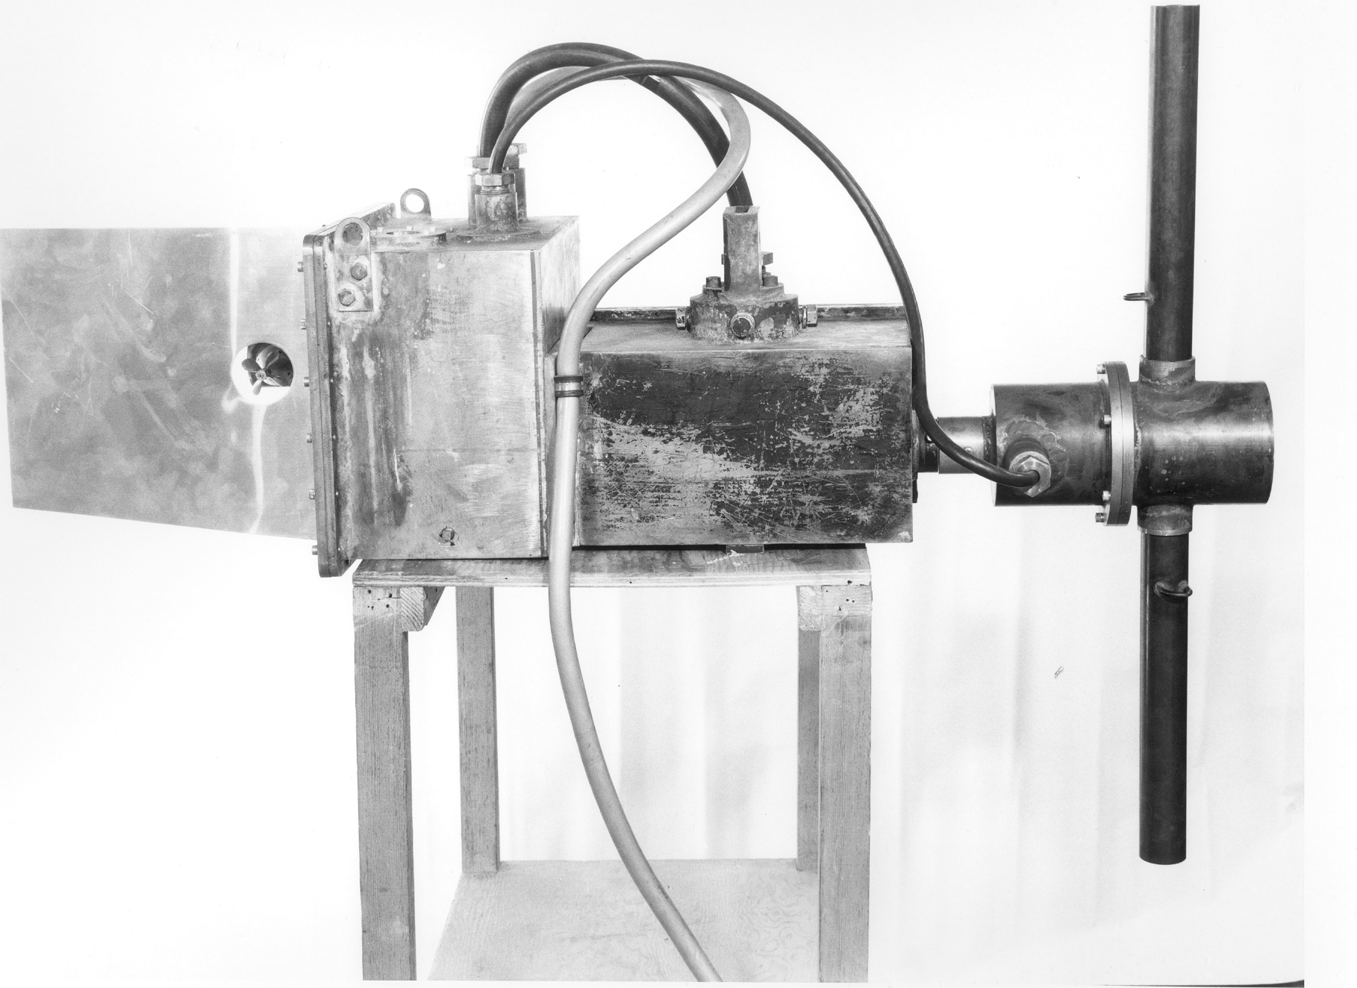
Radiance
Example instruments, Tyler :

Slide 26
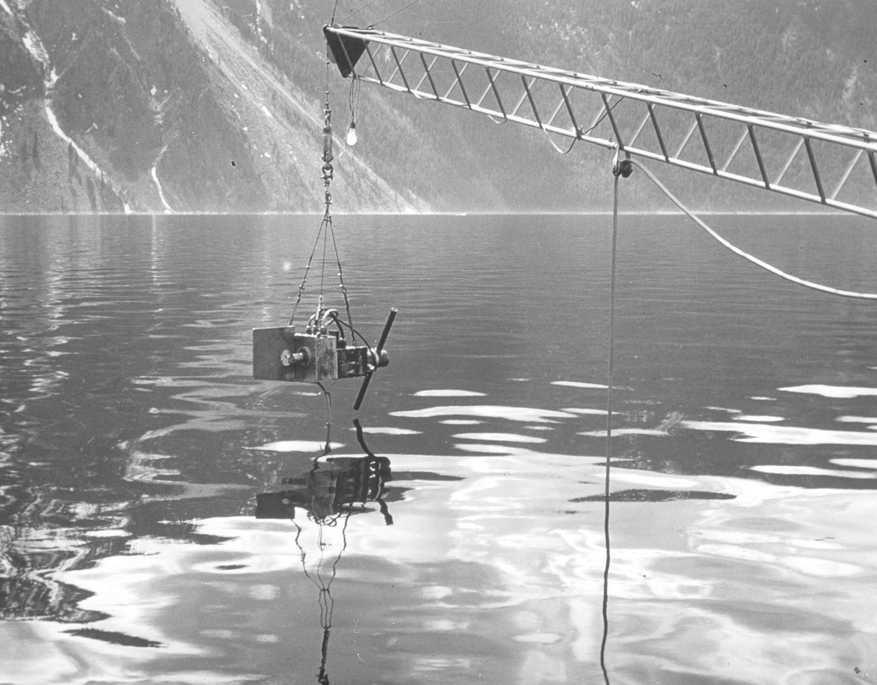
Radiance

Slide 27
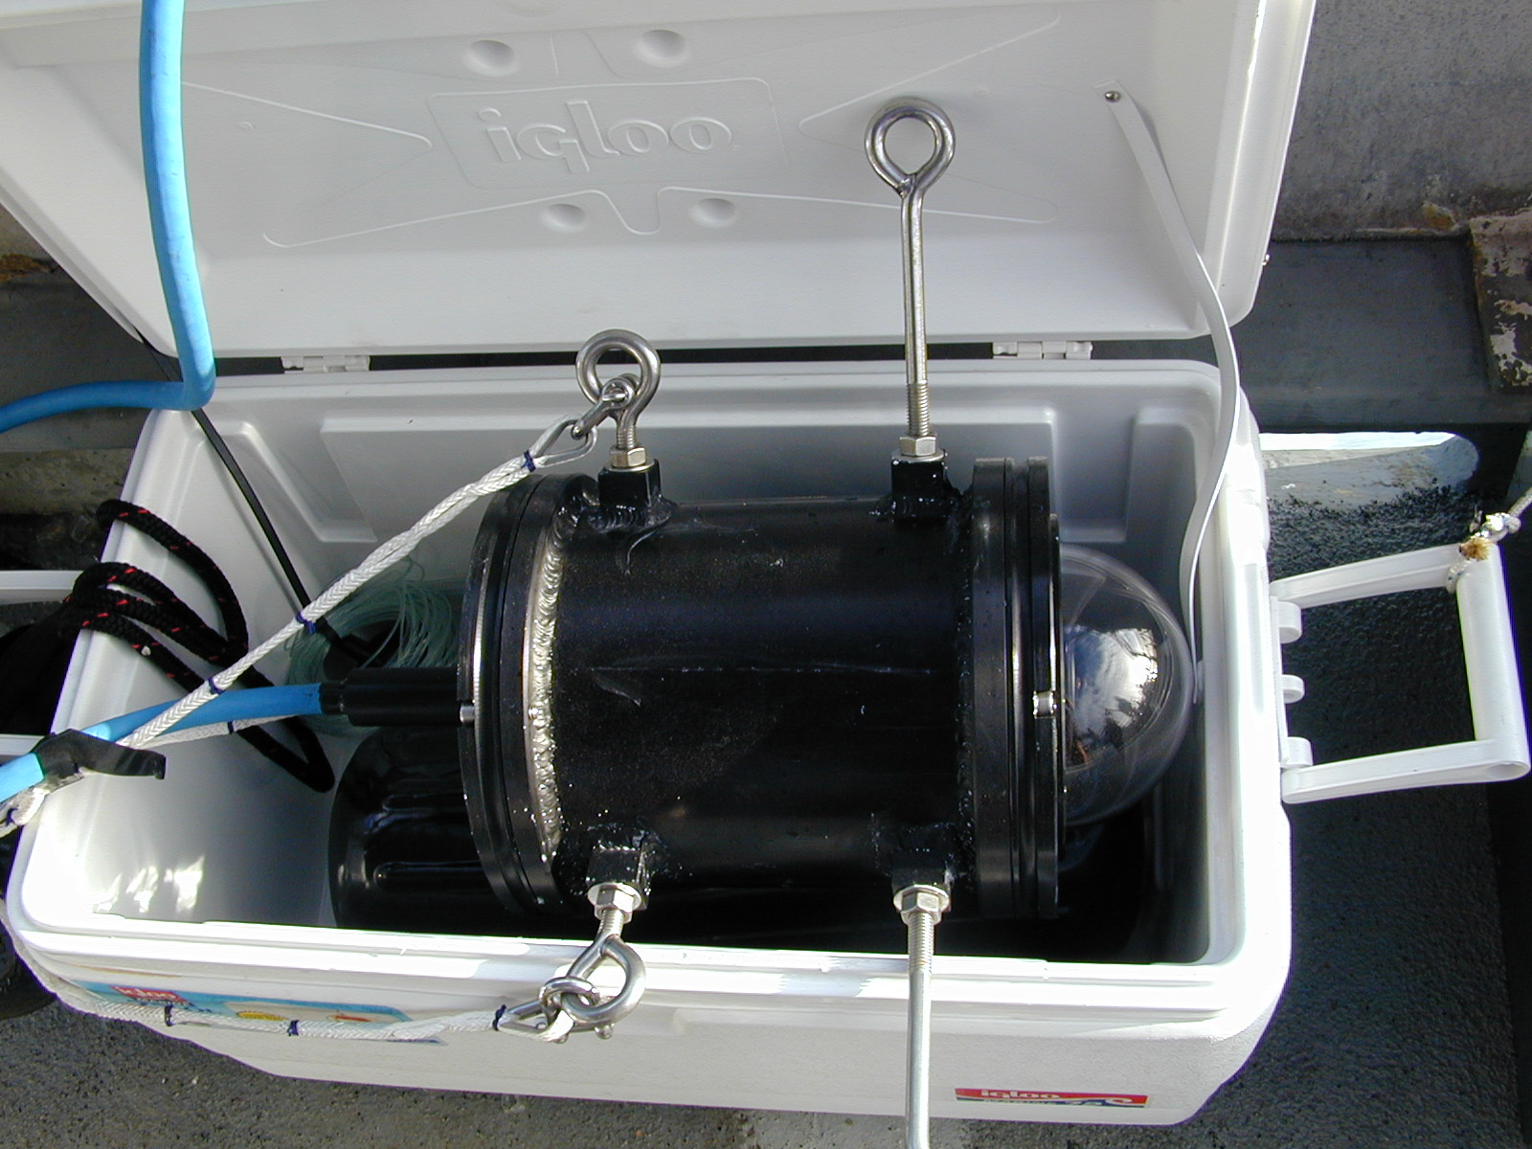
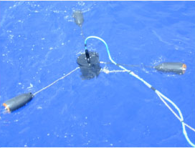
Radiance
More modern instrument, NuRADS

Slide 28
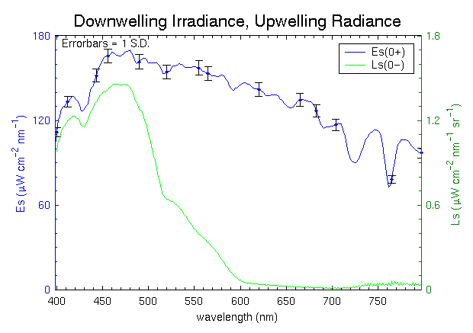
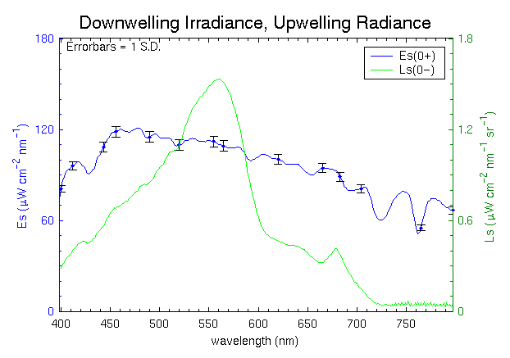
Radiance
Example Nadir Radiance
Blue water station
Green water station
Data from Marlon Lewis

Slide 29
Radiance Distribution
Downwelling
Radiance
Distribution
(520 nm)
1m
Santa Barbara channel
5m
10m
30m

Slide 30
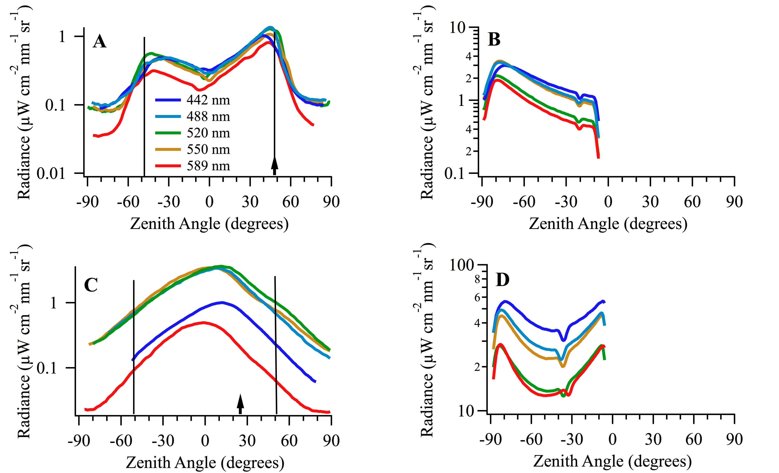
Radiance Distribution
1 m
30 m

Slide 31
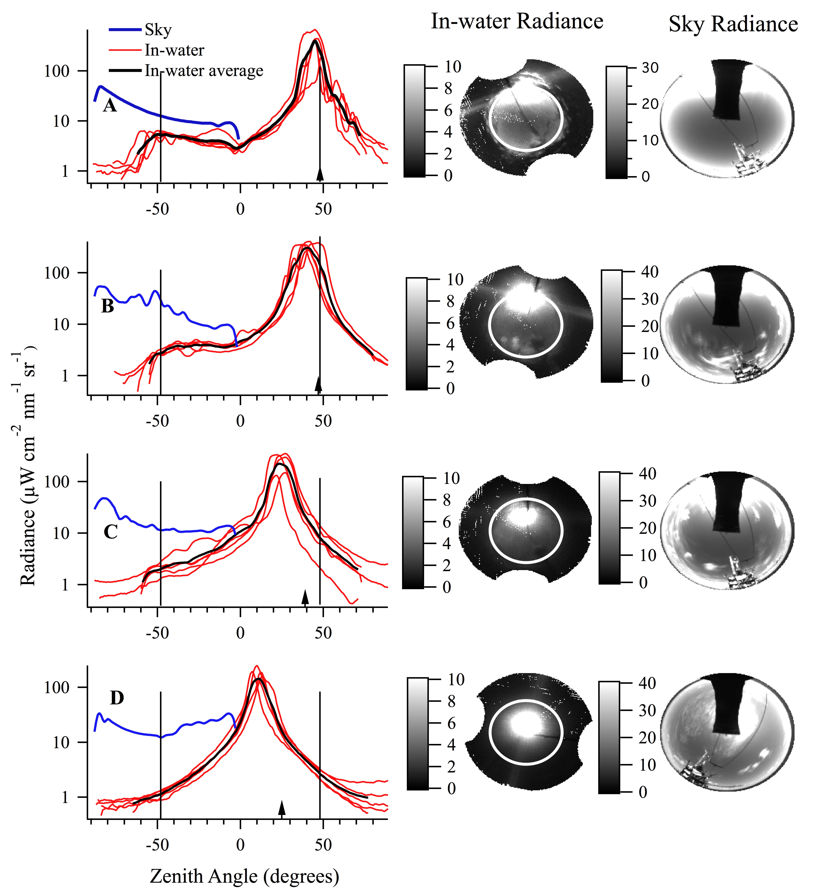
Radiance Distribution
4 m
Clear water, Hawaii
17 m
25 m
50 m

Slide 32
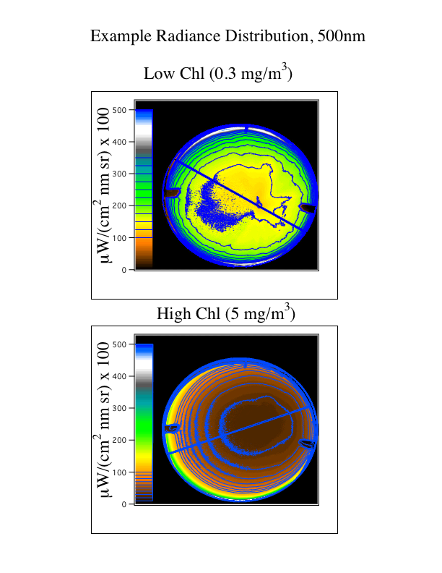
Radiance Distribution

Slide 33
Radiance
Upwelling Radiance distribution
Low Chl
High Chl

Slide 34
Radiance
Calibration: Look at a source of known Radiance
Either bounce light from a lamp off of a plaque, or look into an integrating sphere.
Integrating sphere
lamp
Plaque (spectralon)
Instrument
Instrument

Slide 35
Calibration problems
Different light levels between field and lab
Different colored sources between field and lab
Different temperatures in lab and field (variation in field temperatures)
Scattered light in lab
Geometrical setup in lab
Drifts in calibration sources
Etc…..

