Slide 1
Revision – a single class portfolio that will go on web
Portfolio for week one – revise your analysis products and complete the following:
For each individual sensor, provide:
Description of instrument – what it is, what it does, link to manufacturer, photo, etc.
Data measurement – physical set up, procedure details, calibration (gory details of dark values, what is used to blank, how the blank is done, what is used to calibrate, how calibrated, etc.), what samples (dock, clay, culture, etc., etc.) and how measured
Ancillary data – such as the radiometer measurement of bb9 λ output
Data processing – gory details and figure for each step (raw data, first step, etc.); code
Data results and interpretation.
Figures have captions, Y and X axis labels, units
Cautionary notes (what went wrong, etc.)
Multiple sensor interpretation – multiple measurements on same sample; are data consistent? How do multiple measurements support or not support interpretation

Slide 2
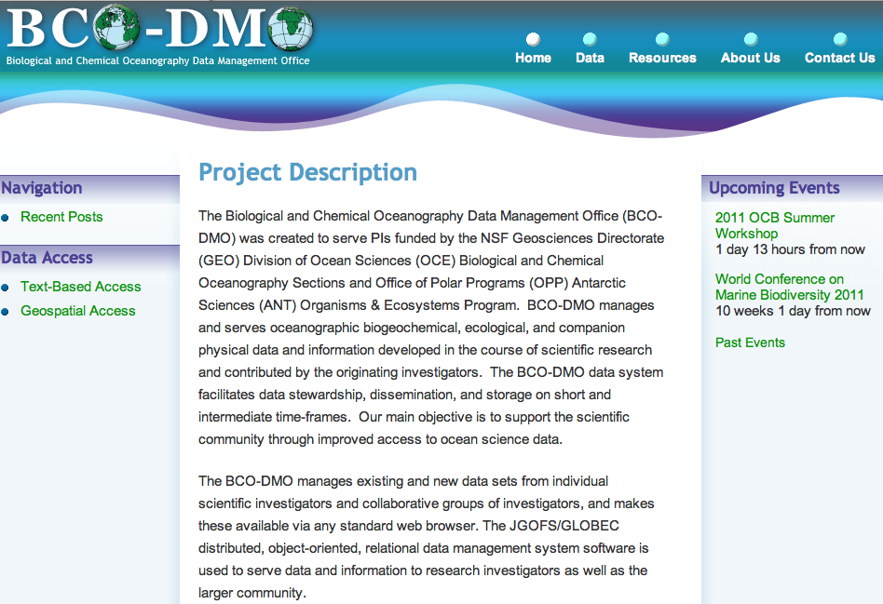
http://bcodmo.org/home

Slide 3
Cruise data – documenting what you did (calibration reports) what sensors, most recent calibration data sheets (manufacturer) other calibration/supporting data – for example radiometer measurement of bb9 λ – own calibration e.g., for fluorescence to chlorophyll, etc.), how data were collected, how data were processed (sequence, values, etc.), example graphs for each step of data processing, final data products. Your cruise report will be presented to NASA by Jeremy as a template for a new SeaBASS data submission protocol.

Slide 4
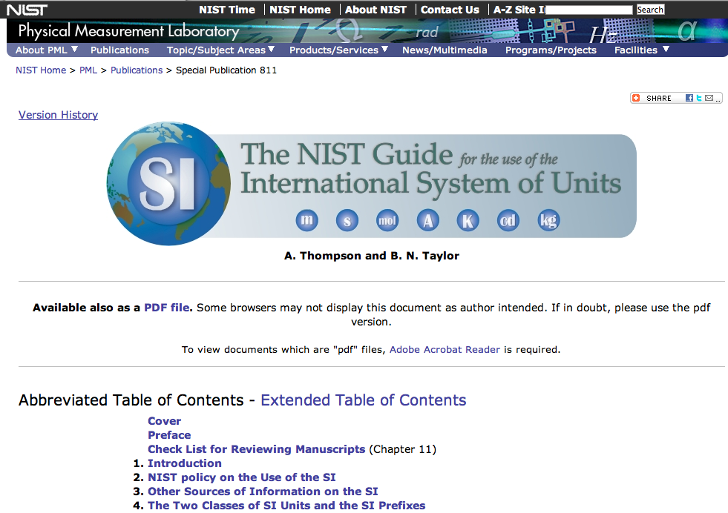
http://www.nist.gov/pml/pubs/sp811/index.cfm

Slide 5
Dinner tonight – 1800 we’ll provide some wine and beer (not from grant) Brunch on Saturday and Sunday will be at 1030 New linen on Monday – verify with folks in the kitchen

