Slide 1
The life cycle of a satellite mission in pictures – Or, why you need a strong calibration & validation program
Ocean Optics Class
University of Maine
July 2011

Slide 2
Why invest in a satellite?

Slide 3
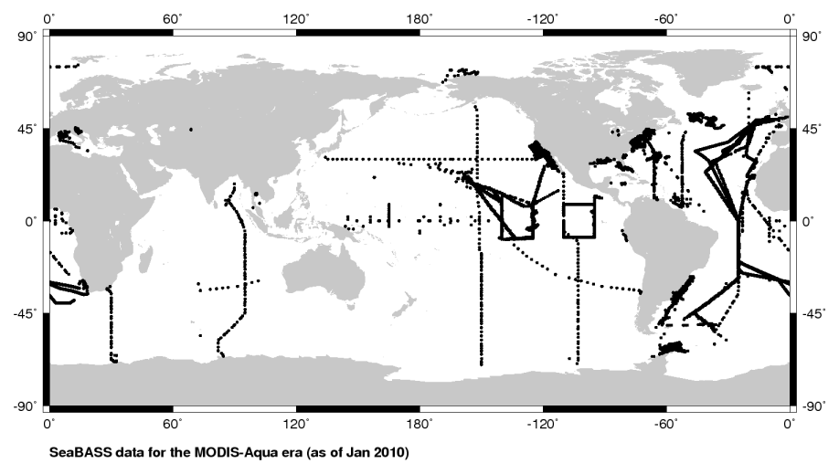
Because it’s hard to sample the global oceans on boats, buoys, & drifters …
bio-optical data collected by NASA-funded scientists during the MODIS-Aqua era

Slide 4
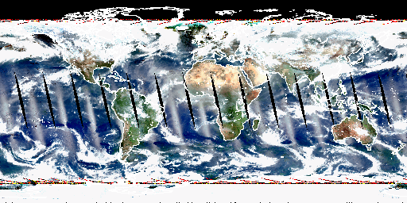
Most ocean color satellites sample the full globe every two days!
MODIS-Aqua observations for one day (1 February 2008)

Slide 5
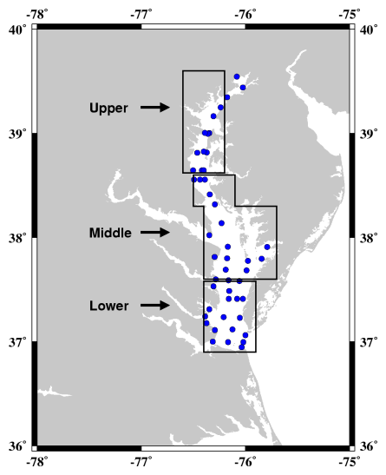
Even if you only care about a small patch of ocean …
Chesapeake Bay Program

Slide 6
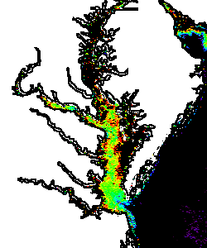
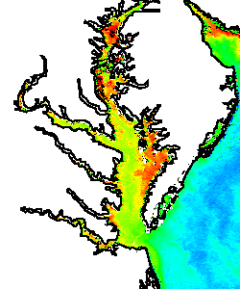
Satellites offer routine synoptic views.
Chesapeake Bay Program

Slide 7
And provide wonderfully complementary data streams!
complementary data streams
Chesapeake Bay Program

Slide 8
So, how does one build a satellite flight project & complementary calibration / validation team?

Slide 9
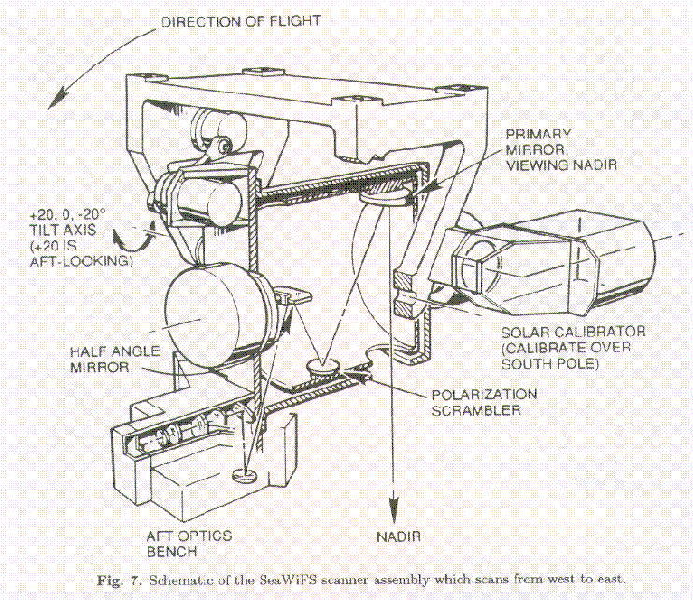
Let’s say that you come up with a good idea …

Slide 10
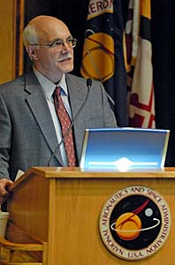
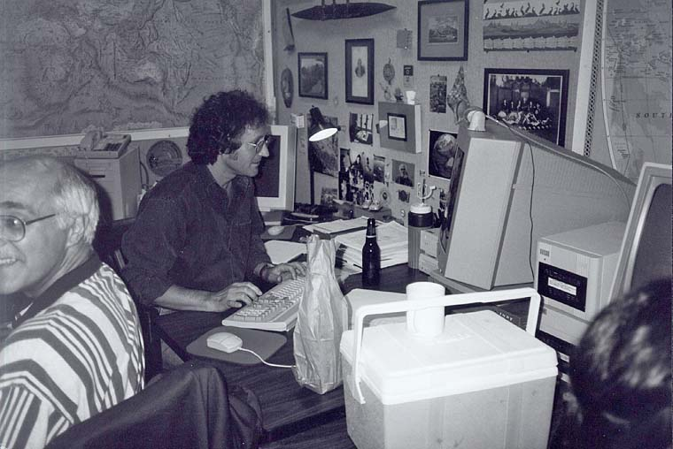
You develop this idea, nurture it in collaboration with scientists & engineers, then pitch it to the powers-that-be.

Slide 11
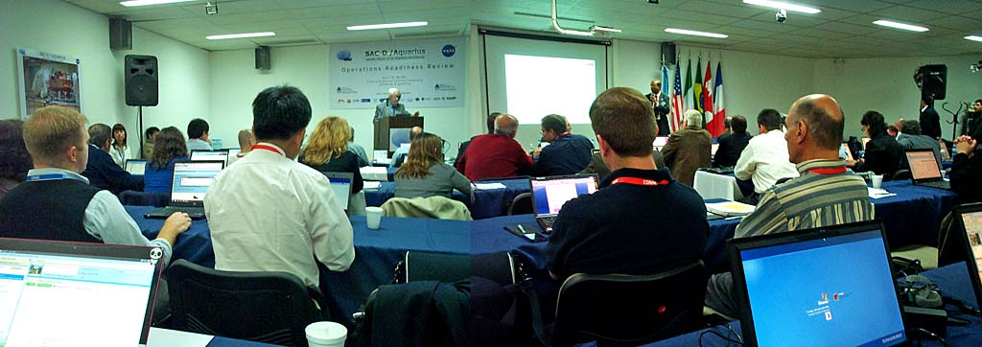
Let’s say the powers-that-be like your idea & can help finance its development. You start hosting meetings to review your instrument concept …
Lots & lots of meetings.

Slide 12
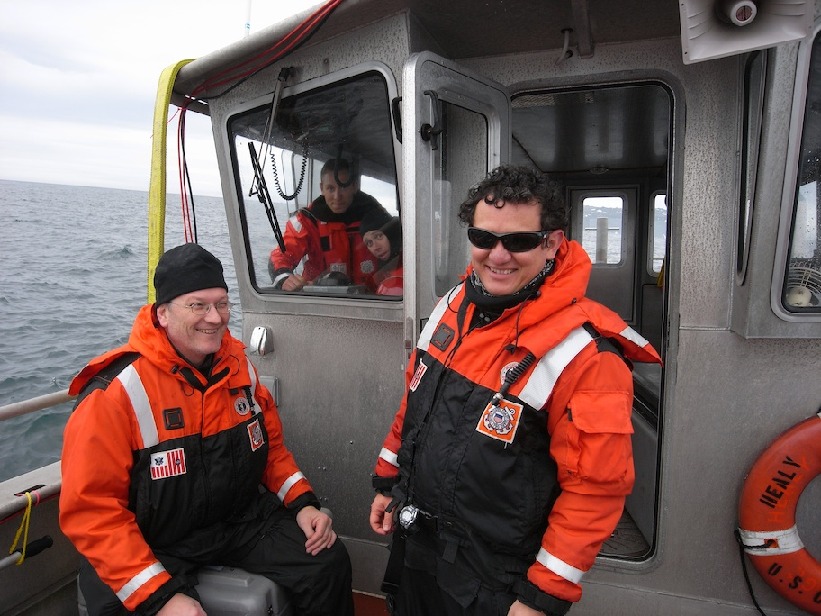
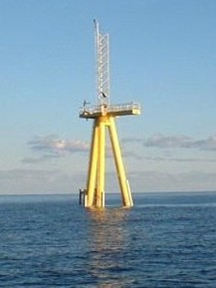
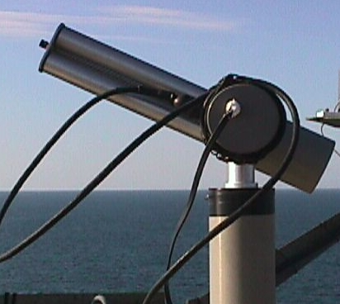
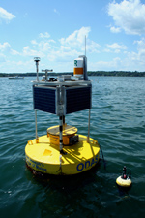
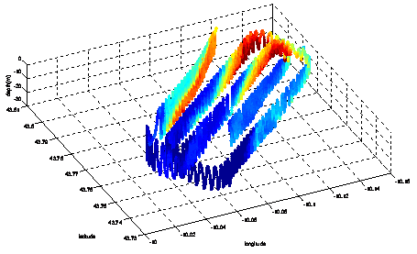
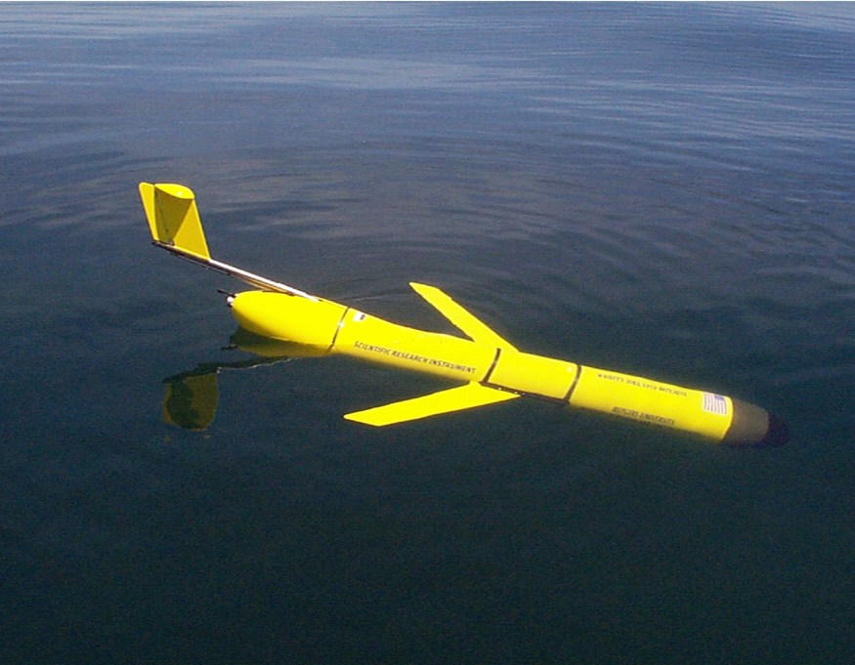
But life is only partially run in powerpoint. Field work also provides critical insight into instrument requirements.
depth
latitude
longitude

Slide 13
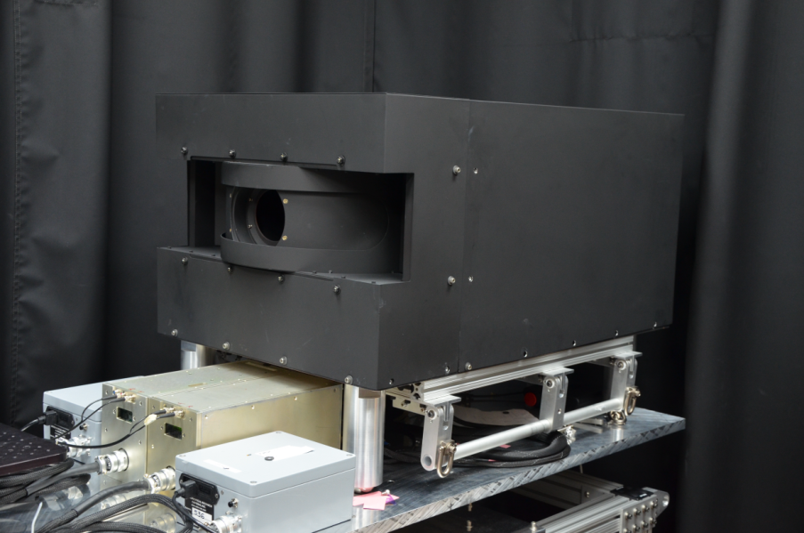
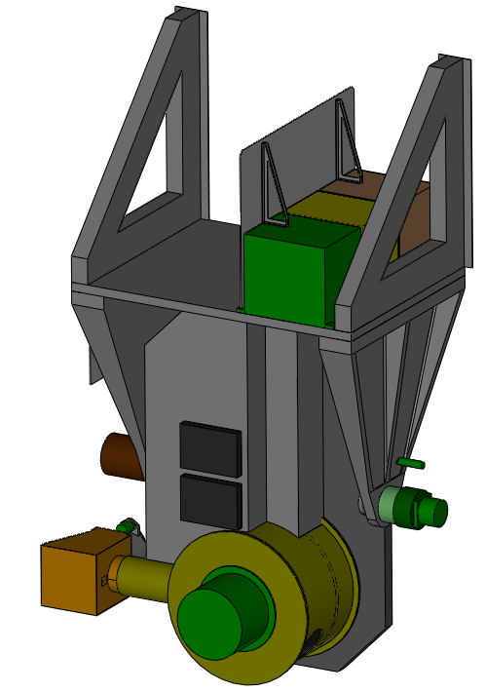
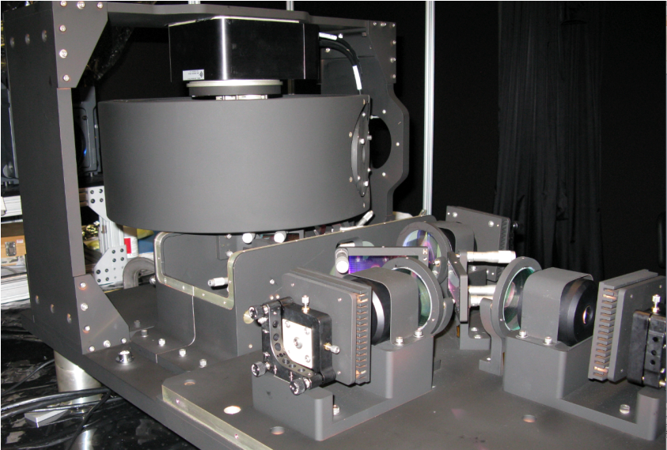
Eventually, your idea could become a realized instrument …

Slide 14
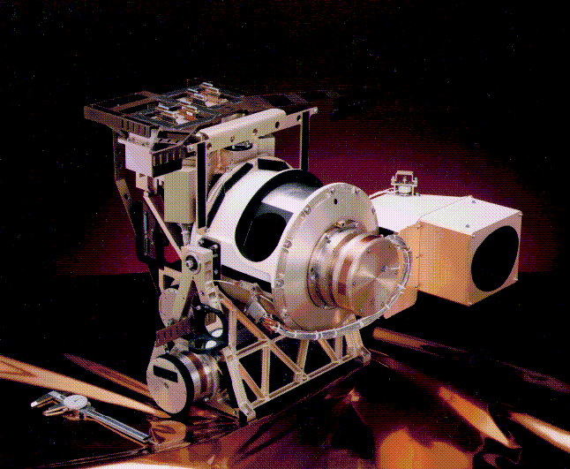
A complete model might even be built …

Slide 15
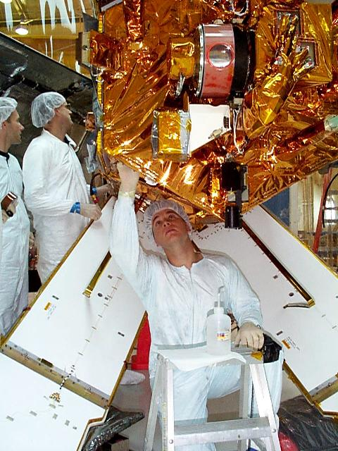
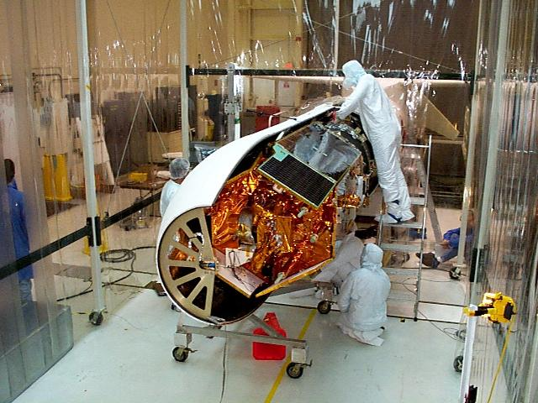
If you’re lucky, the powers-that-be might even let it fly on a real spacecraft mission …

Slide 16
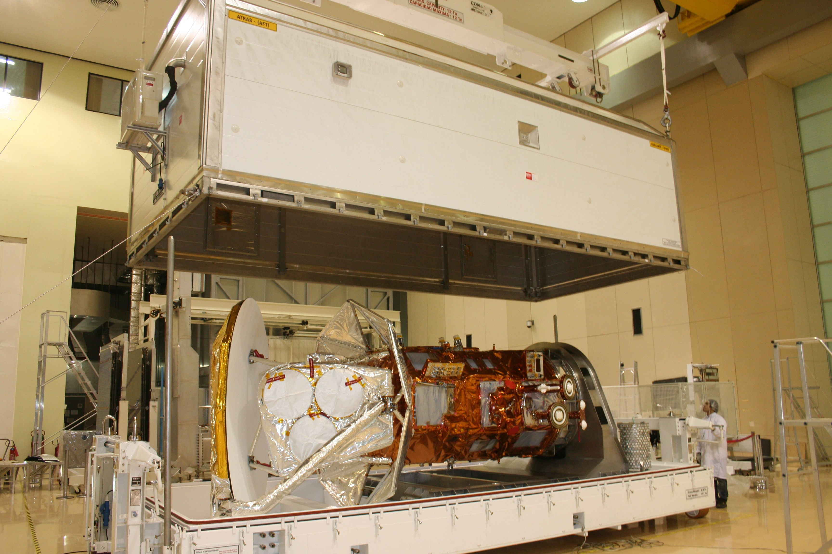
Which requires another series of extensive tests.

Slide 17
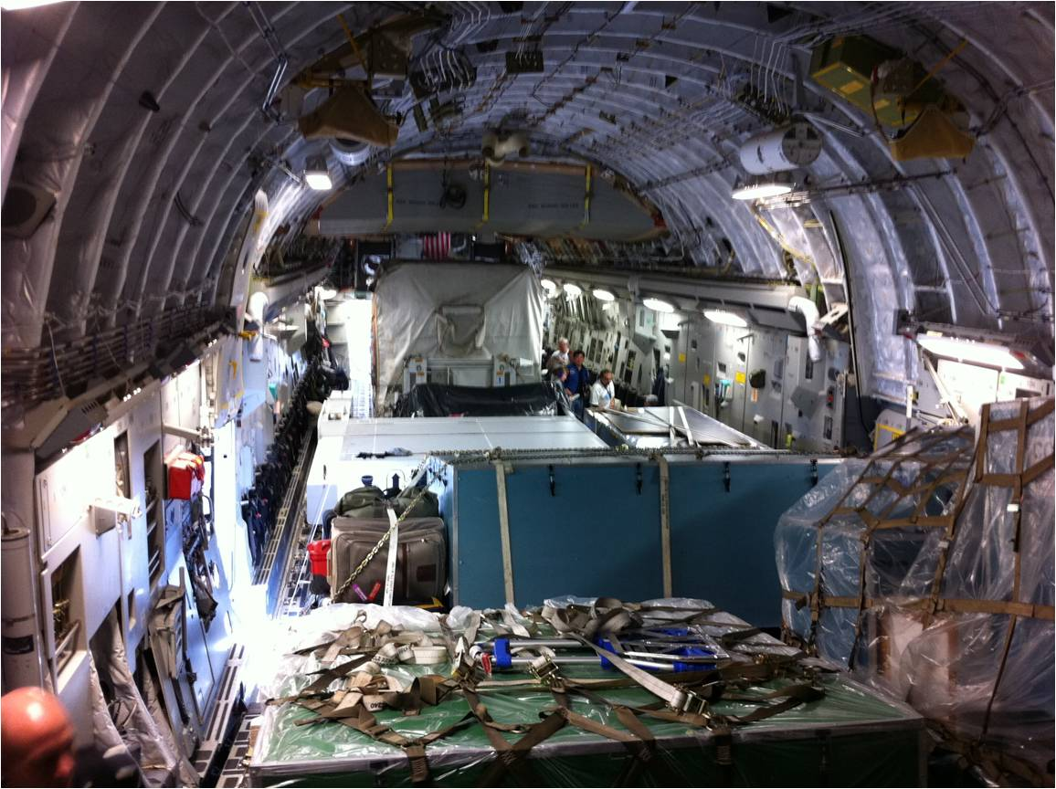
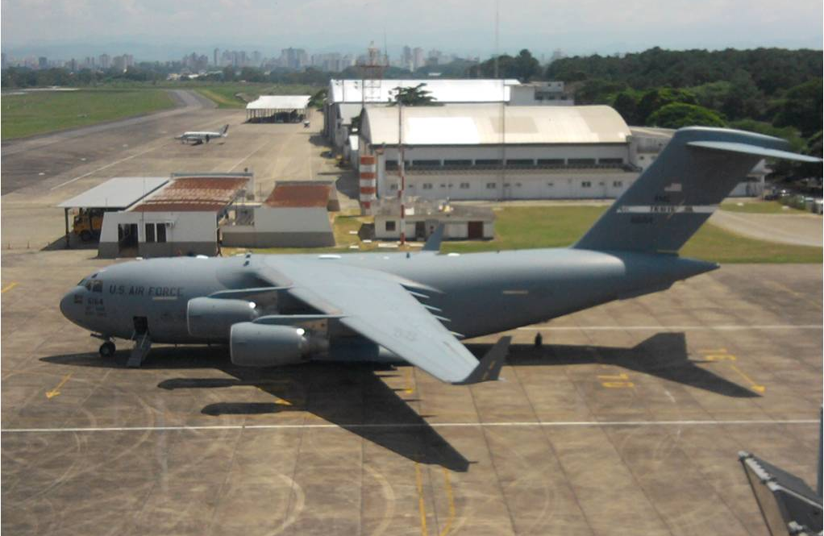
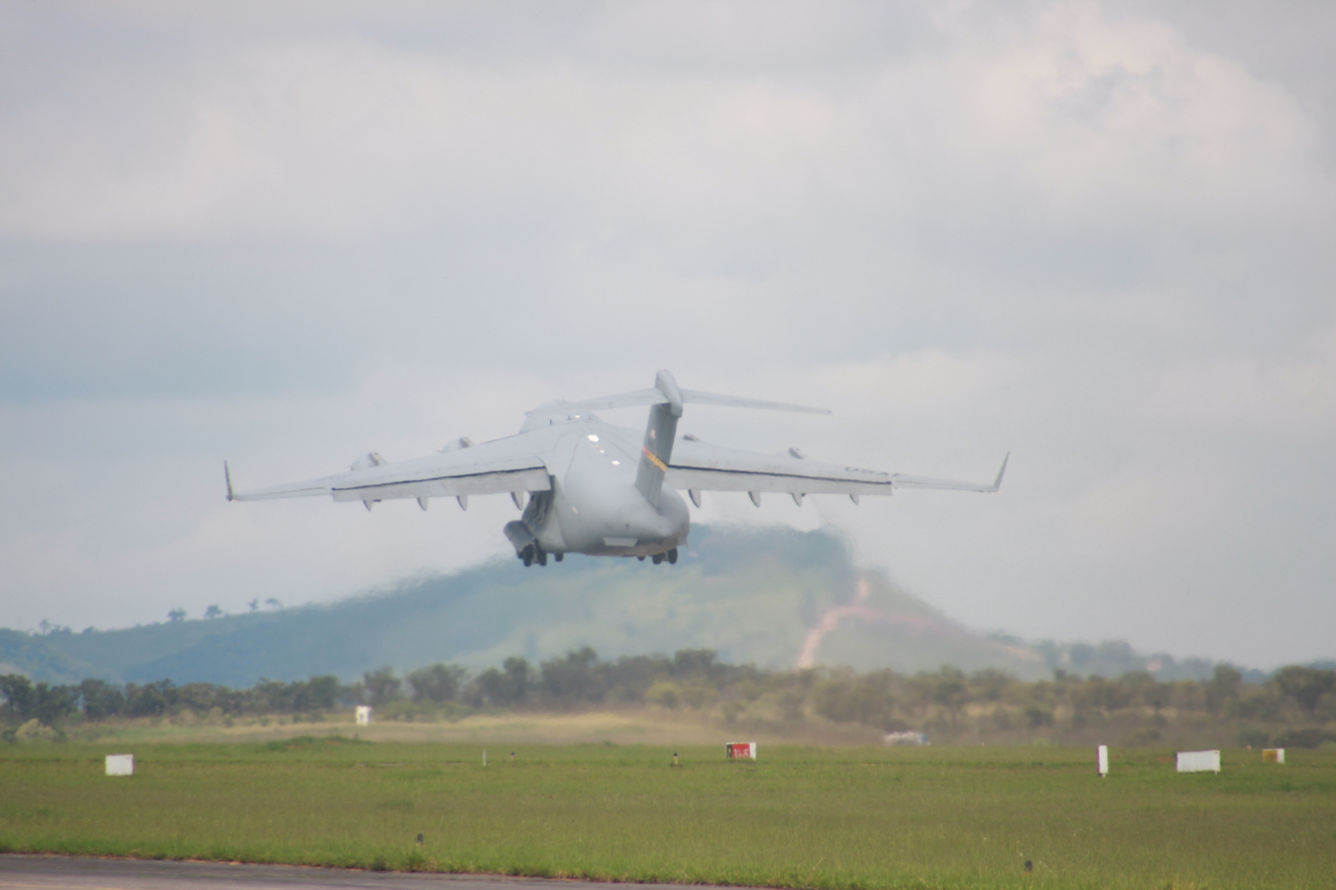
If the instrument passes all of its tests, it’s time to find a ride into space. Chances are, this isn’t near where you live.

Slide 18
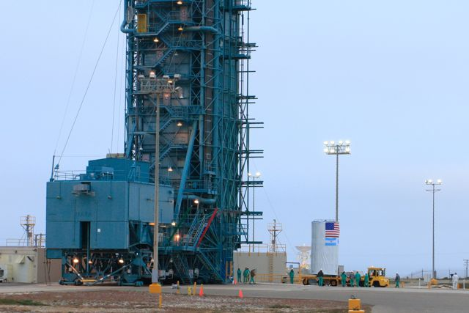
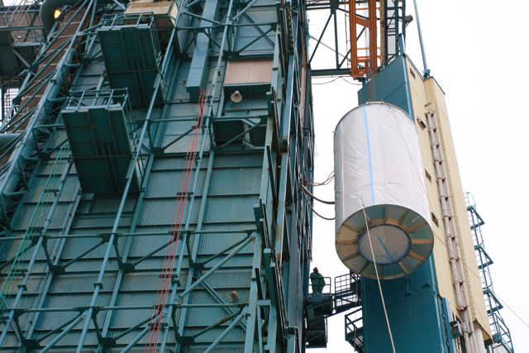
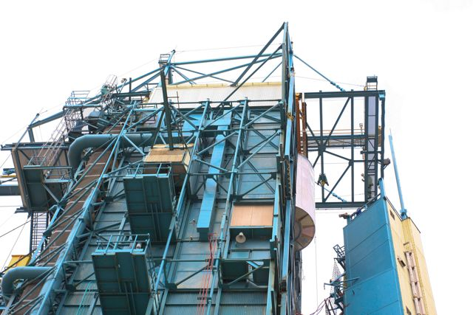
You start holding your breath as the instrument reaches the launch pad …

Slide 19
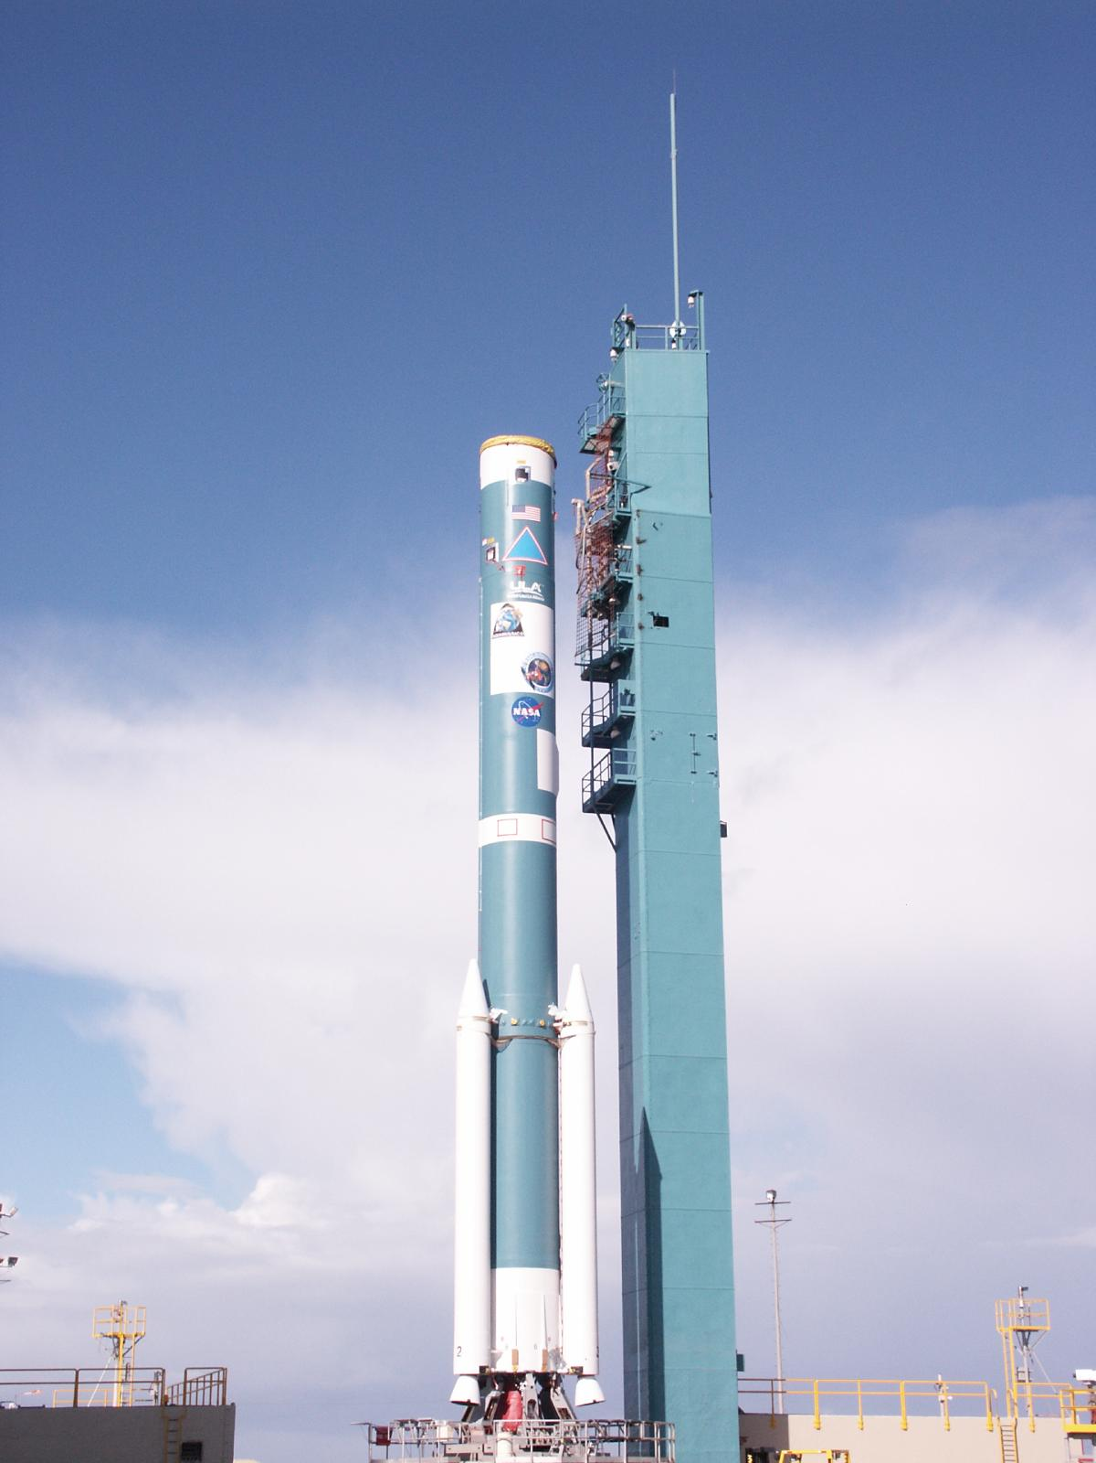
… keep holding …

Slide 20
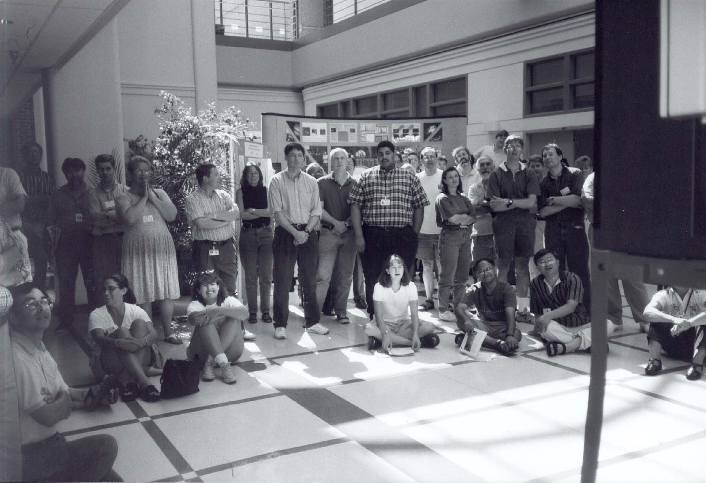
… keeeeeeeeep holding …

Slide 21
Finally, launch day! You haven’t exhaled, right?

Slide 22
How about now? Did I mention that 10-yrs have passed, 1000’s of man-hours expended, & $100M’s been spent since you first came up with your idea?
http://www.youtube.com/watch?v=WY00J_PgeYc
http://www.youtube.com/watch?v=sYHh8C8Kcrk

Slide 23
Finally, data! Now what? Are you done?

Slide 24
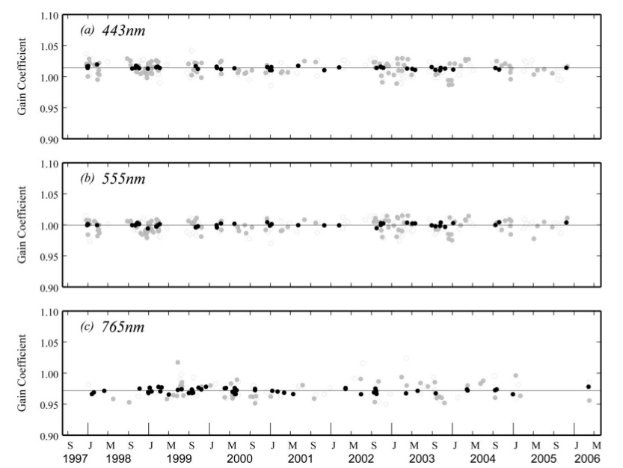
Sorry, you’re not even close to done. First, you discover that your absolute laboratory calibrations are a little off …

Slide 25
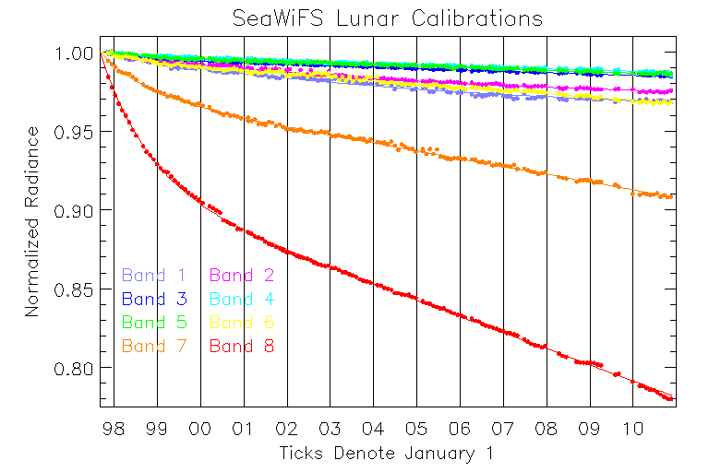
And, your instrument response is changing with time …

Slide 26
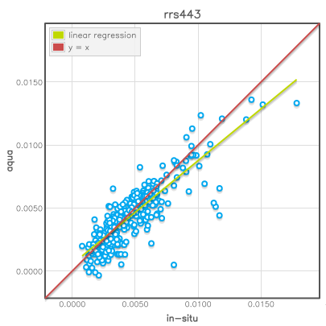
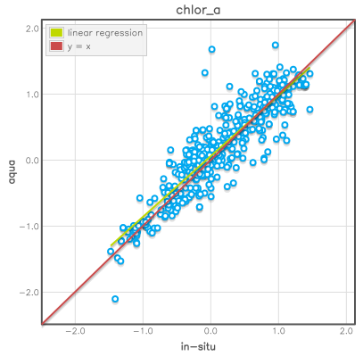
And, your data products can always be improved …

Slide 27
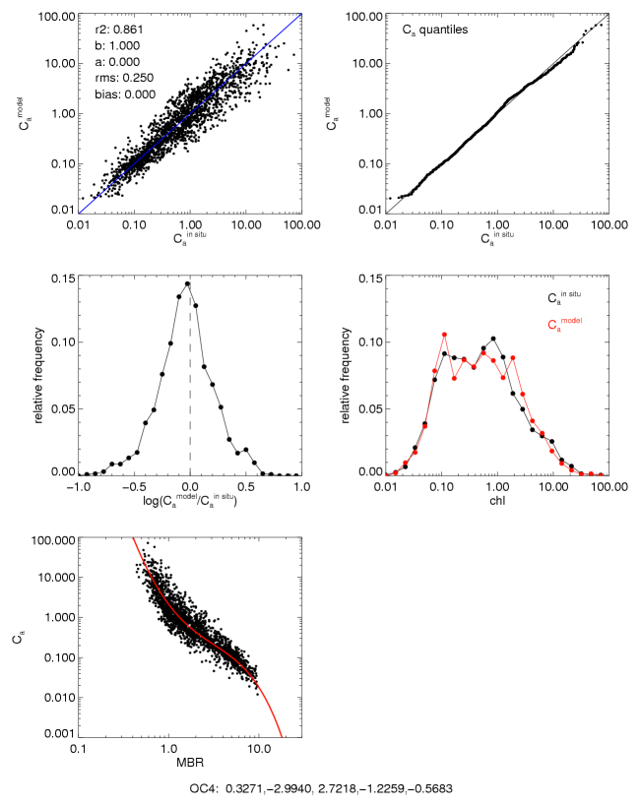
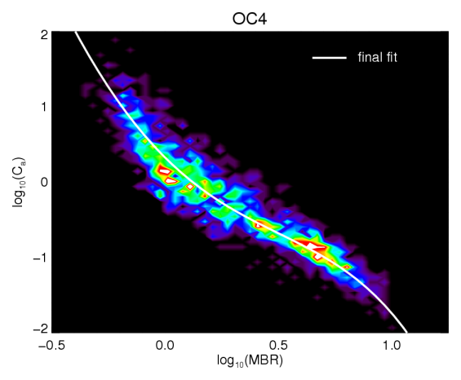
As can your algorithms.

Slide 28
Field work support many of these post-launch activities.
depth
latitude
longitude

Slide 29
Ultimately, with the proper investment of time, energy, money, collaborative efforts & other resources, you can achieve this … which is pretty cool.

