Slide 1
In situ data in support of (most) ocean color satellite calibration & validation activities
How are my data used? Part I
Ocean Optics Class
University of Maine
July 2011

Slide 2
in situ data are important for ocean color cal/val
- vicarious calibration
- data product validation
- algorithm development
- atmospheric correction
LATER

Slide 3
satellite ocean color
the satellite views the spectral light field at the top-of-the-atmosphere
SATELLITE
TOP-OF-THE-ATMOSPHERE
1. remove atmosphere from total signal to derive estimate of light field emanating from sea surface (remote-sensing reflectance, R_{rs})
3. spatially / temporally bin and remap satellite C_{a} observations
SEA SURFACE
2. relate spectral R_{rs} to C_{a} (or geophysical product of interest)
PHYTOPLANKTON

Slide 4
in situ data are important for ocean color cal/val
- vicarious calibration
- data product validation
- algorithm development
overview
operational / MOBY
model-based
alternative data sources
population statistics

Slide 5
vicarious calibration
what is vicarious calibration?
spectral on-orbit calibrations
1. instrument calibration
- e.g., focal plane temperature
2. temporal calibration
- reference Sun or Moon
3. absolute (vicarious) calibration
- reference Earth surface
- final, single gain adjustment
- calibration of the combined
instrument + algorithm system
SATELLITE
TOP OF
ATMOSPHERE
L_{t}^{target}
from the satellite
+ L_{r} , t_{d} , …
TARGET

Slide 6
vicarious calibration
a single, spectral radiometric adjustment
gain vs. time
gain vs. solar zenith angle
gain vs. satellite zenith angle
Franz et al. 2007

Slide 7
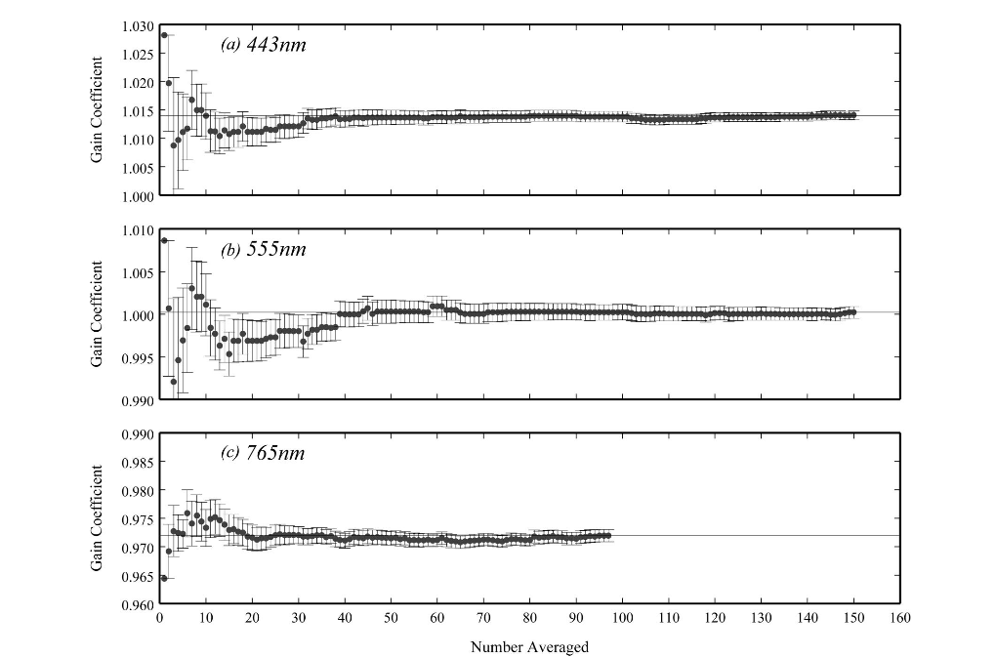
vicarious calibration
~40 match-ups required to achieve “stable” vicarious gain
SeaWiFS and Aqua average ~20 MOBY match-ups per year
Franz et al. 2007

Slide 8
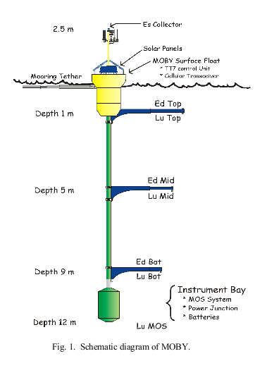
operational vicarious calibration
MOBY - the Marine Optical BuoY
maintained by NOAA & Moss Landing Marine Laboratory
20 miles west of Lanai, Hawaii
L_{u}(λ) and E_{d}(λ) at nominal depths of 1, 5, and 9 meters, plus E_{s}(λ)
spectral range is 340-955 nm & spectral resolution is 0.6 nm
hyperspectral data convolved to specific bandpasses of each satellite
approximately 450-700 samples per year for MODIS-Aqua

Slide 9
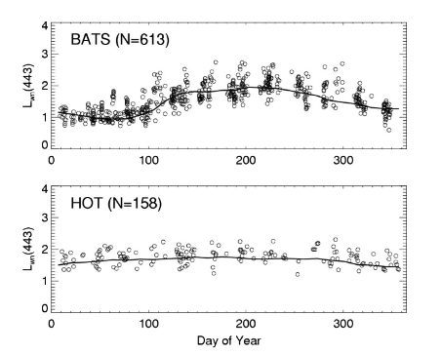
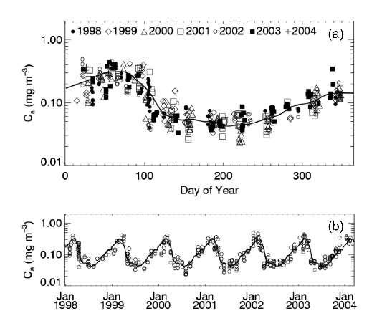
model-based vicarious calibration
build a climatology using a long-term chlorophyll-a record (this is for BATS, near Bermuda) …
… then, develop a radiometric climatology using an ocean reflectance model (e.g., Morel and Maritorena 2001)
Werdell et al. 2007

Slide 10
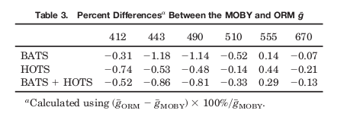
model-based vicarious calibration
model-based gains typically differ from MOBY gains by < 1%
Werdell et al. 2007

Slide 11
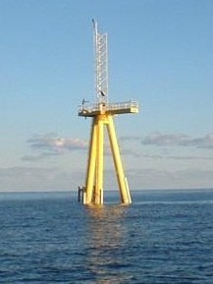
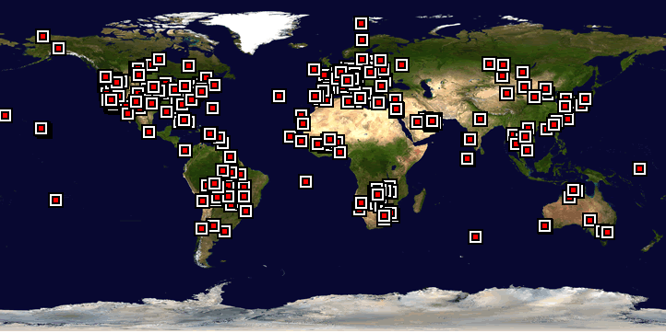
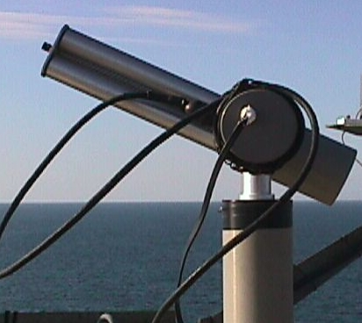
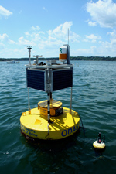
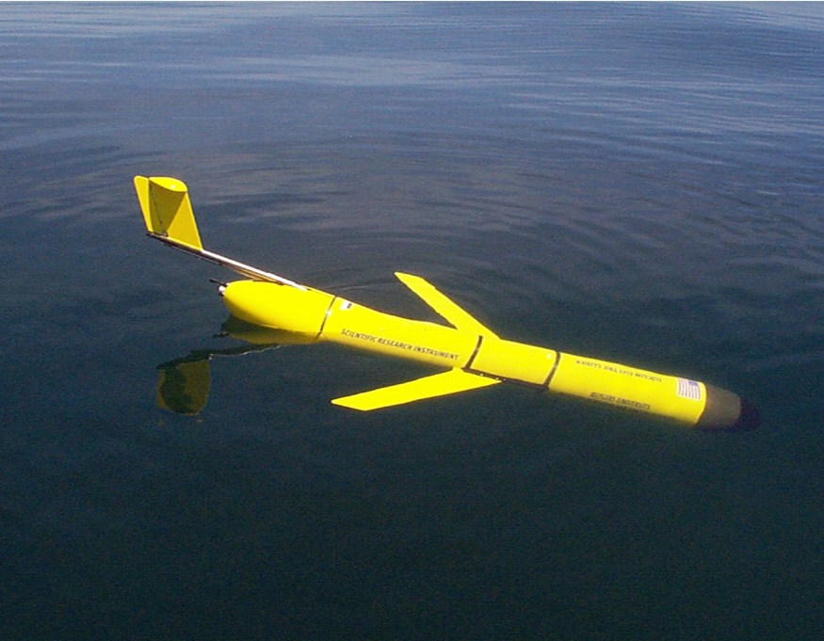
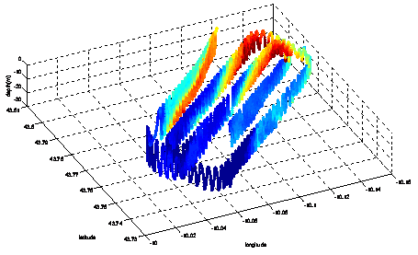
alternative in situ data for vicarious calibration
AERONET (fixed-above water platforms)
buoy networks
towed & underway sampling
depth
gliders, drifters, & other autonomous platforms
latitude
longitude

Slide 12
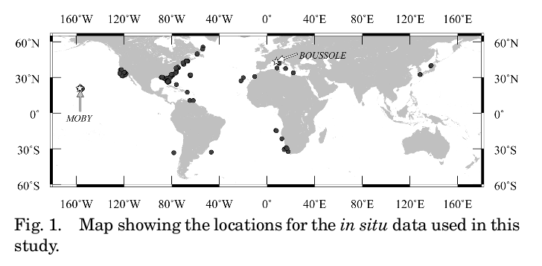
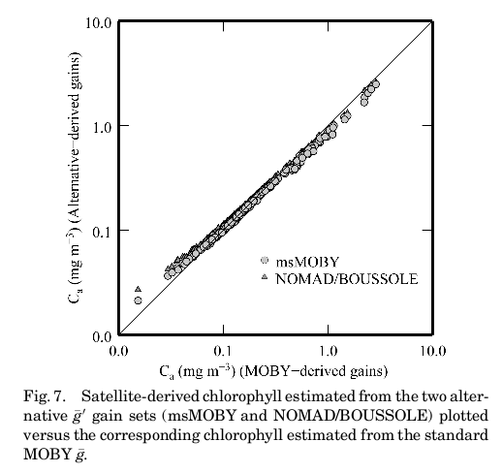
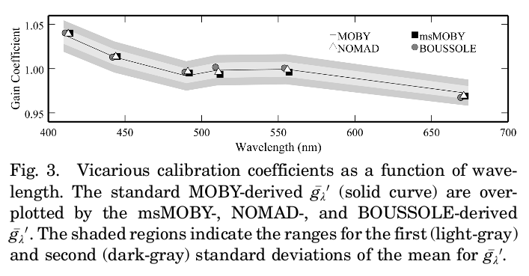
alternative in situ data for vicarious calibration
gains calculated using alternative in situ data typically differ from MOBY by < 0.3%
Bailey et al. 2008

Slide 13
tuning vicarious calibration using population statistics
compare spectral shapes of in situ & satellite populations
valleys have negative SS
hills have positive SS
R_{rs}
R_{rs}
λ⁻ λ λ⁺
λ⁻ λ λ⁺
spectral shape @ 443 nm, SS(443), uses R_{rs}(412), R_{rs}(443), & R_{rs}(490)
Stumpf & Werdell 2010

Slide 14
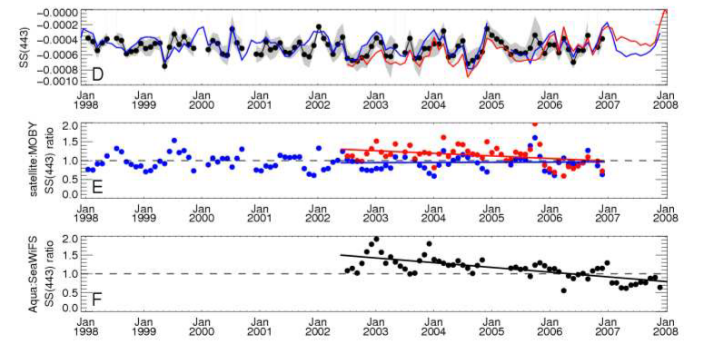
tuning vicarious calibration using population statistics
in situ, SeaWiFS, & MODIS-Aqua spectral shapes compared at MOBY site
Stumpf & Werdell 2010

Slide 15
in situ data are important for ocean color cal/val
- vicarious calibration
- data product validation
- algorithm development
Level-2 match-ups
Level-2 time-series
community efforts

Slide 16
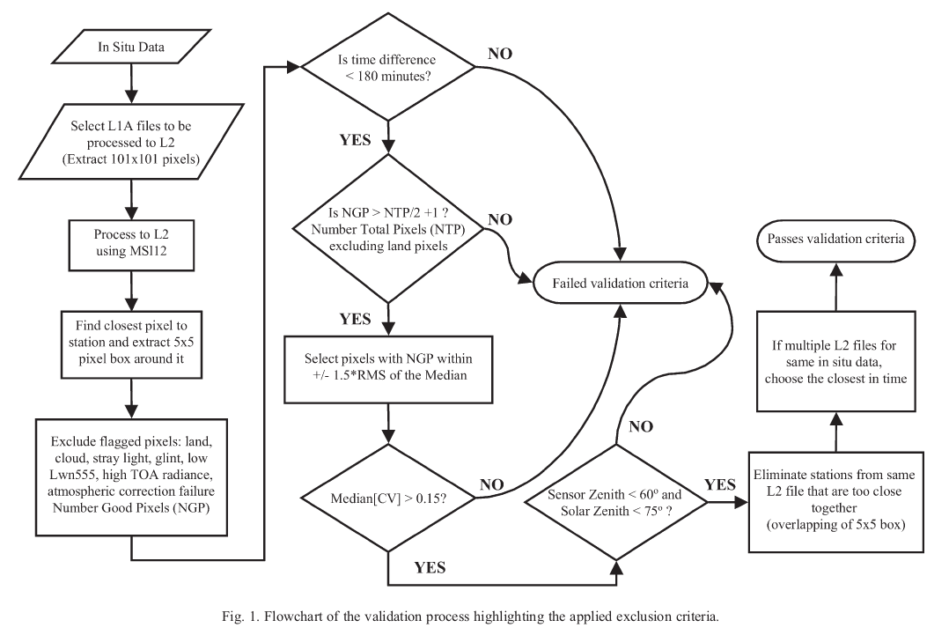
satellite data product validation: discrete match-ups
general flow of match-up process, with exclusion criteria

Slide 17
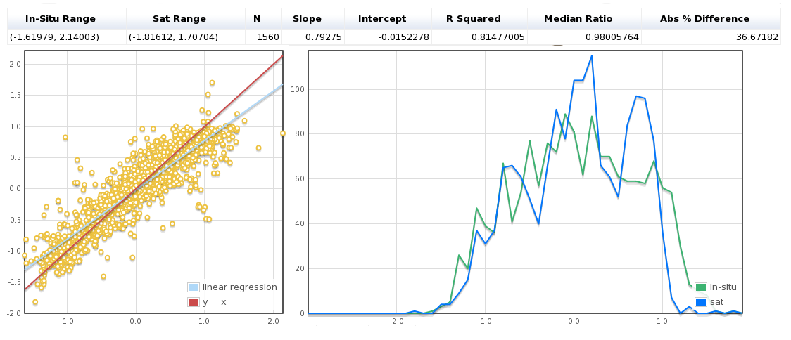
Level-2 match-ups
comparison of “coincident” in situ & satellite measurements
SeaWiFS chlorophyll-a match-ups (OC4 algorithm):
SeaWIFS C_{a}
in situ C_{a}
C_{a}
Bailey & Werdell 2006

Slide 18
Level-2 match-ups
Level-2 satellite-to-in situ “match-ups”
strengths:
the only truly independent validation of the science data products using ground truth measurements.
limitations:
quality of in situ data is highly variable and difficult to assess.
coverage for OC in situ data is limited, both geographically & temporally.
assumes that highly localized (~meters) measurements are representative of pixel (km) area.
in situ measurements require discipline expertise to analyze & compare with satellite values
generally useful only for assessing static biases in final products.
availability of in situ data in future (e.g., VIIRS) is unknown

Slide 19
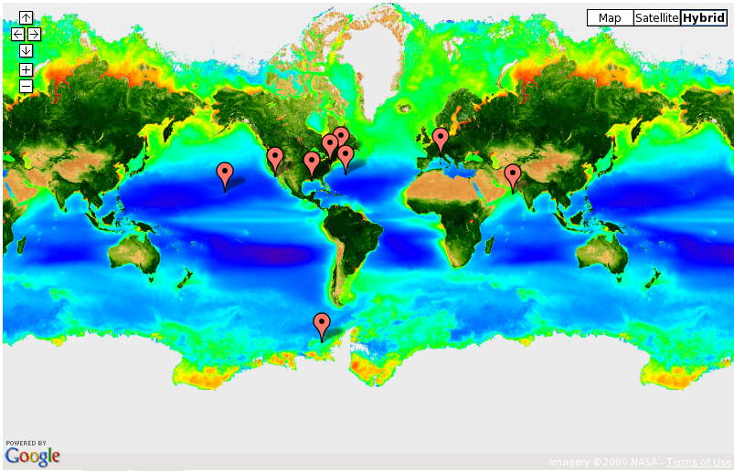
Level-2 time-series analyses

Slide 20
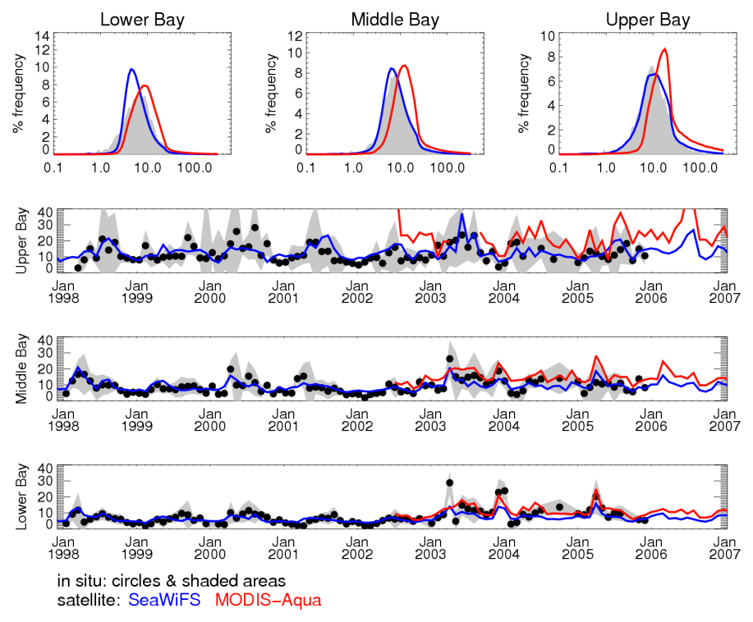
Level-2 time-series analyses
Chl-a (mg m⁻³)
Werdell et al. 2009

Slide 21
in situ data are important for ocean color cal/val
- vicarious calibration
- data product validation
- algorithm development
operational algorithms
semi-analytic IOP algorithm
atmospheric correction
community efforts
data sets

Slide 22
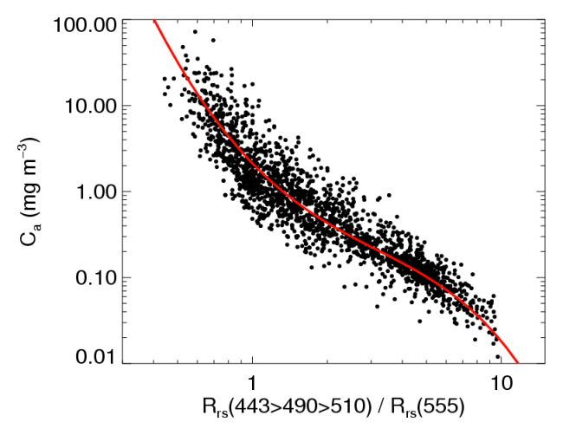
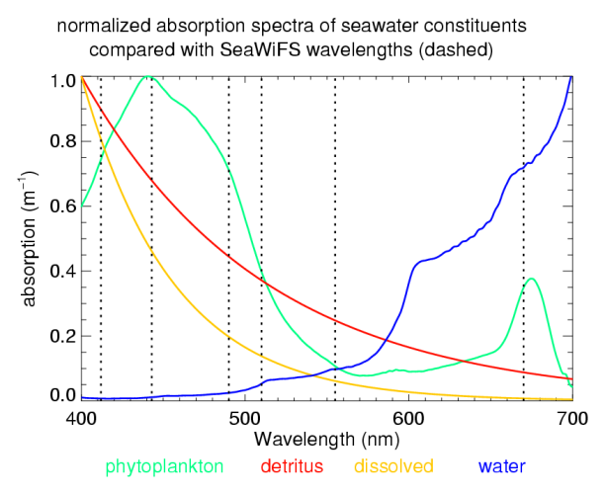
bio-optical algorithm development
“empirical”
“semi-analytical”
spectral matching of R_{rs} & IOPs
R_{rs} statistically related to pigments, IOPs, carbon stocks, etc.

Slide 23
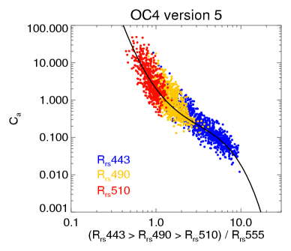
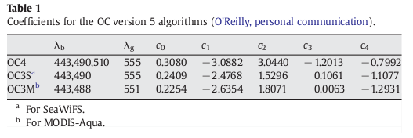
operational empirical algorithms
operational empirical (statistical) algorithms typically have a form that resembles
including all OC* & KD* algorithms developed by the OBPG, plus POC, TSM, etc. algorithms developed elsewhere

Slide 24
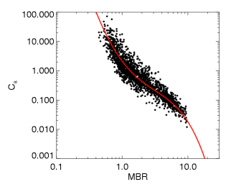
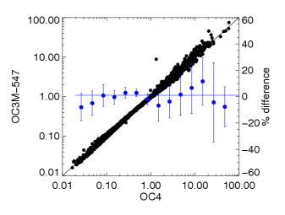
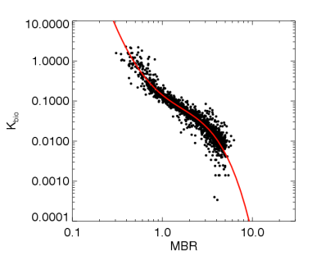
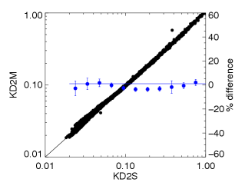
operational empirical algorithms
chlorophyll-a
AOP vs. stock
K_{d}(490)
AOP vs. AOP

Slide 25
semi-analytic IOP models
construction (& deconstruction) of an semi-analytic algorithm …
satellite provides R_{rs}(λ)
a(λ) and b_{b}(λ) are desired products
Bulk Inversion:
* no predefined shapes
* piece-wise solution: b_{bp}(λ), then a(λ), via empirical K_{d} (λ) via RTE
* ex: LS00
1
3
Spectral Optimization:
* define shape functions for (e.g.) b_{bp}(λ), a_{dg}(λ), a_{ph}(λ)
* solution via L-M, matrix inversion, etc.
* ex: RP95, HL96, GSM
2
Spectral Deconvolution:
* partially define shape functions for b_{bp}(λ), a_{dg}(λ)
* piece-wise solution: b_{bp}(λ), then a(λ), then a_{dg}(λ) + a_{ph}(λ)
* ex: QAA, PML, NIWA

Slide 26
atmospheric correction
in situ data … it’s not just for in-water algorithm development anymore
- development of new aerosol tables (via AERONET)
Ahmad et al. 2010
- refinement of the correction for non-zero R_{rs}(NIR)
Bailey et al. 2010
- refinement of the correction bidirectional effects (f/Q)
- evaluation of the correction for spectral bandpass effects

Slide 27
community algorithm development efforts
International Ocean Color Coordinating Group (IOCCG)
- working group “Ocean-Colour Algorithms” (Report 5)
- working group “Phytoplankton Functional Types”
- proposed working group “Regional bio-Optical algorithms Initiative (ROI)”
Optical Water Type classification schemes
100’s of other bio-optical algorithm development papers

Slide 28
some issues we wrestle with regarding in situ data:
limited spatial distribution
limited temporal distribution
variance within the data archive

Slide 29
some issues we wrestle with regarding in situ data:
limited spatial distribution
limited temporal distribution
variance within the data archive

Slide 30
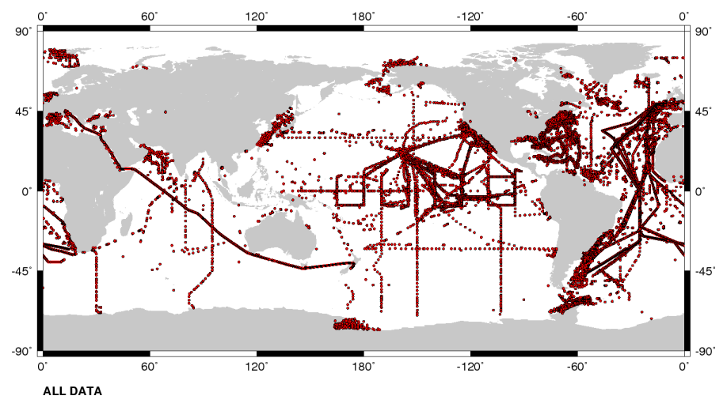
SeaBASS data archive
AOPs, IOPs, carbon stocks, CTD, pigments, aerosols, etc.
continuous & discrete profiles; some fixed observing or along-track

Slide 31
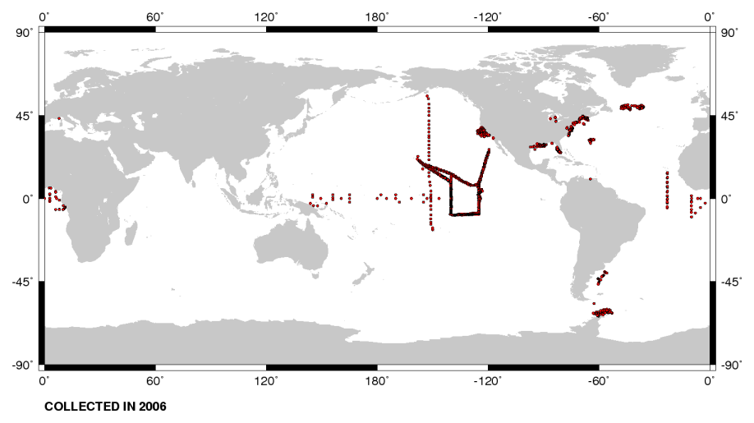
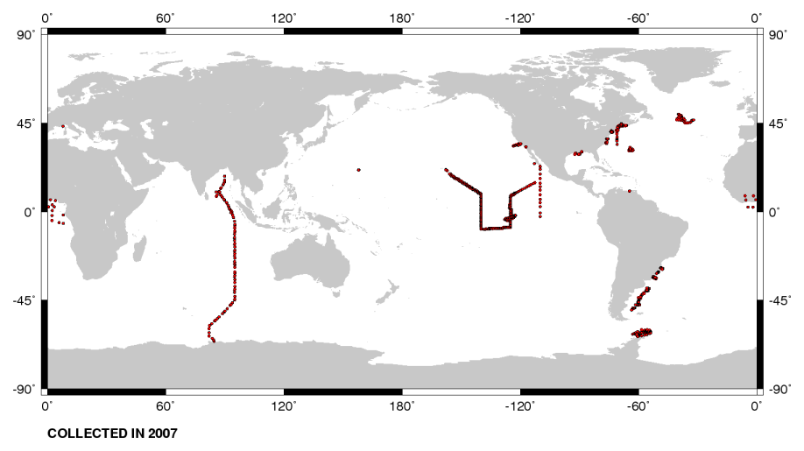
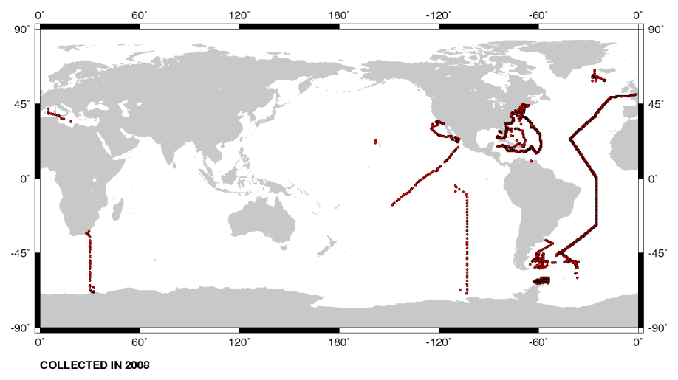
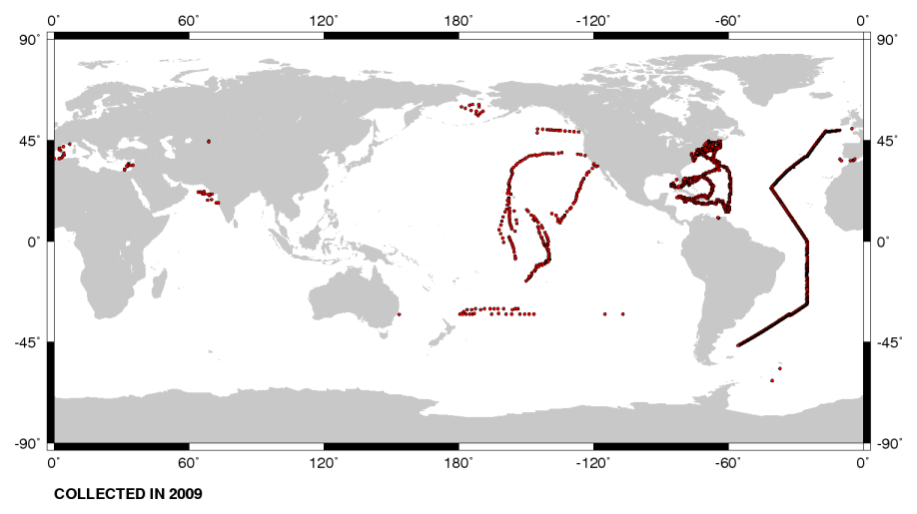
SeaBASS holdings by year: 2006-2009
2006
2007
2008
2009

Slide 32
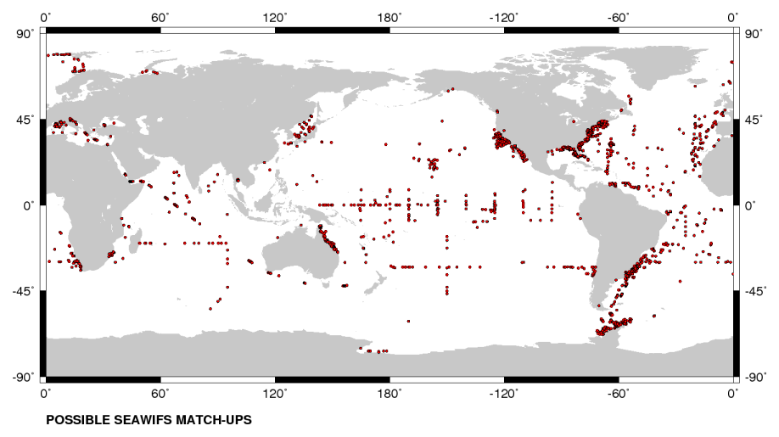
coincident SeaWiFS & in situ data

Slide 33
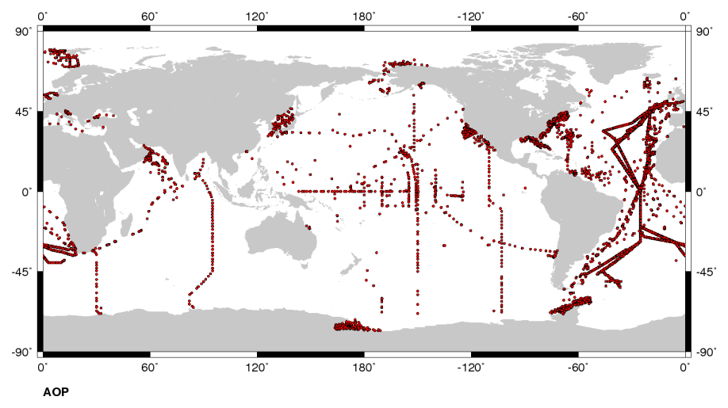
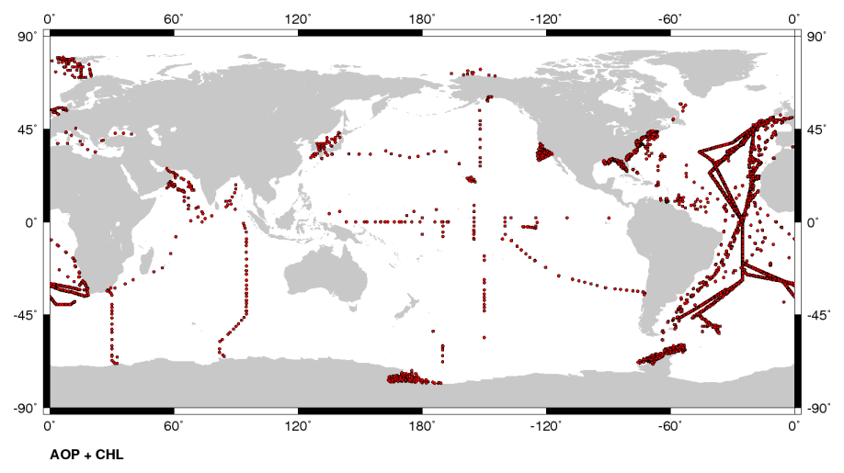
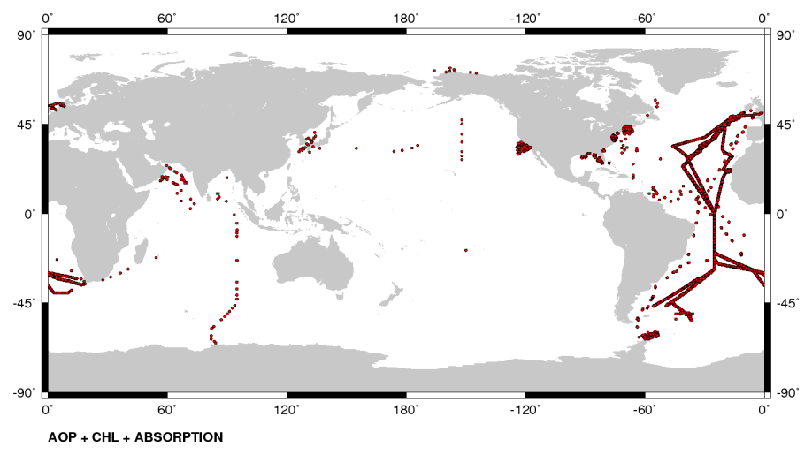
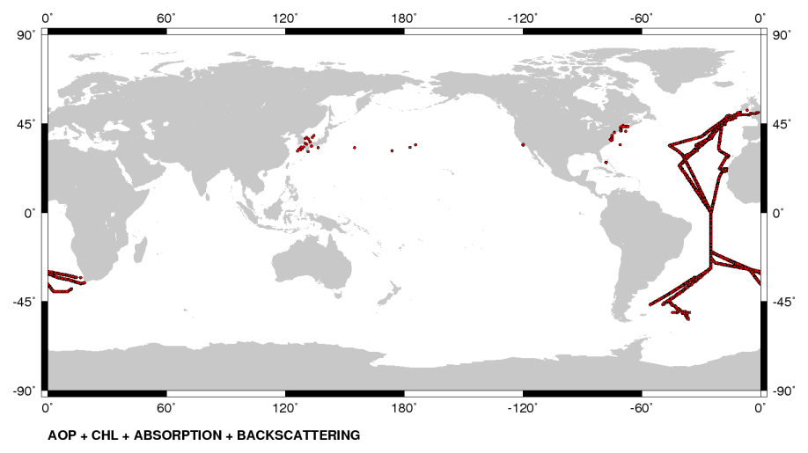
bio-optical algorithm development data sets
R_{rs}
R_{rs} & Chl
R_{rs} & Chl & absorption
Rrs & Chl & absorption & backscattering

Slide 34
bio-optical algorithm development data sets
R_{rs}
R_{rs} & Chl

Slide 35
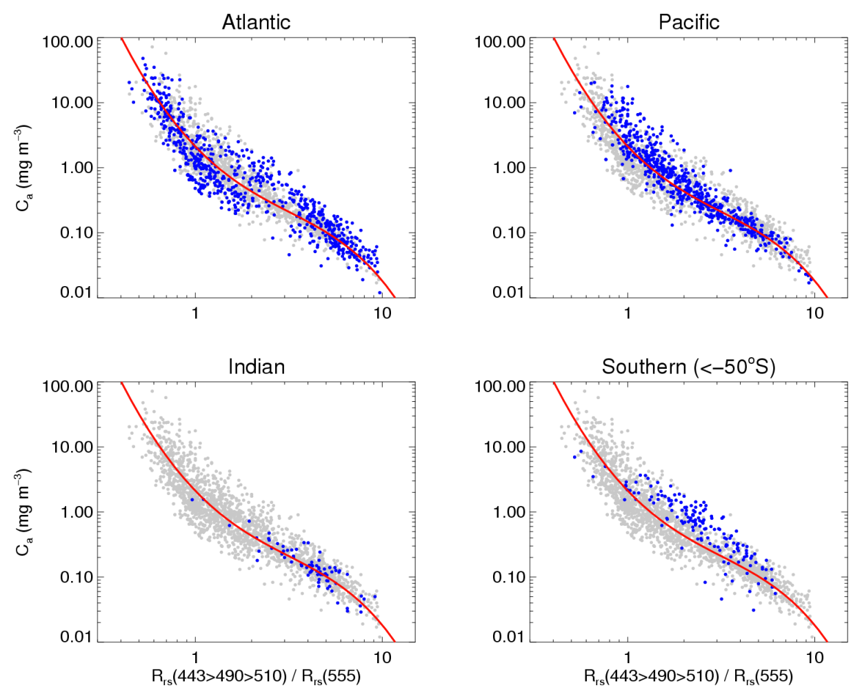
bio-optical algorithm data sets

Slide 36
some issues we wrestle with regarding in situ data:
limited spatial distribution
limited temporal distribution
variance within the data archive

Slide 37
for example, variance in AOP data sets
AOP instrumentation in SeaBASS or available commercially:
many companies & instruments
Biospherical, Satlantic, HOBI, Trios/Ramses, DALEC, SIMBAD-A, ASD, Spectron, custom
many platforms & deployment strategies
profilers, buoys, above-water (ship, permanent, hand-held), gliders, AUVs
dynamic range of problem set is growing:
new missions emphasize research in shallow, optically complex water
spectral domain stretching to UV and SWIR
new missions have immediate, operational requirements

Slide 38
Measurement in field
AOP(λ,z), IOP(λ,z), & C_{a}/CTD/bottle(z)
format provided by PI
minimal exclusion
L_{U}(λ,z) → L_{W}(λ)
Remote-sensing relevant values
AOP(λ,0⁺), IOP(λ, 0⁺), & C_{a}/CTD/bottle(0⁺)
no restrictions on coincidence
exclusion criteria applied (×2) / data reduction
calibration quality with protocol adherence
Algorithm Development
AOP(λ,0⁺) + IOP(λ, 0⁺) + C_{a}/CTD/bottle(0⁺)
coincidence requirement

Slide 39
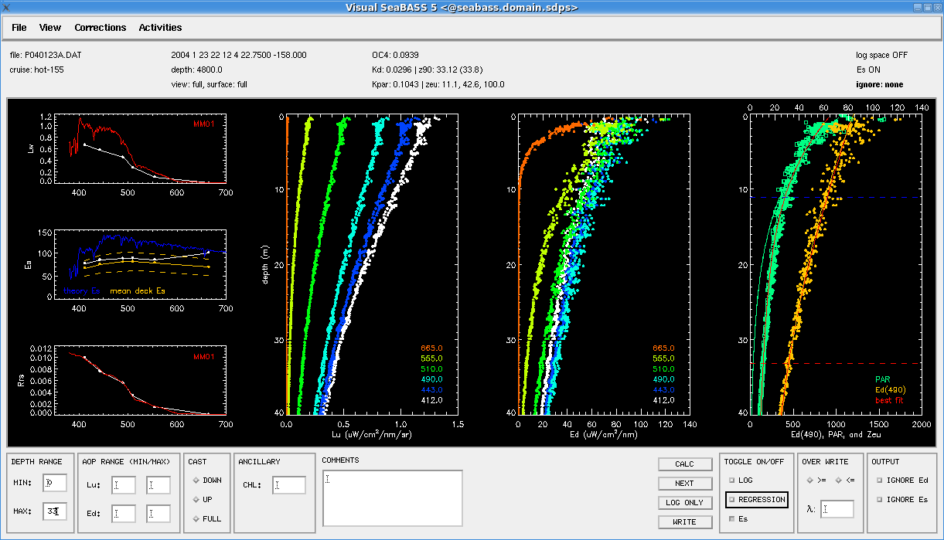
data analysis
L_{u}(z), E_{d}(z) -> L_{w}, E_{s}

Slide 40
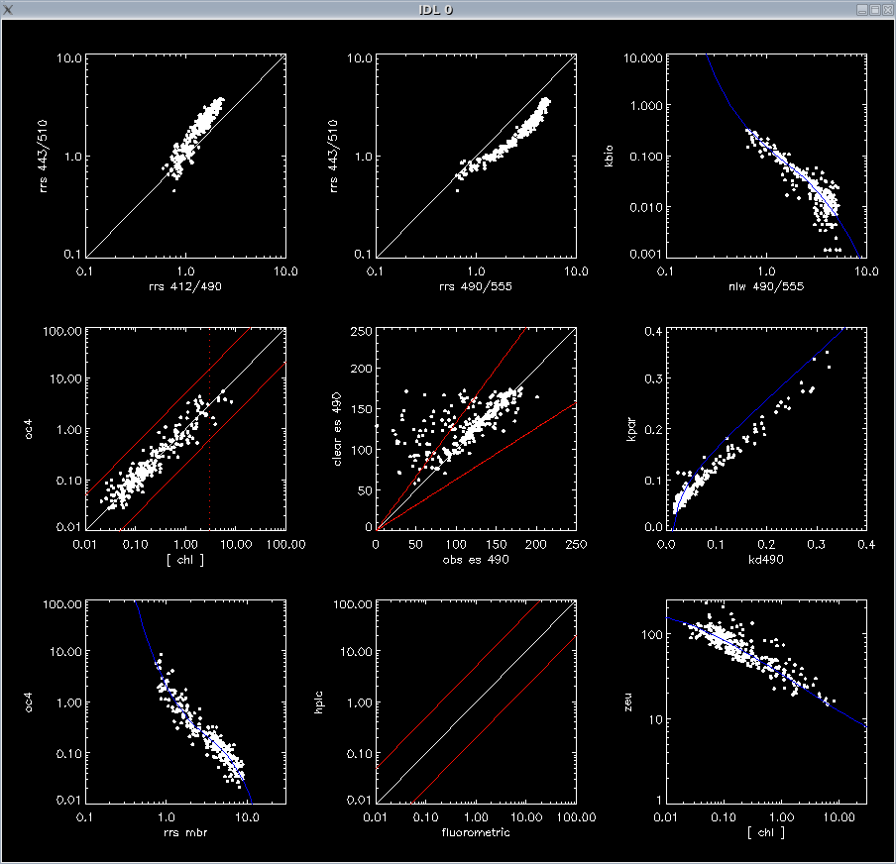
SeaDAS
evaluation at the cruise level

Slide 41
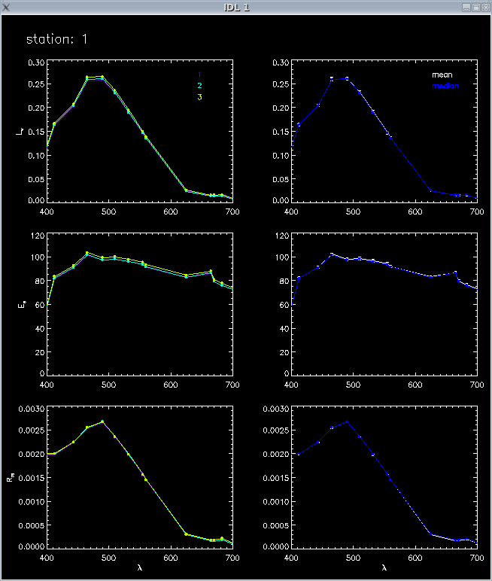
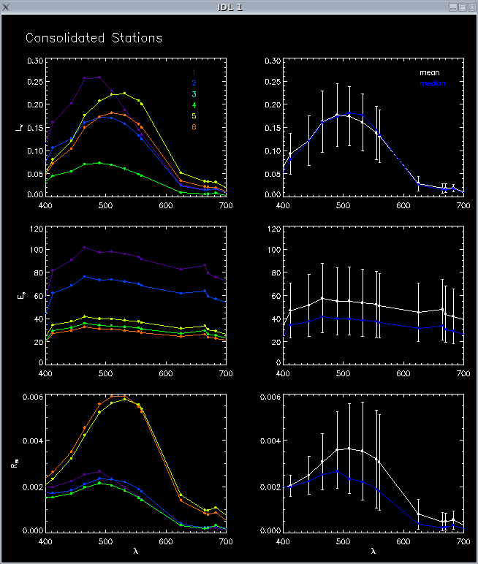
replicate cast reduction

Slide 42
in summary, with regards to in situ data, we would benefit from:
increased spatial resolution
latitudinal distributions of data are insufficient to evaluate sensor sensitivities
regional biases exist in our algorithm development & satellite validation data sets
increased temporal resolution
existing time-series are insufficient to evaluate large dynamic ranges of satellite retrievals
temporal biases exist in our algorithm development & satellite validation data sets
reduced variance within the data archive
need systematic adherence to protocols & data processing methods
need ability to effectively reprocess data (& replace these data in the archive)
higher frequency data acquisition
vicarious calibration of recently launched instruments requires rapid access to in situ data

