Slide 1
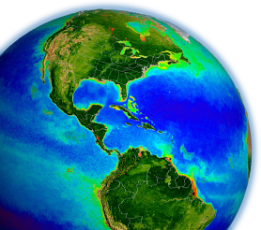
Ocean color atmospheric correction – Using a bio-optical model to address the “black pixel assumption”
Ocean Optics Class
University of Maine
July 2011

Slide 2
satellite ocean color
ocean color satellites view the top of the atmosphere
this signal includes contributions from:
Rayleigh (air molecules)
surface reflection
aerosols
water
model
model
0
to remove the aerosol signal, we make some assumptions about the “blackness” of the water signal in near-infrared (NIR) bands

Slide 3
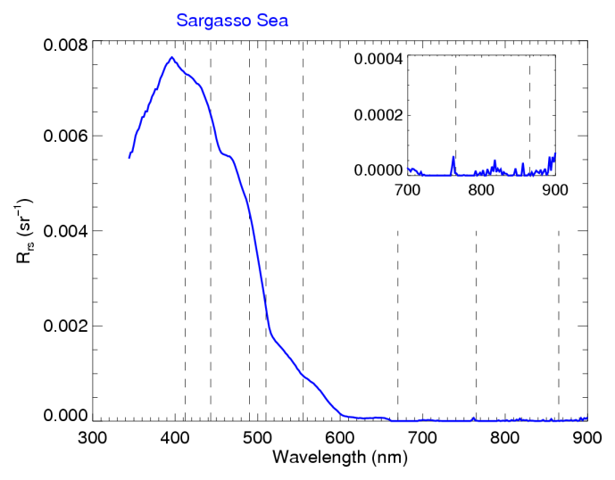
are Rrs(NIR) really black?

Slide 4
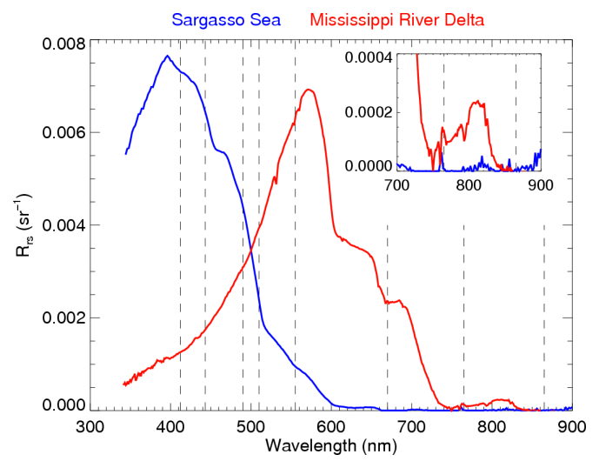
are Rrs(NIR) really black?

Slide 5
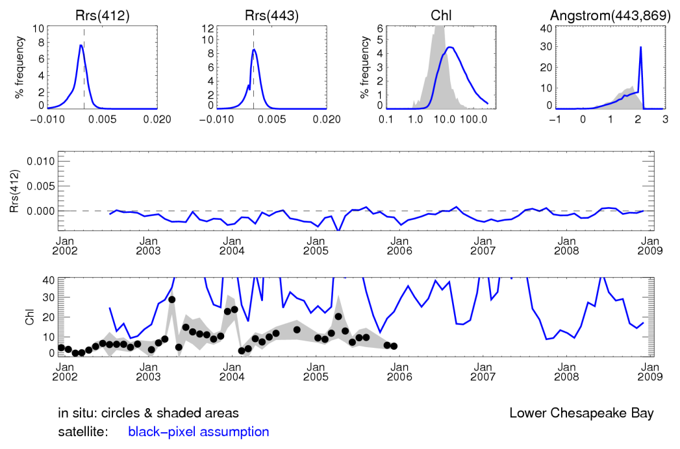
what happens when we don’t account for R_{rs}(NIR) > 0?
use the “black pixel” assumption (e.g., SeaWiFS 1997-2000)

Slide 6
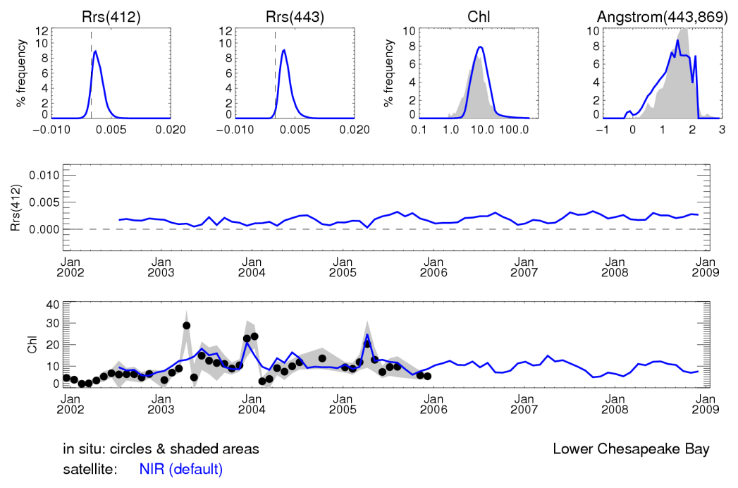
correction of non-negligible R_{rs}(NIR)
estimate R_{rs}(NIR) using a bio-optical model
operational SeaWiFS & MODIS processing ~ 2000-present

Slide 7
bio-optical model
initial R_{rs}(670) measured by satellite (using R_{rs}(765) = 0)

Slide 8
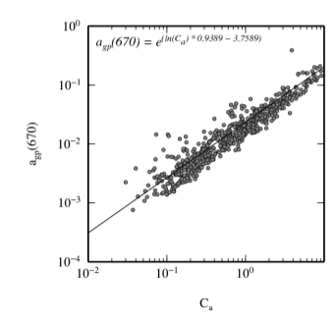
bio-optical model
initial R_{rs}(670) measured by satellite (using R_{rs}(765) = 0)
model a(670) = a_{w}(670) + a_{pg}(670)
= 0.1 m⁻¹
a_{w}(670) = 0.44 m⁻¹

Slide 9
bio-optical model
initial R_{rs}(670) measured by satellite (using R_{rs}(765) = 0)
model a(670) = a_{w}(670) + a_{pg}(670)
estimate b_{b}(670) using R_{rs}(670), a(670), & G(670) [Morel et al. 2002]

Slide 10
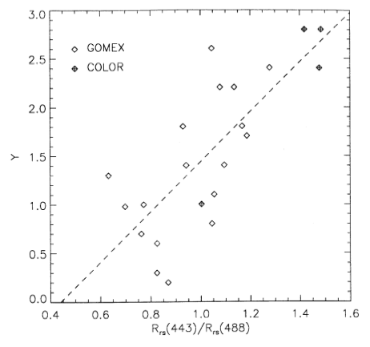
bio-optical model
initial R_{rs}(670) measured by satellite (using R_{rs}(765) = 0)
model a(670) = a_{w}(670) + a_{pg}(670)
estimate b_{b}(670) using R_{rs}(670), a(670), & G(670) [Morel et al. 2002]
model η using R_{rs}(443) & R_{rs}(555) [Lee et al. 2002]
from Carder et al. 1999

Slide 11
bio-optical model
initial R_{rs}(670) measured by satellite (using R_{rs}(765) = 0)
model a(670) = a_{w}(670) + a_{pg}(670)
estimate b_{b}(670) using R_{rs}(670), a(670), & G(670) [Morel et al. 2002]
model η using R_{rs}(443) & R_{rs}(555) [Lee et al. 2002]
estimate b_{b}(765) using b_{b}(670) & η

Slide 12
bio-optical model
initial R_{rs}(670) measured by satellite (using R_{rs}(765) = 0)
model a(670) = a_{w}(670) + a_{pg}(670)
estimate b_{b}(670) using R_{rs}(670), a(670), & G(670) [Morel et al. 2002]
model η using R_{rs}(443) & R_{rs}(555) [Lee et al. 2002]
estimate b_{b}(765) using b_{b}(670) & η
reconstruct R_{rs}(765) using b_{b}(765), a_{w}(765), & G(765)
a_{w}(765) = 2.85 m⁻¹

Slide 13
bio-optical model
initial R_{rs}(670) measured by satellite (using R_{rs}(765) = 0)
model a(670) = a_{w}(670) + a_{pg}(670)
estimate b_{b}(670) using R_{rs}(670), a(670), & G(670) [Morel et al. 2002]
model η using R_{rs}(443) & R_{rs}(555) [Lee et al. 2002]
estimate b_{b}(765) using b_{b}(670) & η
reconstruct R_{rs}(765) using b_{b}(765), a_{w}(765), & G(765)
iterate until Rrs(765) changes by <2% (typically 3-4 iterations)

Slide 14
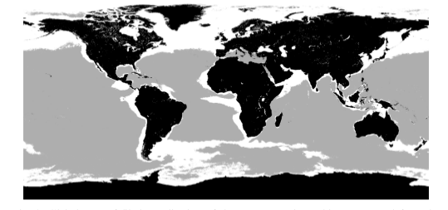
locations of application of bio-optical model
black = land; grey = Chl < 0.3 mg m⁻³; white Chl > 0.3 mg m⁻³
not applied when Chl < 0.3 mg m⁻³
weighted application when 0.3 < Chl < 0.7 mg m⁻³
fully applied when Chl > 0.7 mg m⁻³

Slide 15
what happens when we don’t account for R_{rs}(NIR) > 0?
use the “black pixel” assumption (e.g., SeaWiFS 1997-2000)

Slide 16
correction of non-negligible R_{rs}(NIR)
estimate R_{rs}(NIR) using a bio-optical model
operational SeaWiFS & MODIS processing ~ 2000-present

Slide 17
references
Bailey et al. 2010, Optics Express 18, 7521-7527
Stumpf et al. 2003, SeaWiFS Postlaunch Tech Memo Vol. 22, Chapter 9
Siegel et al. 2000, Applied Optics 39, 3582-3591
others

Slide 18
