Slide 1
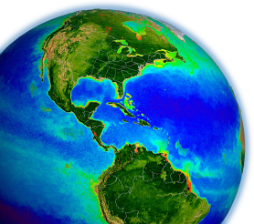
In situ data in support of (atmospheric) ocean color satellite calibration & validation activities
How are my data used? Part 2
Ocean Optics Class
University of Maine
July 2011

Slide 2
ocean color satellite data products
primary data product:
L_{w}(λ)
secondary data products (those derived from L_{w}(λ)):
AOPs: R_{rs}(λ), K_{d}(λ), PAR
IOPs: a(λ), b_{b}(λ)
pigments: Chl, accessory pigments
carbon stocks: DOC, POC, SPM
phytoplankton/productivity: FLH, NPP, ϕ, PFTs, PSCs
etc.

Slide 3
outline
accounting for R_{rs}(NIR) < 0
spectral bandpass adjustments
BRDF considerations
all 3 modify the final satellite R_{rs}(λ) using in situ data (thus, in situ data directly impact the fundamental climate data record)

Slide 4
outline
accounting for R_{rs}(NIR) < 0
spectral bandpass adjustments
BRDF considerations

Slide 5
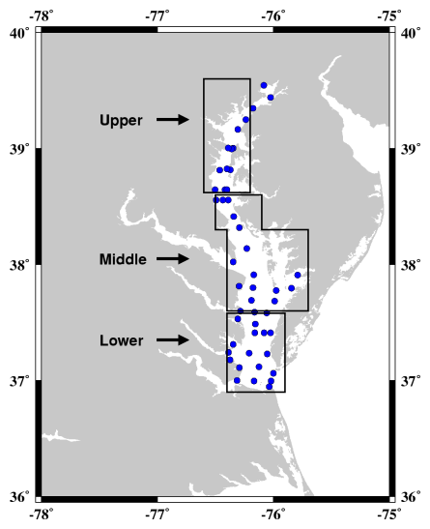
challenges for remote sensing of coasts & estuaries
temporal & spatial variability
satellite sensor resolution
satellite repeat frequency
validity of ancillary data (SST, wind)
resolution requirements & binning options
straylight contamination (adjacency effects)
non-maritime aerosols (dust, pollution)
region-specific models required?
absorbing aerosols
suspended sediments & CDOM
complicates estimation of R_{rs}(NIR)
complicates BRDF (f/Q) corrections
saturation of observed radiances
anthropogenic emissions (NO₂ absorption)
AERONET
COVE
Chesapeake Bay Program

Slide 6
atmospheric correction & the “black pixel” assumption
ρ_{t}(λ) = ρ_{w}(λ) + ρ_{g}(λ) + ρ_{f}(λ) + ρ_{r}(λ) + ρ_{a}(λ)
TOA water glint foam air aerosols
need ρ_{a}(λ) to get ρ_{w}(λ) and vice-versa

Slide 7
atmospheric correction & the “black pixel” assumption
ρ_{t}(λ) = ρ_{w}(λ) + ρ_{g}(λ) + ρ_{f}(λ) + ρ_{r}(λ) + ρ_{a}(λ)
TOA water glint foam air aerosols
need ρ_{a}(λ) to get ρ_{w}(λ) and vice-versa
the “black pixel” assumption (pre-2000):
ρ_{a}(NIR) = ρ_{t}(NIR) - ρ_{g}(NIR) - ρ_{f}(NIR) - ρ_{r}(NIR) - ρ_{w}(NIR)
0

Slide 8
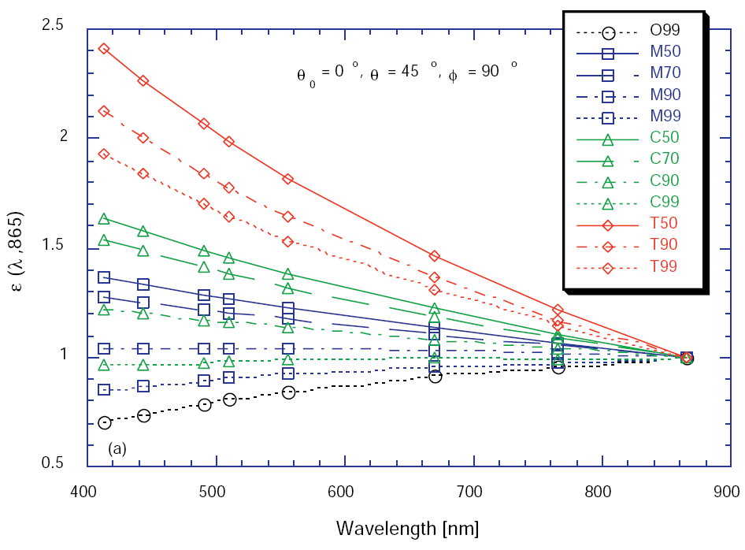
atmospheric correction & the “black pixel” assumption
ρ_{t}(λ) = ρ_{w}(λ) + ρ_{g}(λ) + ρ_{f}(λ) + ρ_{r}(λ) + ρ_{a}(λ)
TOA water glint foam air aerosols
need ρ_{a}(λ) to get ρ_{w}(λ) and vice-versa
the “black pixel” assumption (pre-2000):
ρ_{a}(NIR) = ρ_{t}(NIR) - ρ_{g}(NIR) - ρ_{f}(NIR) - ρ_{r}(NIR) - ρ_{w}(NIR)
calculate aerosol ratios, ε :
ε(748,869)
ε(λ,869)
0
ρ_{a}(748)
≈
ρ_{a}(869)
ρ_{a}(λ)
≈
ε(748,869)
ρ_{a}(869)

Slide 9
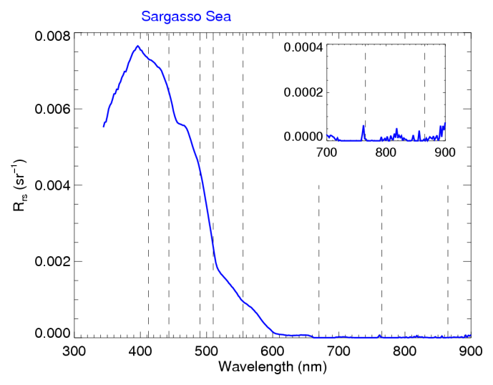
are Rrs(NIR) really black?

Slide 10
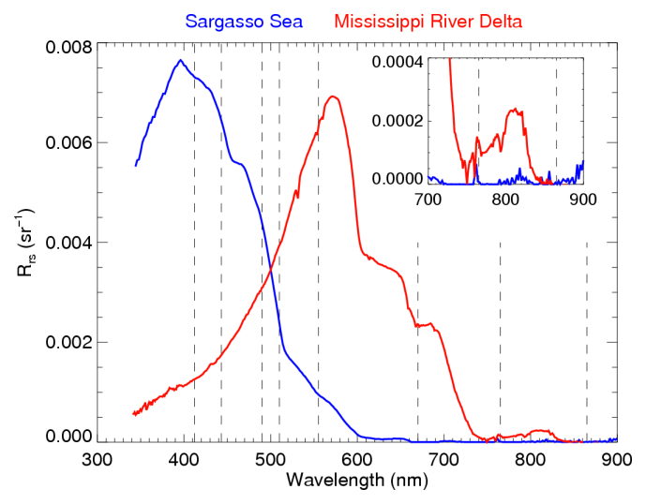
are Rrs(NIR) really black?

Slide 11
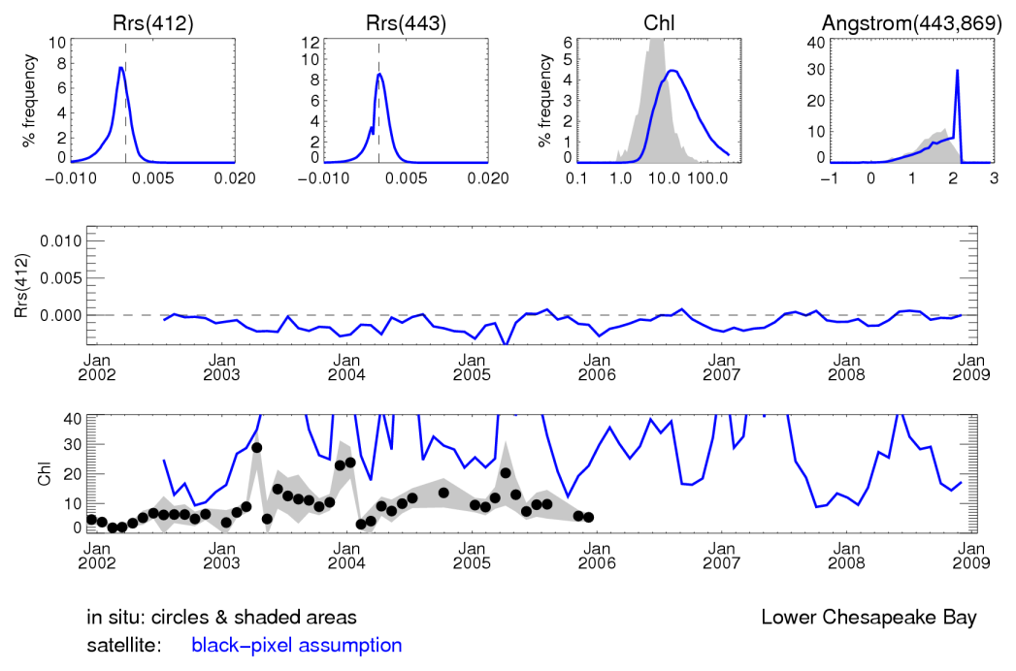
what happens when we don’t account for R_{rs}(NIR) > 0?
use the “black pixel” assumption (e.g., SeaWiFS 1997-2000)

Slide 12
what to do when Rrs(NIR) > 0?
many approaches exist, here are a few examples:
assign aerosols (ε) and/or water contributions (Rrs(NIR))
e.g., Hu et al. 2000, Ruddick et al. 2000
use shortwave infrared bands
e.g., Wang & Shi 2007
correct/model the non-negligible R_{rs}(NIR)
Siegel et al. 2000 used in SeaWiFS Reprocessing 3 (2000)
Stumpf et al. 2003 used in SeaWiFS Reprocessing 4 (2002)
Lavender et al. 2005 MERIS
Bailey et al. 2010 used in SeaWiFS Reprocessing 6 (2009)
use a coupled ocean-atmosphere optimization
e.g., Chomko & Gordon 2001, Stamnes et al. 2003, Kuchinke et al. 2009
field data!

Slide 13
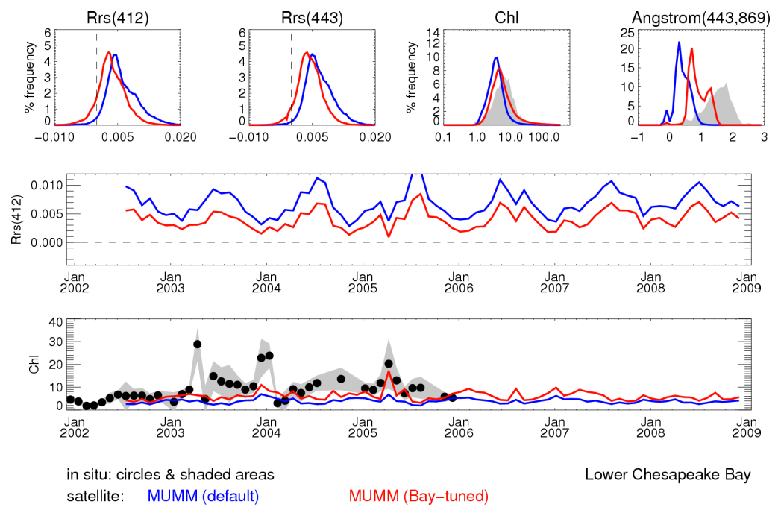
fixed aerosol & water contributions (MUMM)
assign ε & ρ_{w}(NIR) (via fixed values, a climatology, nearby pixels)

Slide 14
advantages & disadvantages
advantages:
accurate configuration leads to accurate aerosol & R_{rs}(NIR) retrievals
several configuration options: fixed values, climatologies, nearby pixels
method available for all past, present, & future ocean color satellites
disadvantages:
no configuration is valid at all times for all water masses
requires local knowledge of changing aerosol & water properties
implementation can be complicated for operational processing

Slide 15
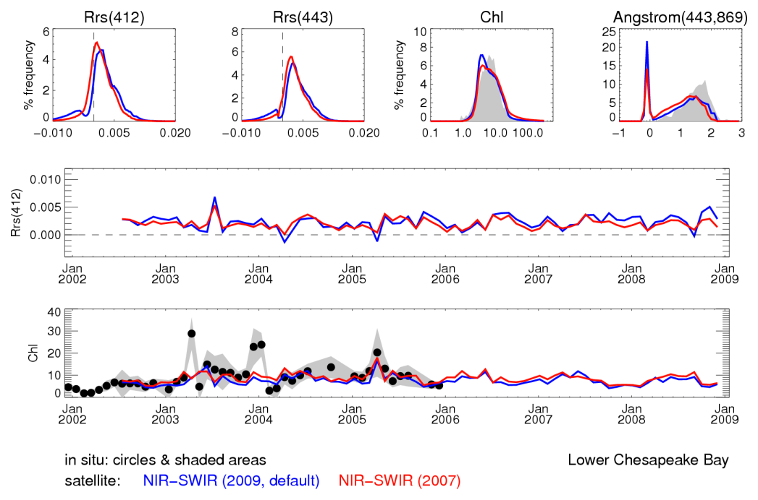
use of NIR + SWIR bands
use SWIR bands in “turbid” water, otherwise use NIR bands

Slide 16
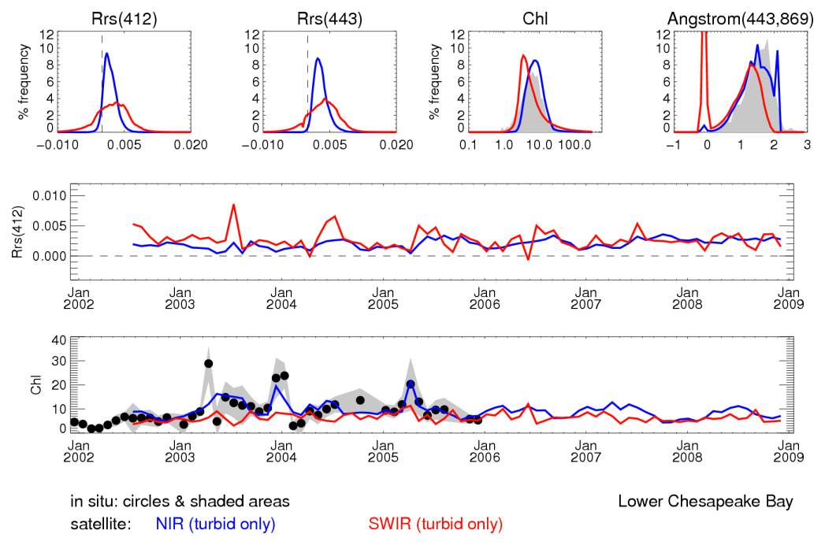
use of SWIR bands only
compare NIR & SWIR retrievals when considering only “turbid pixels”

Slide 17
advantages & disadvantages
advantages:
“black pixel” assumption largely satisfied in SWIR region of spectrum
straightforward implementation for operational processing
disadvantages:
only available for instruments with SWIR bands
SWIR bands on MODIS have inadequate signal-to-noise (SNR) ratios
difficult to vicariously calibrate the SWIR bands on MODIS
must define conditions for switching from NIR to SWIR

Slide 18
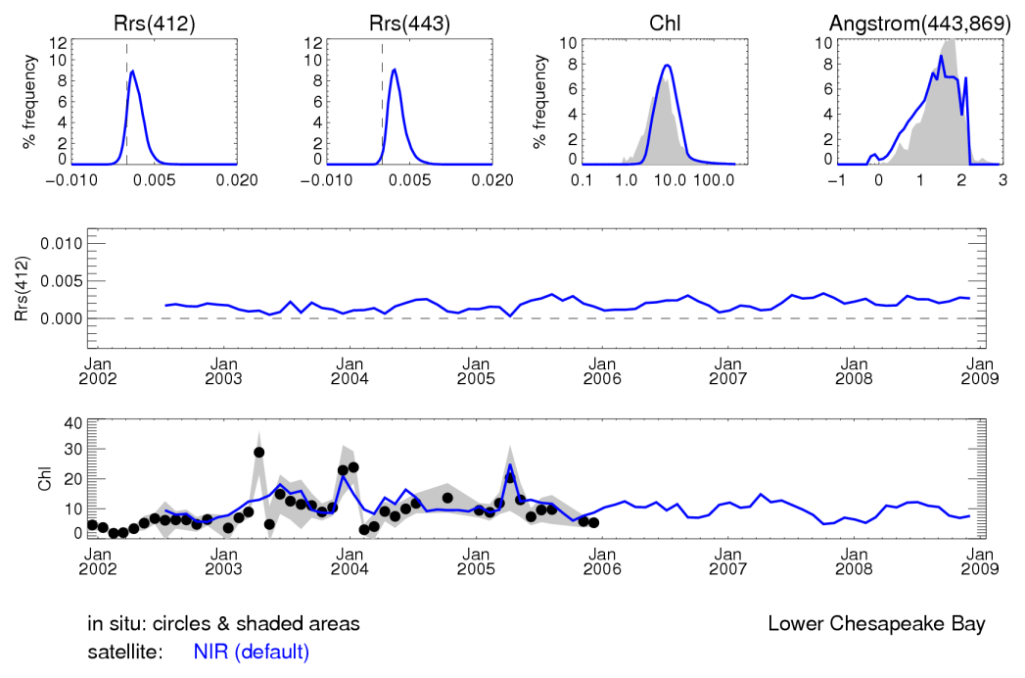
correction of non-negligible R_{rs}(NIR)
estimate R_{rs}(NIR) using a bio-optical model
operational SeaWiFS & MODIS processing ~ 2000-present

Slide 19
advantages & disadvantages
advantages:
method available for all past, present, & future ocean color missions
straightforward implementation for operational processing
disadvantages:
bio-optical model not valid at all times for all water masses
this is the method we discussed last Thu

Slide 20
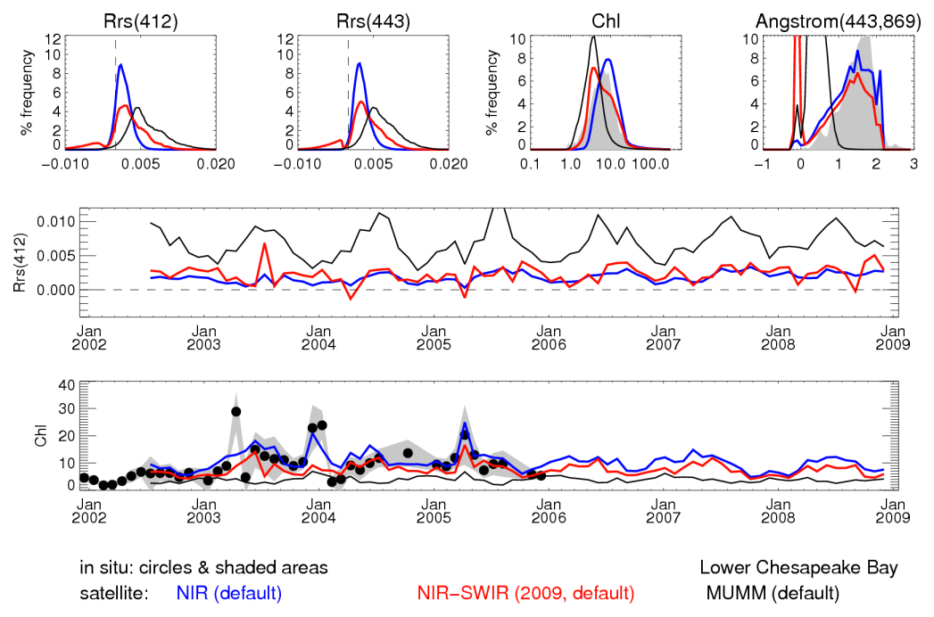
summary of the three approaches
defaults as implemented in SeaDAS

Slide 21
outline
accounting for R_{rs}(NIR) < 0
spectral bandpass adjustments
BRDF considerations

Slide 22
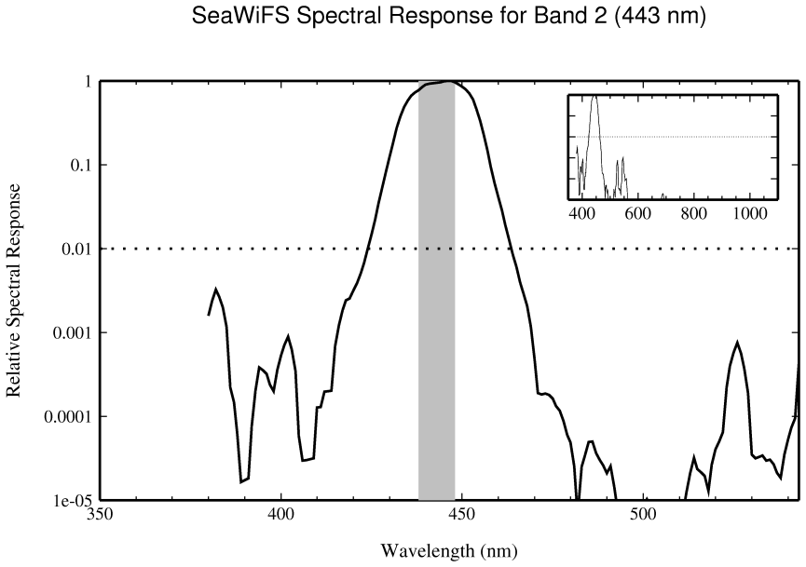
spectral bandpass correction
satellite filter
in situ filter

Slide 23
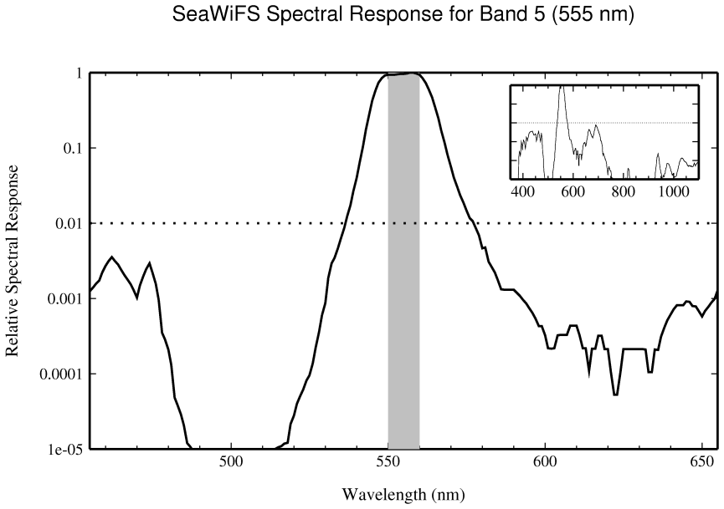
spectral bandpass correction
!
satellite filter
in situ filter

Slide 24
spectral bandpass correction
why do we care?
satellite R_{rs} adjusted using a bio-optical model
relevant for satellite-to-in situ R_{rs} match-ups
field data!

Slide 25
spectral bandpass correction
Morel & Maritorena 2001 (MM01) is an open ocean reflectance model for modeling R_{rs}(λ) from Chl at ~ 1-nm resolution
it includes empirical relationships based on field data

Slide 26
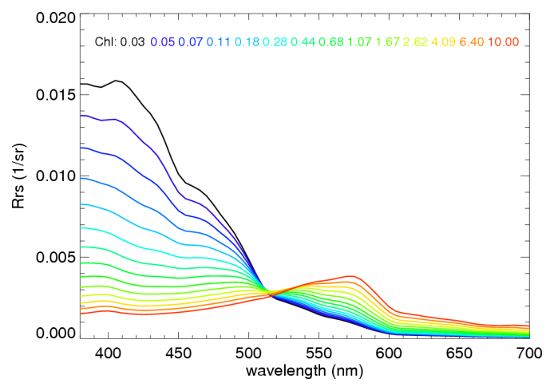
spectral bandpass correction
calculate R_{rs}(λ) using MM01 for 0.01 < Chl < 3 mg m⁻³

Slide 27
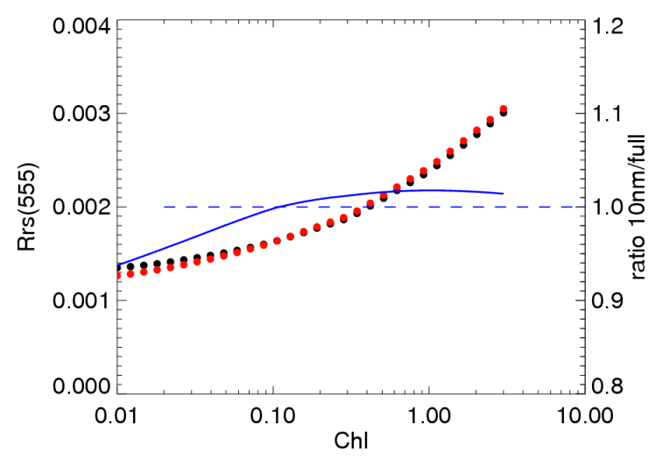
spectral bandpass correction
calculate R_{rs}(λ) using MM01 for 0.01 < Chl < 3 mg m⁻³
for each satellite band λ_{i}:
for each Chl_{j}:
calculate 10-nm mean R_{rs}(λ_{i},Chl_{j})
calculate full-spectral-response R_{rs}(λ_{i},Chl_{j})
ratio r(λ_{i},Chl_{j}) = 10-nm / full-band
10-nm
full-band
ratio

Slide 28
spectral bandpass correction
calculate R_{rs}(λ) using MM01 for 0.01 < Chl < 3 mg m⁻³
for each satellite band λ_{i}:
for each Chl_{j}:
calculate 10-nm mean R_{rs}(λ_{i},Chl_{j})
calculate full-spectral-response R_{rs}(λ_{i},Chl_{j})
ratio r(λ_{i},Chl_{j}) = 10-nm / full-band
10-nm
full-band
ratio

Slide 29
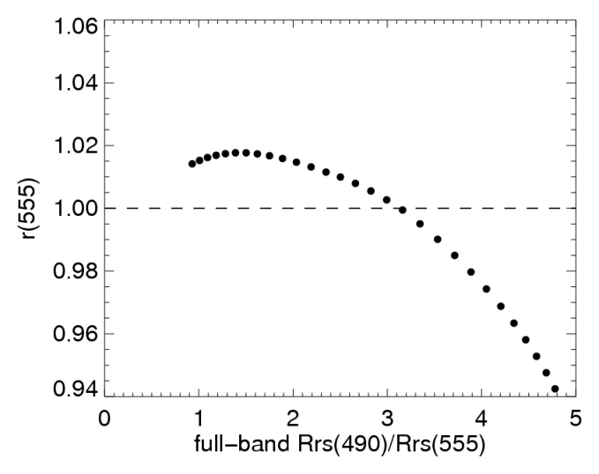
spectral bandpass correction
calculate R_{rs}(λ) using MM01 for 0.01 < Chl < 3 mg m⁻³
for each satellite band λ_{i}:
for each Chl_{j}:
calculate 10-nm mean R_{rs}(λ_{i},Chl_{j})
calculate full-spectral-response R_{rs}(λ_{i},Chl_{j})
ratio r(λ_{i},Chl_{j}) = 10-nm / full-band
plot / regress ratio vs. full-band R_{rs}(490) / R_{rs}(555)
derive polynomial expression to estimate ratio from full-band ratio

Slide 30
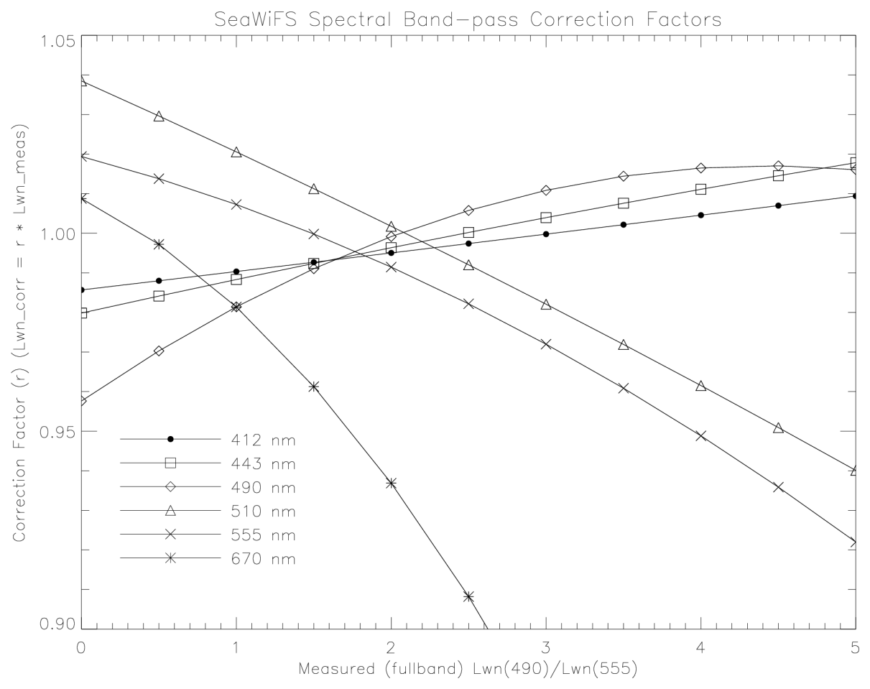
spectral bandpass correction
r = R_{rs}(10nm) / R_{rs}(full)
full-band R_{rs}(490) / R_{rs}(555)

Slide 31
spectral bandpass correction
calculate R_{rs}(λ) using MM01 for 0.01 < Chl < 3 mg m⁻³
for each satellite band λ_{i}:
for each Chl_{j}:
calculate 10-nm mean R_{rs}(λ_{i},Chl_{j})
calculate full-spectral-response R_{rs}(λ_{i},Chl_{j})
ratio r(λ_{i},Chl_{j}) = 10-nm / full-band
plot / regress ratio vs. full-band R_{rs}(490) / R_{rs}(555)
derive polynomial expression to estimate ratio from full-band ratio
to “adjust” satellite full-band to 10-nm, apply correction factors
Rrs(λ_{i},10-nm) = r(λ_{i}) * Rrs(λ_{i},full-band)

Slide 32
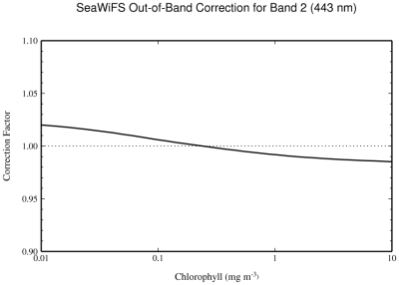
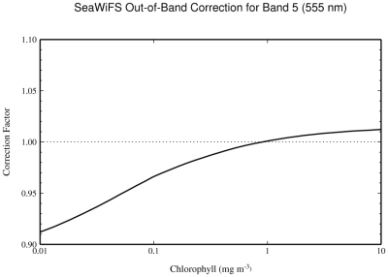
spectral bandpass correction

Slide 33
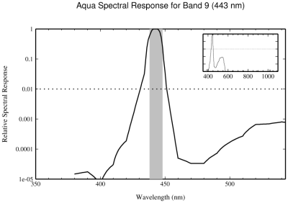
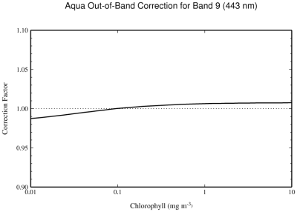
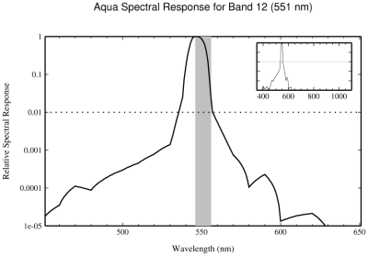
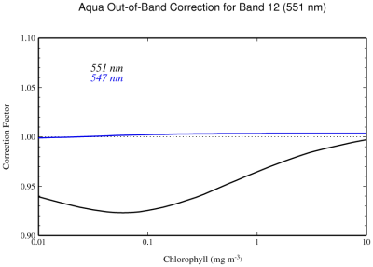
spectral bandpass correction

Slide 34
spectral bandpass correction
take care when executing satellite-to-in situ match-ups
when using multispectral in situ radiometers:
enable the bandpass adjustment
when using hyperspectral in situ radiometers:
enable the adjustment when applying 10-nm filter to in situ R_{rs}
enable the adjustment when applying full-spectral-response to in situ R_{rs}

Slide 35
outline
accounting for R_{rs}(NIR) < 0
spectral bandpass adjustments
BRDF considerations

Slide 36
SUN
IN SITU

Slide 37
SUN
SUN
IN SITU

Slide 38
SUN
SUN
SATELLITE
SUN
IN SITU

Slide 39
normalizing Rrs
account for Sun’s changing position in the sky:
pathlengths through atmosphere
transmission of light through air-sea & sea-air interfaces
angular features of in-water volume scattering functions

Slide 40
normalizing Rrs
account for Sun’s changing position in the sky:
pathlengths through atmosphere
transmission of light through air-sea & sea-air interfaces
angular features of in-water volume scattering functions
field data!
normalize Rrs based on estimates of Chl or IOPs
Morel, Voss, Lee - 1991 - present

Slide 41
modeling IOPs from Chl
b_{b} (λ,CHL)
Loisel and Morel (1998)
empirical
dominated by oligotrophic observations
power law
K_{bio} (λ,CHL)
Morel and Maritorena (2001)
empirical
dominated by oligotrophic observations
power law
VSF (λ,CHL)
Morel et al. (2002)
semi-empirical (field data + Monte-Carlo)
uses b_{b} model described above
the point being that
this is a Case 1 (Chl only) model
acknowledged by the authors
field data!

Slide 42
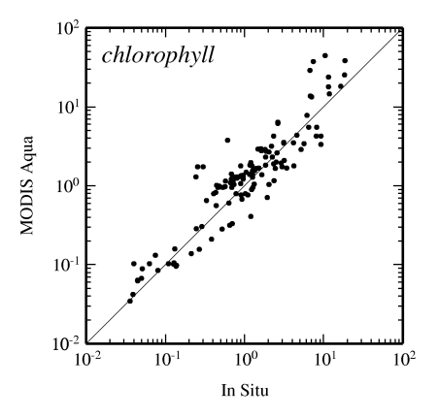
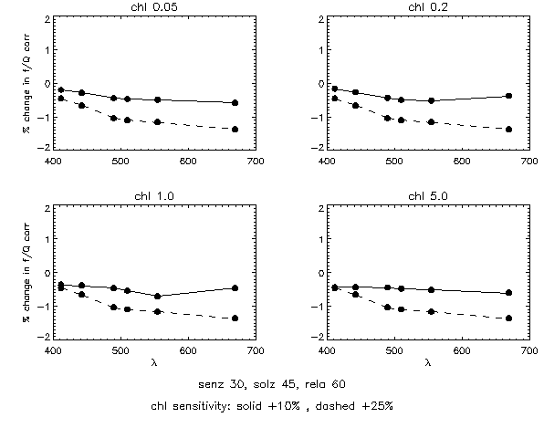
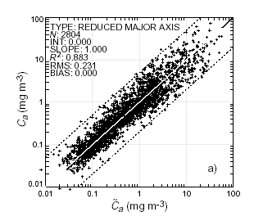
using estimates of Chl to adjust satellite Rrs
Assume BRDF normalization model is correct. How much error introduced by using an erroneous input Chl value?

Slide 43
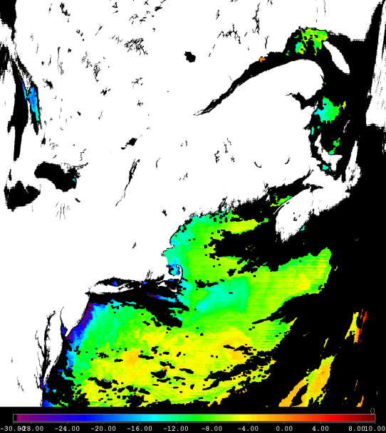
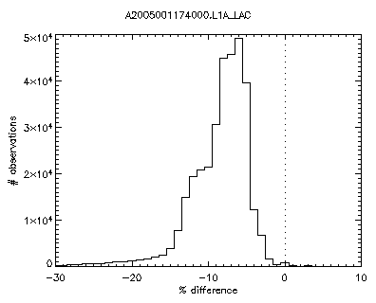
variations in Level-2 satellite data, part 1
% difference

Slide 44
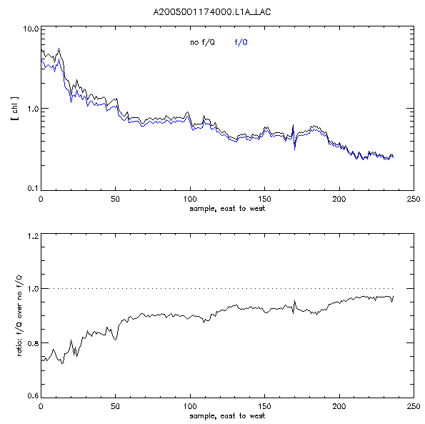
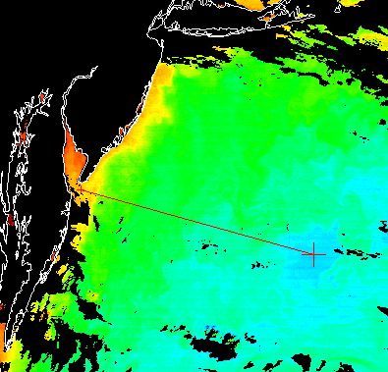
variations in Level-2 satellite data, part 2
norm / unnorm CHL
sample

Slide 45
what normalizing Rrs using Chl …
… has going FOR it:
a theoretical need for the additional normalization
convergence of SeaWiFS and MODIS-Aqua level-3 time series
few visual inconsistencies in level-2 files
… has going AGAINST it:
(currently) limited Case 1 water model design, acknowledged by authors
operates via R_{rs} → derived product (Chl,IOP) → R_{rs}
few level-2 analyses
difficult for community to verify models in the field
paucity of peer-reviewed options (until recently)

Slide 46
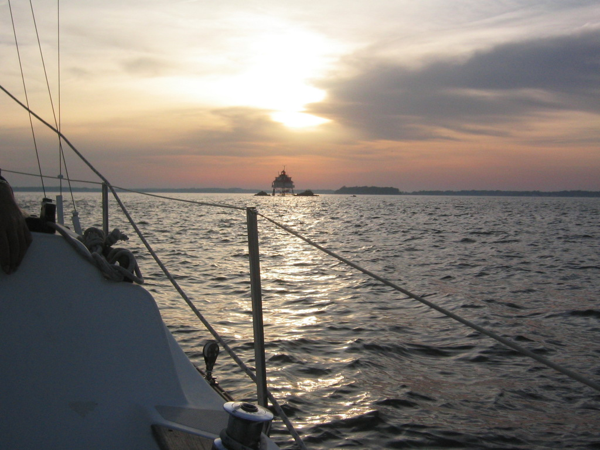

Slide 47
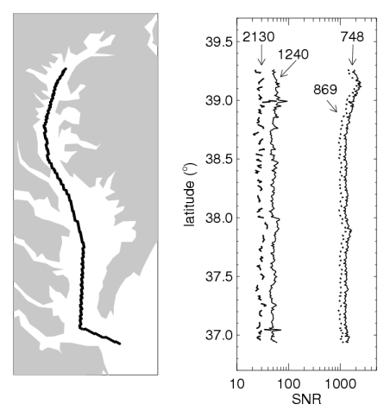
SNR transect for MODIS-Aqua NIR & SWIR bands

Slide 48
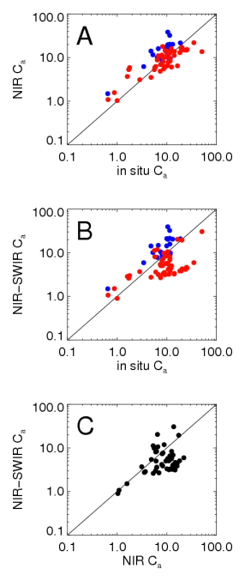
MODIS-Aqua Level-2 Chl “match-ups” for NIR & SWIR processing

Slide 49
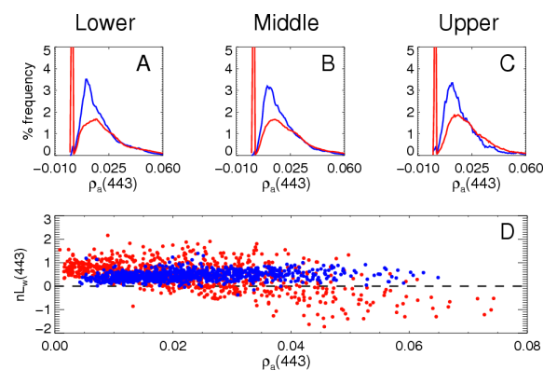
MODIS-Aqua ρ_{a}(443)

Slide 50
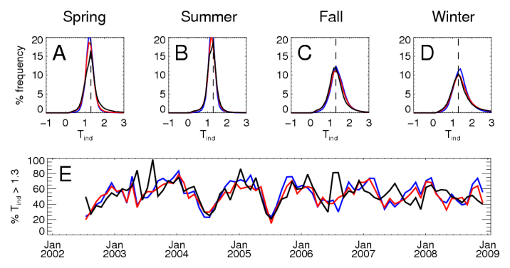
distribution of the turbidity index using in NIR-SWIR switching

Slide 51
MARINE CONSITUENT ( f/Q ) BRDF CORRECTION
A brief history of the Morel model:
1991: study of how η modifies subsurface reflectance, as a function
of solar zenith angle (Morel and Gentili 1991)
1993: study of f, Q, and f/Q as a function of η, with an emphasis on
remote-sensing geometrical conditions (Morel and Gentili 1993)
1995: first field verification of Q (Morel, Voss, and Gentili 1995)
1996: study of f, Q, and f/Q as a function of CHL; introduction of
normalization method and lookup tables for remote-sensing;
introduction of R_{goth} (Morel and Gentili 1996)
2002: update to 1996 work; new VSF’s and consideration of Raman
scattering; expansion of high CHL from 1 to 10 mg m⁻³ (Morel,
Gentili, and Antoine 2002)
2004: second field verification of Q (Voss and Morel in press)
η = ratio of molecular scattering to the total (molecular + particulate) scattering

Slide 52
MARINE CONSITUENT ( f/Q ) BRDF CORRECTION
WATER-INCIDENT
incident (water)
L_{wn} = F R_{goth} (f/Q) (b_{b}/a)
relate radiance to IOPs
both f & Q IOP-dependent
transmitted
AIR
n_{a} = 1.00
WATER
n_{w} = 1.33
defined by the following IOPs:
b_{b} (λ,CHL)
K_{bio} (λ,CHL) ~ proxy for a(λ)
VSF (λ,CHL)
reflected
light field modified by in-water constituents

Slide 53
VOLUME SCATTERING FUNCTION
β(θ) = dΦ(θ) * dω ⁻¹ * dr ⁻¹ * Φ₀ ⁻¹
VSF = radiant flux
per solid angle
per unit path length
expressed as a portion of the incident flux
defines angular distribution of scattered flux
scattering coefficient, b = ∫_{4π} β(θ) dω
β = β_{water} + β_{particles}
β_{water} fixed
β_{particles} varies with CHL ( ↑ CHL ≈ ↓ b_{bp} )
particulate scattering dominates at CHL > 1.0 mg m⁻³
as of 2002, particles defined by 2 populations
relative role of small particles ↓ with ↑ CHL
Φ(θ)
ω
r
forward
scattering
θ
medium
backward
scattering
Φ₀

Slide 54
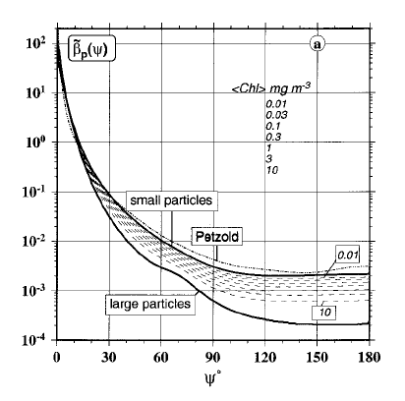
VOLUME SCATTERING FUNCTION
Φ(θ)
ω
r
forward
scattering
θ
medium
backward
scattering
water
Figure 3a from Morel et al. 2002
Φ₀

Slide 55
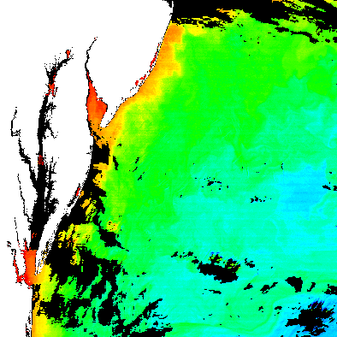
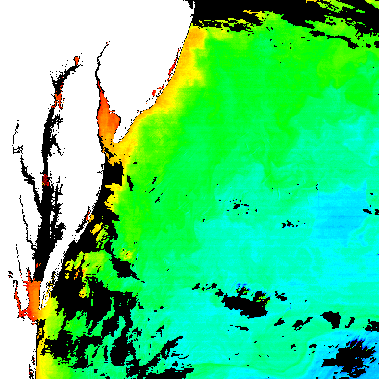
one scene with this correction, one without

