Slide 1
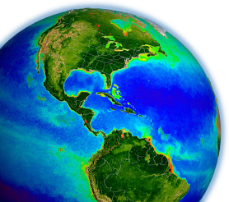
Evaluating & generalizing ocean color inversion models that retrieve marine IOPs
Ocean Optics Summer Course
University of Maine
July 2011

Slide 2
purpose
you’re a discriminating customer …
how do you choose which algorithm (or parameterization) to use?
more importantly, how do you validate this choice?

Slide 3
outline
recent evaluation activities
review construction (& deconstruction) of a semi-analytical IOP algorithm
introduce a generic approach
review emerging questions regarding algorithm validation & sensitivities

Slide 4
International Ocean Colour Coordinating Group (IOCCG)
http://www.ioccg.org
Report 1 (1998): Minimum requirements for an operation ocean colour sensor for the open ocean
Report 2 (1999): Status and plans for satellite ocean colour missions: considerations for complementary missions
Report 3 (2000): Remote sensing of ocean colour in coastal and other optically complex waters
Report 4 (2004): Guide to the creation and use of ocean color Level-3 binned data products
Report 6 (2007): Ocean color data merging
Report 7 (2008): Why ocean color? The societal benefits of ocean color radiometry
Report 8 (2009): Remote sensing in fisheries and aquaculture
Report 9 (2009): Partition of the ocean into ecological provinces: role of ocean color radiometry
Report 10 (2010): Atmospheric correction for remotely sensed ocean color products

Slide 5
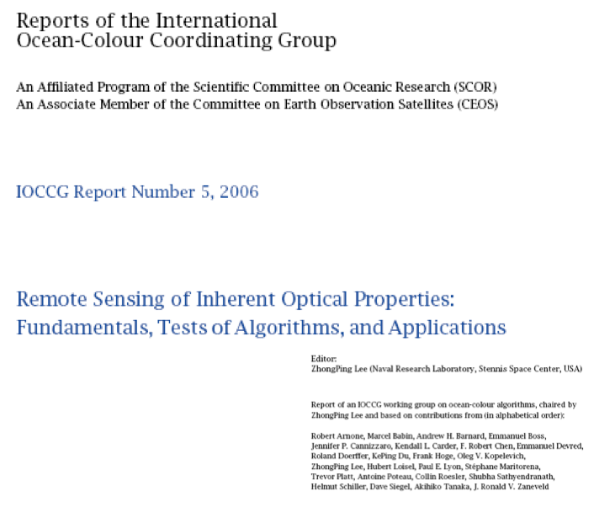
IOCCG Report 5

Slide 6
IOCCG Report 5
large assemblage of IOP algorithms evaluated using in situ (subset of SeaBASS) and synthetic (Hydrolight) data sets:
3 empirical (statistical) algorithms
1 neural network algorithm
7 semi-analytical algorithms

Slide 7
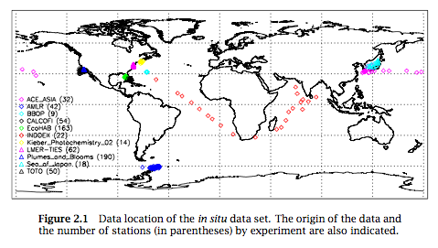
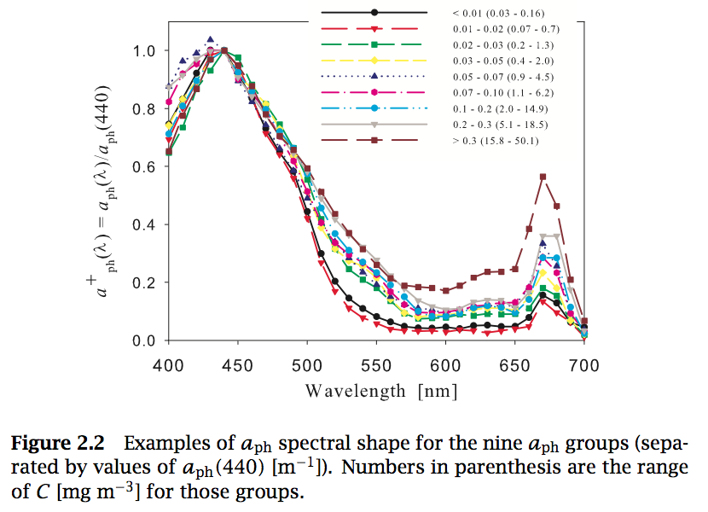
IOCCG Report 5
global distribution of in situ data:
synthetic data set (500 stations)
represents many possible
combinations of optical properties,
but not all, and cannot represent
all combinations of natural
populations:

Slide 8
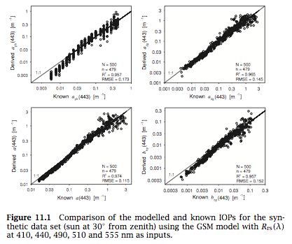
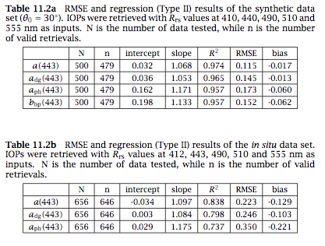
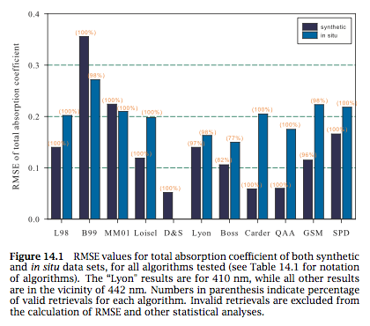
IOCCG Report 5

Slide 9
purpose
you’re a discriminating customer …
how do you choose which algorithm (or parameterization) to use?
more importantly, how do you validate this choice?

Slide 10
inversion algorithms operate similarly
IOCCG report compared 11 common IOP algorithms
but, most of these algorithms are very similar in their design & operation
an alternative approach to evaluating inversion algorithms might be at the level of the eigenvector (spectral shape) & statistical inversion method

Slide 11
constructing (deconstructing) a semi-analytical algorithm
measured by satellite
desired products
dissolved + non-phytoplankton particles
phytoplankton
particles

Slide 12
constructing (deconstructing) a semi-analytical algorithm
eigenvalue (magnitude)
eigenvector (shape)

Slide 13
constructing (deconstructing) a semi-analytical algorithm
N knowns, R_{rs}(λ_{N})
User defined:
G(λ_{N})
a*_{dg}(λ_{N})
a*_{φ}(λ_{N})
b*_{bp}(λ_{N})
3 (< N) unknowns, M
spectral optimization, deconvolution, inversion
eigenvalue (magnitude)
eigenvector (shape)

Slide 14
constructing (deconstructing) a semi-analytical algorithm
most algorithms differ in their eigenvectors & inversion approach
significant effort within community over past 30+ years
how to choose between algorithms?
we (NASA) couldn’t decide, so we initiated a series of workshops

Slide 15
IOP Algorithm Workshops
Ocean Optics XIX (2008, Barga, Italy) & XX (2010, Anchorage, Alaska)
27 participants from Australia, Canada, France, Italy, Japan, UK, & US
conceptual goal: achieve community consensus on an effective algorithmic approach for producing global-scale, remotely sensed IOP products
practical goal: develop tools, resources, & methods for developing & evaluating global & regional ocean color data products
the NASA OBPG developed GIOP – a consolidated, community supported, configurable framework for ocean color modeling of IOPs
allows construction of different IOP models at run time by selection from a wide assortment of published absorption & scattering eigenvectors
http://oceancolor.gsfc.nasa.gov/WIKI/GIOP.html

Slide 16
generic IOP algorithm framework
power-law, η:
fixed
Lee et al. (2002)
Ciotti et al. (1999)
Hoge & Lyon (1996)
Loisel & Stramski (2001)
Morel (2001)
tablulated b*_{bp}(λ)
Lee et al. (2002)
fixed b_{bp}(λ) [=M_{bp} b*_{bp}(λ)]
Lee et al. (2002)
Loisel & Stramski (2001)
other features to be considered:
a_{w} and b_{bw} dependence on T and S
alternative, tunable a*_{φ} eigenvectors & methods
IOP-based AOP to IOP method(s)
uncertainties & cost functions
Levenberg-Marquardt
SVD matrix inversion
tabulated a*_{φ}(λ)
Bricaud et al. (1998)
Ciotti & Bricaud (2006)
Morel f/Q
Gordon quadratic
exponential, S_{dg}:
fixed (= 0.0145)
Lee et al. (2002)
OBPG (2010)
tabulated a*_{dg}(λ)

Slide 17
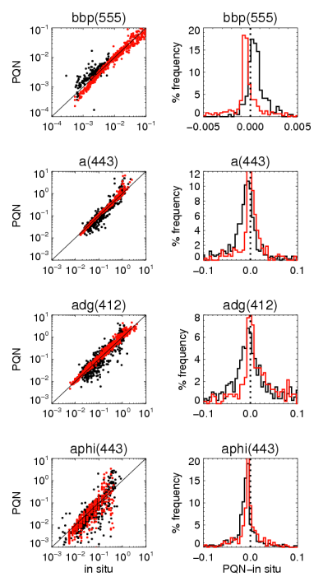
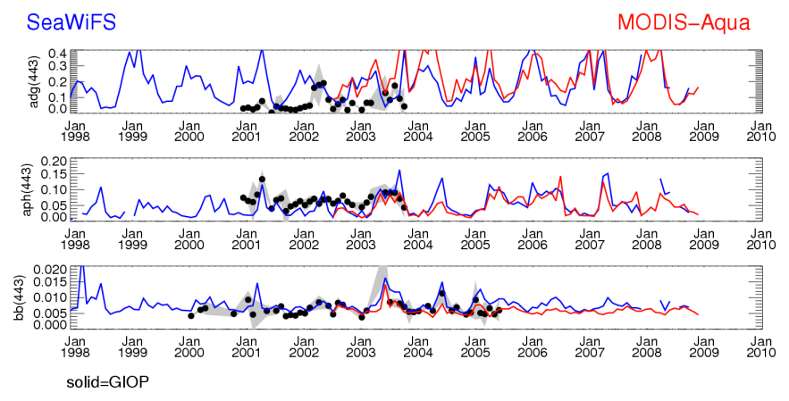
emerging questions
how well does any given configuration perform globally / regionally ?
how does one define validate a SAA? how does one define improvement?
which data products (a, a_{φ}, a_{dg}, b_{bp})?
what spectral ranges (400-700 nm)?
what trophic levels (oligotrophic vs. eutrophic)?
spatial coverage vs. accuracy?
how sensitive is a GIOP-like SAA to its eigenvectors?

Slide 18
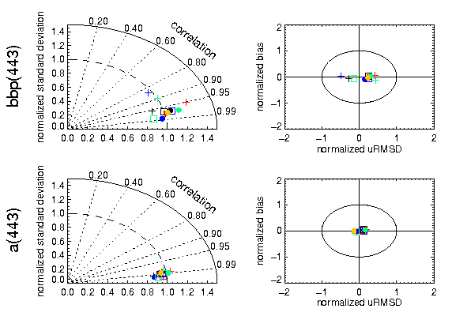
summary plots

Slide 19
emerging questions
how well does any given configuration perform globally / regionally ?
how does one define validate a SAA? how does one define improvement?
which data products (a, a_{φ}, a_{dg}, b_{bp})?
what spectral ranges (400-700 nm)?
what trophic levels (oligotrophic vs. eutrophic)?
spatial coverage vs. accuracy?
how sensitive is a GIOP-like SAA to its eigenvectors?

Slide 20
GIOP sensitivity analyses
Levenberg-Marquardt
SVD matrix inversion
inversion method
inversion cost function
AOP-IOP relationship, G(λ)
eigenvectors
number of λ
Morel f/Q
Gordon quadratic
a*_{φ} Bricaud et al. (1998)
a*_{φ} Bricaud et al. (1998) with Chl +/- 33%
a*_{φ} Ciotti & Bricaud (2006) with S_{f}=0.5
a*_{dg} exponential, S_{dg} = 0.0145
a*_{dg} exponential, S_{dg} default +/- 33%
a*_{dg} exponential, S_{dg} from Lee et al. (2002)
b*_{bp} power-law, η from Lee et al. (2002)
b*_{bp} power-law, η default +/- 33%
6 (412-670 nm)
5 (412-555 nm)

Slide 21
GIOP sensitivity analyses
Levenberg-Marquardt
SVD matrix inversion
hierarchical summary of sensitivities:
tier 1 (very sensitive):
Morel f/Q vs. Gordon quadratic
Levenberg-Marquardt vs. SVD matrix inversion
alternative, fixed a*_{φ} [Ciotti & Bricaud (2006)]
S_{dg} +/- 33%
tier 2 (sensitive in parts of dynamic range):
6 λ vs. 5 λ
alternative, dynamic S_{dg} [Lee et al. (2002)]
tier 3 (not sensitive):
a*_{φ} from Bricaud et al. (1998) with Chl +/- 33%
η +/- 33%
inversion method
inversion cost function
AOP-IOP relationship, G(λ)
eigenvectors
number of λ
Morel f/Q
Gordon quadratic
goodness of fit: input vs. reconstructed R_{rs}(λ)
goodness of fit: modeled IOP(λ) vs. in situ IOP(λ)
regression statistics
population statistics
Taylor & Target diagrams
a*_{φ} Bricaud et al. (1998)
a*_{φ} Bricaud et al. (1998) with Chl +/- 33%
a*_{φ} Ciotti & Bricaud (2006) with S_{f}=0.5
a*_{dg} exponential, S_{dg} = 0.0145
a*_{dg} exponential, S_{dg} default +/- 33%
a*_{dg} exponential, S_{dg} from Lee et al. (2002)
b*_{bp} power-law, η from Lee et al. (2002)
b*_{bp} power-law, η default +/- 33%
6 (412-670 nm)
5 (412-555 nm)

Slide 22
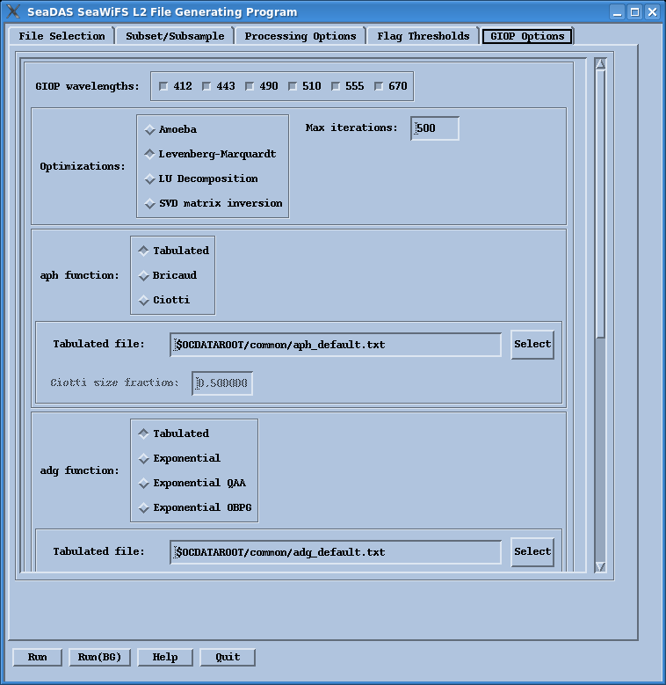
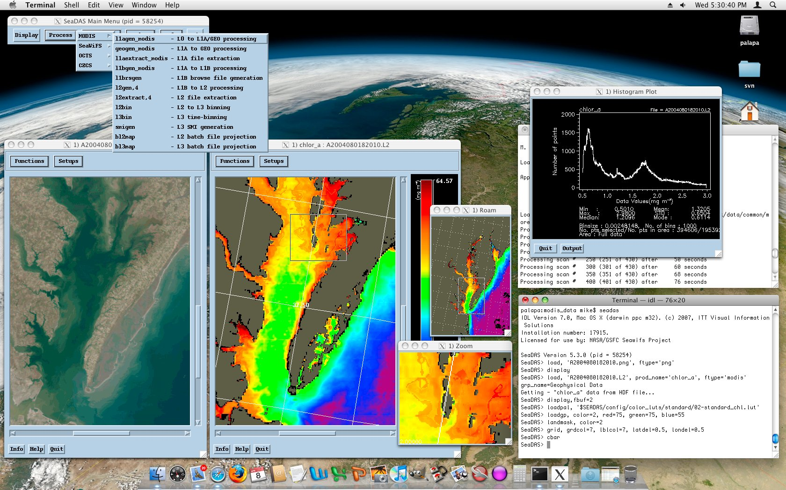
GIOP in SeaDAS (seadas.gsfc.nasa.gov)

Slide 23
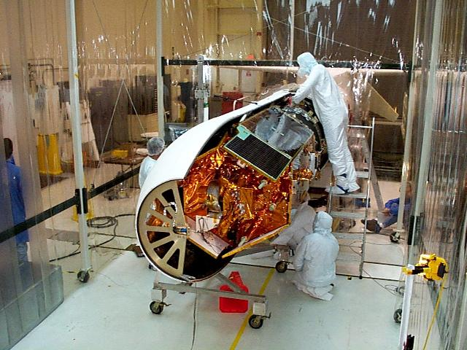
Thank you

