Slide 1
Chasing photons – considerations for making & maintaining useful satellite ocean color measurements
Ocean Optics Class
University of Maine
July 2011
Acknowledgement:
W. Bryan Monosmith
NASA GSFC Code 550

Slide 2
(1) Why don’t all ocean color satellite measure hyperspectral radiances at meter-scales?
(2) What do the different processing levels (0 to 3 to SMI) mean?
(3) How does one create a multi-satellite climate data record?

Slide 3
Why don’t all ocean color satellite measure hyperspectral radiances at meter-scales?
How many photons leave a 1 m² of ocean surface?
How many photons from this patch reach the satellite detector?
How many photons must the detector collect to achieve useful SNR?

Slide 4
We’ll explore 3 case studies:
Stationary satellite staring at 1 m² for 1 s
Moving satellite staring at 1 m²
Moving satellite scanning side to side
Sit back, relax, & don’t stare too hard at the equations.
Grab a calculator if you’re interested.
No matter, they’re provided for your future reference.

Slide 6
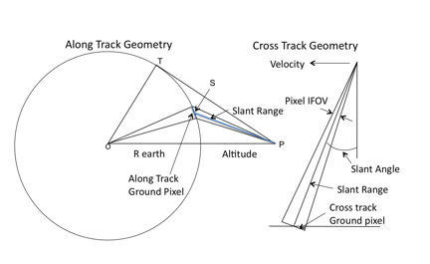
satellite viewing geometry

Slide 8
Consider a satellite instrument with the following characteristics:
Optical efficiency (OE) = 0.66
Quantum efficiency (QE) = 0.9
Bandwidth (BW) = 0.01 um
View angle = 20 deg
Aperture = 0.009 m (90 mm)
Altitude = 650,000 m (650 km)
Slant Range = 700,000 m (700 km)
Let’s focus on a fluorescence channel:
Wavelength = 0.678 um (678 nm)
Typical TOA radiance = 14.5 W m⁻² um⁻¹ sr⁻¹

Slide 9
Some preliminary calculations:
given the instrument aperture & slant range:
solid angle of aperture: = 1.3 e⁻¹⁴ sr
given instrument altitude:
ground velocity = 6838 m s⁻¹

Slide 10
Consider a stationary satellite taking a quick peek at Earth:
power reaching detector for 1 m² areal footprint & 1 s integration time:
1.24e⁻¹⁵ = 14.5 * 1.3e⁻¹⁴ * 0.01 * 1 * 0.66
W = W m⁻² sr⁻¹ um⁻¹ sr um m² (none)
photoelectrons reaching detector:
3812 = 1.24e⁻¹⁵ * 1 * 0.9 * 0.678 / 6.63e⁻³⁴ / 3e¹⁴
(none) = J s⁻¹ s (none) um J⁻¹ s⁻¹ s um⁻¹
This is for top-of-atmosphere.
If we consider that the ocean contributes ~5% of this signal, then the number of photoelectrons from the ocean surface reaching the detector is ~190.

Slide 11
Consider a moving satellite that stares at 1 m² at nadir:
ground velocity = distance / time
6838 m s⁻¹ = 1 m / t
integration time, t = 0.00146 s
Repeat calculations with new integration time
photoelectrons from ocean surface reaching detector = 0.028
But, increase pixel size to 1 km² …
integration time increases by 3 orders of magnitude
area increases by 6 orders of magnitude
Repeat calculations with new area and integration time
photoelectrons from ocean surface reaching detector ~ 28,000,000

Slide 12
Now, consider a moving satellite that scans from side to side
instantaneous field of view (IFOV) = pixel size / altitude
0.0014 rad = 1 km / 700 km
For a cross-track scanning instrument with a single detector & a swath width of 2 rad, the integration time must be divided by 1,400 pixels
1,400 = 2 rad / 0.0014 rad
Dividing the 28M photoelectrons by 1,400 pixels leaves ~19,900 photoelectrons from the ocean surface reaching the detector
But, useful duty cycle of of scan mirror is < 1/3
so really, we’re talking about ~6,000 ocean surface photons

Slide 13
How does this relate to signal to noise (SNR)?
SNR = counts / sqrt(counts)
SNR defined for top-of-atmosphere.
Propagate 6,000 photons from ocean surface to TOA
~120,000 photons reach detector
SNR = 120,000 / sqrt(120,000) = 346
SNR requirements for new missions at 678-nm are > 1,400
This requires ~ 16X photons reaching detector.

Slide 14
Scanning eliminated by using array of detectors, but at a cost in calibration & in tracking the change in launch calibration as each detector degrades in orbit.
At some point, multiple detectors become impractical, as the optical system cost & complexity increase with FOV, & image quality rapidly decrease.
Parts count & light loss:
Multiband filter instruments are simpler & cheaper than a spectrograph, until the number of bands reaches some point, where it becomes more light efficient & less costly to use a spectrograph.

Slide 15
What do the different processing levels (0 to 3 to SMI) mean?

Slide 16
data processing & flow: Level-0 to Level-2
Level 0
raw digital counts
native binary format
ATT & EPH
spacecraft attitude
spacecraft position
Level 1A
raw digital counts
HDF formatted
GEO
geolocation
radiant path geometry
Level 1A Subset
reduced to standard ocean bands only
Level 1B
calibrated reflectances
converted telemetry
Ancillary data
wind speed
surface pressure
total ozone
Reynolds SST
Level 2
geolocated geophysical products for each pixel

Slide 17
common processing framework
ancillary data
sensor-specific tables:
Rayleigh, aerosol, etc.
SeaWiFS L1A
MODISA L1B
MODIST L1B
OCTS L1A
MOS L1B
OSMI L1A
CZCS L1A
MERIS L1B
OCM-1 L1B
OCM-2 L1B
observed
radiances
Multi-Sensor
Level-1 to Level-2
(common algorithms)
in situ water-leaving
radiances (MOBY)
water-leaving
radiances and
derived prods
predicted
at-sensor
radiances
Level-2 Scene
vicarious calibration
gain factors
Level-3 Global
Product
Level-2 to Level-3

Slide 18
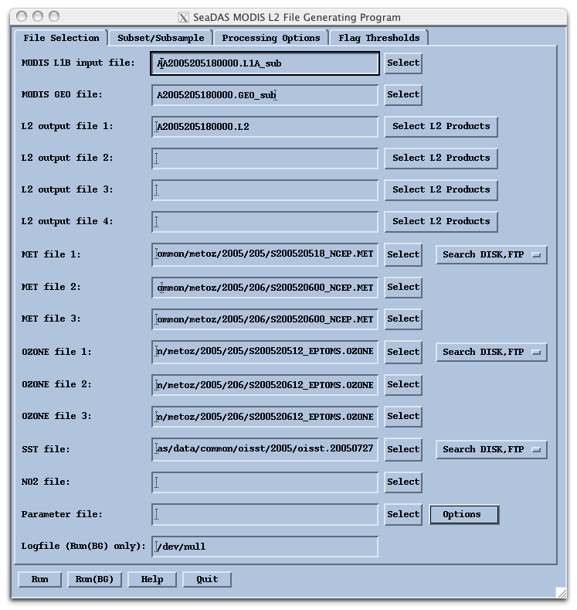
L2gen
common software for Level-2 processing of MODIS, SeaWiFS, & other sensors consistently
supports a multitude of product algorithms & processing methodologies:
standard and non-standard, validated and experimental
run-time selection of output product suite

Slide 19
- As data is processed by l2gen from Level 1 to Level 2, checks are made for different defined conditions. - When certain tests and conditions are met for a given pixel, a flag is set for that pixel for that condition. - A total of 31 flags can be set for each pixel. - These l2gen Level 2 processing flags are stored in the Level 2 data file as the "l2_flags" product. - The storage method sets bits to 0 or 1 in 32-bit integers that correspond to each pixel.
Level-2 processing flags & masks

Slide 20
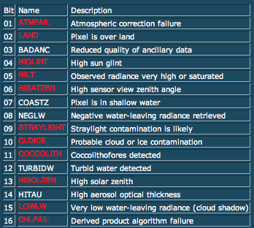
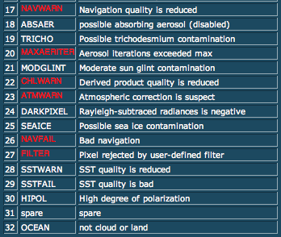
Level-2 processing flags & masks
*
*
*
* *
* *
*
For Level 1 to Level 2 processing (l2gen), masked pixels (*) are not processed and are typically set to zero so as to eliminate them from future analysis.
(flags in red are masked during Level 3 processing)

Slide 21
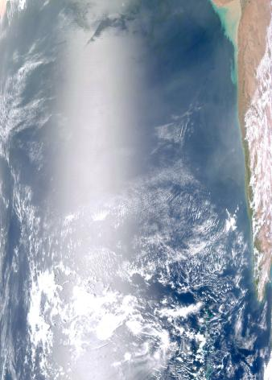
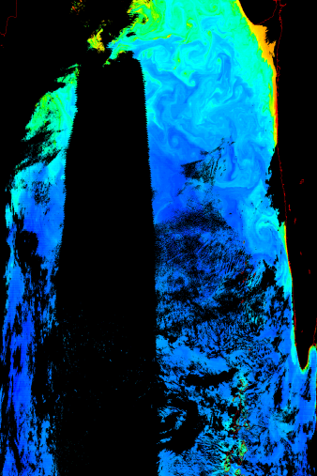
Level-2 processing flags & masks
RGB Image
Chlorophyll
Sediments
Glint
Cloud
Notes:
Only masking is for clouds
Physical saturation, no retrieval
Can eliminate or change cloud masking, but can’t change saturation
Chlorophyll looks good, even near in glint (band ratio) What about radiances?

Slide 22
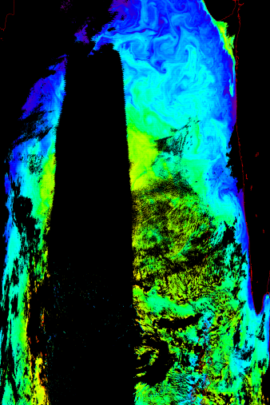
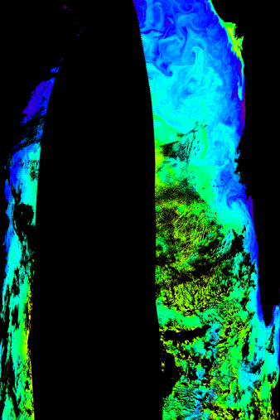
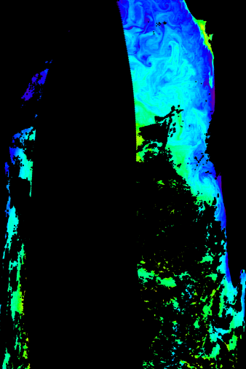
Level-2 processing flags & masks
RGB Image
nLw (443)
Sediments
Glint
Cloud
Add masking for high glint
Add masking for straylight
Notes:
Only masking is for clouds
Physical saturation, no retrieval
Can eliminate or change cloud masking, but can’t change saturation
Chlorophyll looks good, even near in glint (band ratio) What about radiances?

Slide 23
definitions
Projection - any process which transforms a spatially organized data set from one coordinate system to another.
Mapping - a process of transforming a data set from an arbitrary spatial organization to a uniform (rectangular, row-by-column) organization, by processes of projection and resampling.
Binning - a process of projecting and aggregating data from an arbitrary spatial and temporal organization, to a uniform spatial scale over a defined time range. Ideally the binning process will preserve both the central tendency (e.g., average) and the variation in the data points that contribute to a bin.

Slide 24
Level-3 processing
Level 2
geolocated geophysical products for each pixel
Level 3 binned
geophysical products averaged spatially and/or temporally
sinusoidally distributed, equal area bins
Level 3 mapped
images created by mapping and scaling binned products
user-friendly, cylindrical equiangular projection

Slide 25
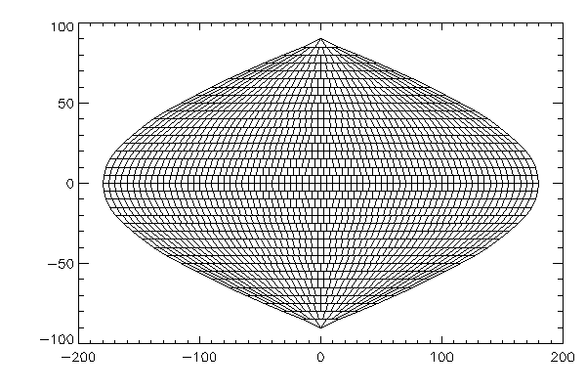
sinusoidal equal-area projection
Equal-area: sinusoidal, with equally space rows and number of bins per row proportional to sine of latitude; resolutions of 4.6 and 9.2 km

Slide 26
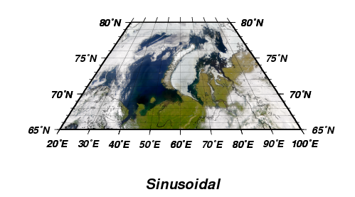
Level-3 binned vs. mapped
bin file grid
bin files
multiple products
stored as float
sampling statistics included
map files
single product
stored as scaled integer
Equal-area: sinusoidal, with equally space rows and number of bins per row proportional to sine of latitude; resolutions of 4.6 and 9.2 km
map file grid
Equal-angle: rectangular (Platte Carre) with rows and columns equally spaced in latitude and longitude; resolutions of 24 and 12 points per degree.

Slide 27
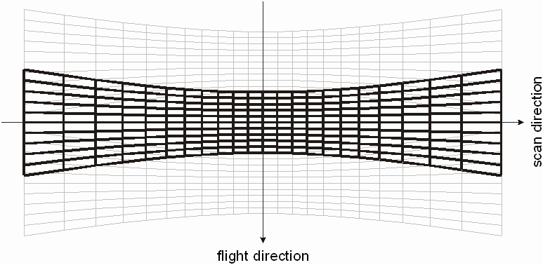
MODIS “bow tie” effect
Increasing Pixel Size

Slide 28
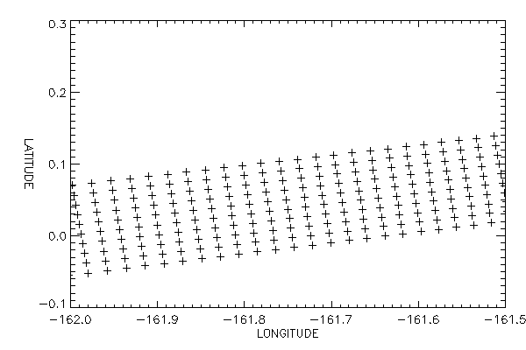
One MODIS scan at ~45 degrees scan angle

Slide 29
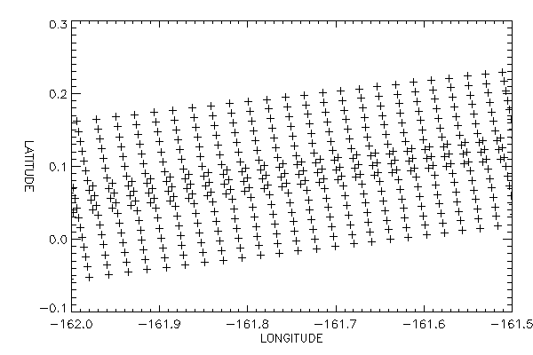
Two MODIS scans showing overlap of pixels

Slide 30
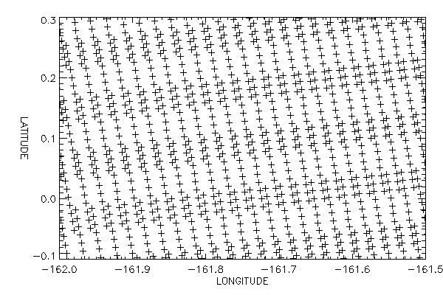
Multiple MODIS scans showing pixel overlap

Slide 31
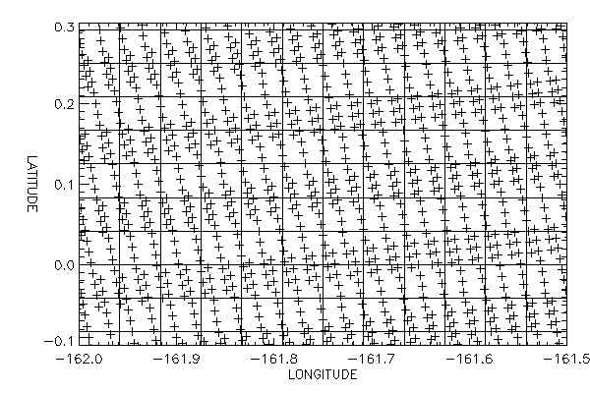
Bin boundaries overlaid on pixel locations

Slide 32
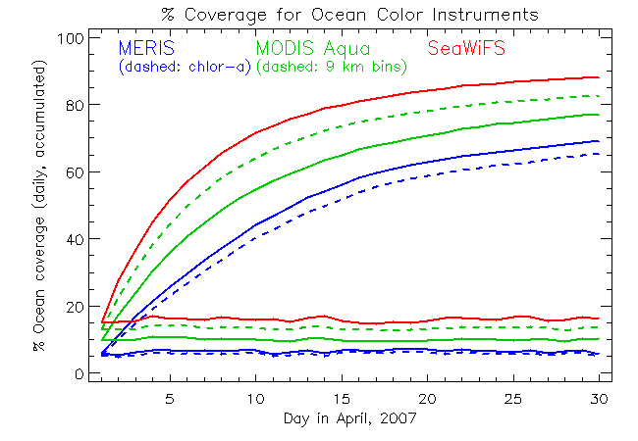
Ocean coverage over time for binned files

Slide 33
binned & mapped products
Binned products: generated daily from Level-2, and then aggregated to:
-8 days
-monthly
-seasonal
-annual
-mission
Standard mapped image (SMI) products are generated at each temporal resolution by projecting binned files to the equal-angle grid.

Slide 34
How does one create a multi-satellite climate data record?
“A climate data record is a time series of measurements of sufficient length, consistency, & continuity to determine climate variability & change.”
U.S. National Research Council, 2004
consistency:
consistency between different sensors can be achieved through standardization of processing algorithms, calibration sources & methods, & validation techniques

Slide 35
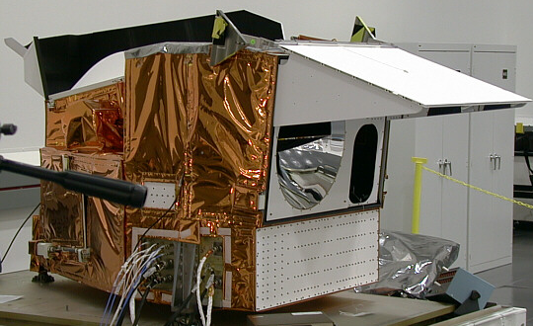
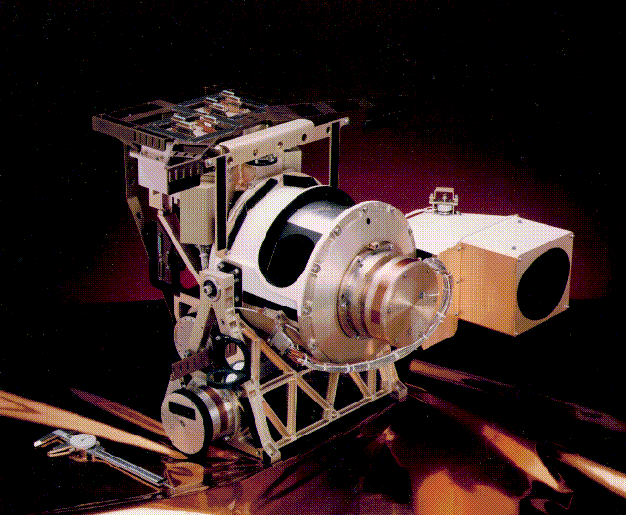
calibrating & reprocessing an ocean color mission
MODIS
SeaWiFS
36 bands, 9 for OC (412-869nm)
rotating scan mirror
solar, lunar, bb, sdsm, srca
polarization sensitivity ~3%
no tilting capability
12 bit digitization
10 detectors per band along track
higher SNR in most bands
8 bands for OC (412-865nm)
rotating telescope
solar and lunar calibration
polarization scrambler
tilting to avoid sun glint
12-bit truncated to 10-bit
4 detectors averaged to 1 sample
higher dynamic range (bilinear gain)
sensor design & performance varies

Slide 36
common processing framework
ancillary data
sensor-specific tables:
Rayleigh, aerosol, etc.
SeaWiFS L1A
MODISA L1B
MODIST L1B
OCTS L1A
MOS L1B
OSMI L1A
CZCS L1A
MERIS L1B
OCM-1 L1B
OCM-2 L1B
observed
radiances
Multi-Sensor
Level-1 to Level-2
(common algorithms)
in situ water-leaving
radiances (MOBY)
water-leaving
radiances and
derived prods
predicted
at-sensor
radiances
Level-2 Scene
vicarious calibration
gain factors
Level-3 Global
Product
Level-2 to Level-3

Slide 37
calibrating & reprocessing an ocean color mission
analysis topics related to reprocessing
temporal calibration
residual detector dependence
residual scan dependence
Level-3 time-series
temporal anomalies
discussed elsewhere
vicarious calibration
data product validation

Slide 38
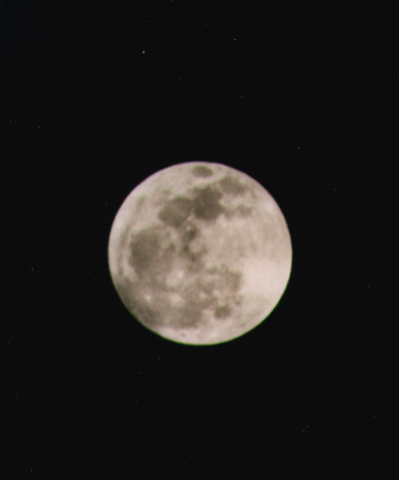
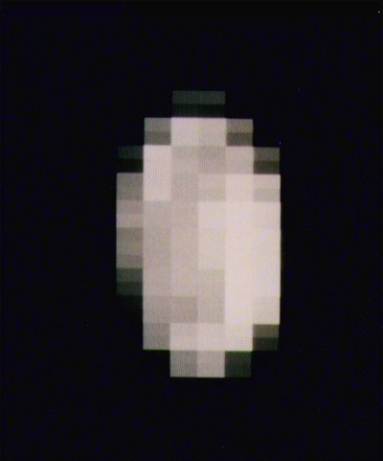
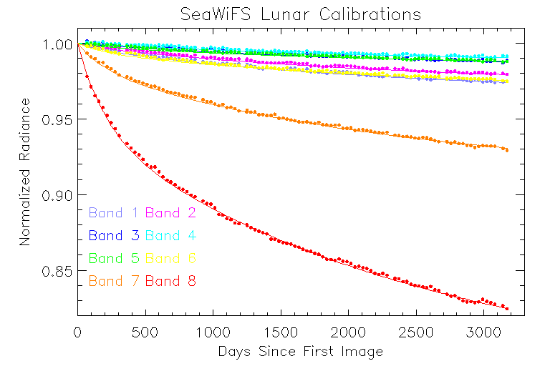
Temporal Calibration

Slide 39
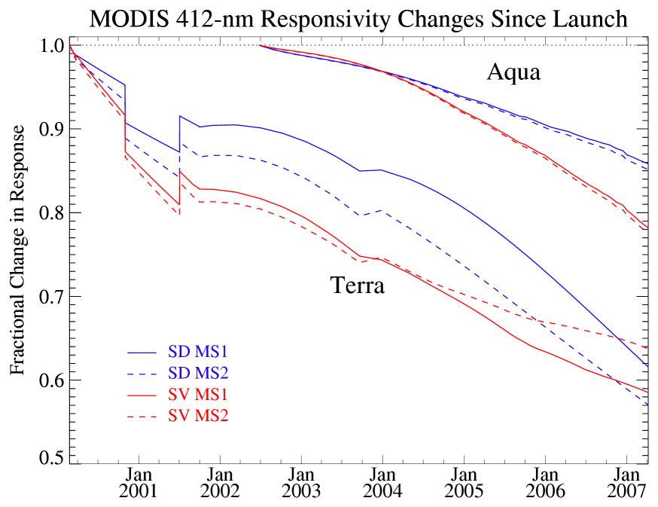
MODIS temporal degradation @ 412 nm - lunar & solar calibration trends
0%
10%
20%
30%
5%
40%
50%

Slide 40
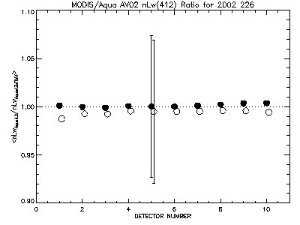
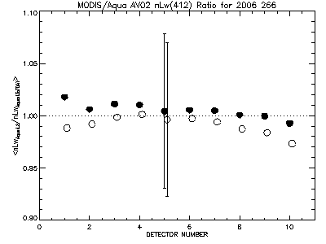
calibrating & reprocessing an ocean color mission
residual detector dependence
Level-3 multi-day products (same or different sensor) are resampled to generate values at Level-2 resolution.
comparisons are performed by detector & mirror side to evaluate residual detector response errors

Slide 41
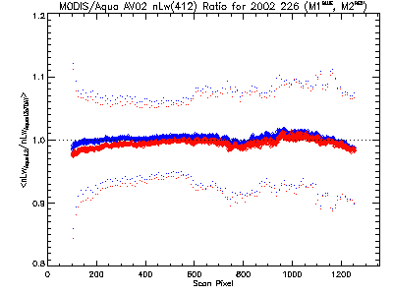
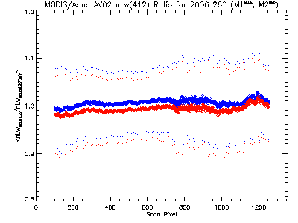
calibrating & reprocessing an ocean color mission
residual scan dependence
Level-3 multi-day products (same or different sensor) are resampled to generate values at Level-2 resolution.
comparisons are performed by pixel number and mirror side to evaluate residual response-vs-scan (RVS) errors

Slide 42
calibrating & reprocessing an ocean color mission
residual detector / scan dependence
strengths:
provides evaluation of response vs. detector, scan angle & mirror side independent of onboard calibration
can also be used to evaluate errors in other sensor characteristics
limitations:
works well mainly in temporally stable areas
noise levels may be large compared with residual errors
Franz, B.A., E.J. Kwiatkowska, G. Meister, and C. McClain, “Moderate Resolution Imaging Spectroradiometer on Terra: limitations for ocean color applications,” J. Appl. Rem. Sens (2008)
Kwiatkowska, E.J., B.A. Franz, G. Meister, C. McClain, and X. Xiong, “Cross-calibration of ocean-color bands from Moderate Resolution Imaging Spectroradiometer on Terra platform,” Appl. Opt. (2008)

Slide 43
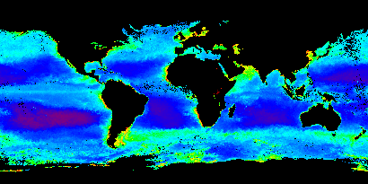
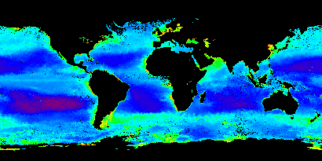
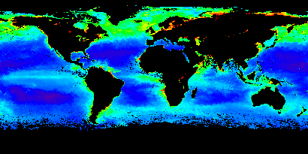
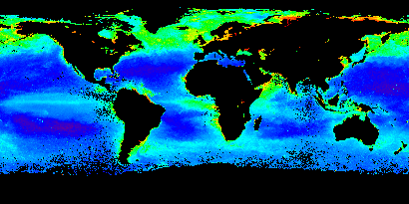
calibrating & reprocessing an ocean color mission
Seasonal Chlorophyll Images
MODIS/Aqua
SeaWiFS
Winter 2004
Winter 2004
Summer 2004
Summer 2004
0.01-64 mg m⁻³

Slide 44
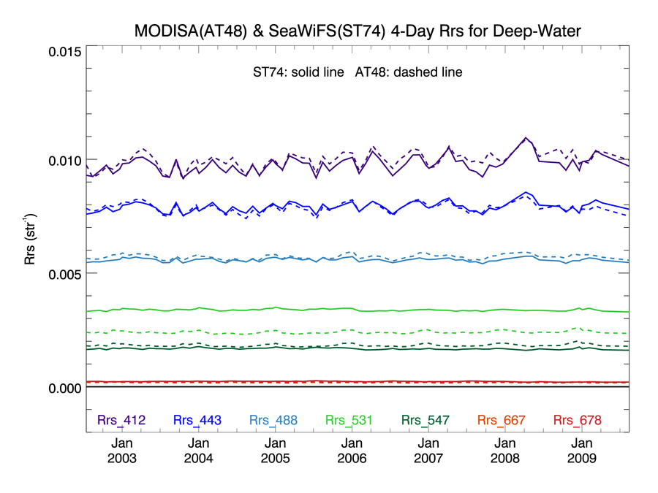
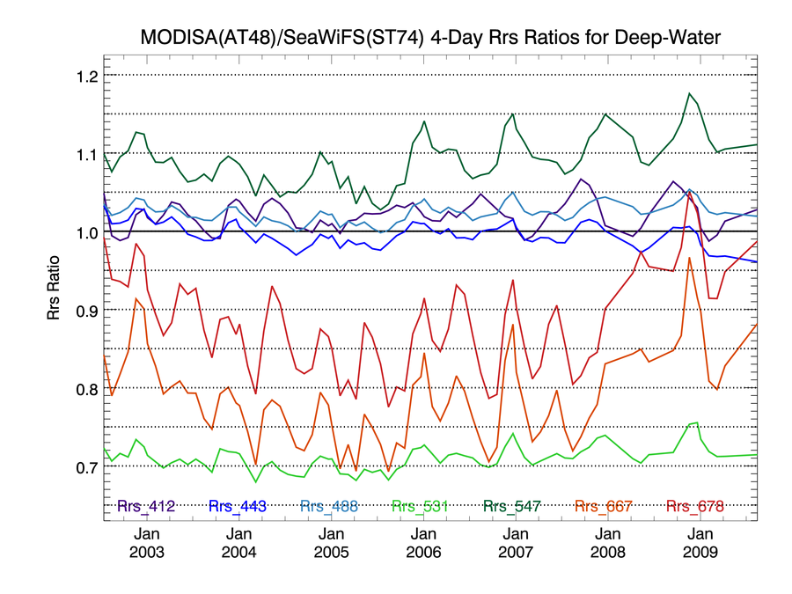
calibrating & reprocessing an ocean color mission
sensor & algorithm comparisons
Level-3 parameters (e.g., Rrs) compared for common spectral bands
common bins extracted & compared over the period of overlap between the sensors
comparisons performed globally, trophically, zonally & for specified regions

Slide 45
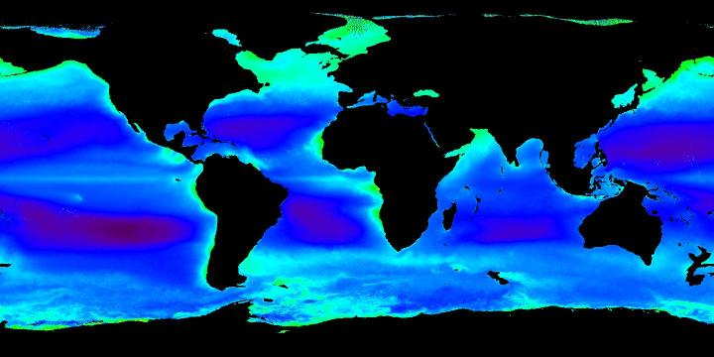
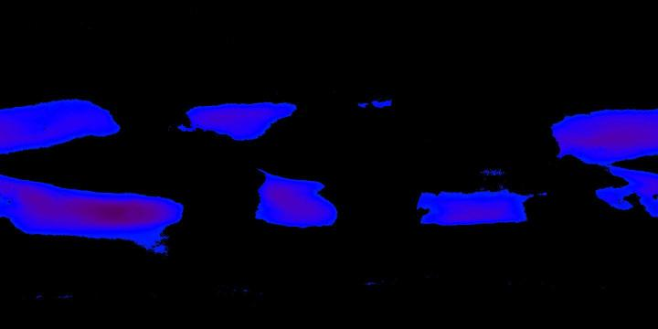
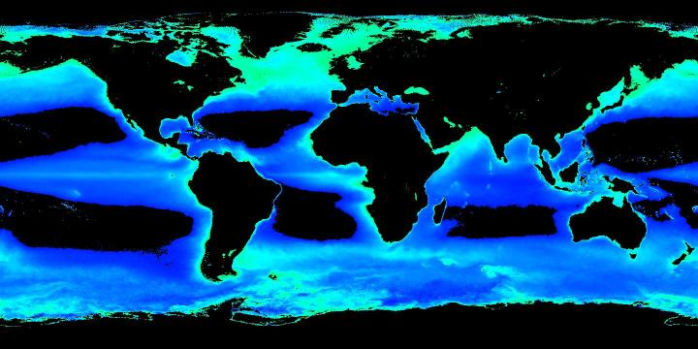
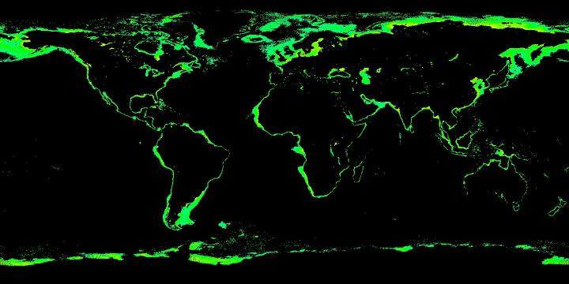
calibrating & reprocessing an ocean color mission
definitions of trophic subsets
Deep-Water (Depth > 1000m)
Oligotrophic (Chlorophyll < 0.1)
Mesotrophic (0.1 < Chlorophyll < 1)
Eutrophic (1 < Chlorophyll < 10)

Slide 46
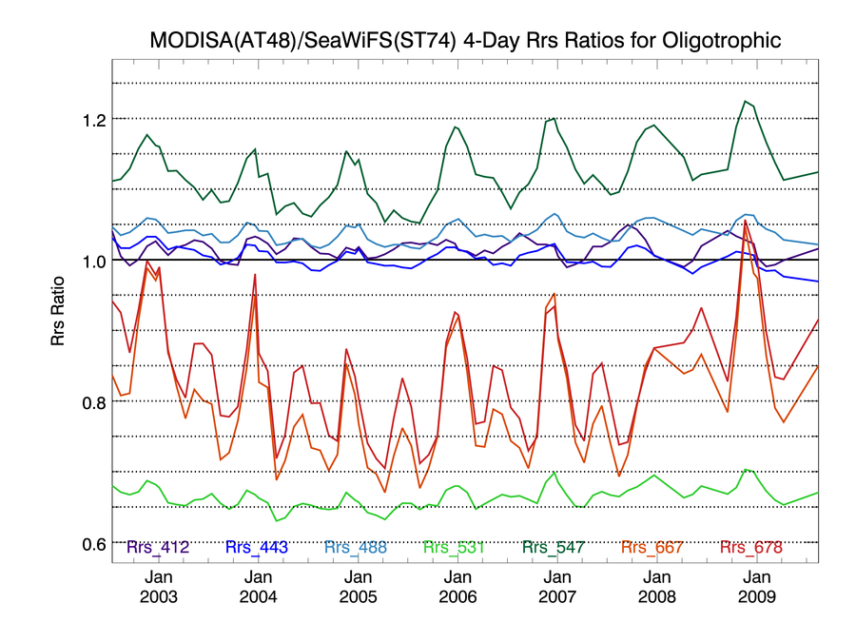
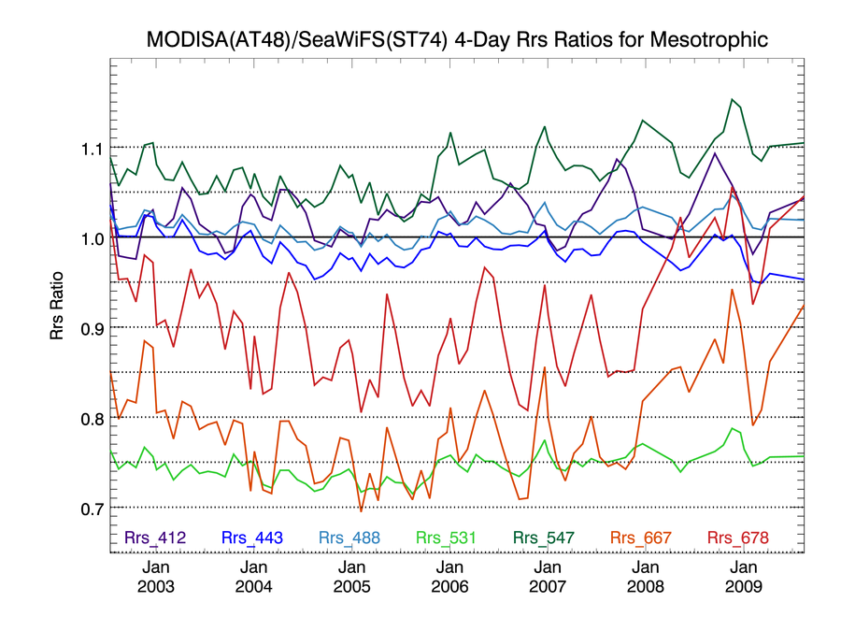
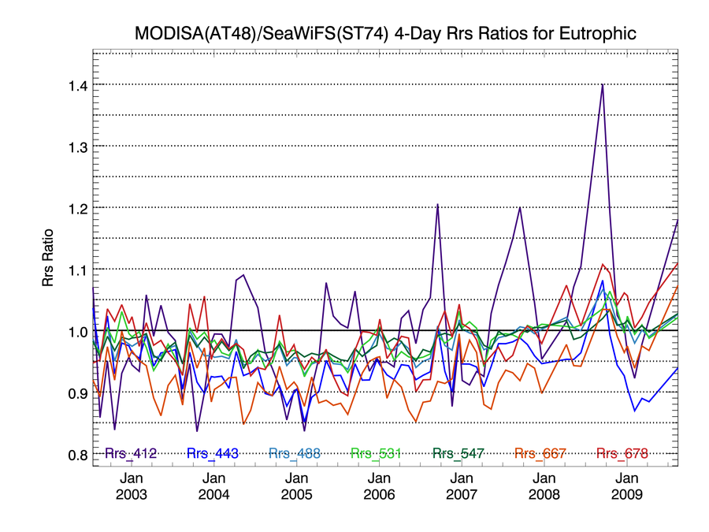
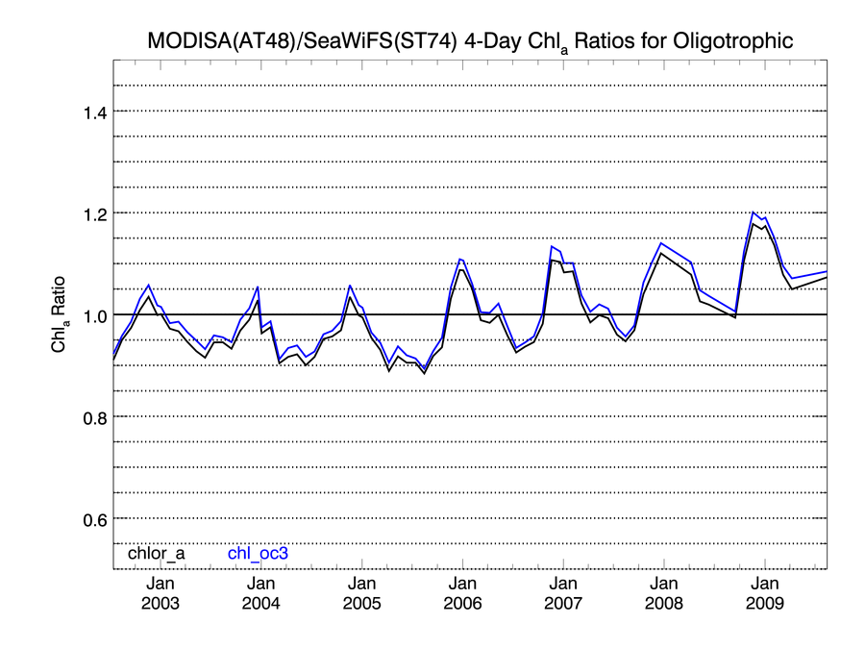
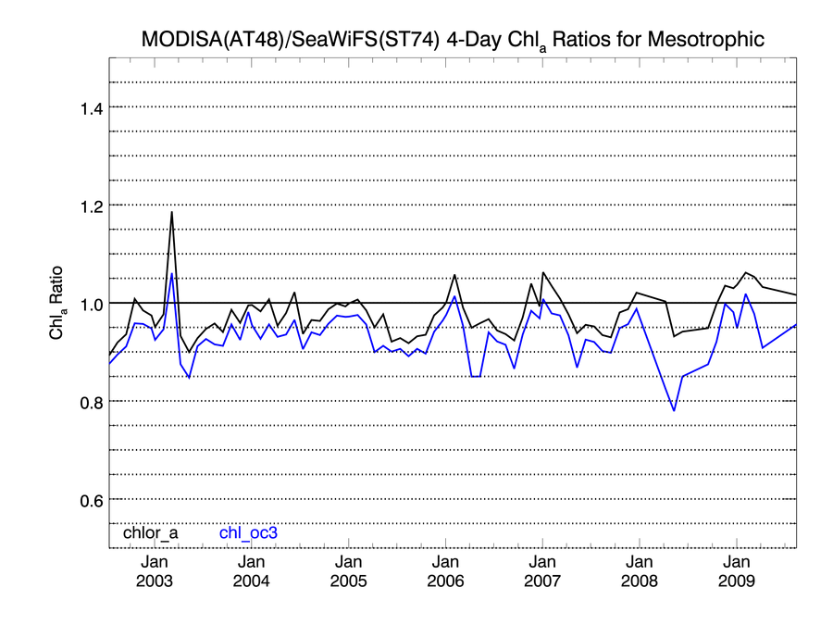
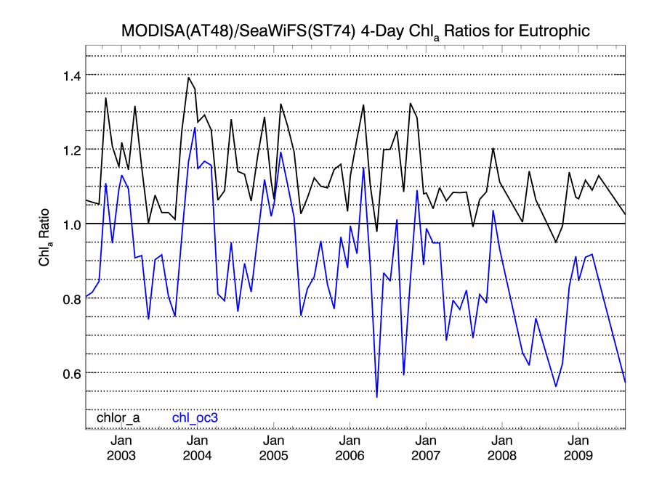
calibrating & reprocessing an ocean color mission
oligotrophic mesotrophic eutrophic
chlorophyll-a Rrs

Slide 47
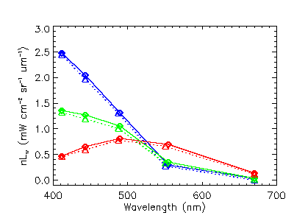
calibrating & reprocessing an ocean color mission
comparison of spectral distribution trends
MODIS & SeaWiFS mean nLw
oligotrophic
mesotrophic
eutrophic

Slide 48
calibrating & reprocessing an ocean color mission
Level-3 comparisons
strengths:
sensitive to small differences in products from different sensors or algorithms
excellent coverage available, both temporal & geographic
can assess continuity among data sets (Climate Data Records)
limitations:
no obvious truth in comparisons.
sensitive to band-pass differences.
may be affected by time-of-observation differences.
availability of other sensors for comparison (SeaWiFS or MODIS) is unknown; climatology is available as an alternative

Slide 49
calibrating & reprocessing an ocean color mission
temporal anomaly evaluations
Level-3 global averages for the entire mission are fit to a periodic function to remove natural annual variability
the differences between the global averages & the annual cycle are then plotted over the mission
the results show both geophysical variations & any unexpected changes due to uncharacterized instrument effects or algorithm artifacts

Slide 50
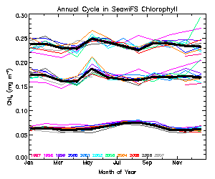
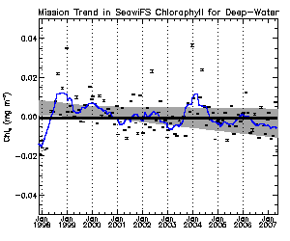
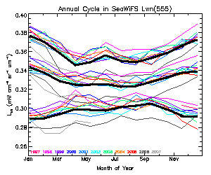
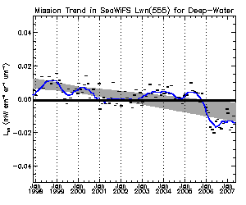
calibrating & reprocessing an ocean color mission
temporal anomaly example

Slide 51
calibrating & reprocessing an ocean color mission
temporal anomaly evaluations
strengths:
very sensitive to small changes in sensor performance
limitations:
difficult to distinguish sensor from real geophysical changes
can be affected by sampling variations.

Slide 52
calibrating & reprocessing an ocean color mission
the problem with recovering MODIS-Terra ocean color
Overheating event in pre-launch testing "smoked" the mirror
pre-launch characterization may not adequately represent at-launch configuration (mirror-side ratios, RVS, polarization sensitivities)
Substantial temporal degradation of instrument response
degradation varies with mirror-side and scan-angle
temporal change in polarization sensitivity, RVS
On-board calibration capabilities (lunar, solar) CANNOT assess
changes in polarization sensitivities, or
changes in RVS “shape”

Slide 53
calibrating & reprocessing an ocean color mission
lessons learned
sensor pre-launch characterization is critical (e.g., cross-scan response, polarization sensitivity, spectral out-of-band response, stray-light). Post-launch characterization may not be possible.
evaluation of advances in on-orbit calibration & processing algorithms requires the capacity for rapid reprocessing, e.g.:
- 10-year SeaWiFS mission can be reprocessed in ~1 day
- SeaWiFS has been reprocessed & redistributed 8 times
- to facilitate new algorithm & calibration evaluations, global SeaWiFS mission has been reprocessed ~100 times
common (sensor-independent) software eliminates potential for algorithm & implementation differences between missions.
consolidated measurement-based team with strong international ties facilitates progress in product development and data quality

Slide 54
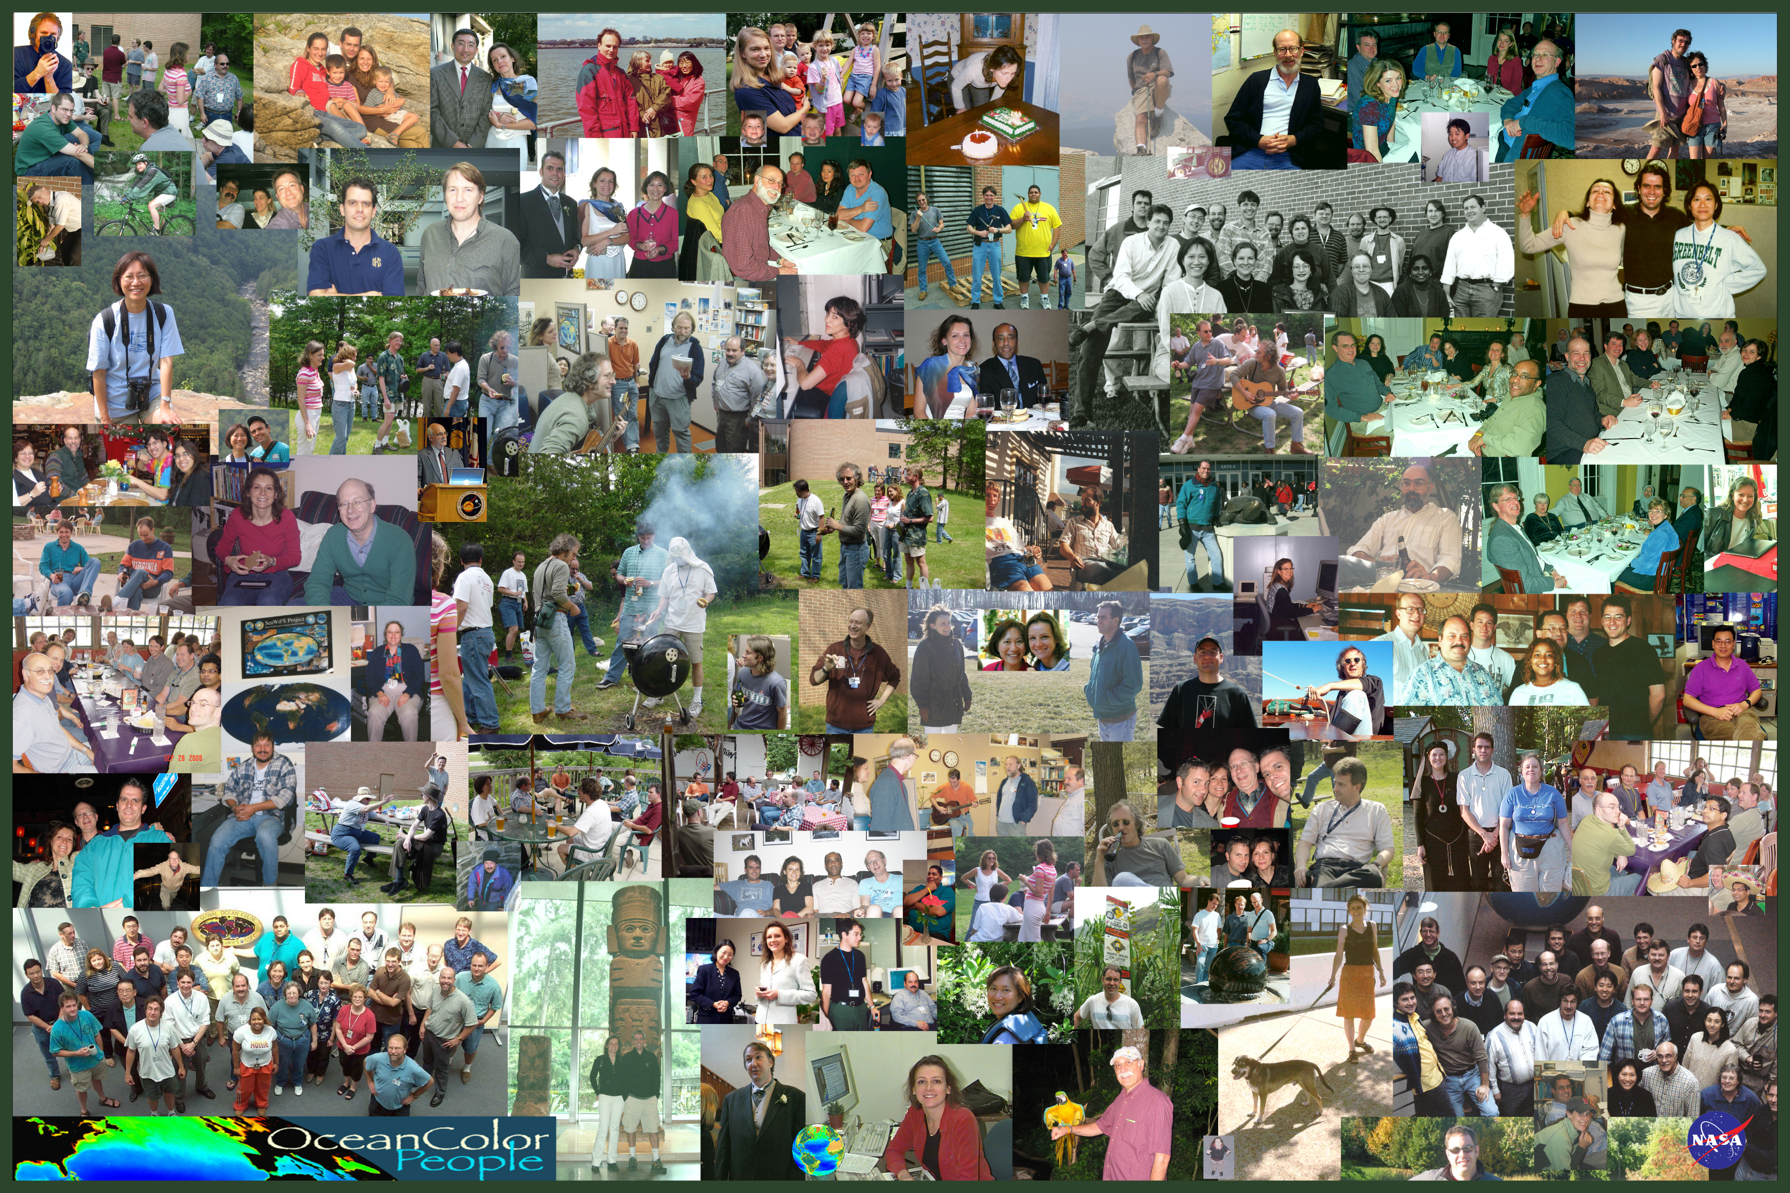
Thank you

