Slide 1
ac-9/ac-s absorption (a tube) and beam attenuation (c tube)
Measuring CDOM absorption coefficients
July 13, 2011

Slide 2
Things we are comparing: sample sources, instruments, filters
Open ocean
Dockside
Biscay pond, and Biscay pond dilution series
ac-9 (0.2 μm Sartoris plastic filter)
ac-9 (0.7 μm Whatman GF/F)
ac-s (0.7 μm Whatman GF/F)

Slide 3
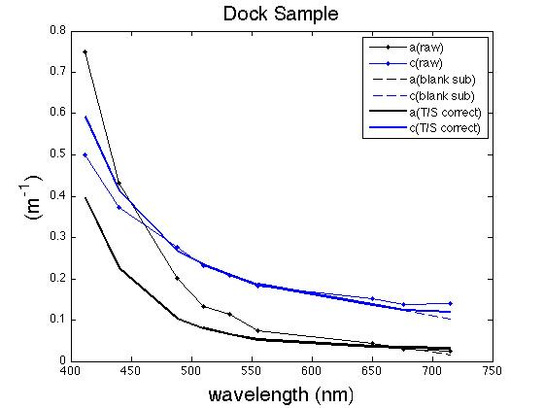

Slide 5
Table of slope comparisons (absorption, using Excel)
 | Open ocean | Dockside | Biscay Pond
ac-9 (0.2 µm filter) | 0.0113 | 0.008 | 0.011
ac-9 (0.7 µm filter) | 0.0155 | 0.009 | 0.0101
ac-s (0.7 µm filter) | NaN | 0.0124 | 0.0138
a_{CDOM} (λ) = a_{CDOM} (λ_{REF}) e – S_{CDOM}(λ- λ_{REF})

Slide 6
Standard error Biscay Pond ac-9 0.2 filter
412 nm | 532 nm | 676 nm
4.02 +/- 0.019 | 0.801 +/- 0.0043 | 0.195 +/- 0.003
Propagated error was low

Slide 7
Is (a) a function of concentration?
ac-s ac-s ac-9 #1 ac-9 #2

Slide 8
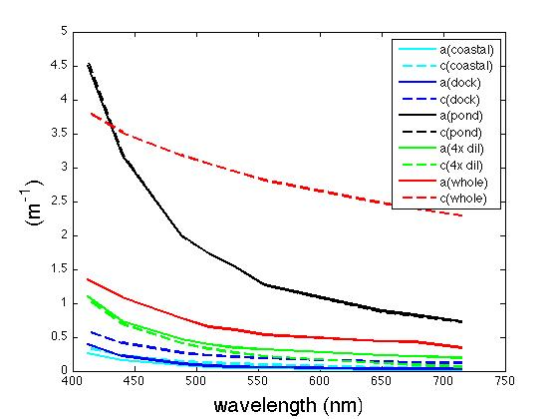
Absorption vs. attenuation

Slide 9
