Slide 1
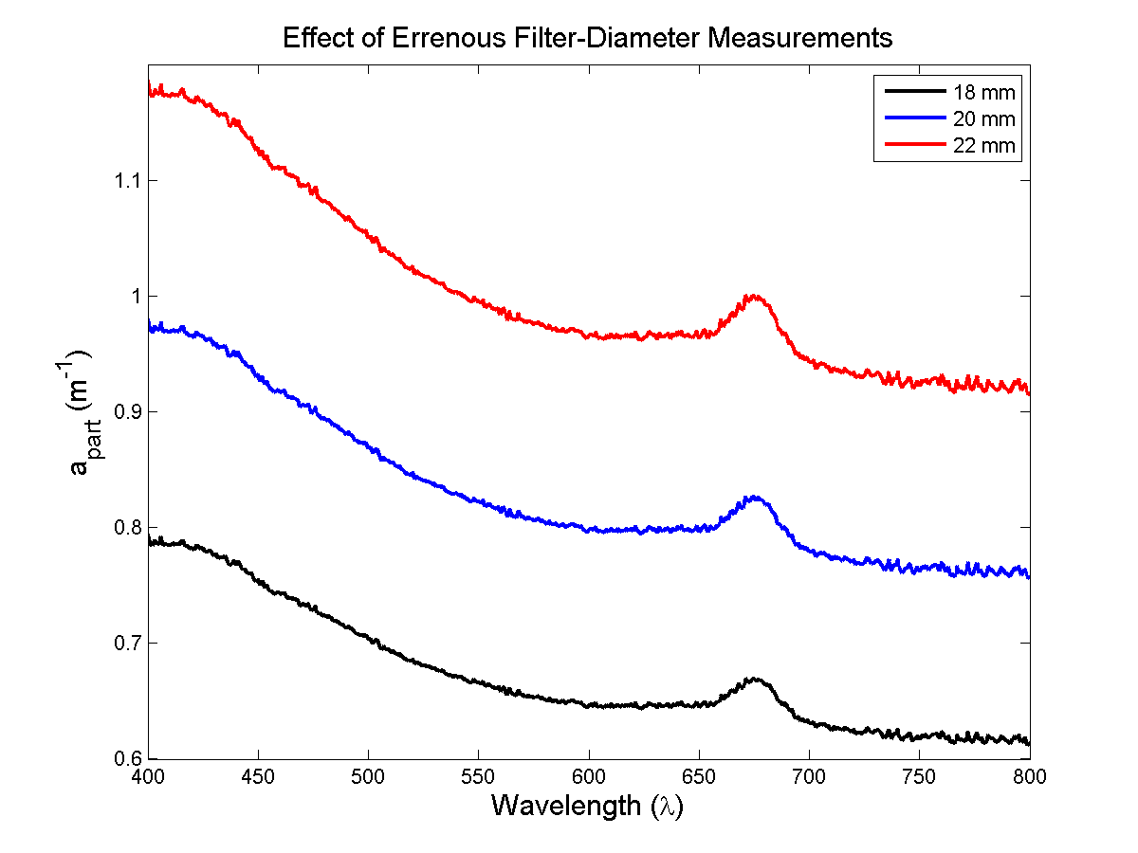
Question 3: What is the effect of an error in the measurement of the filter diameter? (A = π r^2)
An error in the measurement of the filter diameter causes an apparent change in optical pathlength without an associated real change in A_{sample}. Therefore you get an inaccurate calculation of total particulate absorption (a_{part}) where normally a_{part} is independent of pathlength. For this sample profile (800 mL of DRE field water, chaetoseros), a 10% error in sample diameter resulted in ~20% error in a_{part}. It did not appear to change the shape or magnitudes of the curves.

