Slide 1
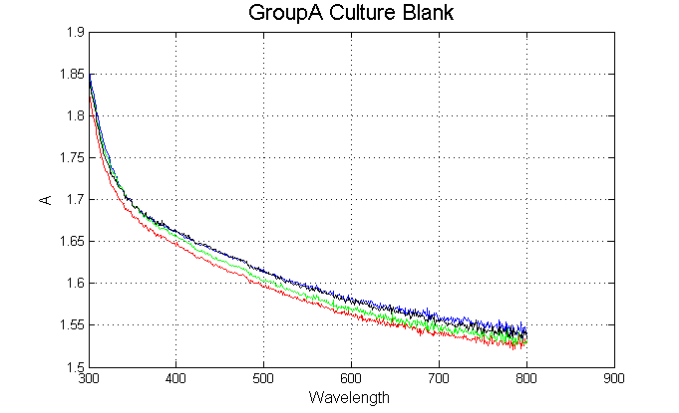
Notes:
1. For the QFT, how variable are the blanks? Are the filtered seawater blanks the same as the Milli-Q blanks?

Slide 2
Comparison of apart(λ) and β–corrected apart(λ)
Notes:
1. For the QFT, how variable are the blanks? Are the filtered seawater blanks the same as the Milli-Q blanks?

