Slide 1
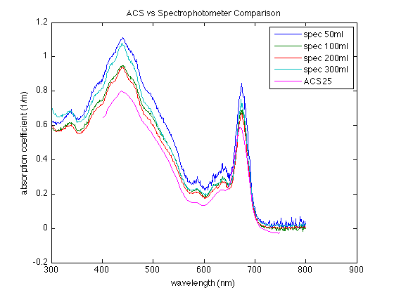
From Lab 2: sample absorption coefficient comparison between spec and ACS
Notes:
Magenta is ACS25, all others are different volumes of the culture filtered

Slide 2
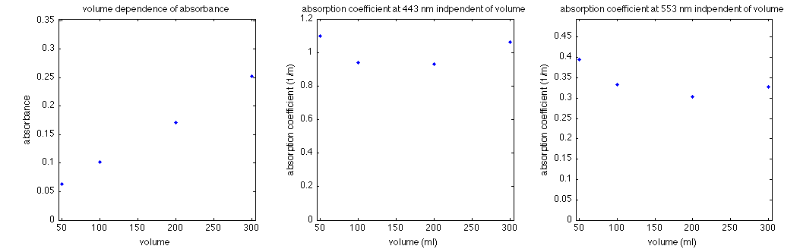
Volume Dependence Removed
Notes:
a_part not dependent of volume after corrections

