Slide 1
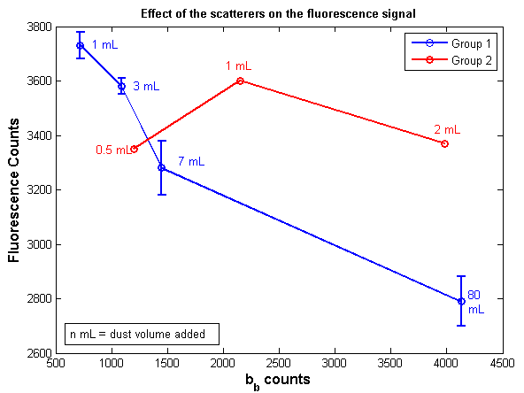
Q-5. Effect of the scatterers (dust) on the fluorescence signal (WetLabs sensor): bb counts vs. Fluorescent counts

Slide 2
Q-5. Effect of the scatterers (dust) on the fluorescence signal (WetLabs sensor): dust volumne vs. Fluorescent counts

