Slide 1
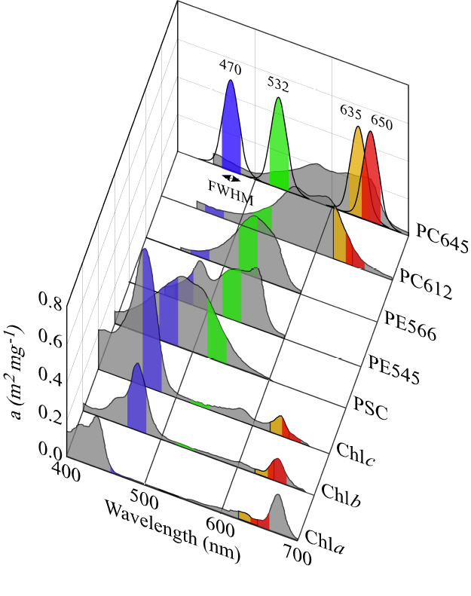
Question 7: Wavelengths Advertised vs. Measured
Instrument | Max Peak | Advertised Value
Turner Chl | 462.05 | Not Advertised
Turner CDOM | 365.60 | Not Advertised
WetLabs | 465.38 | 470
Turner Manual listed the excitatory wavelengths as “visible” for Chlorophyll and “UV” for CDOM. No specific wavelength.
470nm preferentially excites accessory chlorophyll pigments (b and c), as well as photosynthetic carotenoids.
(MacIntyre et al. 2010)

