Slide 3
 | Chl [μg/L] | Phaeo [μg/L]
Average | 2.41 | 0.82
Stdev | 0.82 | 1.78

Slide 4
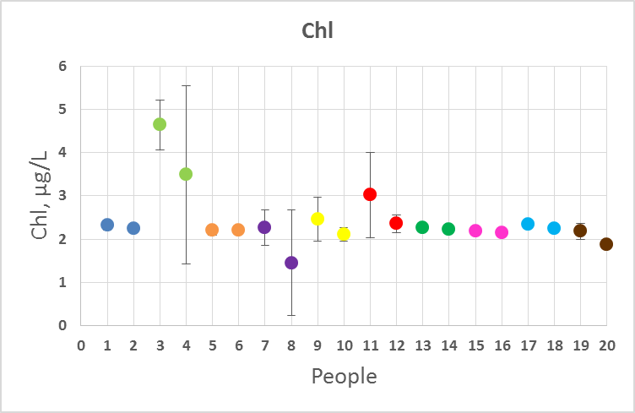
Chl Concentration

Slide 5
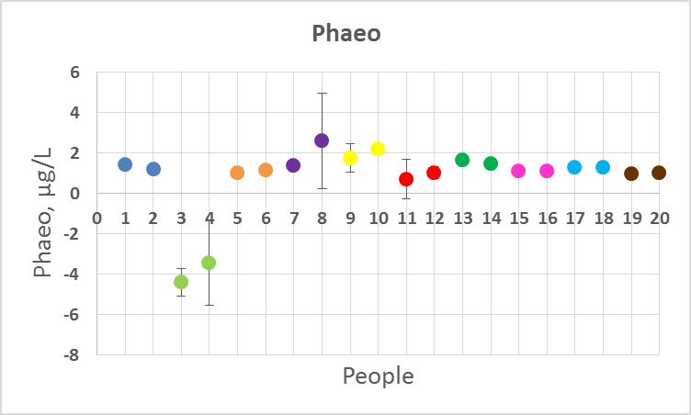
Phaeo Concentration

