Slide 1
Solar Quenching: effects on measurements of chlorophyll fluorescence
Ratio of chl:chl fluorescence changes with variations in PAR
Increased PAR decreases chl fluorescence over sufficiently long exposure periods
There is a delay in acclimatization of the chl to the impact of increased PAR
This effect can be seen if a time series seems to have spikes in chlorophyll every night.

Slide 2
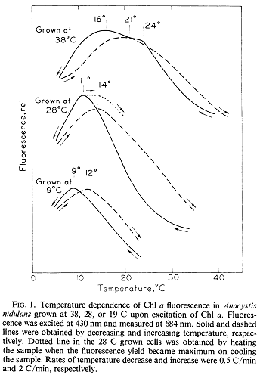
Temperature Effects
As temperature goes up, fluorescence goes down (generally)
Exact nature of the dependence is a functional of
  The speed of the change
  The species of the algae
  The temperature at which the algae was grown
  The direction of the change (heating or cooling)
The samples were 6 degrees warmer than the controls at the end of the experiment
  It would be difficult to determine how the fluorescence of the samples is impacted by the changing temperature.
Figure: Murata & Fork (1975)

