Slide 1
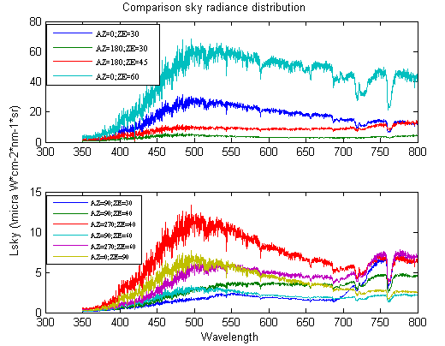
Comparison sky radiance distribution

