Slide 1
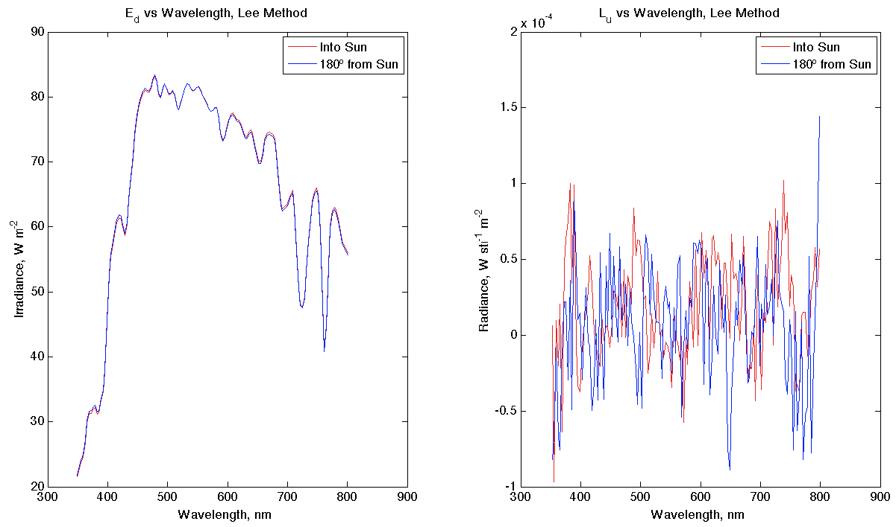
E_{d} looks like we expected. Rotation didn’t affect it.
L_{u} doesn’t look so great, may have forgotten to turn off “immersion” setting?

Slide 2
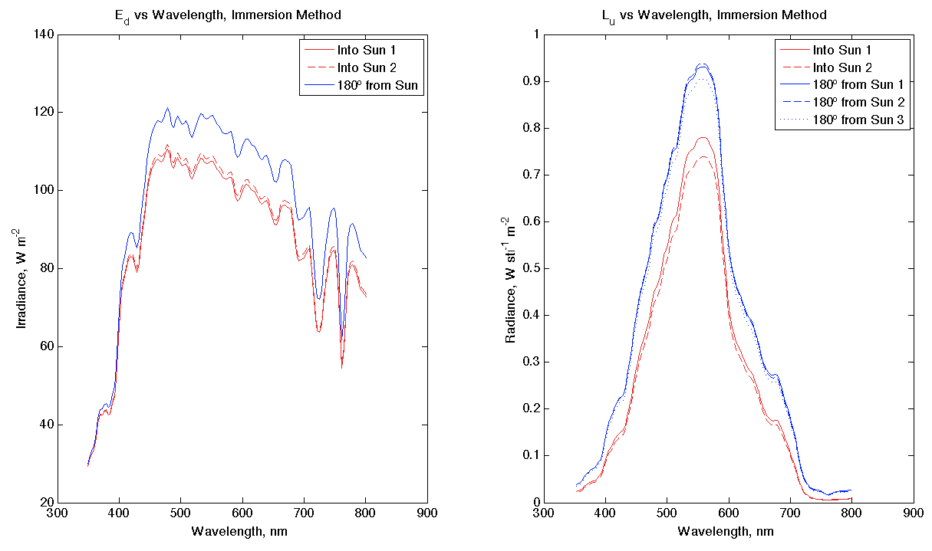
E_{d}, when rotated into the sun, was lower for two separate trials. Would have expected them to be more similar, like last plot. Cloud, perhaps?
L_{u} has replicates that look good, and all look as we’d expect:
All spectra suggest green waters, which is definitely what we see from the dock
L_{u} was lower when E_{d} detector was rotated into the sun (L_{u} detector was in instrument’s shadow)

