Slide 1
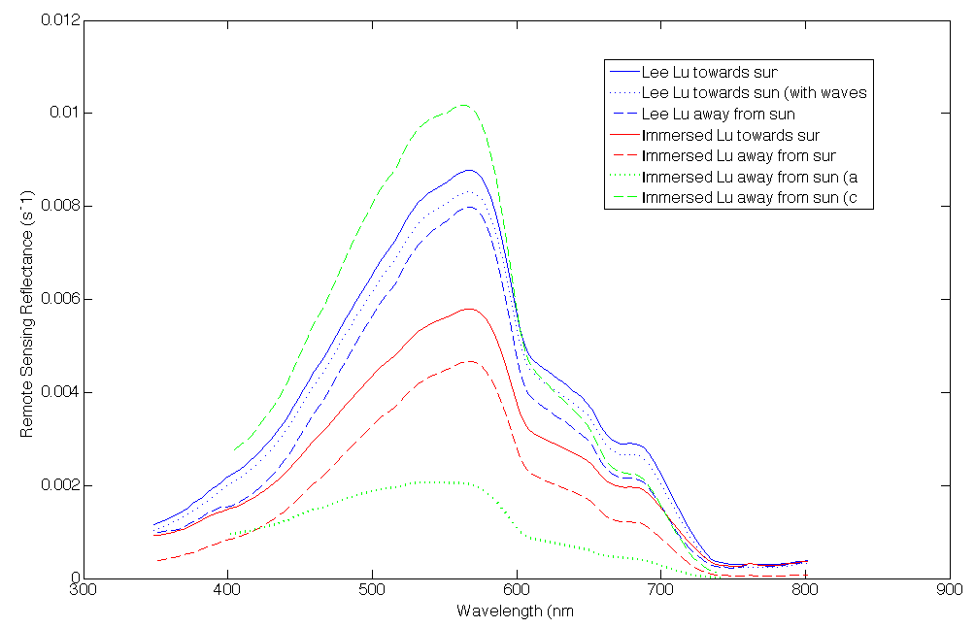
Remote Sensing Reflectance (R_{rs})
R_{rs} higher towards sun than away from sun.
Both Lee and Immersed Lu are comparable to the WISP and HyperSass data.
R_{rs} will improve with better K measurement.
Notes:
Solid lines are the ones where Lu radiometer is facing the sun and the dashed are the ones where it is not facing the sun.
Blue are the Lee methods
Red are the Immersed Lu data
Green lines border both- upper is the c and lower is the a

