Slide 1
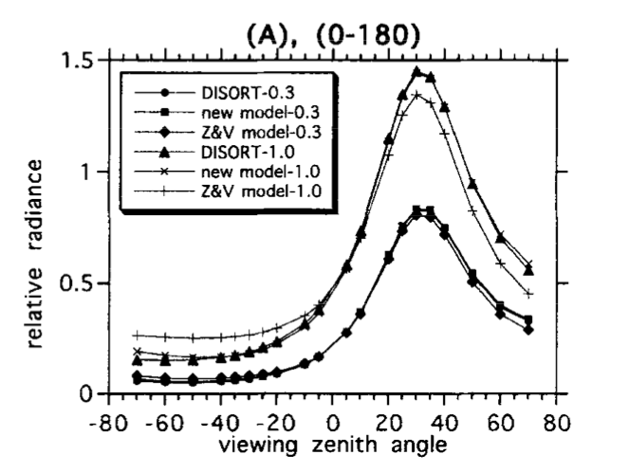
Sky radiance distribution
(Liang and Lewis, 1996)
Figure give a example of simulated sky radiance distribution with solar zenith angle at 30⁰, in the azimuth planes 0⁰-180⁰.
The radiance peak occurs in the solar zenith angle and radiance decreased at both directions away the sun.

Slide 2
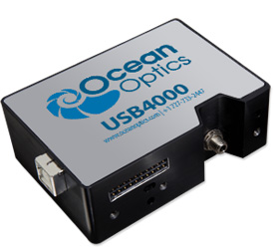
Ocean Optic Spectrometer
Detector range: 200-1100 nm
Integration time: 3.8 ms - 10 seconds
Dark noise: 50 RMS counts

Slide 3





Spec Calibration
E: Irradiance
L: Radiance
M: Measurement
D: Dark
B: Bulb measurement
T: Integration time
We normalized measurements by integration time.

Slide 4
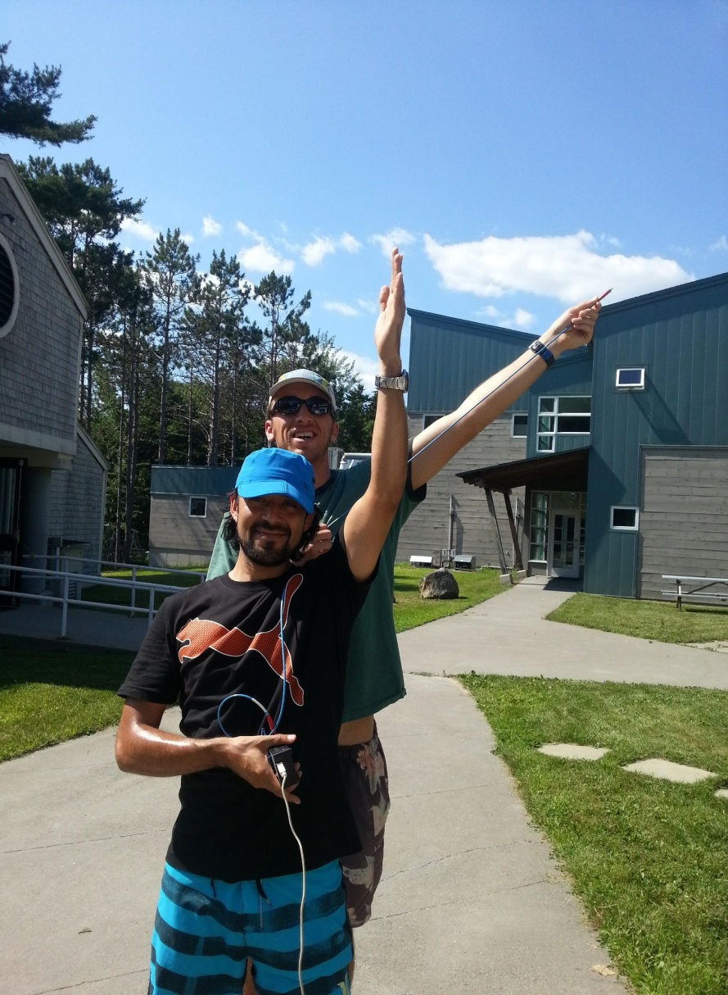
Practical Aspects
Difficult to get full coverage quickly.
Very sensitive to noise.
Must normalize to integration time.
Need horizon views.
Must fully understand azimuth and zenith angle definitions
Arm gets tired

Slide 5
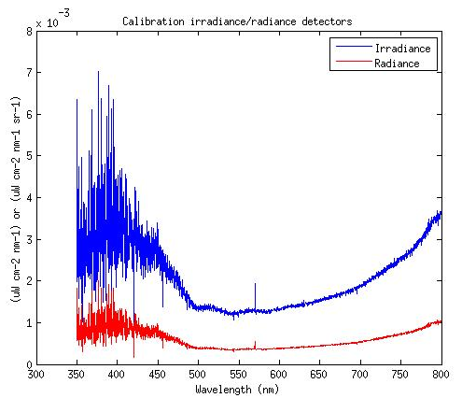
Calibration results
Radiance = Irradiance *R/PI

Slide 6
Group 1: E_{d} PAR Values
 | PAR (W/m²)
 | Lee Method | Immersion Method
Away from Sun | 338.7 | 328.6
Into Sun | 371.3 | 340.0
Into Sun with Waves | 369.7 | ---
Values should be all approximately the same, as orientation of the HyperPro should have minimal effect on the E_{d} sensor
A drop was observed between Group 1 and Group 2, but it was likely just a function of time of day (next slide)
If the point was to find ways to occlude the Ed sensor, we did not achieve that.

Slide 7
Group 2: E_{d} PAR Values
 | PAR (W/m²)
 | Lee Method |  | Immersion Method
 | Trial #1 | Trial #2 | Trial #1 | Trial #2 | Trial #3
Rotated | 223.0 | - | 294.5 | 297.9 | -
Off dock | 198.8 | 207.0 | - | - | -
Upriver | 242.7 | - | 292.4 | 202.2 | -
Downriver | 213.6 | - | 199.4 | - | -
Into sun | 223.1 | - | 325.3 | 309.5 | 308.0

Slide 8
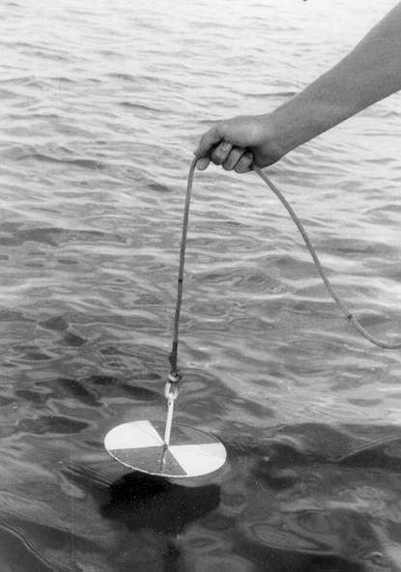
Secchi Disks
Invented in 1865 by Pietro Angelo Secchi
One of the few human-eye measurements still made today.
Surprisingly consistent among operators
AOP related to Kd and c

Slide 9
K_{d} from Secchi Disks
From ACS data, a(530nm)=0.54, c(530nm)=2.51
Poole & Atkins (1929) calculated that z_{sc} agrees well with 1.7/K_{d}
  for our case, Z_sc=2.13m, K_d=0.8
Idso & Gilbert (1974) did a number of experiments using (then) modern equipment which found that Poole & Atkins was surprisingly accurate.
Other relationships have been suggested, but Poole & Atkins appears to have a solid body of evidence in a number of different waters.
Notes:
It’s possible changes in light during the day will change k_d

Slide 10
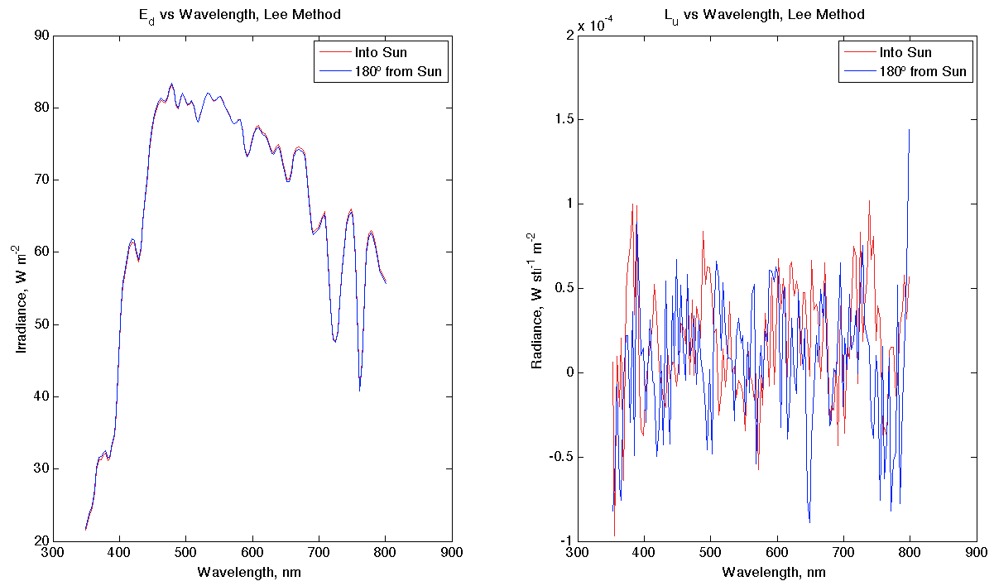
E_{d} looks like we expected. Rotation didn’t affect it.
L_{u} doesn’t look so great, may have forgotten to turn off “immersion” setting?

Slide 11
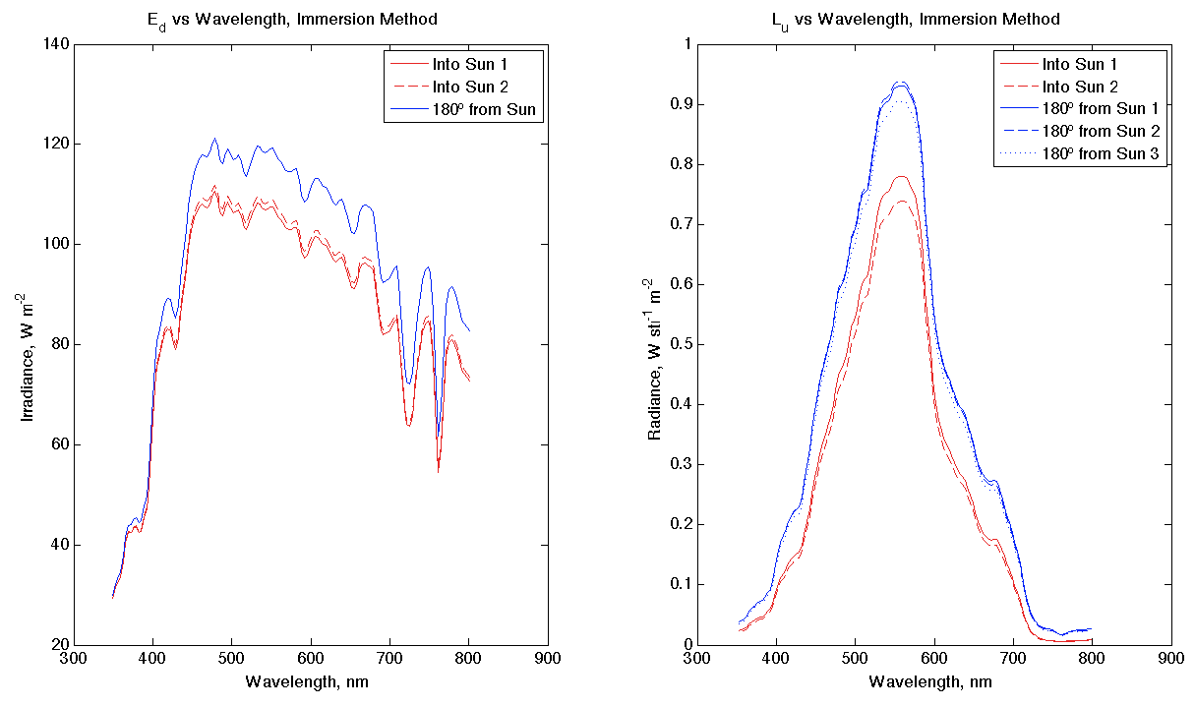
E_{d}, when rotated into the sun, was lower for two separate trials. Would have expected them to be more similar, like last plot. Cloud, perhaps?
L_{u} has replicates that look good, and all look as we’d expect:
  All spectra suggest green waters, which is definitely what we see from the dock
  L_{u} was lower when E_{d} detector was rotated into the sun (L_{u} detector was in instrument’s shadow)

Slide 12
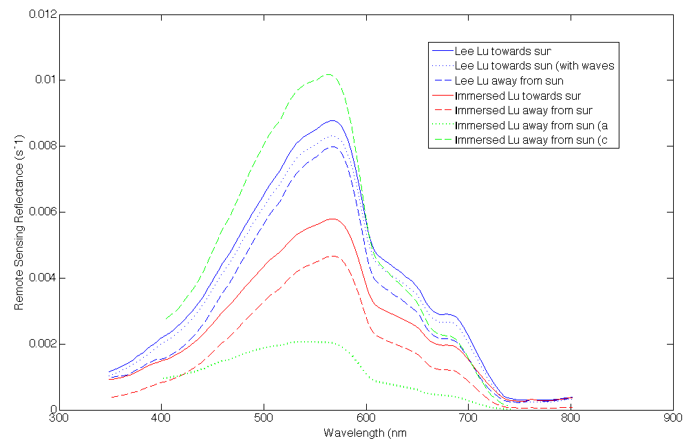
Remote Sensing Reflectance (R_{rs})
R_{rs} higher towards sun than away from sun.
Both Lee and Immersed Lu are comparable to the WISP and HyperSass data.
R_{rs} will improve with better K measurement.
Notes:
Solid lines are the ones where Lu radiometer is facing the sun and the dashed are the ones where it is not facing the sun.
Blue are the Lee methods
Red are the Immersed Lu data
Green lines border both- upper is the c and lower is the a

Slide 13
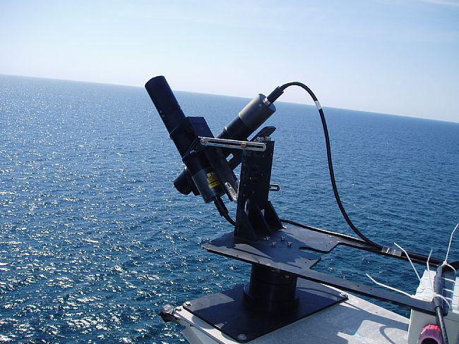
HyperSAS
Measures L_{t} (L_{w} + reflected L_{s}) and L_{s} in a single discreet direction
  Direction and angle between L_{t} and L_{s} measurements can be varied
Also measures E_{d}
R_{RS} can be calculated as R_{RS}=(L_{t}-ρL_{s})/E_{d} where ρ can be estimated.
  ρ estimated as 0.28 in this case

Slide 14
R_{rs} Sensitivity to Azimuth Angle
Rrs measured at the theoretical optimum angle of 35˚, 135˚ falls in between measurements made at other zenith angles

Slide 15
R_{rs} Sensitivity to Zenith Angle
Measurements at multiple zenith angles was limited (only two at the same azimuth angle).
Zenith appears to cause a much larger difference at 45˚ degree azimuth then at a 90 ˚ azimuth

Slide 16
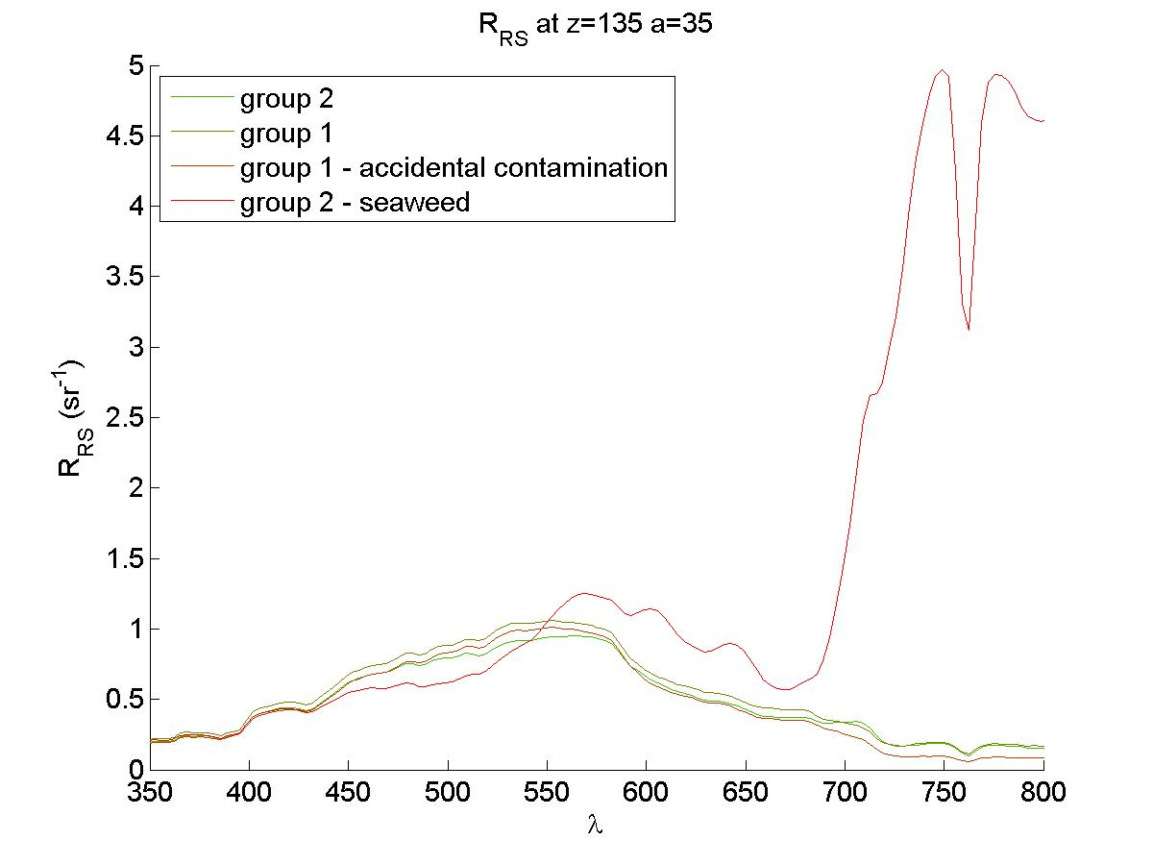
Seaweed in HyperSAS
Group 2 pulled seaweed in front of the HyperSAS to determine its effect on the measurement.
  Intentional contamination showed a clear “red edge” reflectance
Group 1 thought it may have had seaweed contamination on one reading.
  Little effect from accidental contamination in this case

Slide 17
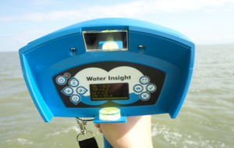
WISP (Water Insight SPectrometer)
Hand-held hyperspectral spectrometer
Provides R_{o (reflectance)}, L_{u}, L_{d}, E_{d}
One vertical (up) spectrometer, 2 spectrometers at 42 degrees
Measures 400 – 800 nm

Slide 18
WISP
Issues:
Group 2: Not functioning
Group 1: Lacking proper notes for all samples
Future Suggestions:
Syncronize watch with meter time
Always right down Chl and TMS readings when measuring for later file matching
Meter setting for Rrs export?
Notes:
I took notes with some times, angles, and chl values but that was not enough to match all of the data, we had about 20 results and could only match 6 of them based on spectra, some of them we could guess at by what the shape/reflectance values looked like but not enough to say anything about definitive angle

Slide 19
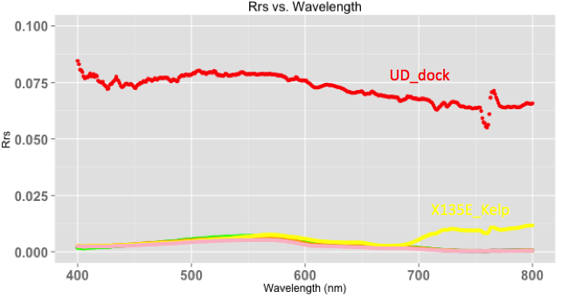
WISP Data*
Sample | Chl (ug/L)
UD-60W | 0.2
Dock | 0
LD-30E | 0.1
LD-135E | 1.3
LD-135E Kelp | 167.5
LD-180 | 0.6
Upper Dock
1/sr
135E Kelp
Dock shows high reflectance, location with kelp shows high reflectance in the 700-800 range, all other samples (including 135E no kelp) show similar trends
Notes:
Only WISP data that we could make sure of the angles and measurements is on this graph, you can see the dock is super high, the kelp deviates from all the other samples

Slide 20
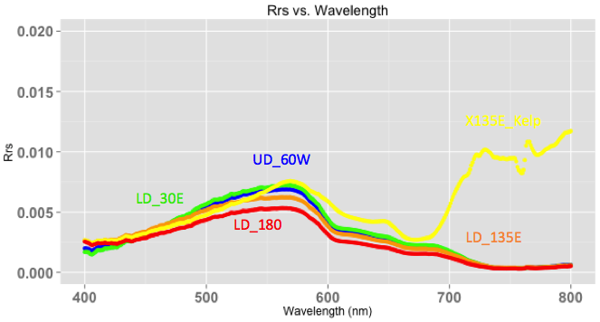
Lower Reflectance Data
Sample | Chl (ug/L)
UD-60W | 0.2
Dock | 0
LD-30E | 0.1
LD-135E | 1.3
LD-135E Kelp | 167.5
LD-180 | 0.6
1/sr
135E Kelp
UD = upper dock, Ld = lower dock
All angles are from 0 degrees = sun
Notes:
This shows the bottom half of the last graph in more detail, you can see the variation in the kelp sample versus the rest (interesting shape in the higher wavelengths), most other chlorophyll values are much lower

Slide 21
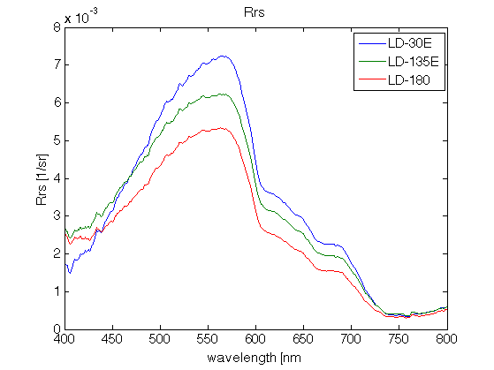
Lower Dock Only
Sample | Chl (ug/L)
LD-30E | 0.1
LD-135E | 1.3
LD-180 | 0.6
ReflectanceIncreases
Angle Increases
Notes:
Highest reflectance is at 30

Slide 22
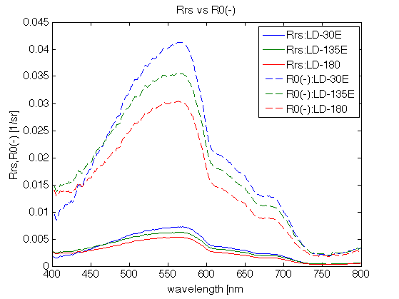
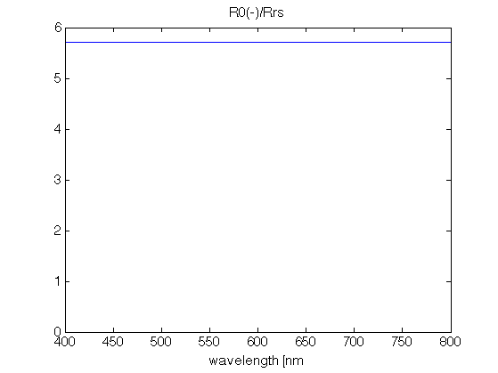
From R_{rs} to R^{w}
Notes:
solid lines are calculated from Lu Ld Ed given by instrument; dotted lines are Ro value that the machine gives
You have to convert the values given to get at Rrs, there’s some weird conversion. Maybe we can set up the meter to do this for us???

Slide 23
From R_{rs} to R^{w}

Slide 24
HyperSAS and WISP Comparison
WISP compares well to HyperSAS data for common zenith and azimuth angles
35˚, 135˚
WISP underestimates Rrs for long wavelengths in both cases
35˚, 180˚

