Slide 1
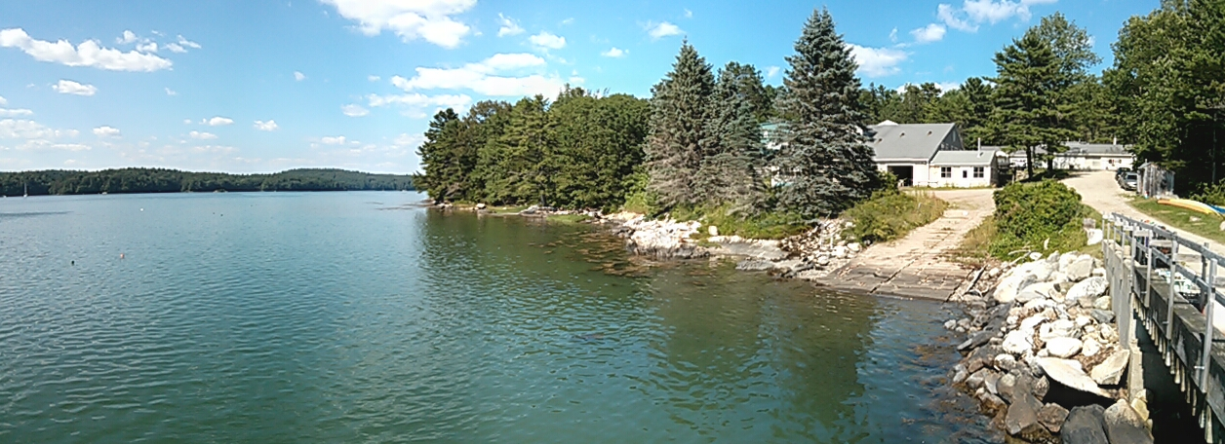
‘But beware Mobley’s Law of Conservation of Misery’ Merry Jane Perry
"It is not our fault that nature has made sea surfaces so complicated” (p. 147, Light and Water). Curt Mobley
There is probably no more challenging measurement to make in ocean optics than to accurately measure remote sensing reflectance. It cannot be measured directly, but must be estimated from either underwater or above water sensors.
Group Presentation, Tuesday July 16, 2013

Slide 2
This is qualitative and semi quantiative
Sources of Uncertainty
Accuracy in angle measurement
Cloud cover
Sea state
Surface reflected glint correction

Slide 3
Secchi Disk, HyperSAS, WISP

Slide 4
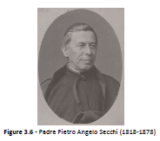
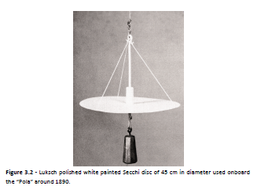
Secchi Disks
Named after Padre Pietro Angelo Secchi
A longstanding optical proxy of sea clarity.
Image Source : Wernand Thesis, 2011

Slide 5
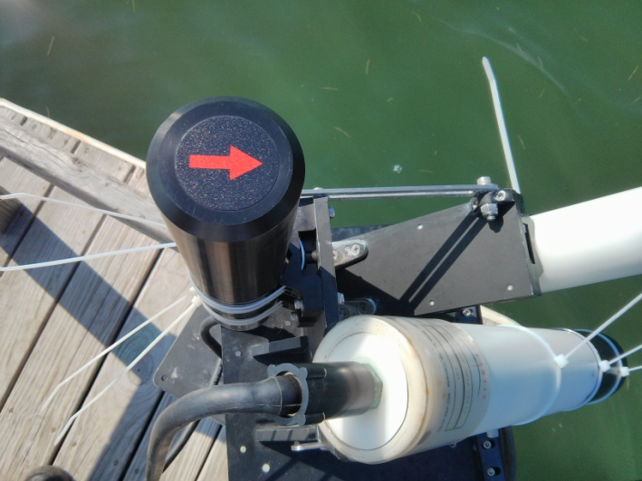
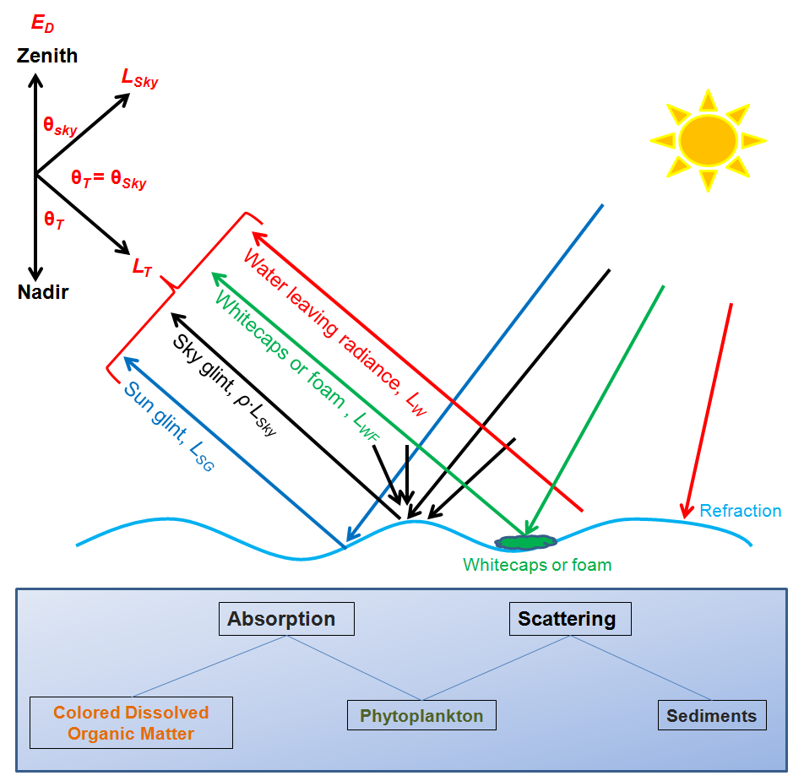
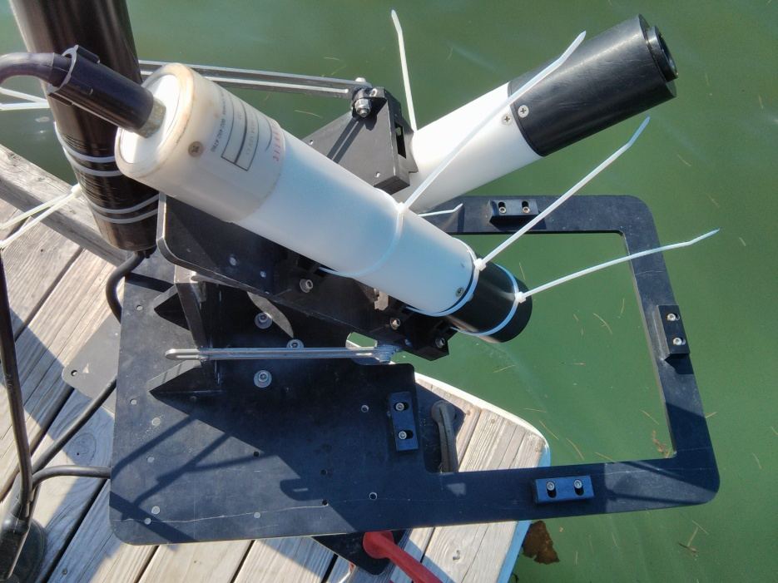
HyperSAS
L_sky = L_T
Re-emission also

Slide 6
R_{rs} Sensitivity to Azimuth Angle
Rrs measured at the theoretical optimum angle of 35˚, 135˚ falls in between measurements made at other zenith angles

Slide 7
R_{rs} Sensitivity to Zenith Angle
Measurements at multiple zenith angles was limited (only two at the same azimuth angle).
Zenith appears to cause a much larger difference at 45˚ degree azimuth then at a 90 ˚ azimuth

Slide 8
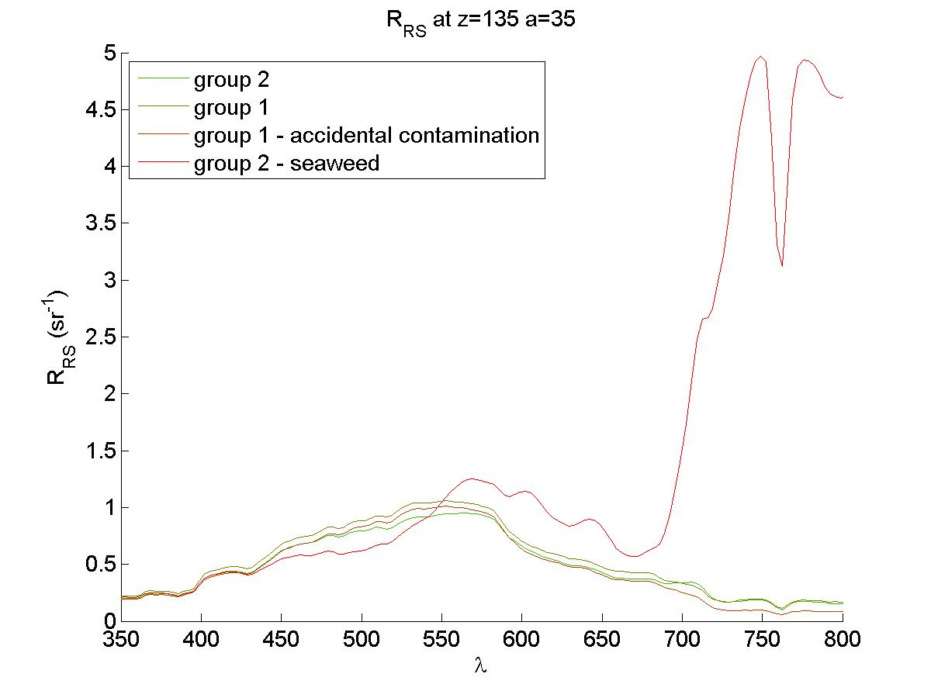
Seaweed in HyperSAS
Group 2 pulled seaweed in front of the HyperSAS to determine its effect on the measurement.
  Intentional contamination showed a clear “red edge” reflectance
Group 1 thought it may have had seaweed contamination on one reading.
  Little effect from accidental contamination in this case

Slide 9
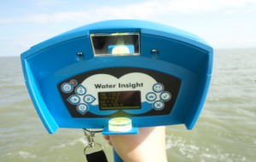
WISP (Water Insight SPectrometer)
Hand-held hyperspectral spectrometer
Provides R_{o (reflectance)}, L_{u}, L_{d}, E_{d}
One vertical (up) spectrometer, 2 spectrometers at 42 degrees
Measures 400 – 800 nm

Slide 10
WISP
Issues:
Group 2: Not functioning
Group 1: Lacking proper notes for all samples
Future Suggestions:
Synchronize watch with meter time
Always right down Chl and TMS readings when measuring for later file matching
Meter setting for Rrs export?
Notes:
SHUNGU: WISP is a QUALITATIVE INSTRUMENT
I took notes with some times, angles, and chl values but that was not enough to match all of the data, we had about 20 results and could only match 6 of them based on spectra, some of them we could guess at by what the shape/reflectance values looked like but not enough to say anything about definitive angle

Slide 11
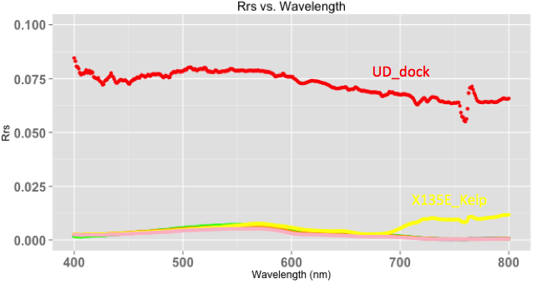
WISP Data*
Sample | Chl (ug/L)
UD-60W | 0.2
Dock | 0
LD-30E | 0.1
LD-135E | 1.3
LD-135E Kelp | 167.5
LD-180 | 0.6
Upper Dock
1/sr
135E Kelp
Dock shows high reflectance, location with kelp shows high reflectance in the 700-800 range, all other samples (including 135E no kelp) show similar trends
Notes:
Only WISP data that we could make sure of the angles and measurements is on this graph, you can see the dock is super high, the kelp deviates from all the other samples

Slide 12
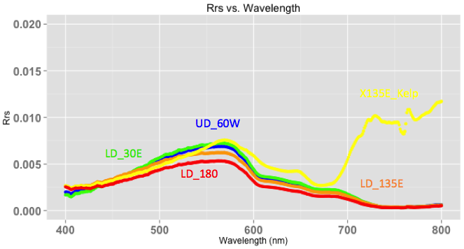
Lower Reflectance Data
Sample | Chl (ug/L)
UD-60W | 0.2
Dock | 0
LD-30E | 0.1
LD-135E | 1.3
LD-135E Kelp | 167.5
LD-180 | 0.6
1/sr
135E Kelp
UD = upper dock, Ld = lower dock
All angles are from 0 degrees = sun
Notes:
This shows the bottom half of the last graph in more detail, you can see the variation in the kelp sample versus the rest (interesting shape in the higher wavelengths), most other chlorophyll values are much lower

Slide 13
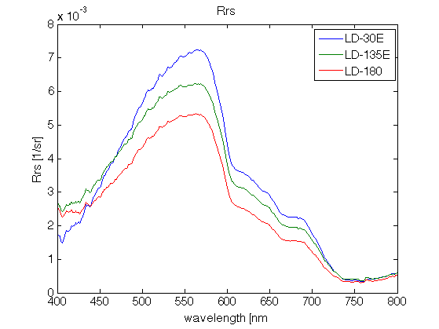
Lower Dock Only
Sample | Chl (ug/L)
LD-30E | 0.1
LD-135E | 1.3
LD-180 | 0.6
ReflectanceIncreases
Angle Increases
Notes:
Highest reflectance is at 30

Slide 14
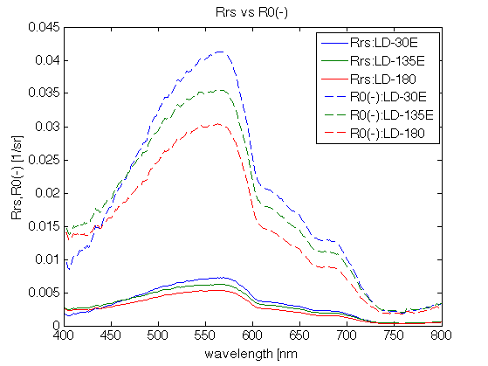
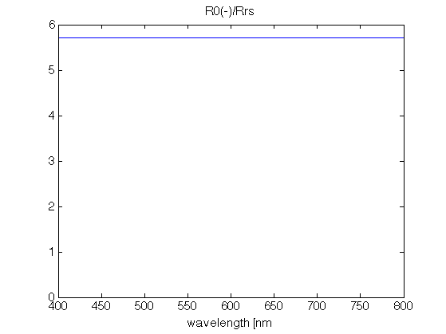
From R_{rs} to R^{w}
Notes:
solid lines are calculated from Lu Ld Ed given by instrument; dotted lines are Ro value that the machine gives
You have to convert the values given to get at Rrs, there’s some weird conversion. Maybe we can set up the meter to do this for us???

Slide 15
From R_{rs} to R^{w}

Slide 16
HyperSAS and WISP Comparison
QUALITATIVE COMPARISON
WISP compares well to HyperSAS data for common zenith and azimuth angles
35˚, 135˚
WISP underestimates Rrs for long wavelengths in both cases
35˚, 180˚

Slide 17
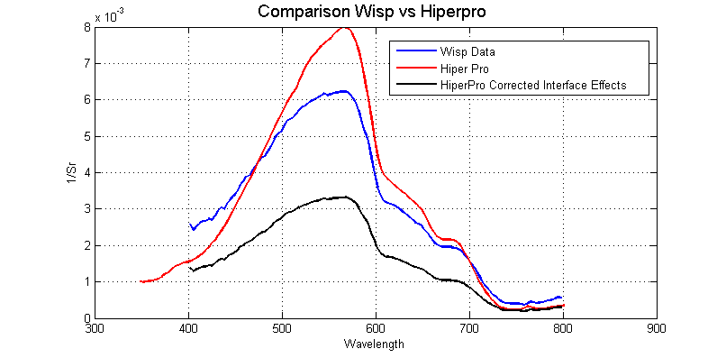
Notes:
Hyperpro from first group, Lu toward the sun

Slide 18
Hyperpro and Radiometer Calibration

Slide 19
Group 1: Hyperpro
Waves had no effect on E_{d}.
L_{u} was lower when Ed detector is facing towards the Sun.
L_{u} was high in the green region because of high Chl conc. Water.

Slide 20
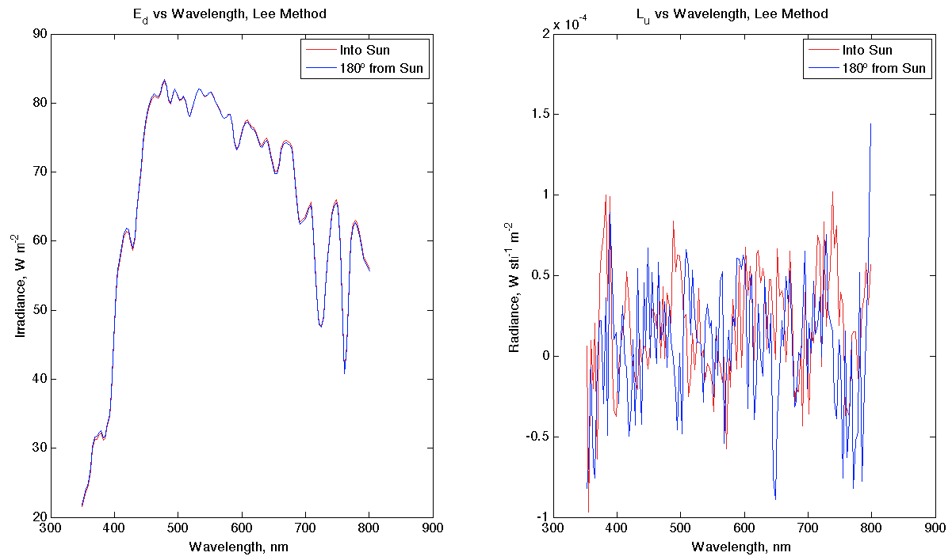
Group 2: Hyperpro
E_{d} looks like we expected. Rotation didn’t affect it.
L_{u} doesn’t look so great, may have forgotten to turn off “immersion” setting?

Slide 21
G1
E_{d} had minimum difference between various positioning towards the Sun.
Consistent with the previous method-- L_{u} is lower again when facing the Sun.

Slide 22
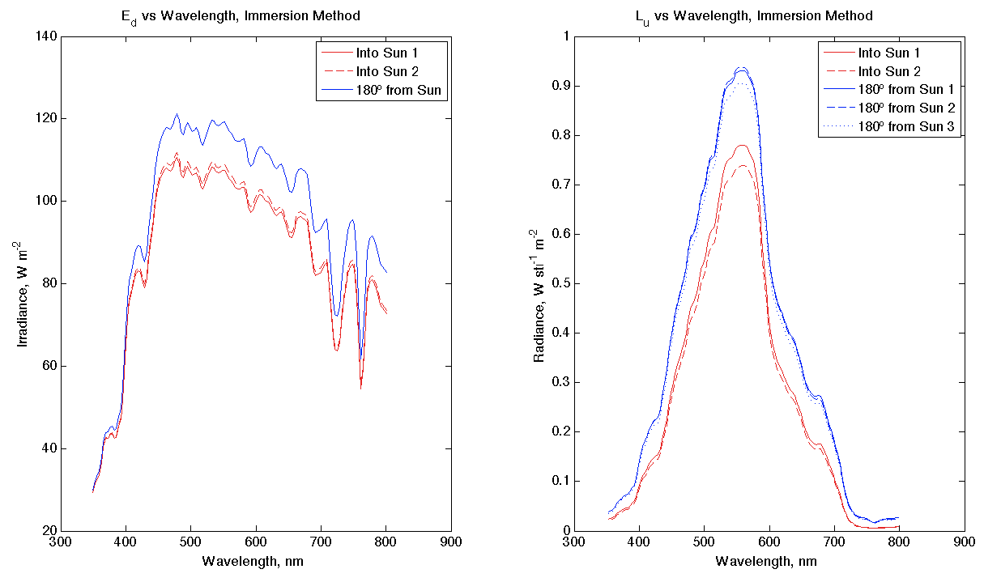
G2
E_{d}, when rotated into the sun, was lower for two separate trials. Would have expected them to be more similar, like last plot. Cloud, perhaps?
L_{u} has replicates that look good, and all look as we’d expect:
  All spectra suggest green waters, which is definitely what we see from the dock
  L_{u} was lower when E_{d} detector was rotated into the sun (L_{u} detector was in instrument’s shadow)

Slide 23
K_{d} from Secchi Disks
From ACS data, a(530nm)=0.54, c(530nm)=2.51
Poole & Atkins (1929) calculated that z_{sc} agrees well with 1.7/K_{d}
  for our case, Z_sc=2.13m, K_d=0.8
Idso & Gilbert (1974) did a number of experiments using (then) modern equipment which found that Poole & Atkins was surprisingly accurate.
Other relationships have been suggested, but Poole & Atkins appears to have a solid body of evidence in a number of different waters.
Notes:
It’s possible changes in light during the day will change k_d

Slide 24
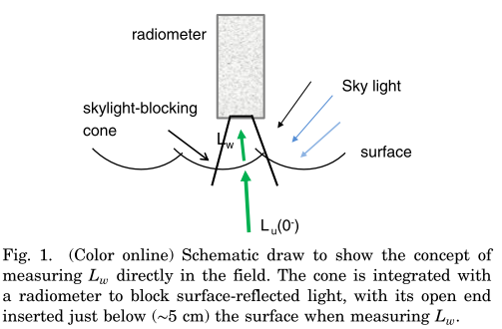
R_{rs} Calculation from radiometric data
Immersion Method:
  L_{u} is measured by a radiance sensor at depth (z).
  E_{d} is measured an planar irradiance sensor at the surface.
  R_{rs} = Lw = Lu(z) * Tas * 1 where n = index of refaction,
  E_{s} T n² E_{s} T_{(as)}= transmission at the air-sea interface, L_{w} = water leaving radiance, E_{s} = incident sky irradiance, and T=transmission=e^{-∫kLu(z)dz}
Lee Method:
  Assuming that the Lee setup does
  directly measure Lw – then the
  calculation is simply: R_{rs} = Lw
  E_{s}
Lee setup measures L_{w} directly

Slide 25
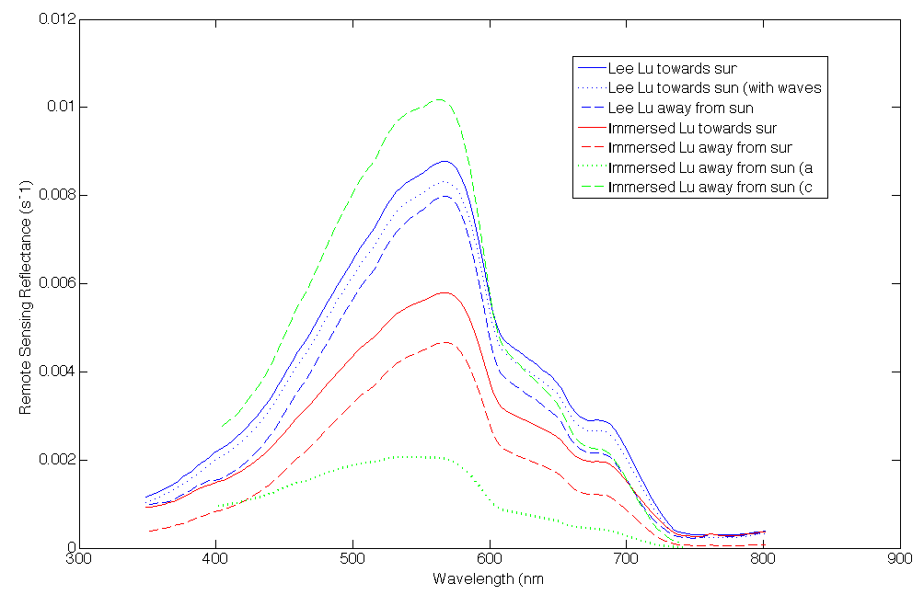
Remote Sensing Reflectance (R_{rs})
R_{rs} higher towards sun than away from sun.
Both Lee and Immersed Lu are comparable to the WISP and HyperSass data.
R_{rs} will improve with better K measurement.
Notes:
Solid lines are the ones where Lu radiometer is facing the sun and the dashed are the ones where it is not facing the sun.
Blue are the Lee methods
Red are the Immersed Lu data
Green lines border both- upper is the c and lower is the a

Slide 26
Group 1: E_{d} PAR Values
 | PAR (W/m²)
 | Lee Method | Immersion Method
Away from Sun | 338.7 | 328.6
Into Sun | 371.3 | 340.0
Into Sun with Waves | 369.7 | ---
Values should be all approximately the same, as orientation of the HyperPro should have minimal effect on the E_{d} sensor
A drop was observed between Group 1 and Group 2, but it was likely just a function of time of day (next slide)
If the point was to find ways to occlude the Ed sensor, we did not achieve that.

Slide 27
Group 2: E_{d} PAR Values
 | PAR (W/m²)
 | Lee Method |  | Immersion Method
 | Trial #1 | Trial #2 | Trial #1 | Trial #2 | Trial #3
Rotated | 223.0 | - | 294.5 | 297.9 | -
Off dock | 198.8 | 207.0 | - | - | -
Upriver | 242.7 | - | 292.4 | 202.2 | -
Downriver | 213.6 | - | 199.4 | - | -
Into sun | 223.1 | - | 325.3 | 309.5 | 308.0

Slide 28
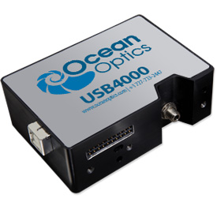
Ocean Optic Spectrometer
Detector range: 200-1100 nm
Integration time: 3.8 ms - 10 seconds
Dark noise: 50 RMS counts

Slide 29





Spec Calibration
E: Irradiance
L: Radiance
M: Measurement
D: Dark
B: Bulb measurement
T: Integration time
R: Reflectance (0.93 for Lambertian surface)
We normalized measurements by integration time.

Slide 30
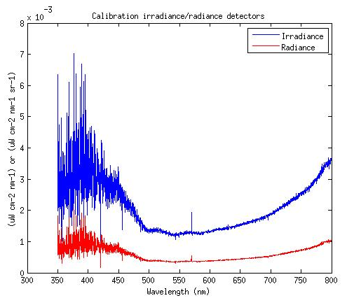
Calibration results
Radiance = Irradiance *R/PI
Notes:
Conversion between radiance and irradiance

Slide 31
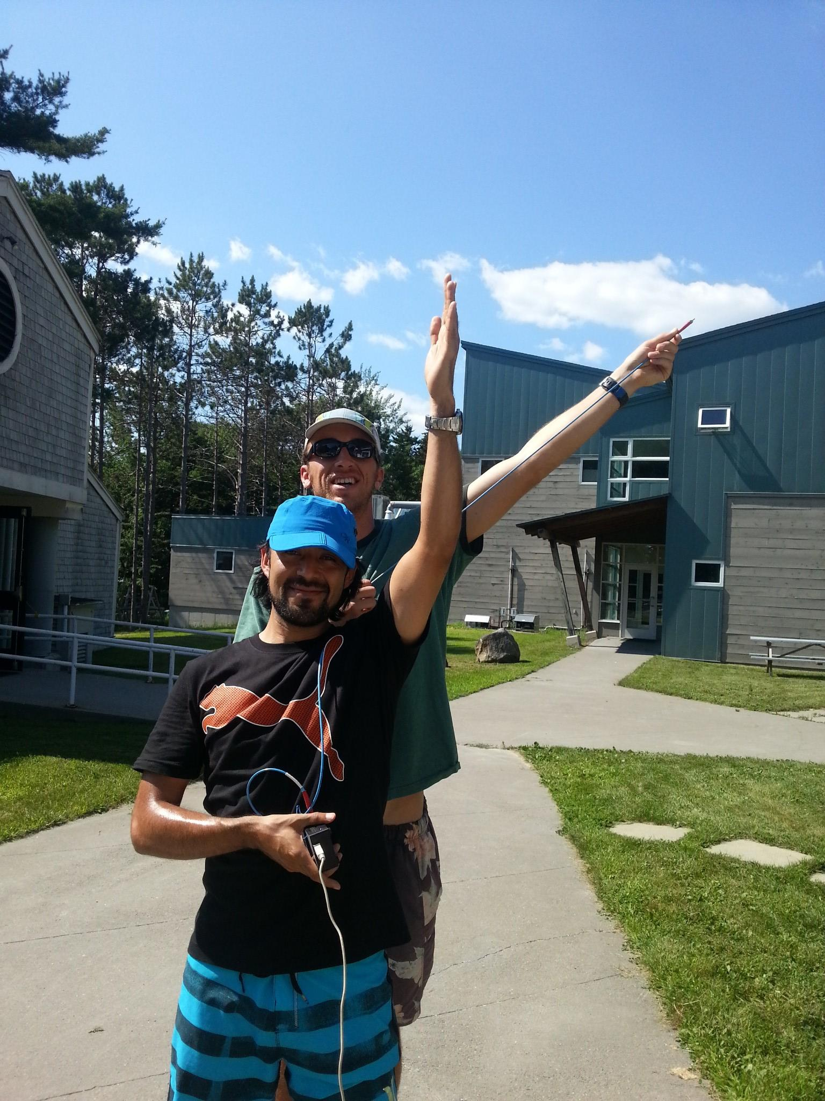
Practical Aspects
Difficult to get full coverage quickly
Very sensitive to noise
Must normalize to integration time
Need horizon views
Must fully understand azimuth and zenith angle definitions
Arm gets tired

Slide 32
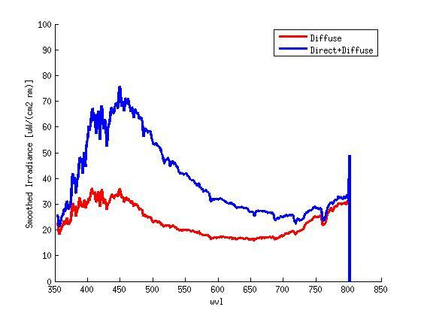
Irradiance
Notes:
Diffuse is with the shadow

Slide 33
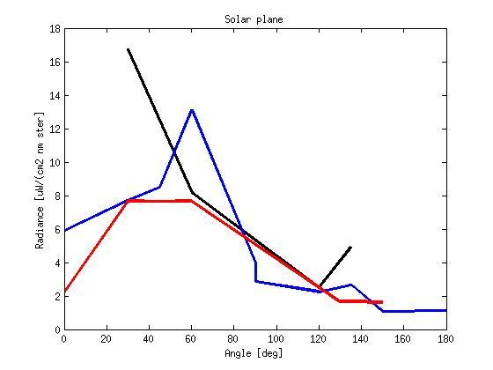
Radiance along Principle Plane
Colors represent different groups

Slide 34
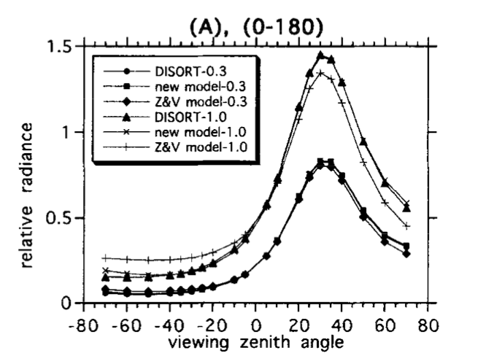
Sky radiance distribution
(Liang and Lewis, 1996)
Figure give a example of simulated sky radiance distribution with solar zenith angle at 30⁰, in the azimuth planes 0⁰-180⁰.
The radiance peak occurs in the solar zenith angle and radiance decreased at both directions away the sun.

Slide 35
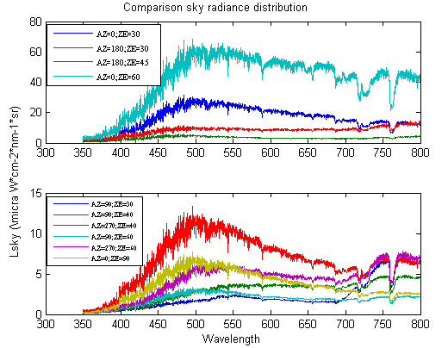
Comparison sky radiance distribution

