Slide 1
‘But beware Mobley’s Law of Conservation of Misery’ Merry Jane Perry
"It is not our fault that nature has made sea surfaces so complicated” (p. 147, Light and Water). Curt Mobley
There is probably no more challenging measurement to make in ocean optics than to accurately measure remote sensing reflectance. It cannot be measured directly, but must be estimated from either underwater or above water sensors.
Group Presentation Maine 16.07.2013

Slide 3
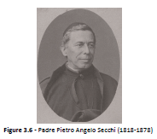
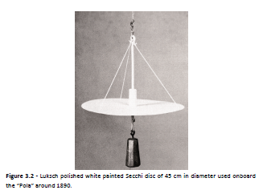
Secchi Disks
Named after Padre Pietro Angelo Secchi
A longstanding optical proxy of sea clarity.
Measurements date
Image Source : Wernand Thesis, 2011

Slide 4
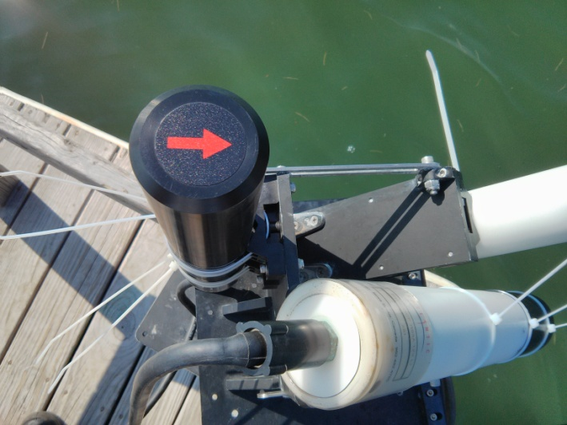
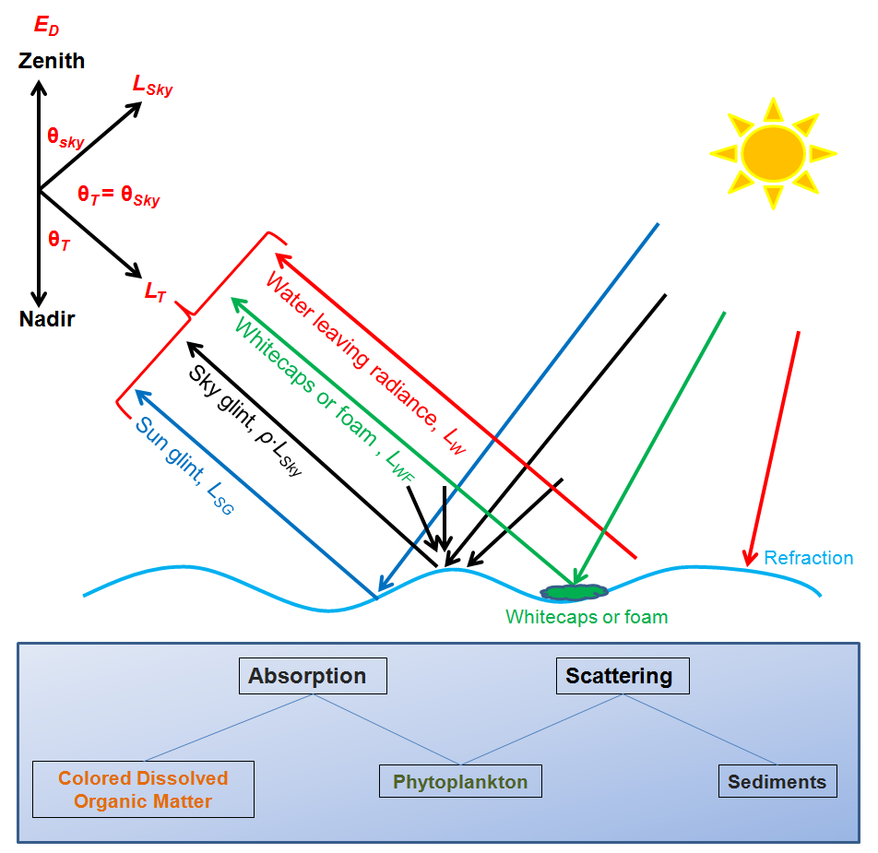
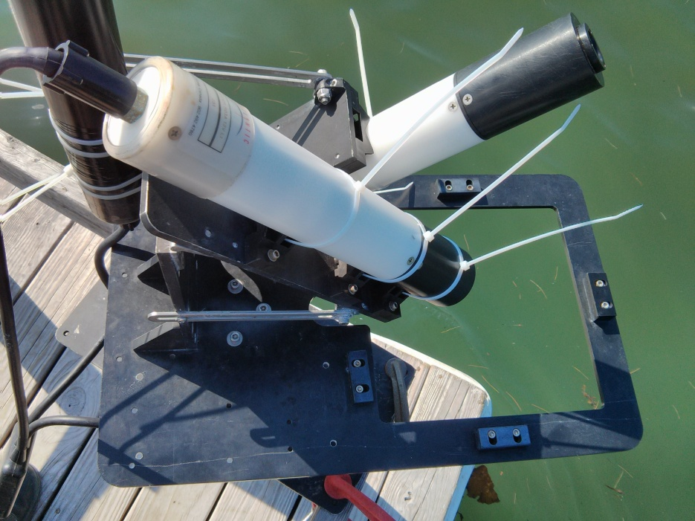
HyperSAS
L_sky = L_T
Re-emission also

