Slide 1
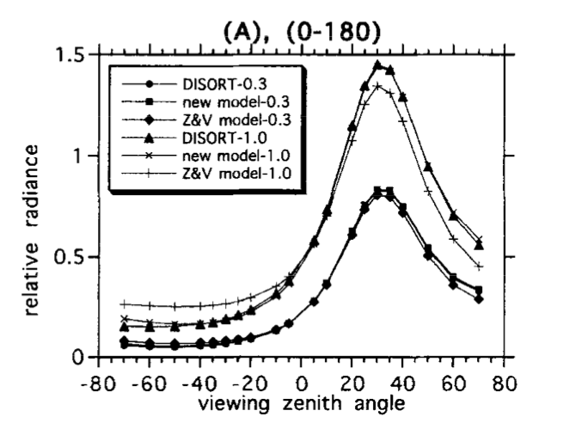
Sky radiance distribution
(Liang and Lewis, 1996)
Figure give a example of simulated sky radiance distribution with solar zenith angle at 30⁰, in the azimuth planes 0⁰-180⁰.
The radiance peak occurs in the solar zenith angle and radiance decreased at both directions away the sun.

Slide 2
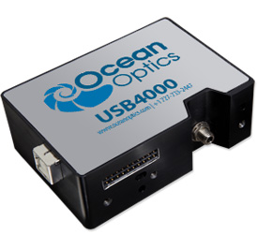
Ocean Optic Spectrometer
Detector range: 200-1100 nm
Integration time: 3.8 ms - 10 seconds
Dark noise: 50 RMS counts

Slide 3
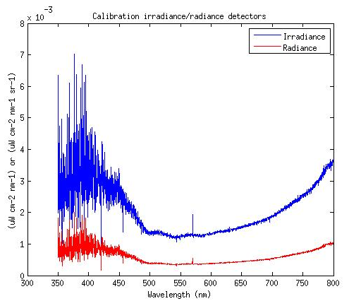
Calibration results
Radiance = Irradiance *R/PI

