Slide 1
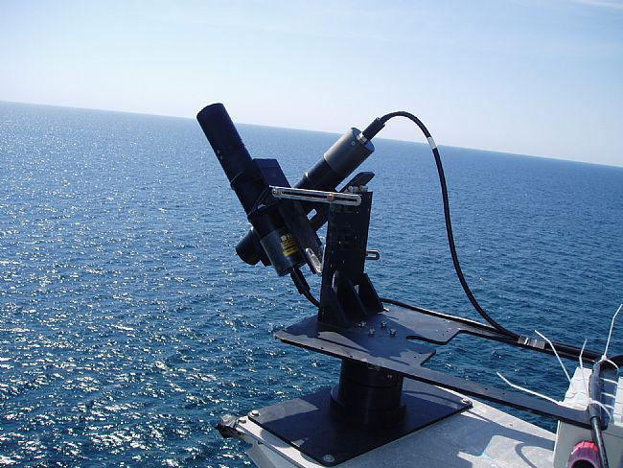
HyperSAS
Measures L_{t} (L_{w} + reflected L_{s}) and L_{s} in a single discreet direction
  Direction and angle between L_{t} and L_{s} measurements can be varied
Also measures E_{d}
R_{RS} can be calculated as R_{RS}=(L_{t}-ρL_{s})/E_{d} where ρ can be estimated.
  ρ estimated as 0.28 in this case

Slide 2
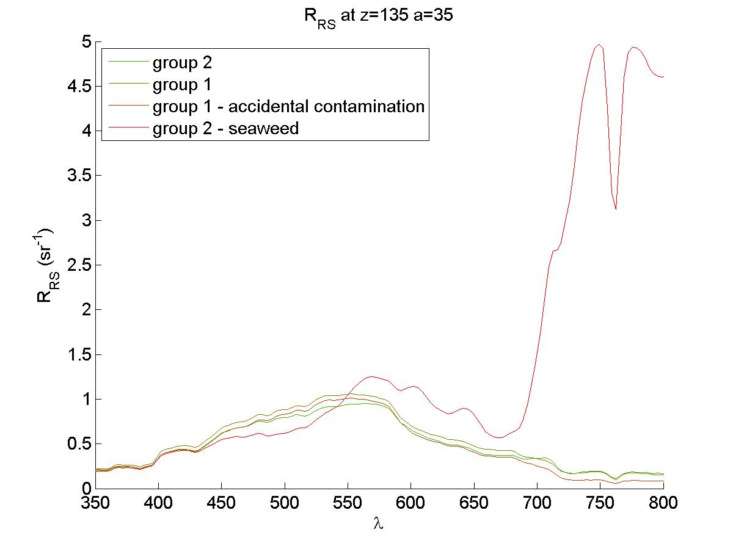
Seaweed in HyperSAS
Group 2 pulled seaweed in front of the HyperSAS to determine its effect on the measurement.
  Intentional contamination showed a clear “red edge” reflectance
Group 1 thought it may have had seaweed contamination on one reading.
  Little effect from accidental contamination in this case

