Slide 1
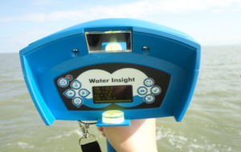
WISP (Water Insight SPectrometer)
Hand-held hyperspectral spectrometer
Provides R_{o (reflectance)}, L_{u}, L_{d}, E_{d}
One vertical (up) spectrometer, 2 spectrometers at 42 degrees
Measures 400 – 800 nm

Slide 2
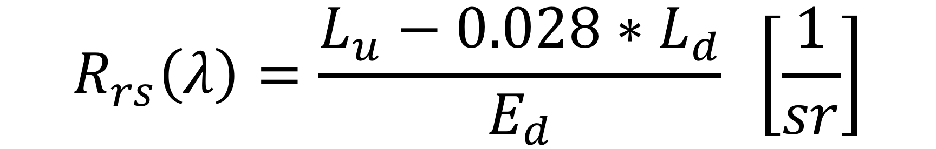
WISP - Calculation

Slide 3
WISP
Issues:
Group 2: Not functioning
Group 1: Lacking proper notes for all samples
Future Suggestions:
Synchronize watch with meter time
Always right down Chl and TSM readings when measuring for later file matching
Meter setting for Rrs export?
Notes:
Little information about reading. Future slides are our best guess at the conditions.
I took notes with some times, angles, and chl values but that was not enough to match all of the data, we had about 20 results and could only match 6 of them based on spectra, some of them we could guess at by what the shape/reflectance values looked like but not enough to say anything about definitive angle

Slide 4
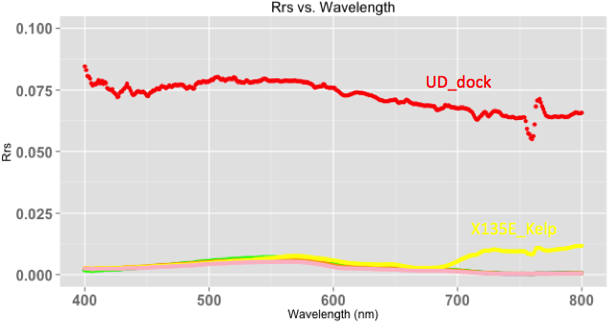
WISP Data*
Sample | Chl (ug/L)
UD-60W | 0.2
Dock | 0
LD-30E | 0.1
LD-135E | 1.3
LD-135E Kelp | 167.5
LD-180 | 0.6
Upper Dock
1/sr
135E Kelp
Dock shows high reflectance, location with kelp shows high reflectance in the 700-800 range, all other samples (including 135E no kelp) show similar trends
Notes:
Only WISP data that we could make sure of the angles and measurements is on this graph, you can see the dock is super high, the kelp deviates from all the other samples

Slide 5
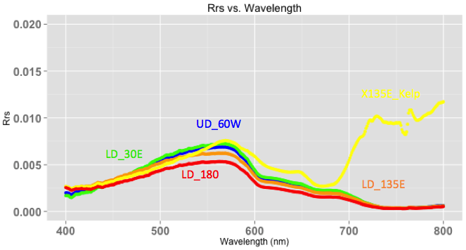
Reflectance Data
Sample | Chl (ug/L)
UD-60W | 0.2
Dock | 0
LD-30E | 0.1
LD-135E | 1.3
LD-135E Kelp | 167.5
LD-180 | 0.6
1/sr
135E Kelp
UD = upper dock, Ld = lower dock
All angles are from 0 degrees = sun
Notes:
This shows the bottom half of the last graph in more detail, you can see the variation in the kelp sample versus the rest (interesting shape in the higher wavelengths), most other chlorophyll values are much lower

Slide 6
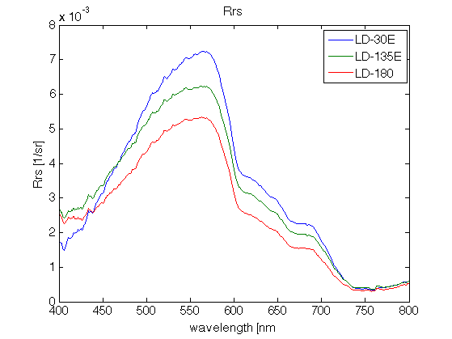
Lower Dock Only
Sample | Chl (ug/L)
LD-30E | 0.1
LD-135E | 1.3
LD-180 | 0.6
ReflectanceIncreases
Angle Increases
Notes:
Highest reflectance is at 30

Slide 7
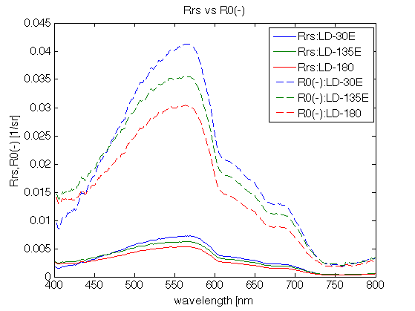
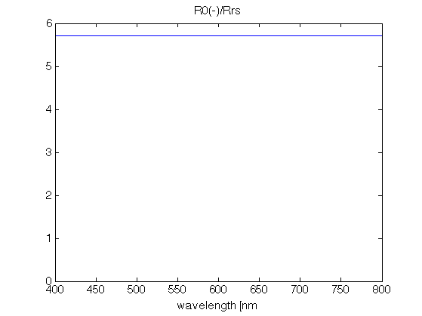
From R_{rs} to R^{w}
Notes:
solid lines are calculated from Lu Ld Ed given by instrument; dotted lines are Ro value that the machine gives
You have to convert the values given to get at Rrs, there’s some weird conversion. Maybe we can set up the meter to do this for us???

Slide 8
From R_{rs} to R^{w}

