Slide 1





Spec Calibration
E: Irradiance
L: Radiance
M: Measurement
D: Dark
B: Bulb measurement
T: Integration time
We normalized measurements by integration time.

Slide 2
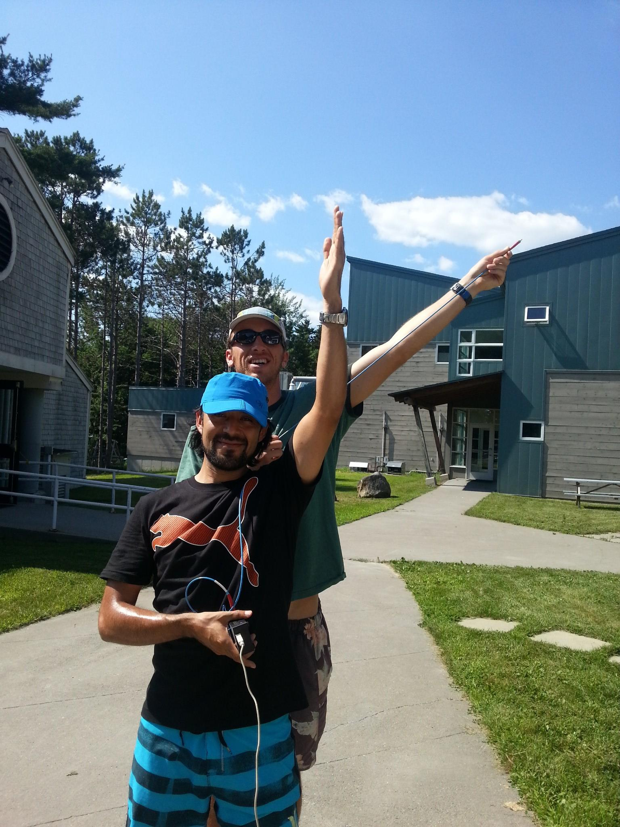
Practical Aspects
Difficult to get full coverage quickly.
Very sensitive to noise.
Must normalize to integration time.
Need horizon views.
Must fully understand azimuth and zenith angle definitions
Arm gets tired

