Slide 1
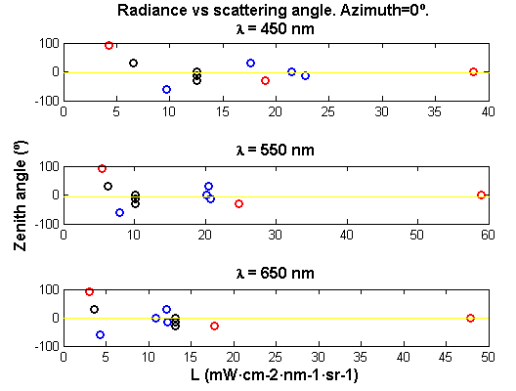
Part b.e.) Radiance vs scattering angle from the sun
Sun position
Sun position
Sun position

