Slide 1
Radiometry Lab
Continued analysis
Group Presentation, July 17, 2013

Slide 2
HyperPro Data
Derived K_{Lu} with R_{rs} measured by Lee’s method

Slide 3

K_{Lu} estimate from Lee Method Hyperpro casts
Equation for Immersion Method correction
where
k_{LU} inversion from Lee Method for estimating T:
Solve for k_{LU ,} given z=.1 m and assuming that changes in z are negligible over the top .1 m from the surface

Slide 4
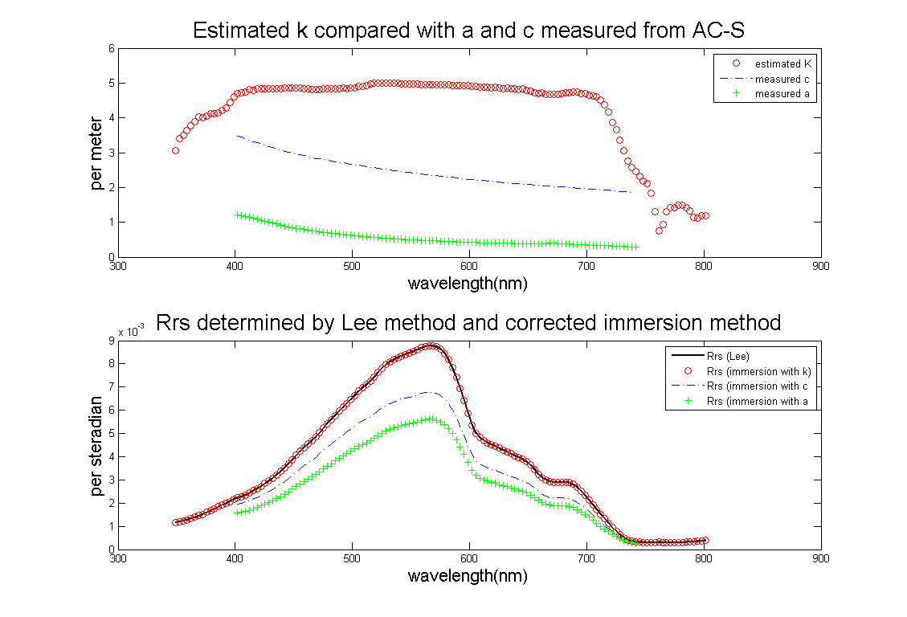
K_{Lu} estimate from Lee Method Hyperpro casts
Notes:
We calculated K by setting the Rrs(Lee) = Rrs(Immersion)
K has less spectral variation than c and a – which implies its proportionality to b (scatter), which mechanistically makes sense for upwelling light
The calculated K is out of the original bounds that we had assigned to its estimation, since it is higher than the measured values of c.
However, this could be explained by variation in the local water content with tidal cycle, since it is an estuary and is inherently ephemeral.
Or – the use of the Lee method to estimate K could be invalid.
Or…. (next slide)

Slide 5
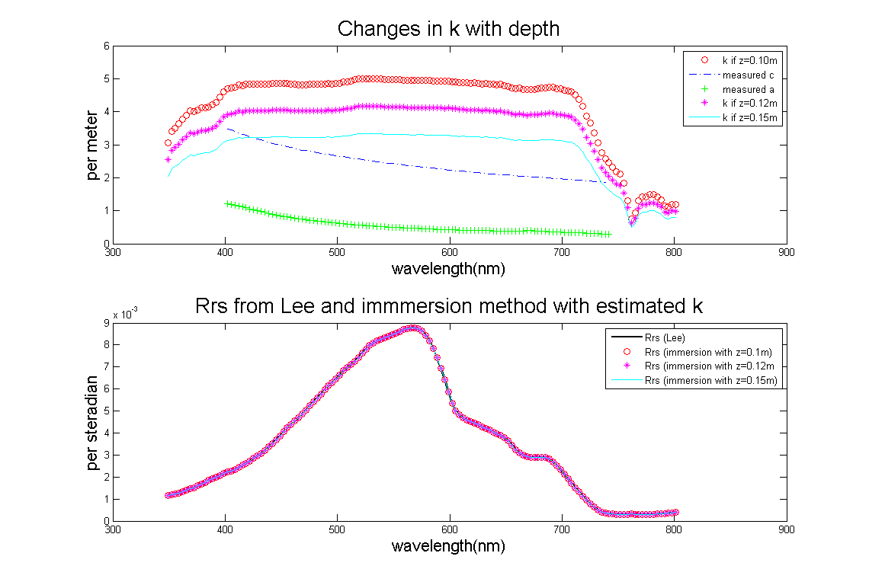
K_{Lu} estimate from Lee Method Hyperpro casts
Notes:
Calculation of k is very sensitive to the measured depth of the sensor.
If the sensor was slightly heavy and was 15cm deep instead of 10cm, K would fall near the measured c from last week.
This error would not affect the calculated Rrs measurement, however, since the K is being calculated to make the Rrs curves agree.

Slide 6
HyperPro Data
PAR derived from Ed sensor

Slide 7
PAR Values from Ed
 | PAR (μmol photons/m²/s)
 | Lee Method |  |  | Immersion Method
 | HyperPro | SeaWiFS | Ratio | HyperPro | SeaWiFS | Ratio
Rotated | 984.88 | 865.85 | 0.879 | 1298.4 | 1139.1 | 0.877
Off dock | 876.07 | 771.11 | 0.880 | - | - | -
Upriver | 1072.3 | 942.31 | 0.878 | 1290.1 | 1131.6 | 0.877
Downriver | 942.99 | 828.96 | 0.879 | 873.82 | 769.47 | 0.880
Into sun | 985.57 | 865.85 | 0.878 | 1437.6 | 1260.0 | 0.876
Spectral resolution affects the derived PAR. However, PAR calculated from SeaWiFS bands always have a ratio ~ 0.88 over PAR from HyperPro Ed.
PAR varies, which is explained at next slide.

Slide 8
Why PAR varies?
PAR values generally decrease with increased sun zenith angle. During 1-hour, PAR almost drops 50%.
There is an outlier (I think), which may be due to cloud.

Slide 9
WISP Data

Slide 10
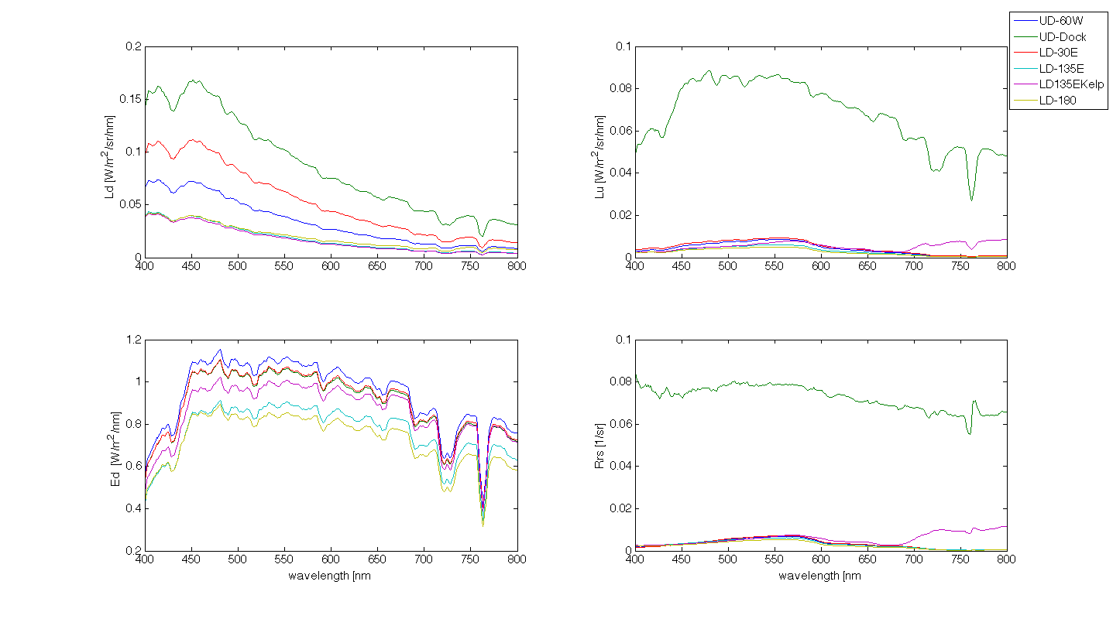
WISP
Notes:
All the correct curves

Slide 11
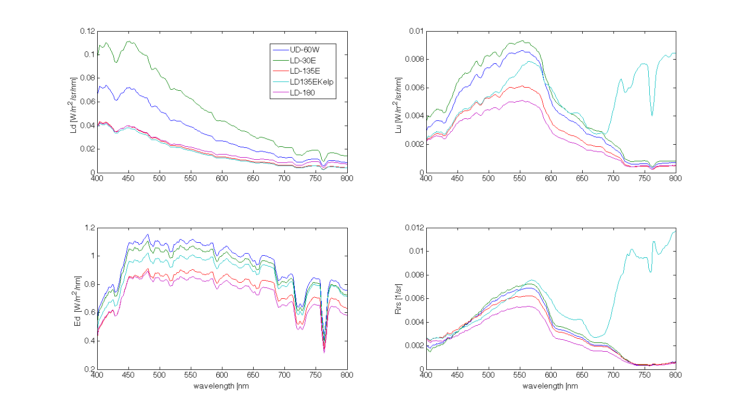
WISP
Notes:
All correct curves without Dock

Slide 12
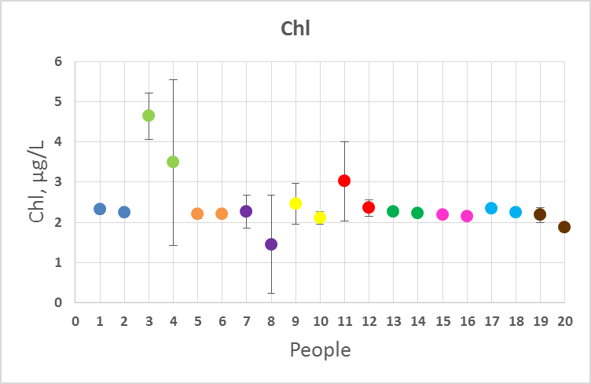
Previous Fluourometer Data (Samples Taken Off Side of Lower Dock, Friday)
WISP Data (Monday)
Sample | Chl (ug/L) | Estimated Chl (ug/L)*
UD-60W | 0.2 | 1.54
Dock | 0 | -
LD-30E | 0.1 | 1.39
LD-135E | 1.3 | 2.91
LD-135E Kelp | 167.5 | -
LD-180 | 0.6 | 2.27
* Estimated Chl from R_{rs}(λ) using model developed for lakes by Linhai Li et al. (RSE, 2013). The estimated values fit our lab measurements much better.
Chl estimation may subject to errors due to different measurement geometries.
Notes:
Comparing what we saw with the flourometer data on one day and the WISP on another. Not directly comparable because the days were different (could have different conditions). WISP values look a little low

Slide 13
Cross-instrument Comparison

Slide 14
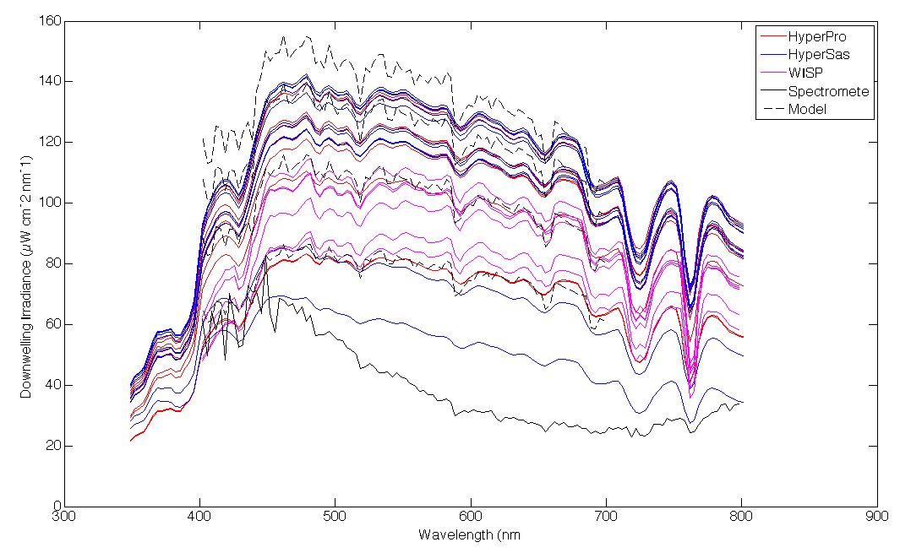
Cross-instrument comparison for E_{d}
Model from Gregg and Carder 1990
Notes:
Model lines are dashed black and represent (from the top) 1-4pm every hour.
Measured one’s low and flat because of the buildings and trees of the surroundings. radiometer

Slide 15
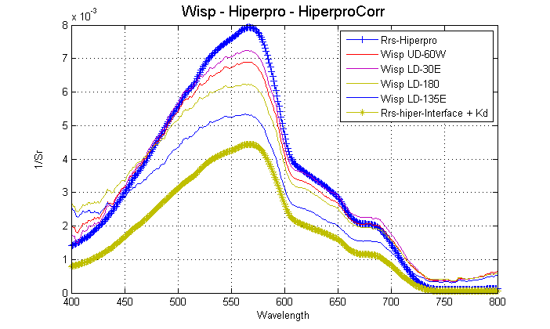

Slide 16
Radiometer Calibration and Sky Radiance

Slide 17
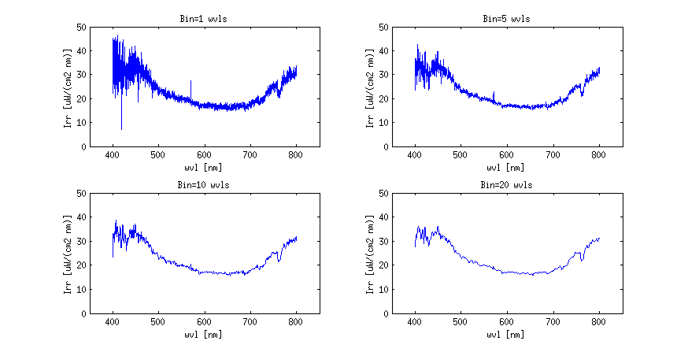
Ocean optics Radiometer
Data Smoothing

Slide 18
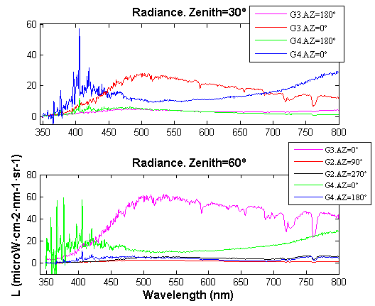
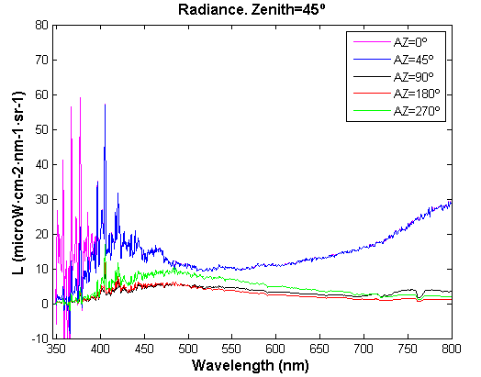
How homogeneous is the sky radiance distribution?

Slide 19
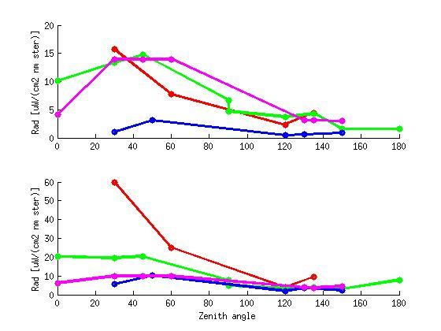
Angular distribution of sky radiance along the principle plane
412 nm
555 nm

Slide 20
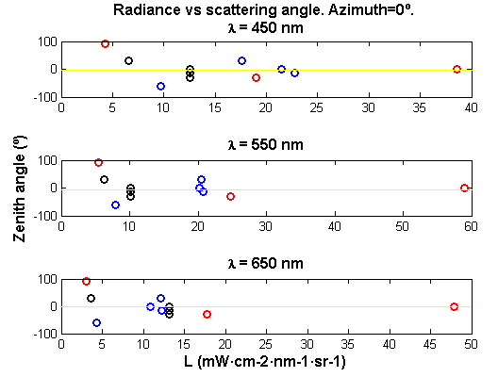

Radiance vs scattering angle from the sun
Sun position
Sun position
Sun position

Slide 21
Thank you!

