Slide 1
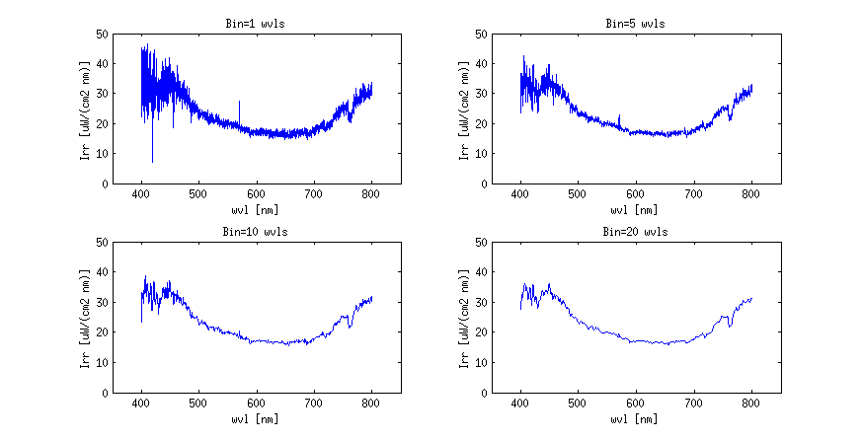
Smoothing

Slide 2
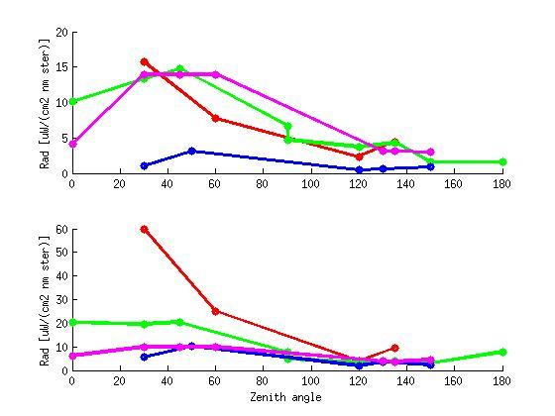
Principle Plane
412 nm
555 nm

