Slide 1
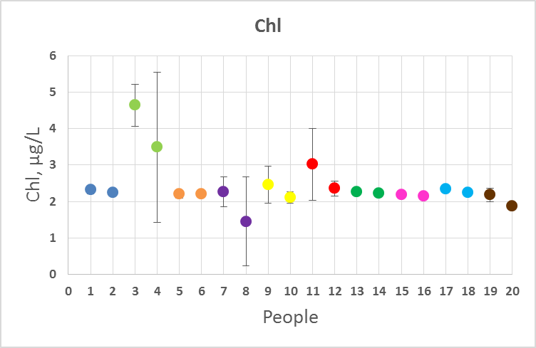
Previous Fluourometer Data (Samples Taken Off Side of Lower Dock, Friday)
WISP Data (Monday)
Sample | Chl (ug/L)
UD-60W | 0.2
Dock | 0
LD-30E | 0.1
LD-135E | 1.3
LD-135E Kelp | 167.5
LD-180 | 0.6
Notes:
Comparing what we saw with the flourometer data on one day and the WISP on another. Not directly comparable because the days were different (could have different conditions). WISP values look a little low

