Slide 1
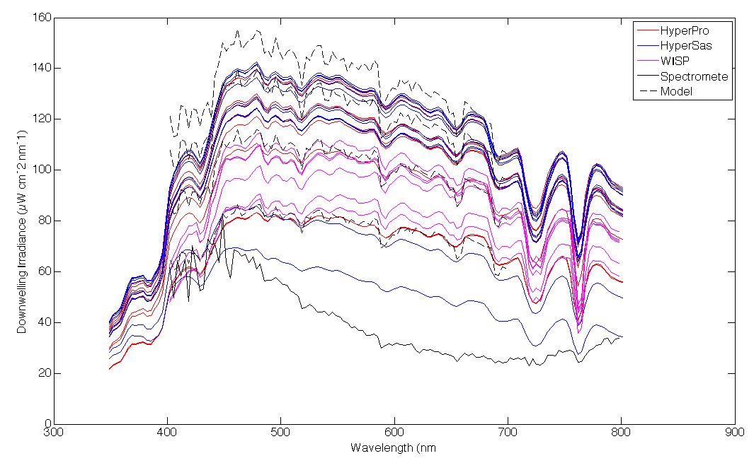
Cross-instrument comparison for E_{d}
Model from Gregg and Carder 1990
Notes:
Model lines are dashed black and represent (from the top) 1-4pm every hour.
Measured one’s low and flat because of the buildings and trees of the surroundings. radiometer

