Slide 1
R_{rs} Dependence on Sun Zenith
Rrs as seen from 40˚, 135˚ viewing angle
Small variations in Rrs with sun zenith angle (assume Rrs is calculated exactly..?)

Slide 2
R_{rs} Dependence on Sun Zenith
The change in Rrs must be due to viewing the VSF at different angles drops off at >60˚ due to less light enter the water at high angles.

Slide 3
Rho Dependence on Sun Zenith
A rho of 0.28 appears to be a good approximation unless the sun is directly overhead. Rho also becomes spectrally dependent at small zenith angles.

Slide 4
Phase Functions
From Lab 4
Arizona Dust – 40-30 um
Platymonas – 16-30 um
Chaetoceros – 7-10 um (chains)
DRE - ????

Slide 5
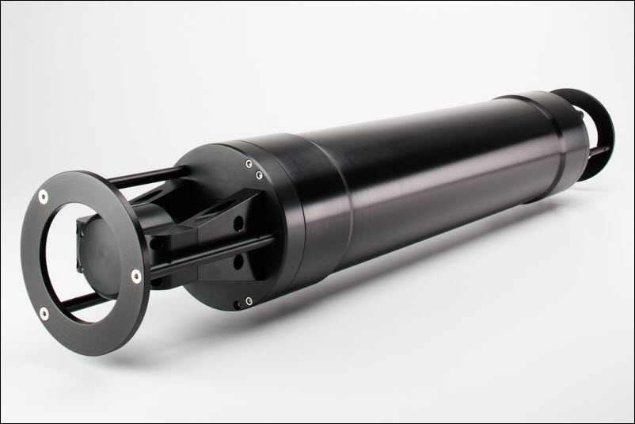
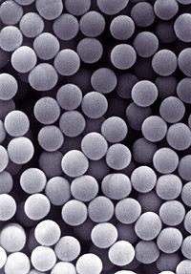
LISST, Eco VSF, Mie Theory
Fit phase function to LISST and VFS measurements of bead mixtures (and well characterized culture? Coccolithophores?).
Compare the phase function to the predicted function calculated using Mie theory.
Video for explaining the calibration, data collection, deployment, data analysis of LISST.

