Slide 2
Unbiased Percent Difference
Unbiased percent difference UPD (Hooker et al., 2002)
where X represents the ocean color product for λ at any discrete wavelength and t is neglected for Hydrolight
The spectral average UPD for N bands or items by summing and weighing equation [1].
..................[1]
.....................................[2]

Slide 3
Exercise 1
a [1/m] 0.01 0.1 1
b [1/m] 0.04 0.4 4
Optical depth 400 40 4
Kfunction 100 10 1
Time was same

Slide 4
Exercise 2
a [1/m] 0.24 0.3 0.36
b [1/m] 1 1 1
UPD Compare 0.3 and 0.24
Depth Lu Ed Lu/Ed
10 90 68 25
50 191 189 25
UPD Compare 0.3 and 0.36
Depth Lu Ed Lu/Ed
10 85 68 20
50 190 188 20

Slide 5
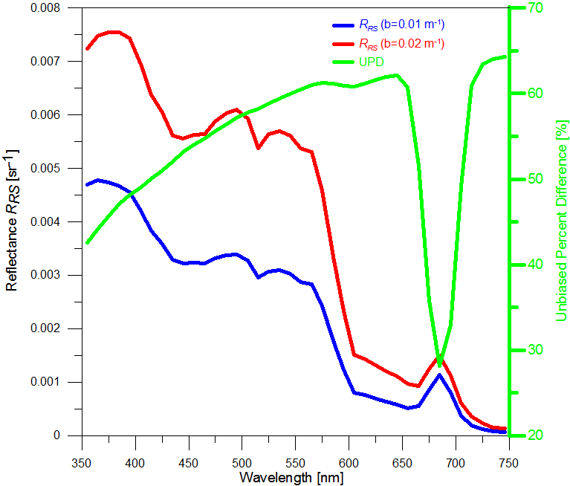
Exercise 3

Slide 6
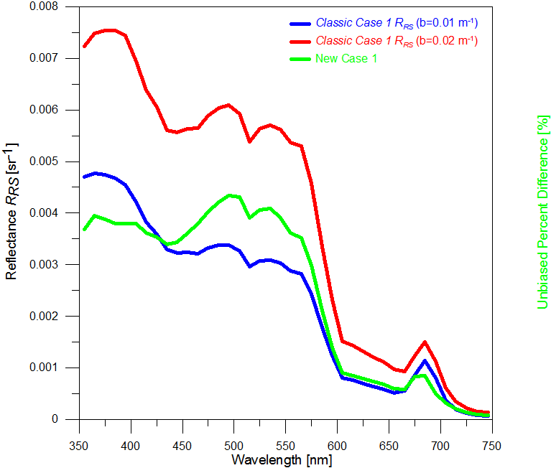
Exercise 4

