Slide 1
Lab 9
Hydrolight and Ecolight

Slide 2
Ex. 1: Inputing measured Chl(z) data

Slide 3
Ex. 2: inputting IOPs from a, c, and b_{b} sensors

Slide 4
Ex. 3: simulating Case 2 water
Increased mineral concentration increases Rrs in the 550nm wavelengths.

Slide 5
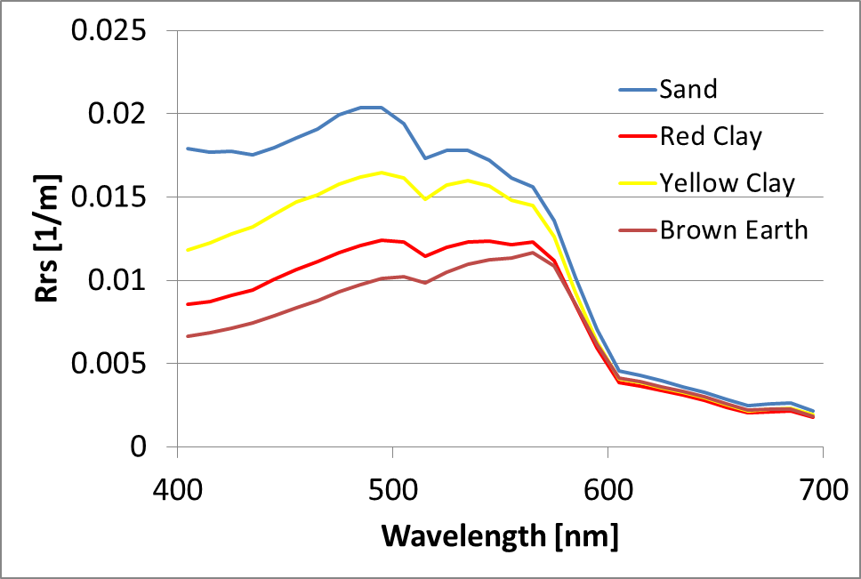
Ex. 3: simulating Case 2 water
Influence of the mineral composition on the Rrs
Notes:
Mineral concentration = 1 gm/m3

Slide 6
Ex. 4: simulating optically shallow water

Slide 8
Ex. 5: Hydrolight User Support
Customer complained about bad Rrs curve
Supplied AC9 input file
Obviously bad data existed in file
Uncorrected customer curve did not match curve customer reported
Did the customer even use his own bad data?

Slide 9
Ex. 5: Apparently Not
Notes:
There were obvious problems with the input data, but that didn’t explain what the user saw. The user appears to have used the example AC data rather than their own. Oops. Taking out the obviously bad AC data yields what looks like a pretty good Rrs curve. Booyah.

Slide 10
Playing with our own data…
Measurements and Hydrolight comparison

Slide 11
Predicted vs. Measured R_{rs}
HydroLight Input:
Parameter | Value | Instrument | Date
Absorption (a) | 0.8 – 0.0 m⁻¹ | ACS | 7/10
Attenuation (c) | 4.0 – 2.0 m⁻¹ | ACS | 7/10
b_{b}/b | 0.01 | BB9 & AC9 | 7/11
Chlorophyll | 2.3 mg/m³ | Extraction method | 7/12
CDOM | Variable | ACS with Filter | 7/10
Depth | 5 meters | Guess | -
a* | Curt’s File (astarchl) | - | -
Clouds | 10% | Eye | 7/15
Bottom Type | Dark Sediment | Guess | -
Wind Speed | 2.0 m | Guess | 7/15

Slide 12
Predicted vs. Measured R_{rs}
Reasonable, given that measurements were taken over a week long period (not ready to ask for my money back yet).
Captures the high absorption of CDOM in the blue, something not capture by the case 1 models.

