Slide 1
Lab 9
Hydrolight and Ecolight

Slide 2
Q1. Imputing measured Chl(z) data

Slide 3
Different models gave us various Rrs

Slide 4
Percent cloud coverage impacts Ed.

Slide 5
Kd (1/m)
Depth (m)
Cloud has no effects on Kd.
At wavelength of 445nm and 555nm, Kd has a similar trend as Chl conc.
Notes:
Chl drives kd
Kd = dowelling irradiance diffuse attenuation coefficent
At different wavelengths, kd changes differently with depth but cloud cover has no effect at any wavelength

Slide 6
Cloud coverage has no effect on Rrs.
But we had a outlier in our model output.

Slide 7
μ_{d}
Depth (m)
As cloud coverage increases, μ_{d} decreases.
Multiple scattering events cause μ_{d} to approach 0.5 with increasing depth.
Notes:
.5 is isotropic
Lower wavelengths decrease to .7 and higher wavelengths decrease to .5

Slide 8
Q2. Import IOPs
a
b
Notes:
The same Chlzdata file from Question 1 was run, using: 1. Custom IOPs from the ac9 data/Hydroscat data files. 2. The IOPs assumed from the New Case 1 Model. This shows what the total “absorption” and “scattering” coefficients look like – the differences in these shapes would propagate through any further calculations done based on “a” and “b” values, so choosing the right initial values are important. The next slides show a Case study, where measured IOPs determined from last week’s data collection were entered in place of the ac9/hydroscat data files.

Slide 9
Predicted vs. Measured R_{rs}
HydroLight Input:
Parameter | Value | Instrument | Date
Absorption (a) | 0.8 – 0.0 m⁻¹ | ACS | 7/10
Attenuation (c) | 4.0 – 2.0 m⁻¹ | ACS | 7/10
b_{b}/b | 0.01 | BB9 & AC9 | 7/11
Chlorophyll | 2.3 mg/m³ | Extraction method | 7/12
CDOM | Variable | ACS with Filter | 7/10
Depth | 5 meters | Guess | -
a* | Curt’s File (astarchl) | - | -
Clouds | 10% | Eye | 7/15
Bottom Type | Dark Sediment | Guess | -
Wind Speed | 2.0 m | Guess | 7/15

Slide 10
Predicted vs. Measured R_{rs}
Reasonable, given that measurements were taken over a week long period (not ready to ask for my money back yet).
Captures the high absorption of CDOM in the blue, something not capture by the case 1 models.
Notes:
Hydrolight with customed IOPs
Not case 1 waters

Slide 11
Q3. IOP Case 2 water model
Influence of the mineral concentration on the R_{rs}
R_{rs} increases with the mineral concentration
Notes:
Same shapes. higher difference between the curves around 550 nm in the green wavelengths.
CDOM is a function of Chl concentration (1 mg/m3).
We jsut change the mineral concentration from 0 to 10 mg/m3.
Absorption of CDOM in the blue, Chl in the blue and red wavelengths.
Increased scattering in the green light.

Slide 12
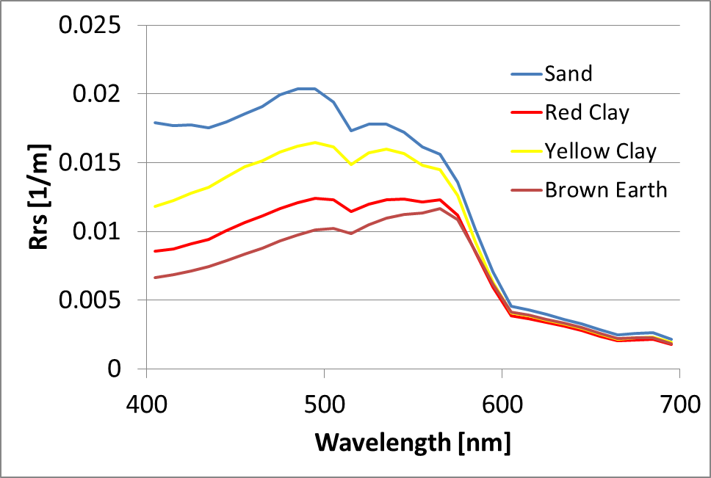
Q3. IOP Case 2 water model
Influence of the mineral composition on the R_{rs}
Notes:
Mineral concentration = 1 gm/m3
Rrs depends on the mineral concentration and composition.

Slide 13
Q4. simulating optically shallow water
Influence of the bottom reflectance on the R_{rs}
Bahamas - Coral sand bottom
Higher R_{rs} for shallower bottoms
Notes:
Ac9 data from the Bahamas.
Sand coral bottom.
Infinitly deep water down to 30m.
It seems that the Rrs curve is becoming flat from 30m with an infinite depth.

Slide 14
Influence of the bottom reflectance on two K functions
Notes:
Klu = upwelled radiance; Kd = downwelling irradiance
Klu: These curves are decreasing with depth and then they follow an asymptote near the bottom because we have high reflectance coming from the white sand bottom. It:s brighter (measurement of the Lu).
Kd: Lots of light coming from shallow bottoms. The upwelled radiance is high.
The Kd is increasing with the depth for the different curves because the downwelled irradiance is decreasing with depth. But when you reach the bottom you can see that Kd is decreasing. We thought it could be due to the reflectance from the white sand bottom, and the light could be diffused near the bottom.
Kd: reflectance of the bottom for the shallow depth.

Slide 15
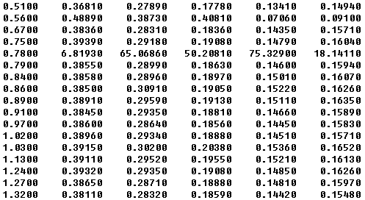
Q5 - hydrolight support user 2 hypotheses: Problems caused by wrong backscatter number or data input Backscatter changes don’t appear to help drop the hydrolight curve Editing out the anomalous data line appears to create the desired shape
Notes:
Customer complained about bad Rrs curve. Ac9 data from the Indian ocean.
We tried to change the backscatter fractions but we did’nt get the good curves didn’t match original data.
Then we looked at the file and we found bad data so we removed them. And the new curve was fitting well the hydrolight curve.

Slide 16
Did the customer even use his own bad data?
Notes:
Blue = in situ data
Red = ac9 data file in the example folder provided with hydrolight. Almost the same curve that he get with the hydrolight.
Green = good hydrolight output that he would get if he used the good ac9 data file.
The red curve is the curve that he got with the hydrolight and which is not matching the blue curve for the measured data. It seems that he used the ac9 file in the example folder provided with the hydrolight software.
The green curve is for the good ac9 data of the user without the bad data that you saw in the previous slide.
There were obvious problems with the input data, but that didn’t explain what the user saw. The user appears to have used the example AC data rather than their own. Taking out the obviously bad AC data yields what looks like a good Rrs curve.

