Slide 1
The link between particle properties (size, packaging, composition, shape, internal structure) and their IOPs.
In order for us to be able to use optical measurements to study oceanic particles (and dissolved materials) we need to develop an understanding of how light interacts with matter.
Corollary: If optical properties of particles did not vary for different particles it would be useless for us to use them as a tool to study particles.

Slide 2
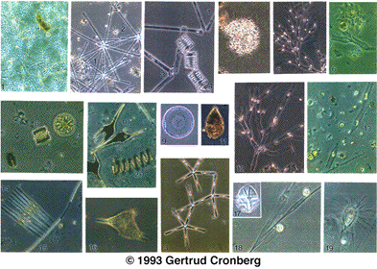
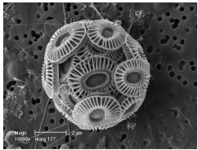
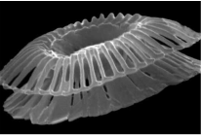
What particles scatter/absorb in the ocean?
Phytoplankton:
Variable in shape, size and pigment composition.
→ Variable in scattering and absorption properties

Slide 3
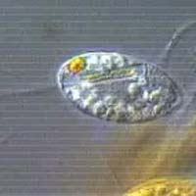
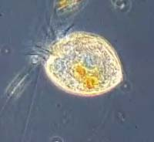
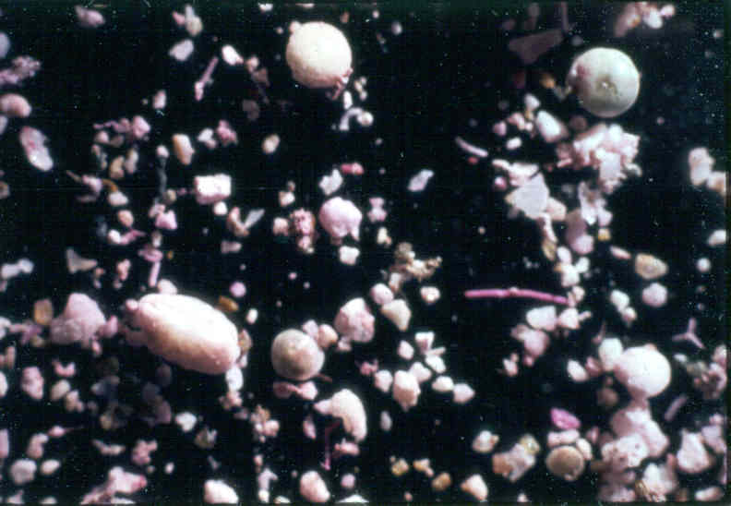
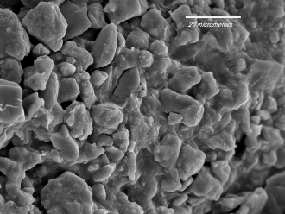
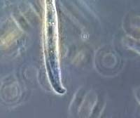
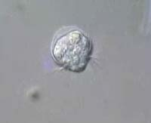
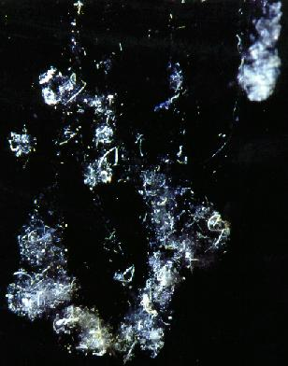
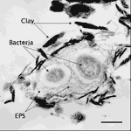
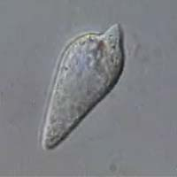
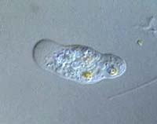
What particles scatter/absorb in the ocean?
Non-algal particles: Organic and inorganic.
Sand
Silt
clay
Aggregates:
Variable in scattering and absorption properties
http://www.aad.gov.au/default.asp

Slide 4
Size – characteristic length scale of particle (e.g. ∝ Volume^{1/3})
composition – characterized by the bulk index of refraction of the particle. How different is it from water?
Shape – departure from sphere – macro/ how smooth –micro (cocolithophores).
internal structure – inhomogeneities within the particle.
‘Packaging’ – How ‘solid’ is the particle. Ratio of interstitial water volume to total volume.

Slide 5
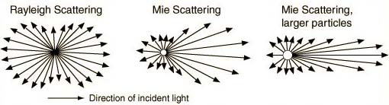
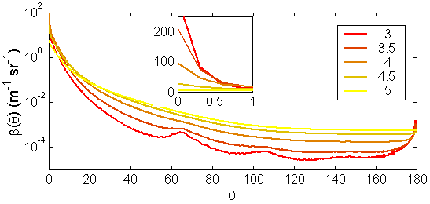
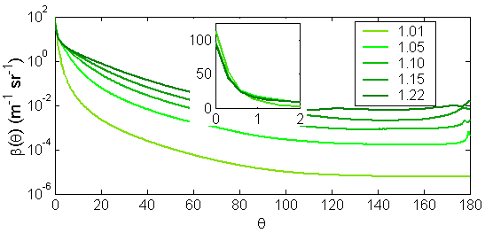
Angular dependence of scattering on size
‘large’
Near forward scattering: Strong dependence on size, less on n.
b_{b}/b: Strong dependence on n, less on size.
‘small’
Roesler and Boss, 2008

Slide 6
Spectral c_{p}
(1) Assuming a power-law particle size distribution
→ c_{p}(λ) is described well as a power law function of wavelength (λ)
c_{p}(λ) ~ λ^{-γ}
N(D) ~ D^{-ξ}
γ ≈ ξ - 3
log N(D)
→ Flatter beam attenuation spectra (small γ) implies flatter particle size distribution (small ξ)
log D
(2) Assuming spherical non-absorbing particles
e.g. Diehl and Haardt 1980, Boss et al 2001

Slide 7
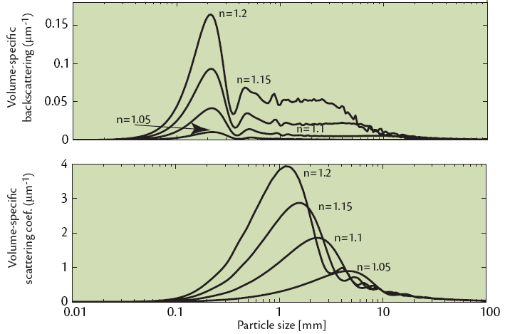
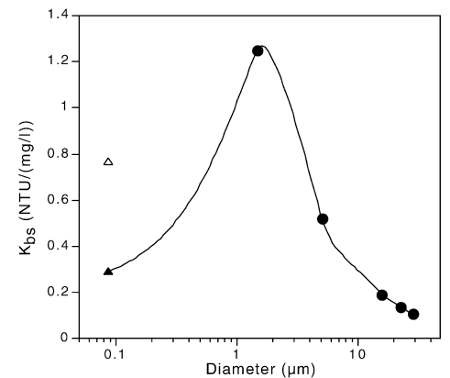
Relationship between optical properties size
b_{bp}/Volume
b_{p}/Volume
Instruments are consistent:
D³
1/D
All curves are ‘resonant’ curves
Highest sensitivity for micron sized particles
Size of max response varies
b_{sp}/Mass

Slide 8
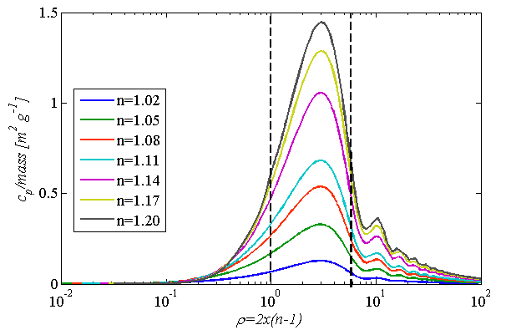
Normalization ‘simplifies’ things
Scattering tends to have a ‘similar’ dependence for similar ρ≡(n-1)D/λ not D!

Slide 9
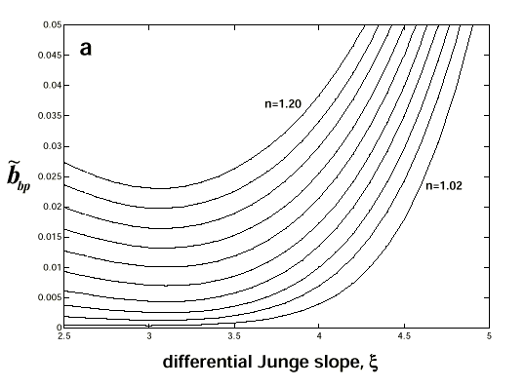
Backscattering ratio- sensitivity to composition and size
backscattering ratio depends on:
Index of refraction (n)
Slope of PSD (ξ)
Twardowski et al., 2001

Slide 10
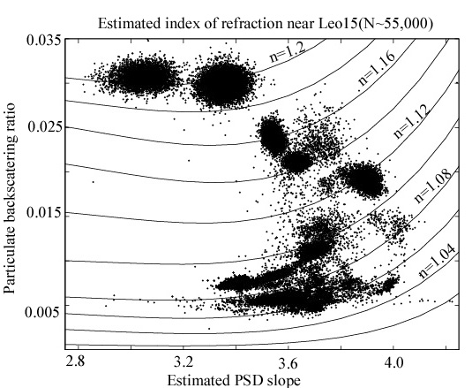
Backscattering ratio (55,000 observations from NJ shelf): consistent with theoretical prediction.
Varies from: phytoplankton → inorganic particles.

Slide 11
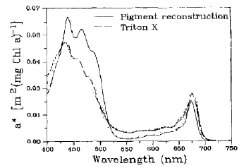
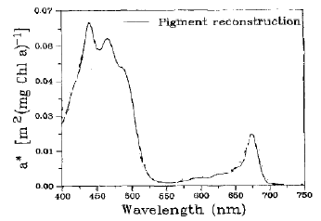
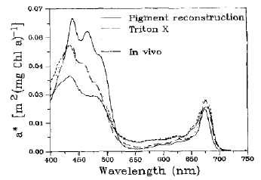
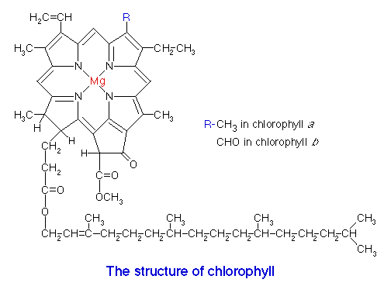


a_{φ} vs Chlorophyll
Size effect on absorption – pigment packaging
Sosik & Mitchell 1991
http://chaitanya1.wordpress.com/2007/07/09/strawberries/
chloroplast
chlorophyll
cell
Packaging: a*=a/[chl] is function of size and [chl].
Same is true for other pigments. Duysens (1956)

Slide 12

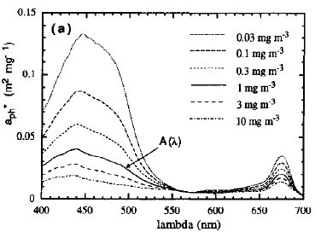
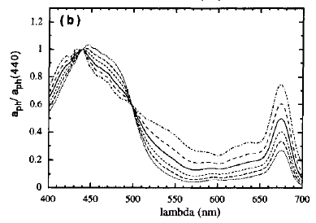
Large, more packaged cells, tend to occur where [chl] is higher.
‘Mean’ a_{φ} as function of [chl]
Bricaud et al., 1995

Slide 13
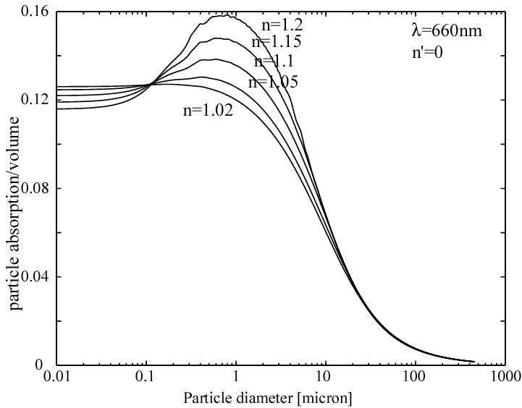
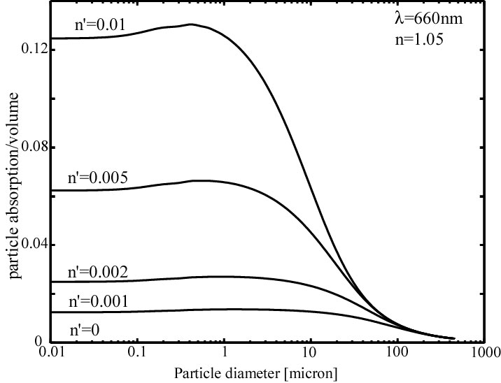
Dependence of IOP on properties of particles
a/V= σ_{abs}·1/{1.33πr³}
n’=0.01
n’=a_{pure}λ/4π
‘Packaging’
C_{abs} = area→
a/V ∝ 1/D
Molecular absorption ∝ volume.

Slide 14
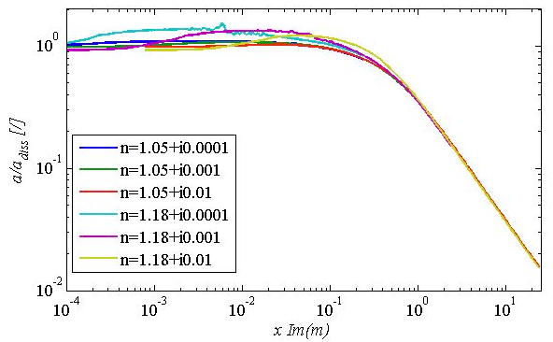
Normalization ‘simplifies’ things
a_{diss}≡4πIm(m)/λ

Slide 15
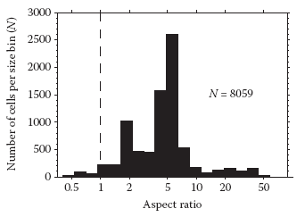
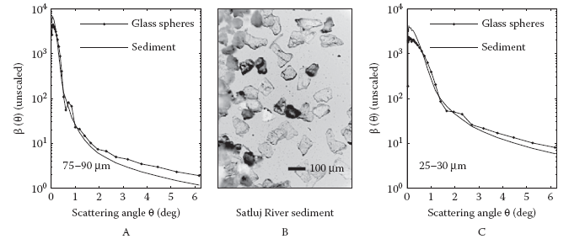
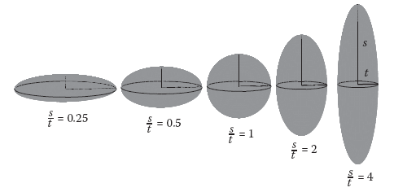
Shape consideration
Clavano et al., 2007

Slide 16
Shape approximations for light scattering calculations
Mie-Theory
T-matrix
Moderate Axis ratios (0.5<AR<2)
10
oblate
2
Size limit
1
Axis ratio
0.5
T-matrix
Axis ratios up to convergence limit
0.1
prolate
0.1
1
10
Particle radius (μm)
Slide From Volten

Slide 17
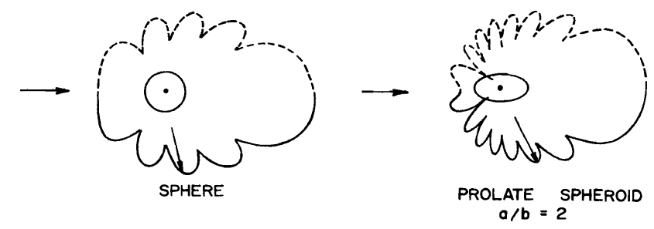

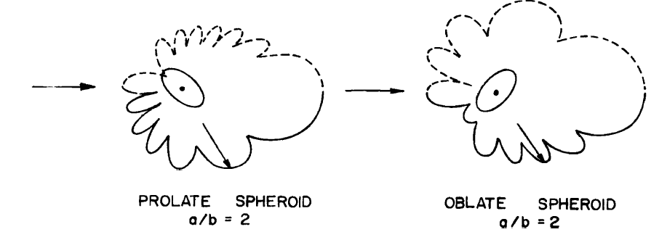

Slide 18
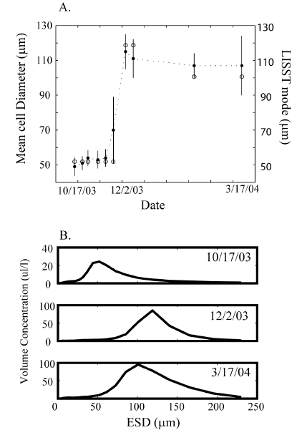
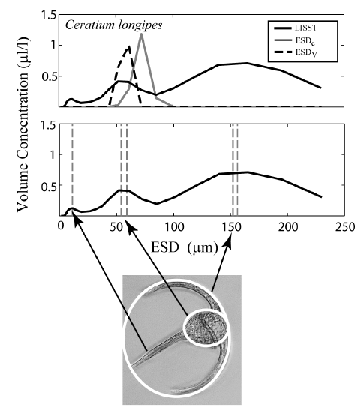
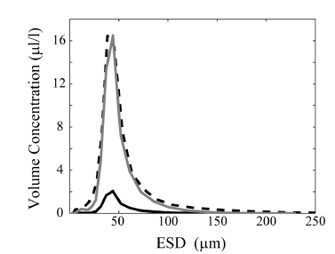
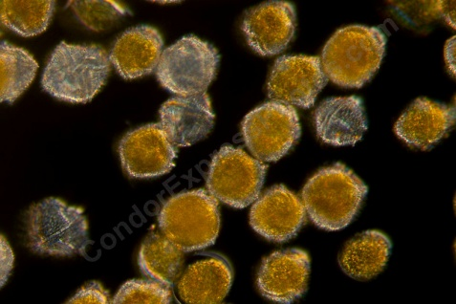
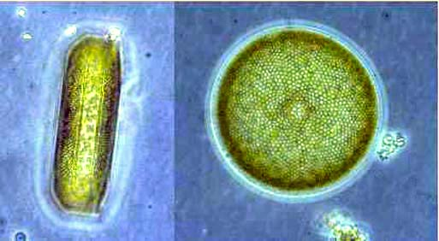
Karp-Boss et al., 2007

Slide 19
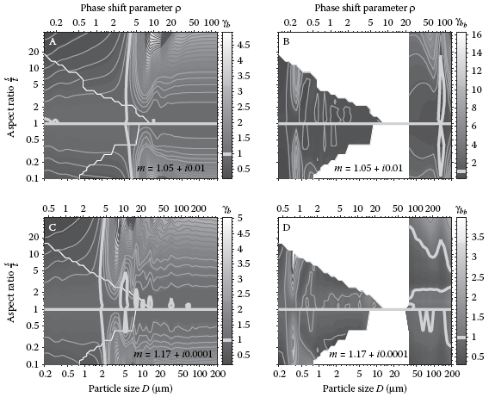
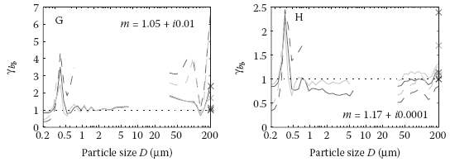

Quantifying differences due to shape:
Clavano et al., 2007

Slide 20
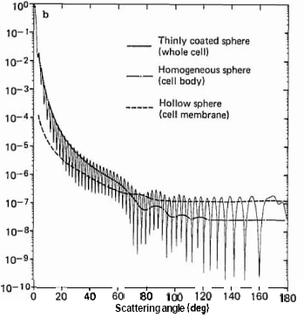
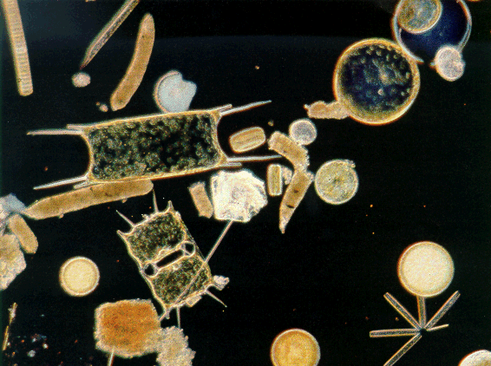
Internal structure:
Relative intensity
Backscattering dominated by membrane.
Meyer, 1979

Slide 21
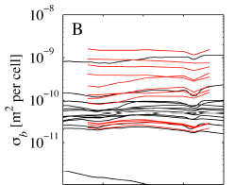
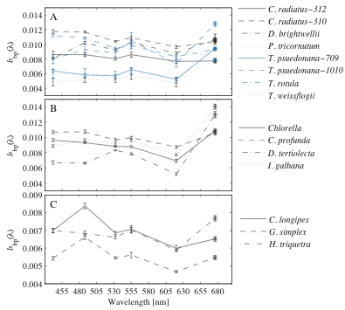
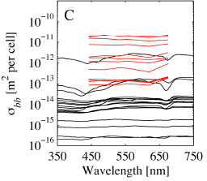
Scattering and backscattering by phytoplankton
b_{b}+F_{chl}
In cultures (watch out for NAP)
Whitmire et al., 2010
Comparison with Mie theory of Stramski et al., 2001

Slide 22
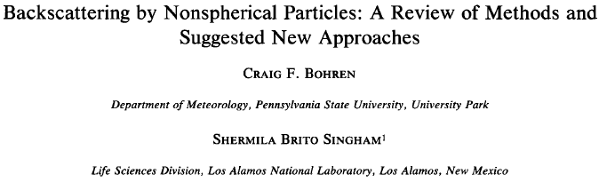
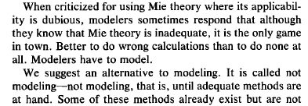
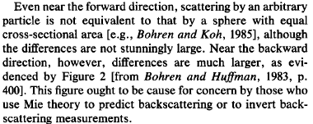

Slide 23

Bohren and Huffman, 1987

Slide 24



Slide 25


Bottom line:
The goal of the study was to obtain some understanding of the differences between the backscattering of a collection of such objects in random orientation and a collection of randomly oriented homogeneous disks of the same size.
In this regime the backscattering is totally governed by the particle’s
gross morphology and effective index of refraction .

Slide 26


Aggregation in the marine environment
Aggregation is a [concentration]² phenomena.
Mechanisms for encounter: Brownian motion, differential settling, and turbulent shear.
Aggregate sink faster than their component particles.
Aggregates break when shear is too high.
Camera pictures at 1mab at a 12m deep site within 1day:
Dominated by <100um particles
Dominated by >1000um particles

Slide 27



Aggregate modeling:
2
Latimer (1985)
4mm
For marine aggregates size and solid fraction correlate.
-points having size-F as in Maggi, 2007, or Khelifa and Hill, 2006.

Slide 28

Aggregation (packaging) and IOPs
Theoretical calculations: monodispersion
Aggregates
Observed range{
Single grain
Boss et al., 2009, OE
Water fraction as in Kehlifa and Hill, 2006
Aggregation approximately ‘conserves’ area not volume

Slide 29


N(D)
V(D)
Sinking flux ∝ w_{s}(D)V(D)
Jackson et al., 1997
Focus is different

Slide 30
It is of fundamental importance that we consider aggregation when dealing with particle suspensions.
When aggregates abound we cannot simply assume:
Such suspensions occur in open ocean as well as coastal areas (can be tested, see below).
Aggregation is essential for predicting the under-water light field as settling velocity, w_{s} ∝ Δρ × D² and w_{s} increases with D.

Slide 31

How do we test that aggregation is important in-situ?
Boss et al., 2009, OE
Small effect on c_{p} large effect on β

Slide 32



Optical properties confirm insensitivity to aggregation in the lab:
b_{b}/Mass
100 μm
Why would aggregation decrease acoustic backscattering per mass?
Opposite to expectation for single particle.

Slide 33

Summary:
There is still a lot of work to do in ocean optics:
Account for diversity in shape.
Account for diversity in internal structure.
Account for diversity in packaging.
Both theoretical and observational (VSF, polarization) advances are needed.

Slide 34
Example: a possible view of the future (inspired by AERONET)
Use all the measurements we have (IOP’s and AOP’s) to invert for the most likely population of particles.

Slide 35

Almucantar (circle on the celestial sphere parallel to the horizon) measurements:
Measurements of cloud free day angular distribution of sky radiance + AOD + RT calculations are used to obtain:
Particulate size distribution
Index of refraction (real and imaginary)
Spectral single scattering albedo
Requires consideration of three main components:
1. Gaseous absorption (avoided by choice of λ, and use of climatologies).
2. Molecular scattering (calculated for given Pressure).
Aerosol absorption and scattering.
Minor (ignored) components: ground albedo, stratification
Use libraries of single particles optical properties (Mie or other)
Needs: RT model
Optimum inversion scheme

Slide 36


- Angstrom Exponent at 440 and 870 nm; n - index of refraction

