Slide 1
Cruise 1, Station 1, Cast 2
Notes:
Data plotted to look at the ratio of chlorophyll to backscatter over depth – in an effort to find any potentially low light adapted cells in the chlorophyll maximum.
In the second figure, The blue dots are the chlorophyll fluorescence from the WetStar fluorometer and the green line has been calculated from a line-height algorithm and corrected ACS data. The green curve has also been normalized to the discrete chlorophyll samples that were taken during this cruise.
In the third figure, Backscatter does show an increase below ~50meters, which we will see again in the next slide.

Slide 2
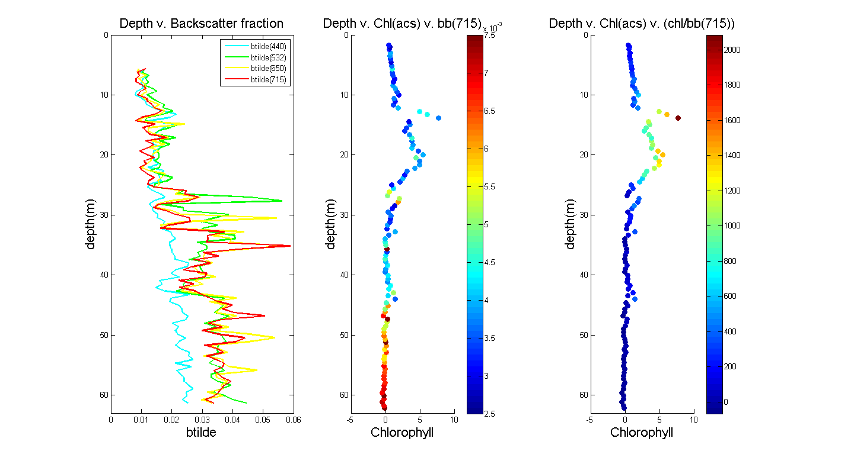
Cruise 1, Station 1, Cast 2
Notes:
B-tilde (the backscatter fraction) is plotted on the left at four different wavelenths.
This shows an increasing amount of inorganic particles towards the bottom, which shows nicely as well in the graph of chlorophyll vs. bb(715) (center and right images)
For the center image, the colorbar is backscatter at 715nm. Higher scatter here should indicate a higher particulate load.
So – the depths below ~50m appear to have increasing particle loads.
I chose 715nm because it is closest to the 700nm backscatter sensors that are often used as Turbidity sensors.
To the best of my understanding - It shouldn’t be strongly affected by chlorophyll concentration itself, but rather by particle abundance.
The figure on the right is displayed simply to highlight the potential for changes in chlorophyll to backscatter within smaller regions (within the chl max) – it may be easier for people to understand one of these or the other, so I put both in to be comprehensive.

Slide 3
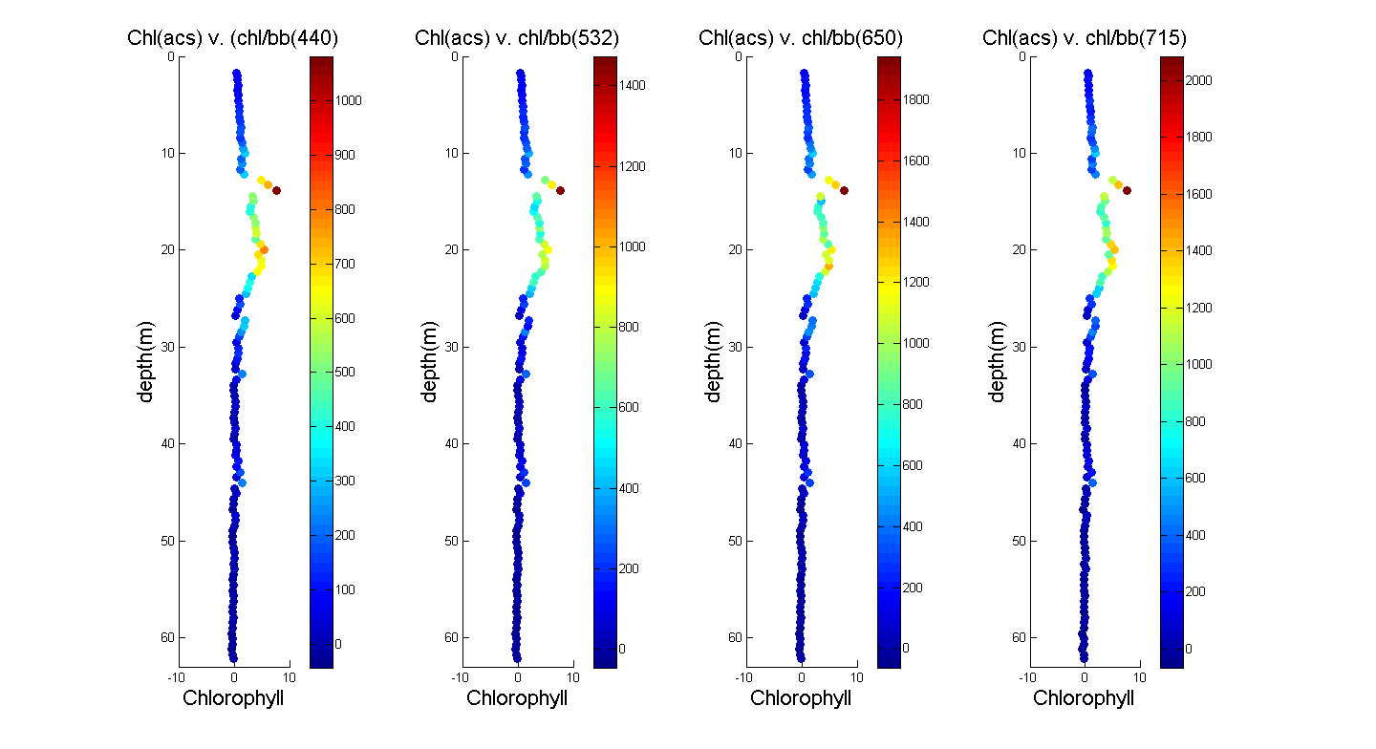
Cruise 1, Station 1, Cast 2
Notes:
This figure simply shows that the chorophyll to backscatter ratio was not strongly affected by the specific wavelength of backscatter used.
Feel free to take it out and to simply say that there was not much variation in the chlorphyll to backscatter ratios when viewed with backscatter at 4 different wavelengths between 440 and 715.

