Slide 1
Radiometry (No) Closure among Instruments

Slide 2
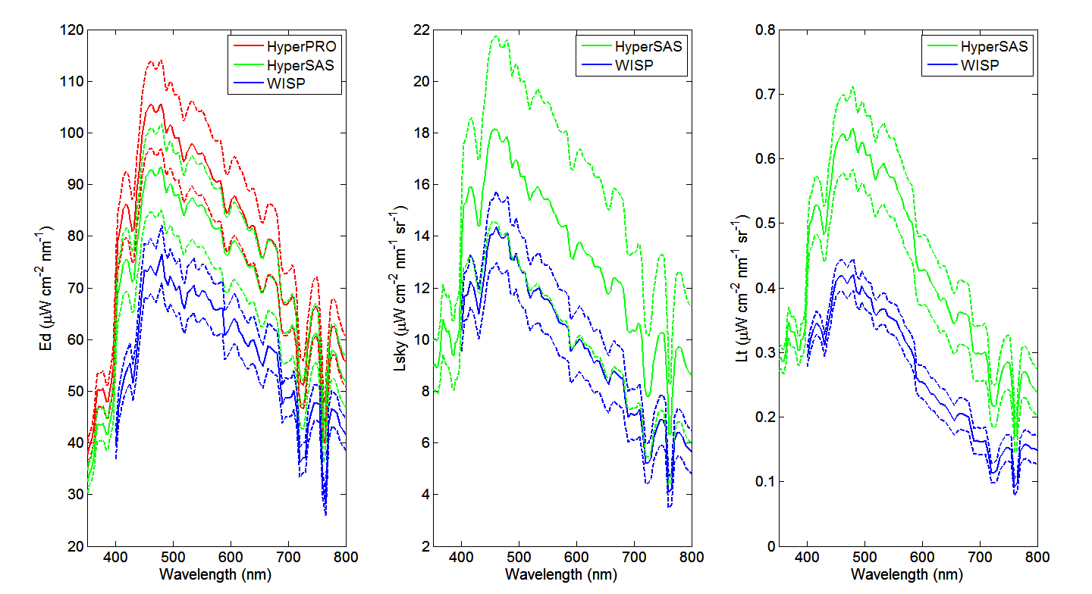
Station 1, Monday Cruise

Slide 3
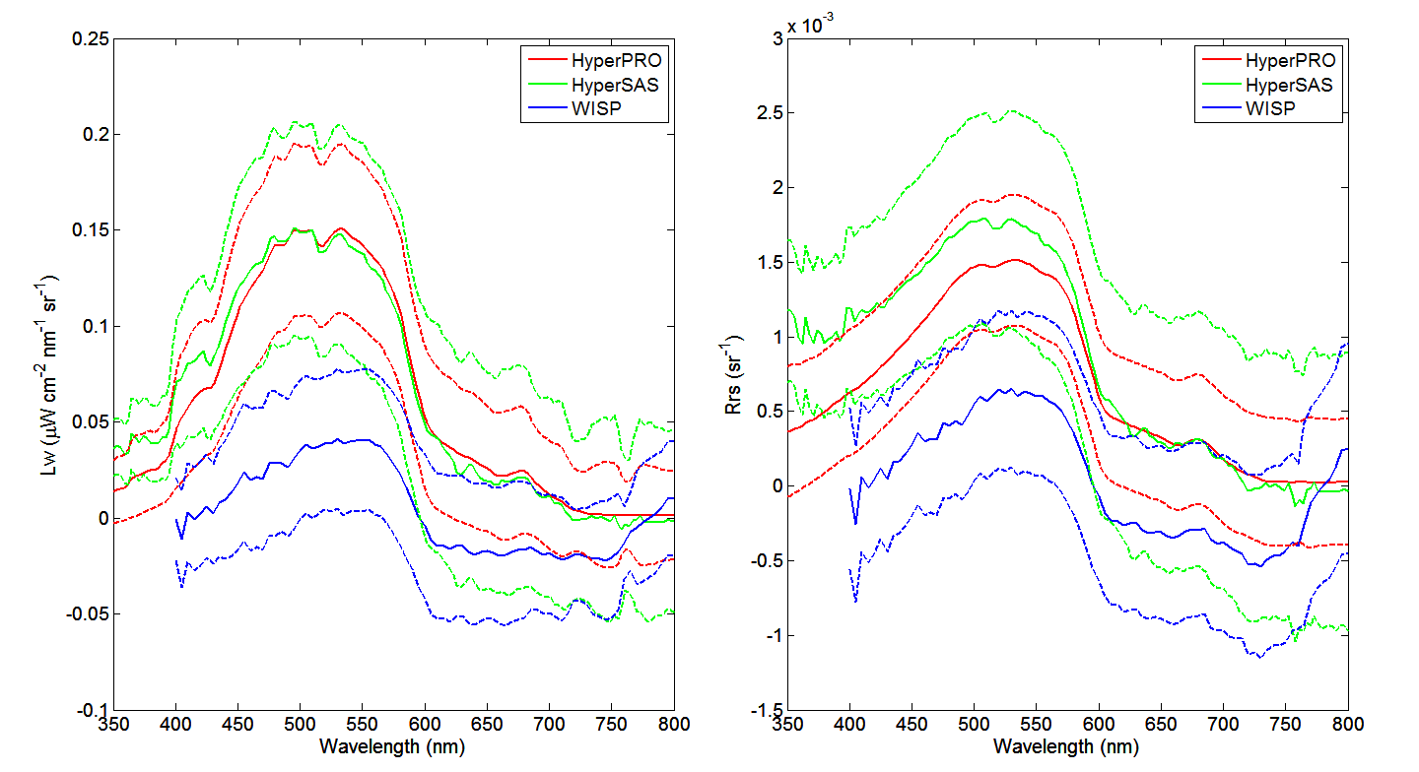
Station 1, Monday Cruise

Slide 4
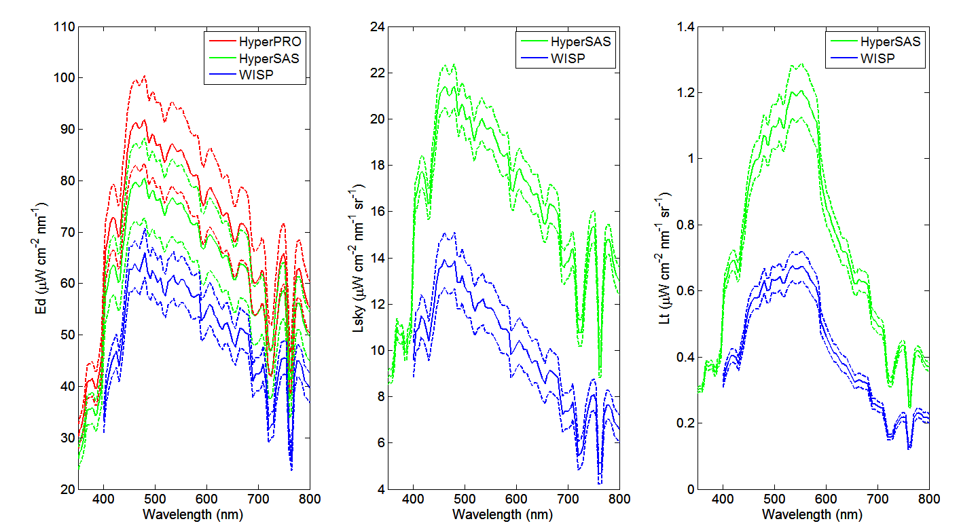
Station 2, Monday Cruise

Slide 5
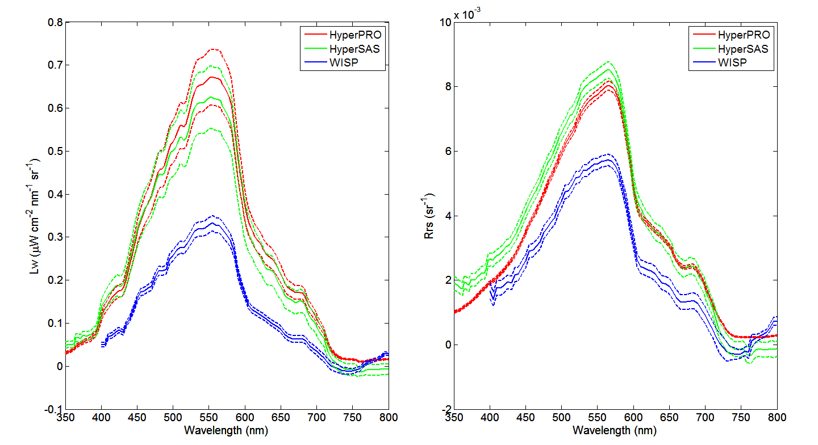
Station 2, Monday Cruise

Slide 6
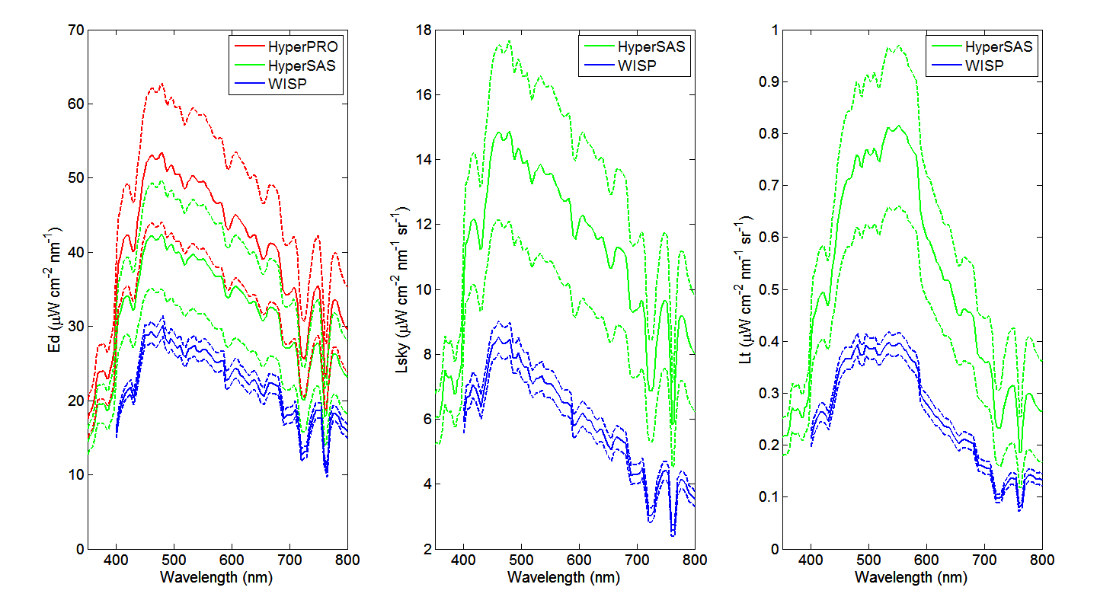
Station 1, Wednesday Cruise

Slide 7
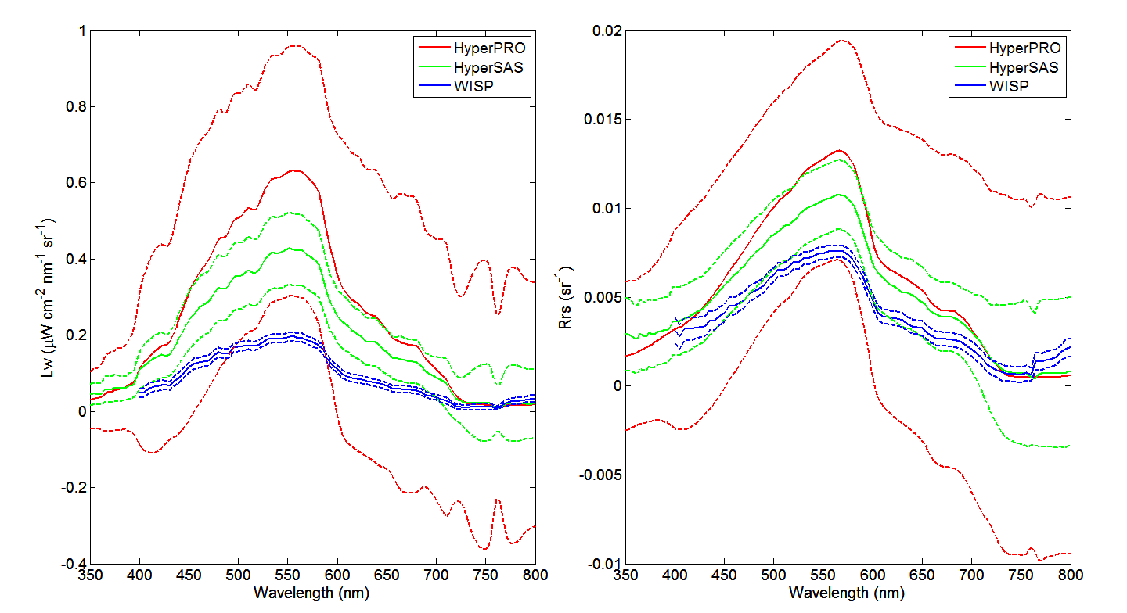
Station 1, Wednesday Cruise

Slide 8
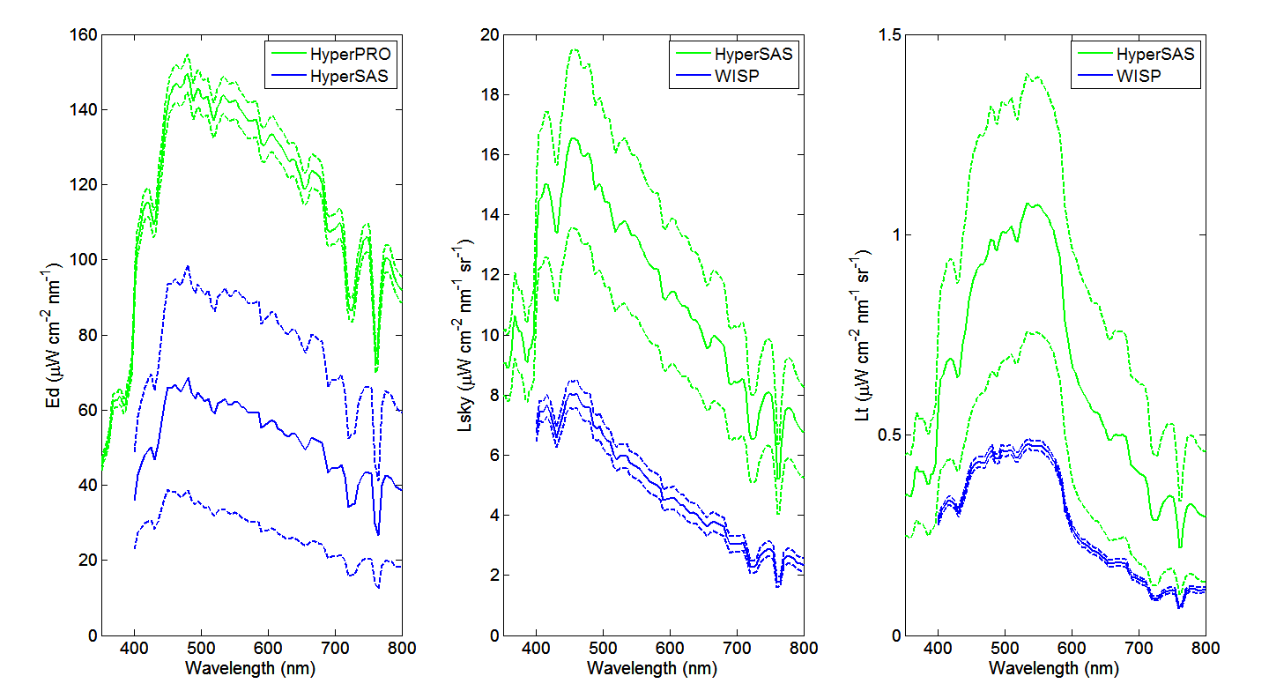
Station 2, Wednesday Cruise

Slide 9
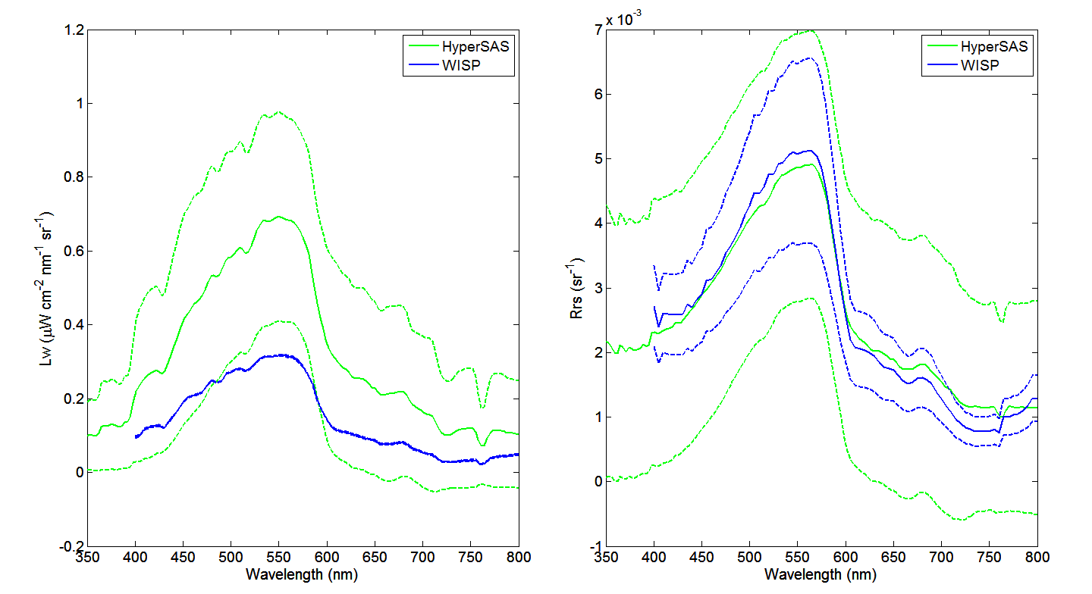
Station 2, Wednesday Cruise

Slide 10
Comments on Cruise Data
Difficult to find a pattern among HyperPro, HyperSAS, and WISP
Measured data subject to large uncertainties
Try to compare the instrument with dock measurements, which is more stable.

Slide 11
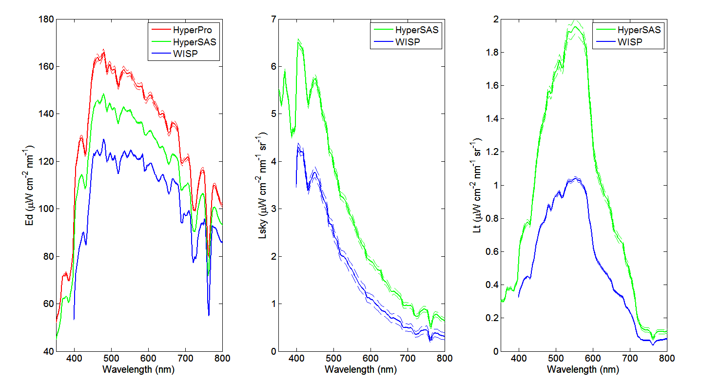
Dock Test, 07-27-13

Slide 12
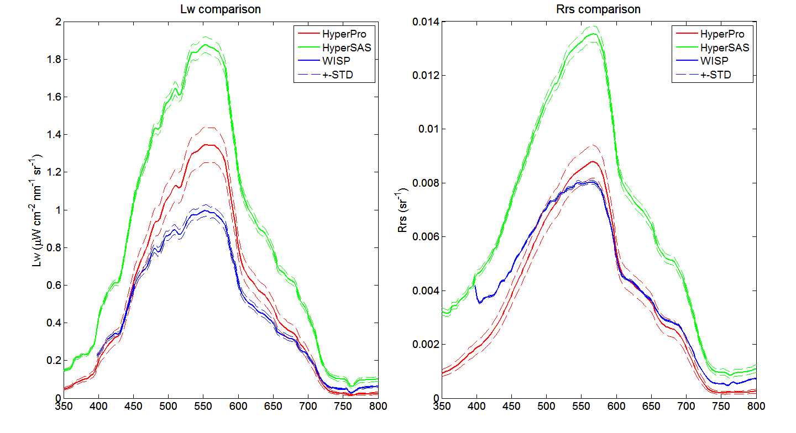
Dock Test, 07-27-13

Slide 13
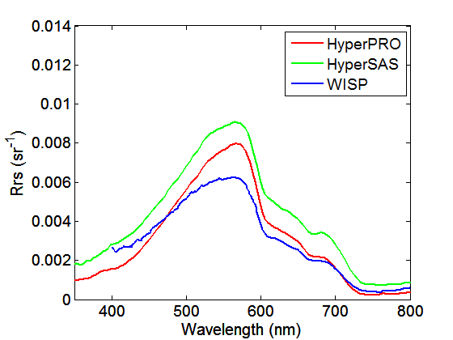
Dock Test, 07-15-13

Slide 14
Comments on Dock Test
Uncertainties is relatively small
At least for Rrs, the pattern for two dock tests is obvious
Thus, based on these dock tests, three instruments do not agree with each other.
However, HyperPRO Rrs by Lee’s method is relatively closer to WISP Rrs.

