Slide 1
Cruise Data: Initial Investigations

Slide 2
Above water radiometry measurements
7/25/2013

Slide 3
Data before removing large tilting
Downwelling Irradiance at station 1: Gulf of Maine
*HyperPro is set to Lee’s method

Slide 4
Data after removing large tilting
Downwelling Irradiance at station 1: Gulf of Maine

Slide 5
Data before removing large tilting
Radiance at station 1: Gulf of Maine

Slide 6
Data after removing large tilting
Radiance at station 1: Gulf of Maine

Slide 7
Data before removing large tilting
Downwelling Irradiance at station 2: Damariscotta River

Slide 8
Data after removing large tilting
Downwelling Irradiance at station 2: Damariscotta River

Slide 9
Data before removing large tilting
Radiance at station 1: Damariscotta River

Slide 10
Data after removing large tilting
Radiance at station 1: Damariscotta River

Slide 11
Some thoughts about tilting
Tilting causes some noise, but is not the main source of noise.
Sky condition, e.g. cloud cover, may be primary cause of variation observed in radiometric quantities.
Therefore, removing large tilting angles seems not sufficient.

Slide 12
WISP DAY 1, Wavelength (nm) v. Rrs (1/sr)
Notes:
This is the raw data
Station 2 (calm water) = better agreement
All of Station 1 samples show high variability
Negative values? Use different correction coefficient?

Slide 13
WISP DAY 2, Wavelength (nm) v. Rrs (1/sr)
Remaining Questions:
Do we remove anomalous spectra or use lowest spectra?
Do we use ‘black pixel assumption’? (e.g. 748 nm = 0)
Notes:
This is the raw data
Station 2 (calm water) = better agreement
All of Station 1 Gulf of Maine samples show high variability

Slide 14
5 Spectra Means of First 4 Locations (no outliers)
?
Notes:
Used MEAN

Slide 15
First 4 Locations with +/- StdErr (L1)

Slide 16
Preliminary Chl Comparison
Station | Average Chl Niskin (ug/L) | Median WISP Field Observation (ug/L) | Median WISP Data Product (ug/L)
1 (Ocean) | 0.54 | 0 | 0
2 (Inlet) | 2.90 | 5.7 | 8.7
Notes:
WISP data….not so good
We will look at TSM data and also do reverse remote sensing calculations to get chlorophyll

Slide 17
Inter-instrumental comparison
Radiance at station 1: Gulf of Maine

Slide 18
Inter-instrument comparison
Radiance at station 2: Damariscotta River

Slide 19
About inter-instrumental comparison
When sea surface is more stable, radiometric quantities are more comparable.
WISP may not work well for rough sea surface.
Sky radiance correction for HyperSAS measurements is more challenging when sea surface is rough.

Slide 20
Eco-VSF

Slide 21
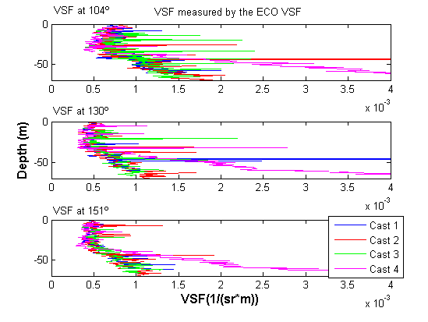
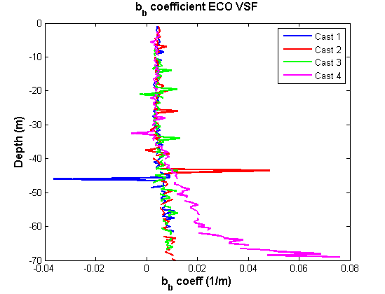
ECO VSF
Notes:
VSF after calibration and dark subtraction.
Backscattering coefficient for 665nm, multiple casts at Station 1, derived from the VSF.
Cast 4’s profile is unusual. It’s a topic of further research.
Next steps: determining errors, cleaning up noise, compare backscattering coefficient with BB9 to determine closure.

Slide 22
BB9

Slide 23
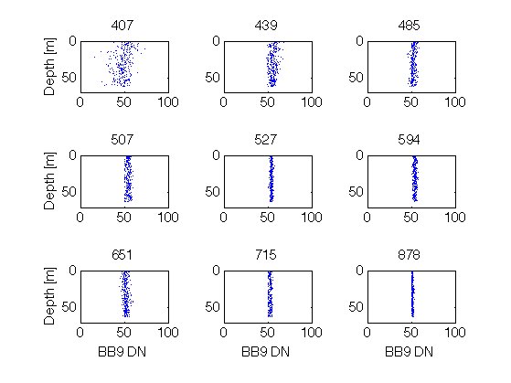
Dark Counts
Notes:
Cast 5 with black tape

Slide 24
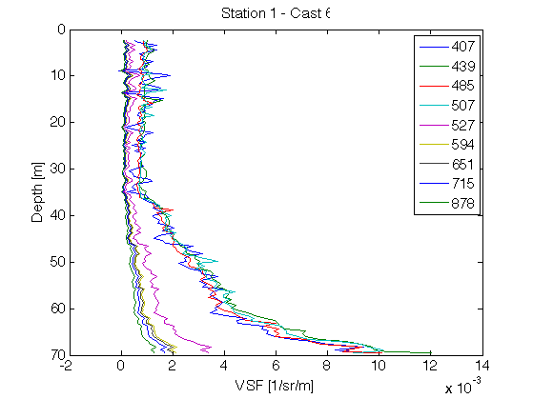
VSF(124°) – Station 1, Cast 6
Notes:
To be done: backscattering conversion and smoothing noise. Binning by depth maybe.

Slide 25
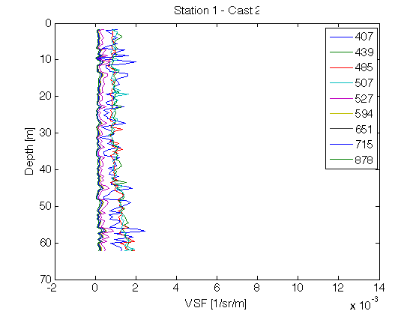
VSF(124°) - Station 1, Cast 2

Slide 26
AC-S

Slide 27
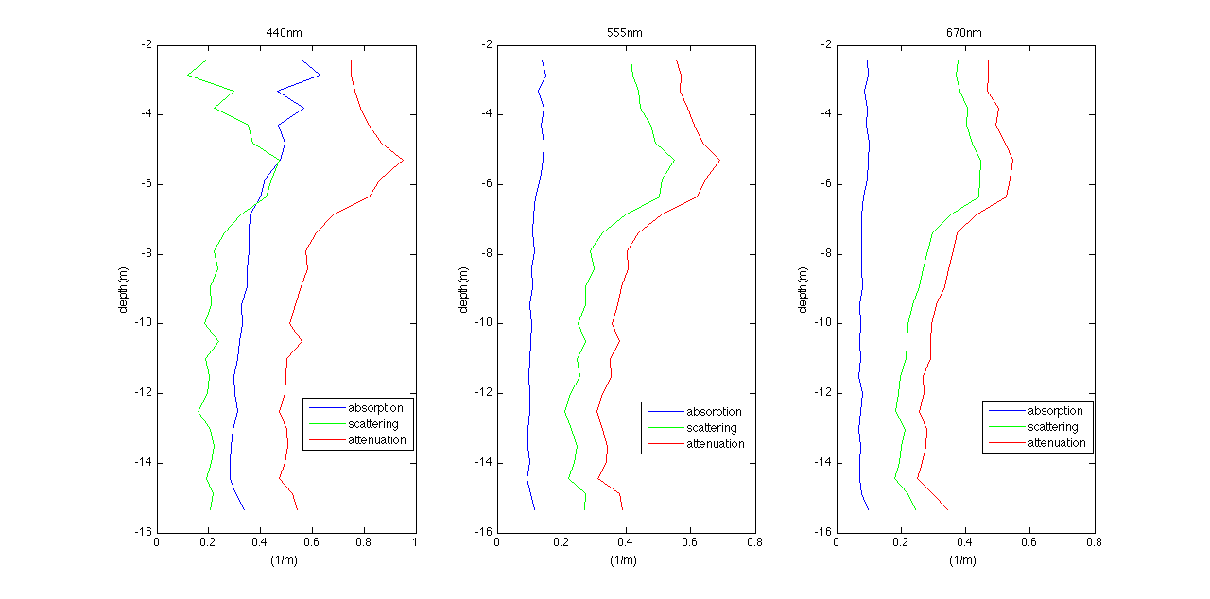
Vertical Profiles of a,b,c
Day 1, Station 1
Notes:
Temperature and Salinity corrected, not scattering corrected.
Calibration from pre-cruise was corrupted, so used the Cal file from the lab last week.

Slide 28
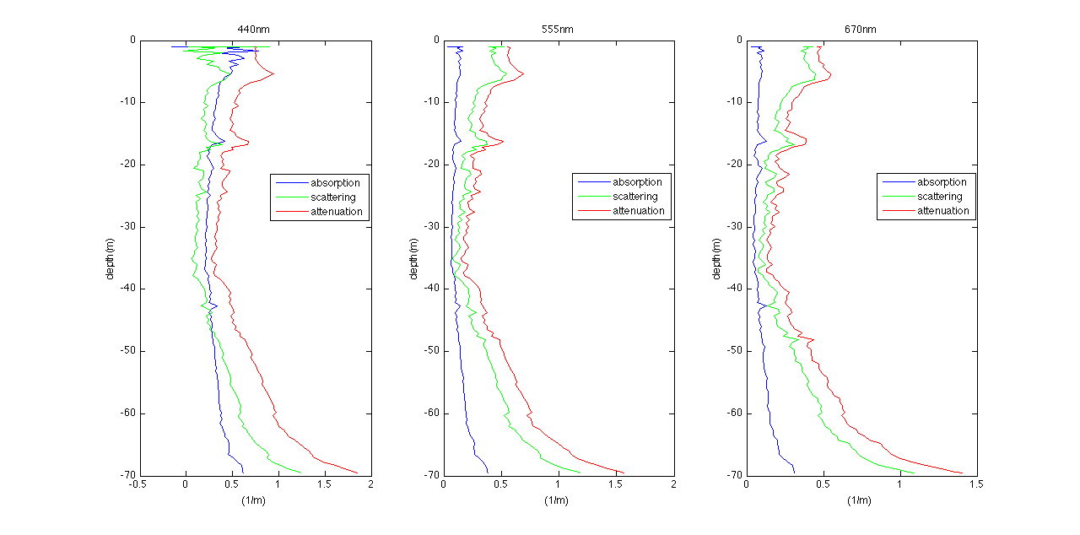
Vertical Profiles of a,b,c
Day 1, Station 2
Notes:
Unfiltered casts. For filtered casts the scattering was mostly negative; couldn’t get a positive b. What could potentially be going wrong?

Slide 29
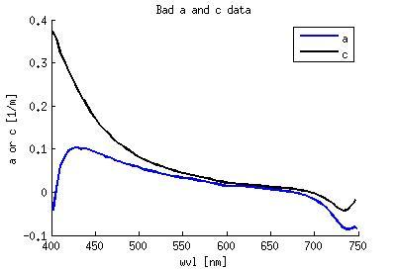
Example of Bad ACS data
Notes:
Portion of a profile where Emmanuel was commenting at the time that it was bad data

Slide 30
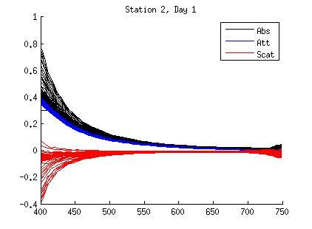
Spaghetti Plots
Attempted to temperature correct. The calibration seems wrong.
Notes:
For some reason A is higher than C. What’s going on.

Slide 31
AC-S vs. Spectrophotometer

Slide 32
CDOM comparison
Cruise 1 Station 2, in the estuary
Estimated the temperature for the spectrophotometer temperature correction
Evidence that we can trust the data from our acs
Notes:
Red Curve: filtered ACS from the field
Blue Curve: water from Niskin, 0.2 um filtered, run on in-lab spectrophotometer. 10cm cuvette.
Excellent matchup. This may be our only slide with closure.
Temperature correction for in-lab portion was estimated. We never measured the temp of the sample, but Tom did some interative temperature corrections and settled on 18oC.
730 nm = null wavelength (abs at that wavelength was the zero).

Slide 33
Chlorophyll Estimates from AC-S

Slide 34
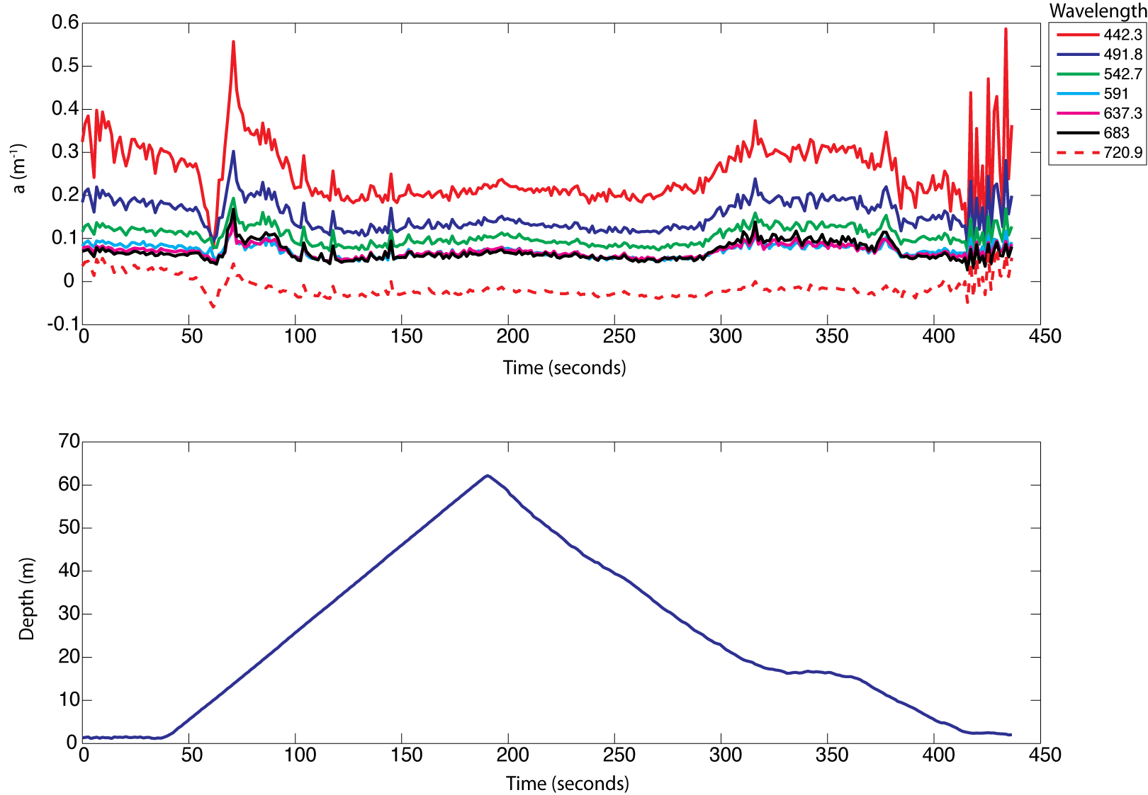
Cropping ACS Data (Cruise #1, Station #1, Cast #2)
Notes:
Need to determine what data should be used.
Downcasts were much smoother than upcasts. This sets the range.

Slide 35
Cropping ACS Data (Cruise #1, Station #1, Cast #2)
Good downcast data

Slide 36
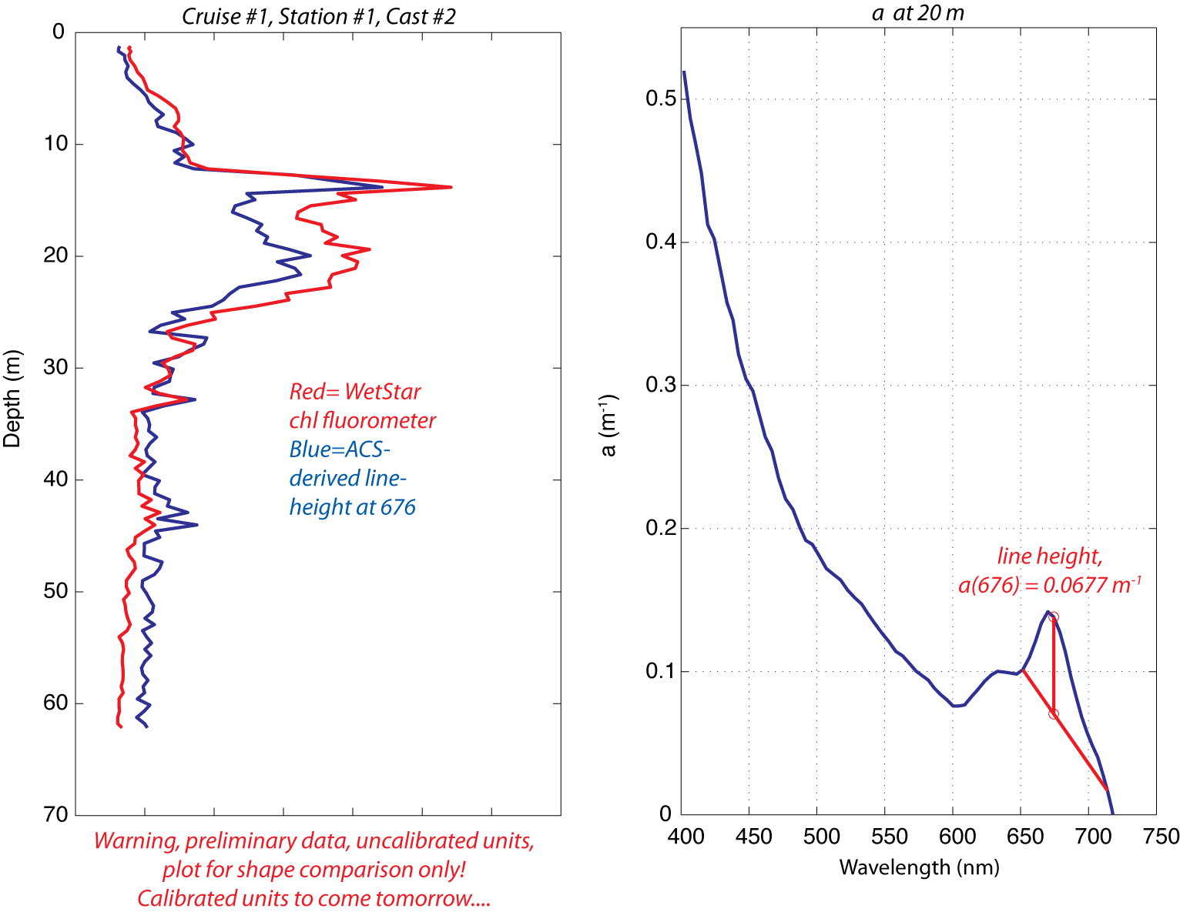
Preliminary A(676) Line Height and Chl Fluorometer Data (uncalibrated, uncorrected)
Notes:
Using the line-height method, can get an estimate of chlorophyll from the absorption spectra.
Good matchup.

Slide 37
WetLabs Fluorescence Profiles

Slide 38
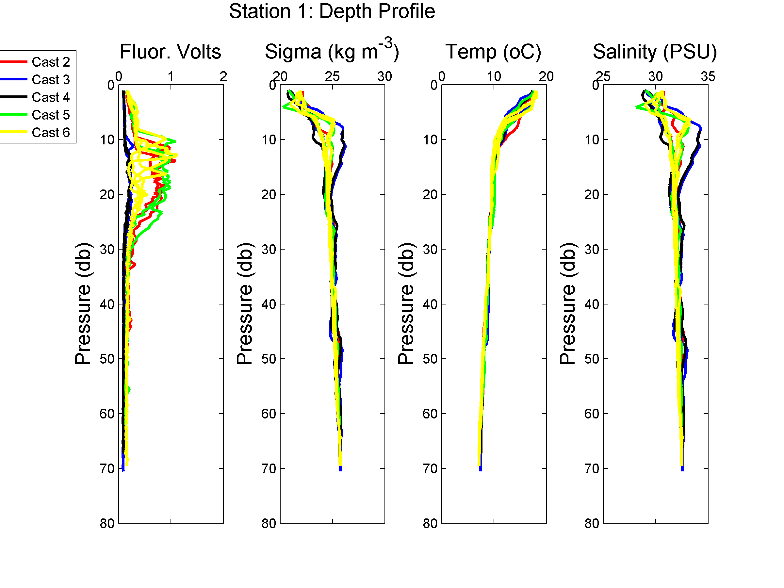
Initial fluorometer profiles (with water column properties) seem okay
Can see filtered vs. unfiltered
Problems with upcast versus downcast

Slide 39
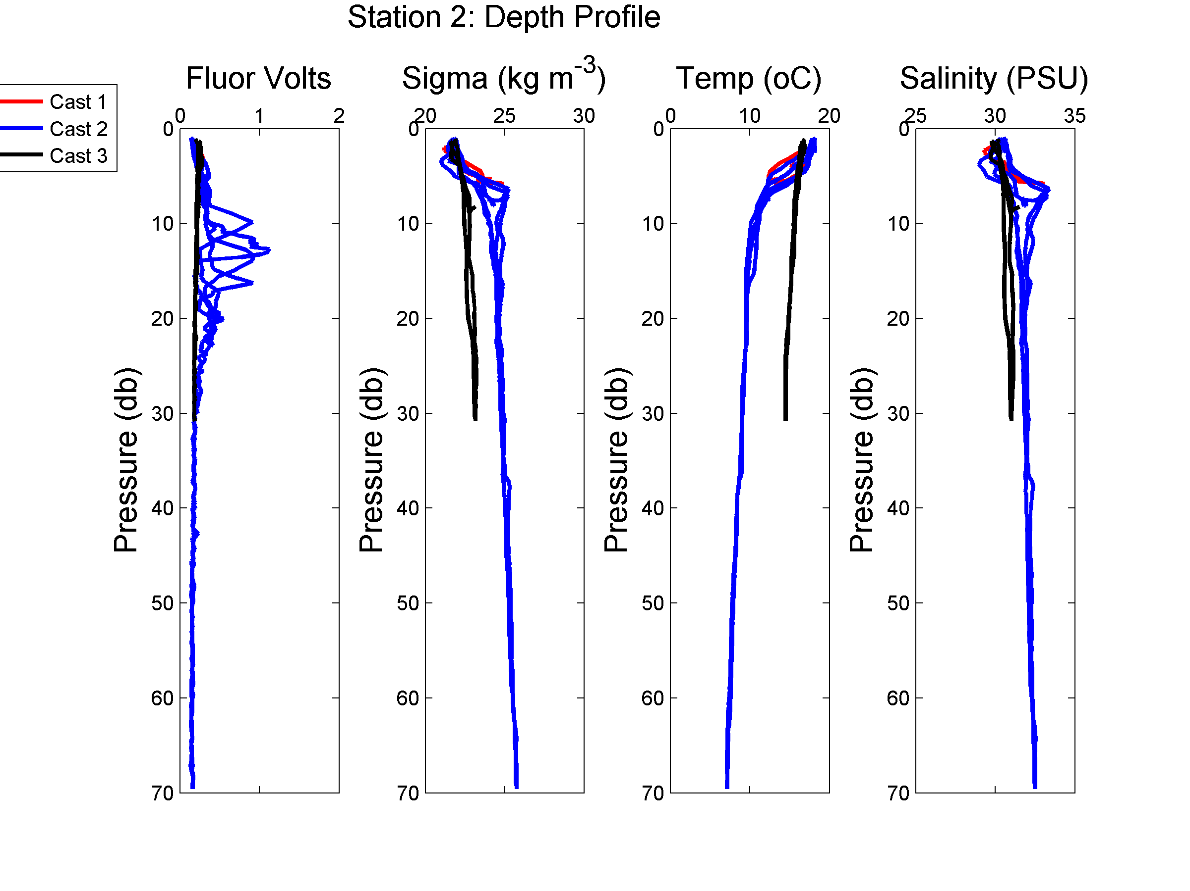
Something has gone terribly wrong
3 casts at Station 2. Cast 1 only goes to ~6m, Cast 2 looks like Station 1, and Cast 3 was filtered.

Slide 40
In-Lab Pigment Concentration
Chl | Depth | Station 1 (Ocean) | Station 2 (River)
 | 0 m | 0.54 ± 0.04 | 2.90 ± 0.04
 | 4m | 0.65 ± 0.06 | 2.44 ± 0.06
Phaeo | Depth | Station 1 (Ocean) | Station 2 (River)
 | 0 m | 0.07 ± 0.01 | 1.07 ± 0.06
 | 4 m | 0.07 ± 0.02 | 1.13 ± 0.09
Can use these values for comparison with other instruments and methods for determining chlorophyll

Slide 41
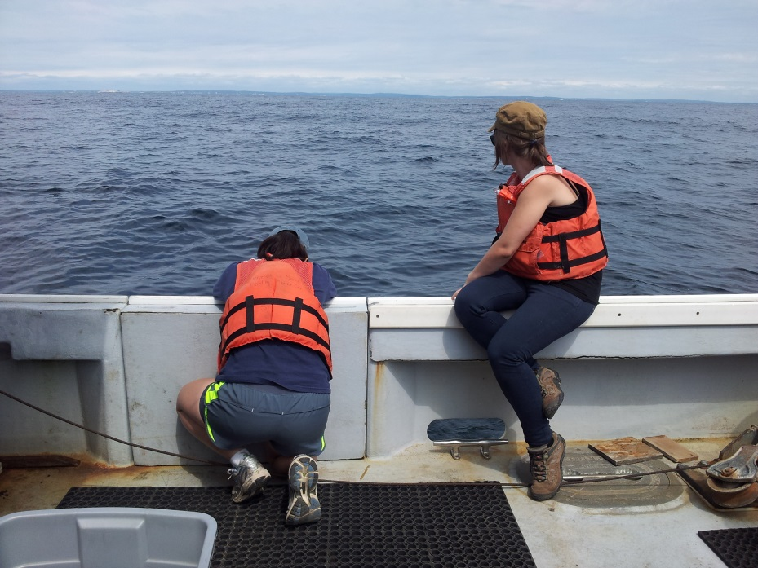
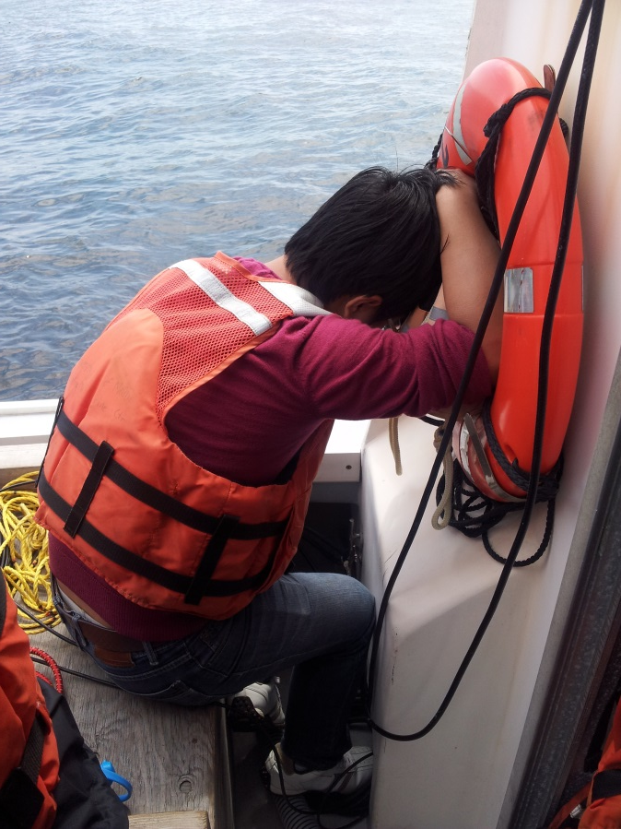
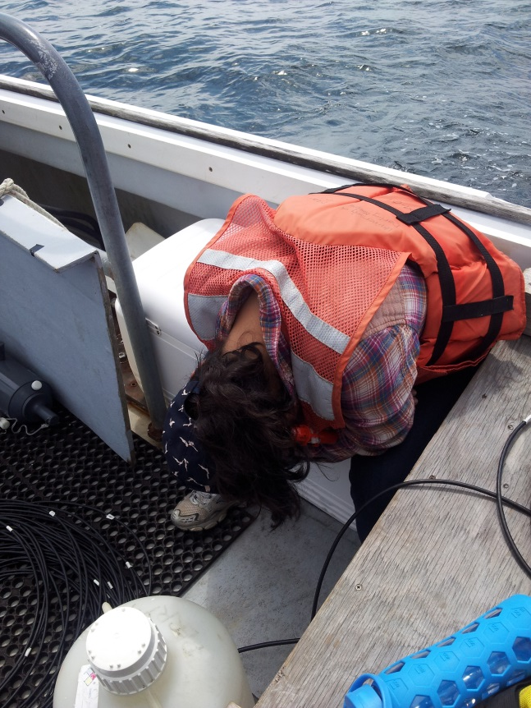
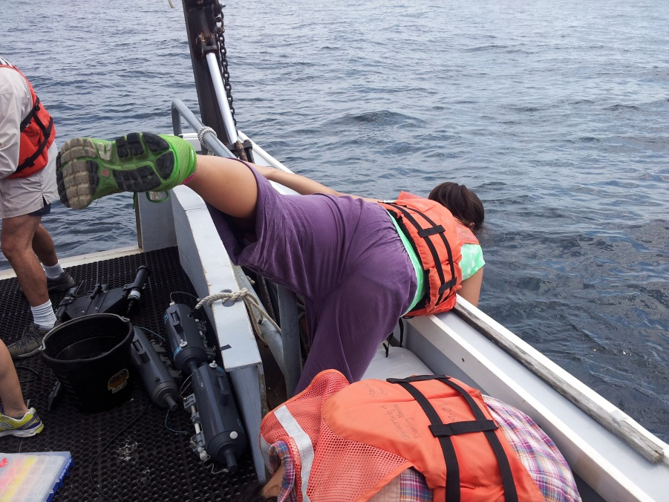
Questions?

