Slide 1
An Introduction to Radiometry:
Taking Measurements, Getting Closure, and Data Applications
Part I: Guide to Radiometric Measurements

Slide 2
An Introduction to Radiometry:
Taking Measurements, Getting Closure, and Data Applications
Part II: Data Processing and Analysis

Slide 3
An Introduction to Radiometry:
Taking Measurements, Getting Closure, and Data Applications
Part III: Closure and Application

Slide 4
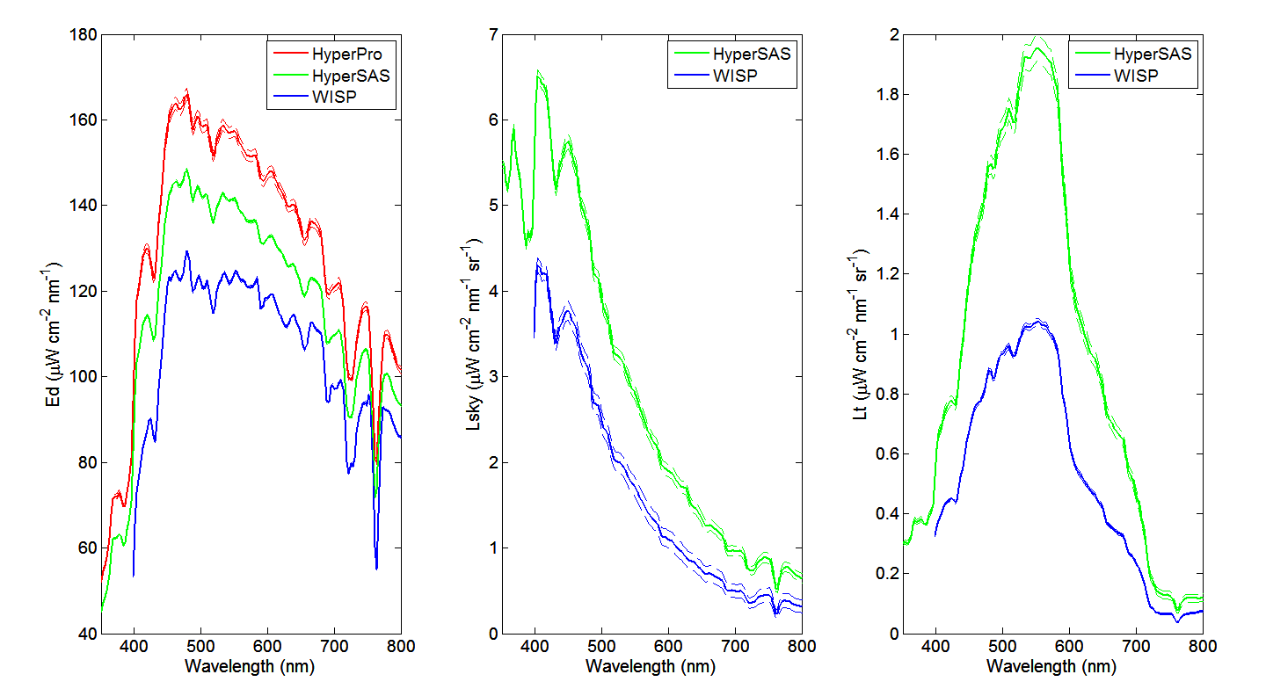
Dock Test, 07-27-13
A REMIND…

Slide 5
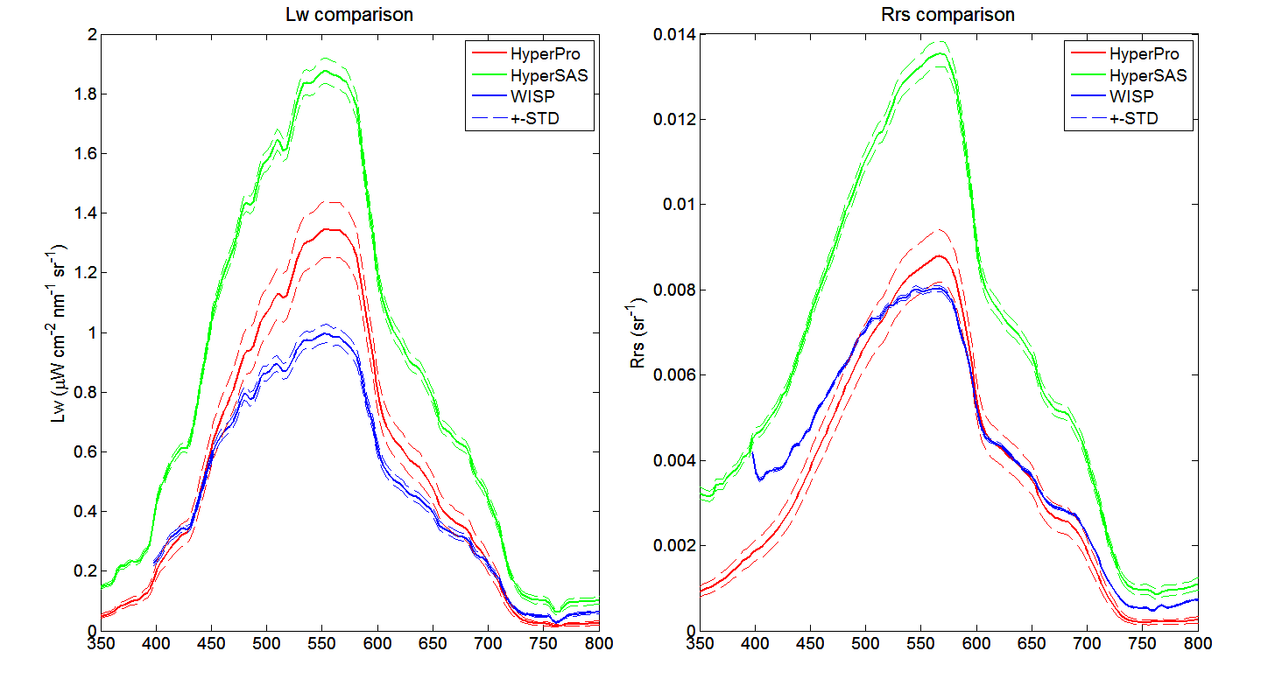
Dock Test, 07-27-13

Slide 6
WISP and HyperPro ‘Transformation’
Assumed Dock Test was the most ‘ideal’ control conditions
Assumed HyperSAS was accurate enough to be the ‘right’ system
Used Dock Test spectra for SAS, Pro, and WISP to get ratios Pro/SAS and WISP/SAS for all wavelengths (3 nm bins)
Applied Dock Test ratios to transform cruise data
Assumed ρ_{sky}= 0.028

Slide 7
Cruise 1: River Station

Slide 10
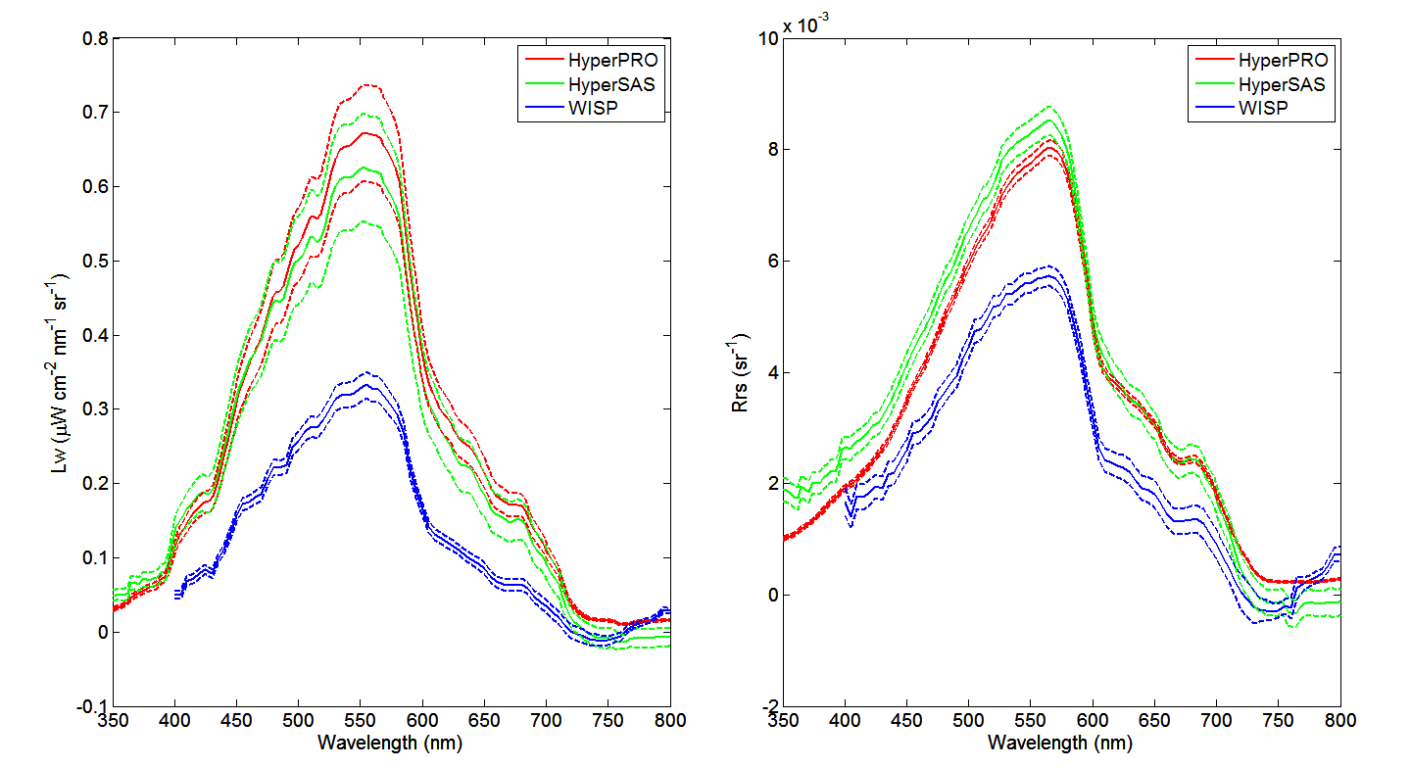
Before transformation

Slide 11
After transformation

Slide 12
After transformation

Slide 13
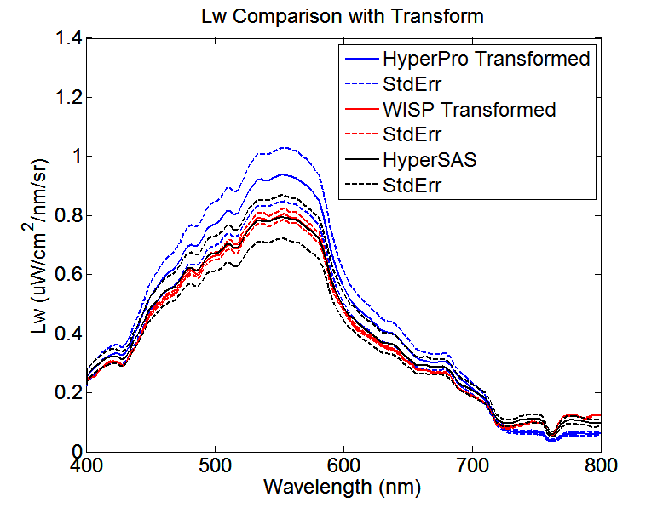
Three Lw’s can match if we use ρ_{sky}=0.021 instead of 0.028. Therefore, this means we overcorrected sky radiance initially (?).

Slide 14
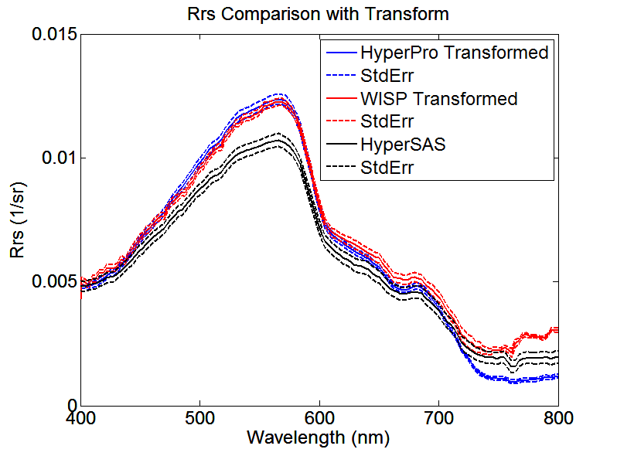
Three Rrs’s can match if we use ρ_{sky}=0.021 instead of 0.028. Therefore, this means we overcorrected sky radiance initially (?).

Slide 15
Cruise 1: Ocean Station

Slide 20
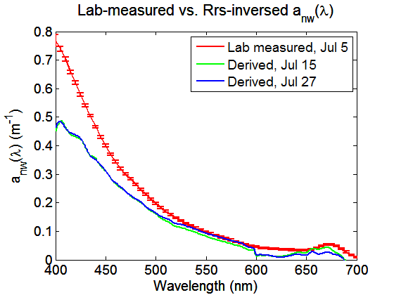
Inversion Application Example
R_{rs}(λ) a_{nw}(λ), b_{bp}(λ) Pigments
Chlorophyll (mg/m³)
Date | Lab | Inversed
Jul 15 | ~2.1 | 2.47
Jul 27 | ~2.2 | 1.88
Interesting fact is that inversed results are always better when using WISP-measured R_{rs}(λ). The estimated non-water absorption a_{nw}(λ) and Chl concentration with WISP R_{rs}(λ) is shown above for dock test on Jul 15 and Jul 27.

Slide 21
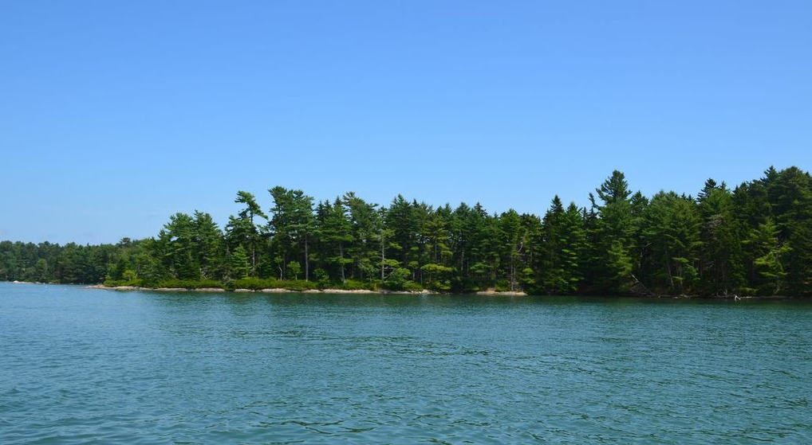
CLOSURE ANALYSIS

Slide 22
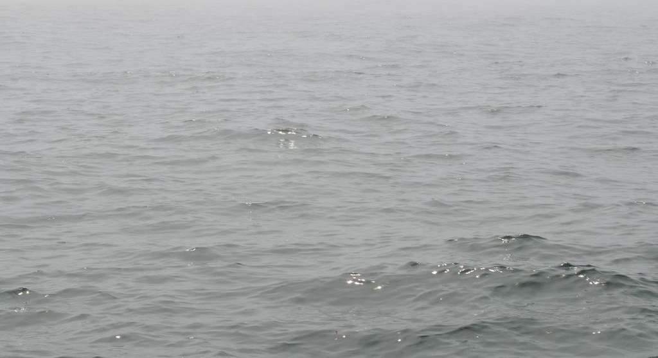
Differences between instruments’ response could be explained by:
Offsets between sensors,
Spatial variations during deployment,
Not accurate information about atmospheric conditions and sea level state,
Inappropriate angle corrections,
Handling errors (especially for WISP),
…
Due to the lack of more information, some of the corrections we can perform are only assumptions and we can’t justify them.
Incorrect values of sea-surface reflectance factor, ρ
Hydrolight model provides a very useful tool which can be used for this purpose.

Slide 23
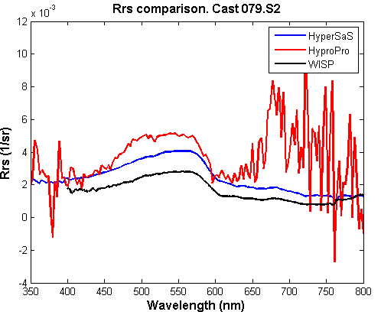
CRUISE 2- “OFFSHORE” STATION
HyperPRO, noisy and useless signal

Slide 24
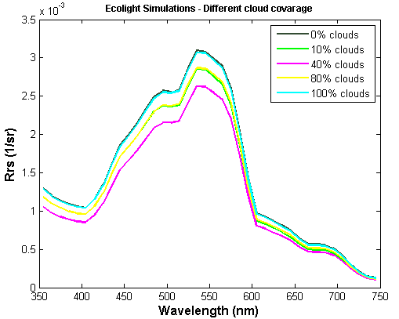
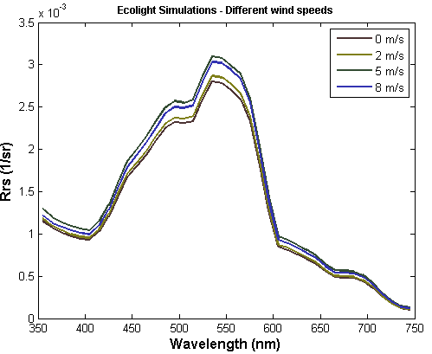
ECOLIGHT SIMULATIONS:
Inputs: IOPs (a_{P},b_{b},a_{CDOM})
10%
16%
Simulations under different cloud coverage and wind speeds

Slide 25
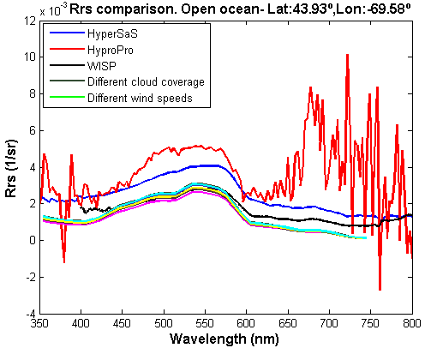
Same shape between spectra, different magnitude.
1) The measured Rrs at [720-750] significantly higher than zero → open ocean → “dark pixel” correction
2) Imprecise sky and measurement conditions, unknown → try with another rho values

Slide 26
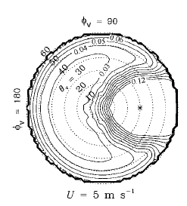
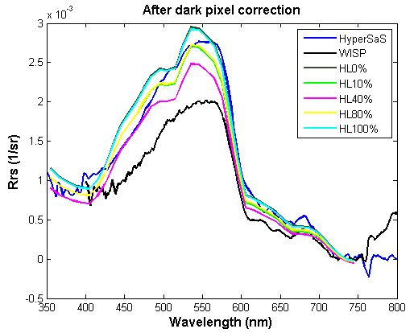
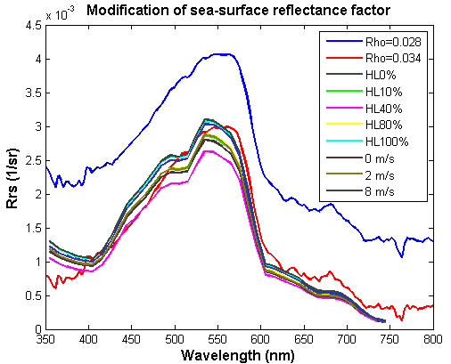
.
Mobley (1999)
ρ≈0.034 when φ ≈ 135º, θ ≈43º and U=5 m/s
 | EUCLIDEAN DISTANCE
Without corrections | 0.0076
Forcing Rrs_{[720-750]} = 0 | 8.05E-04
Sea-surface reflectance factor= 0.034 | 0.0014

Slide 27
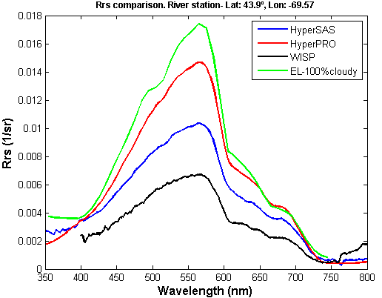
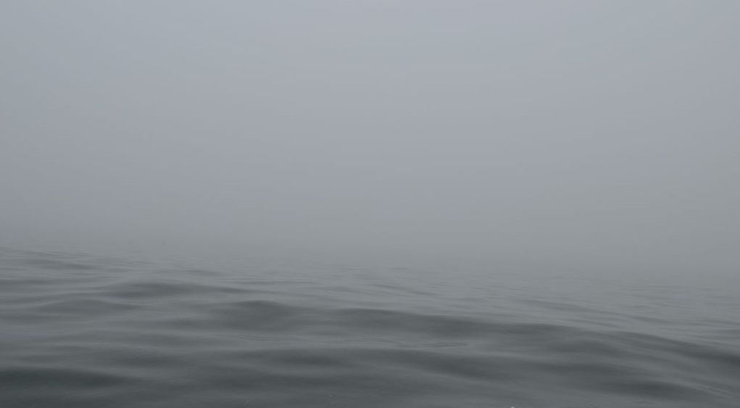
CRUISE 2- RIVER STATION
EUCL. DISTANCE | HyperSAS | HyperPRO | WISP | Ecolight
HyperSAS | 0 | 0.0138 | 0.0134 | 0.0215
HyperPRO | 0.0138 | 0 | 0.027 | 0.008
WISP | 0.0134 | 0.027 | 0 | 0.0346
Ecolight | 0.0215 | 0.008 | 0.0346 | 0
Full overcast (no “dark pixel” corrections nor change of sea-surface reflectance factor).

Slide 28
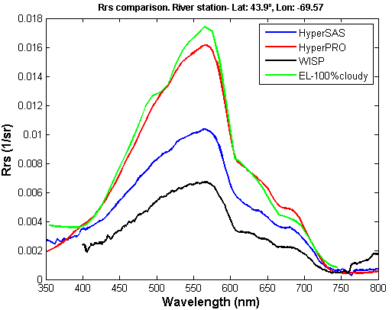
Euclidean_dist [Ecolight-HyperPRO]= 0.0036
Lab/ Dock test using the Ed sensors under the same light conditions → Ed_{PRO}= 1.1Ed _{SAS}

Slide 29
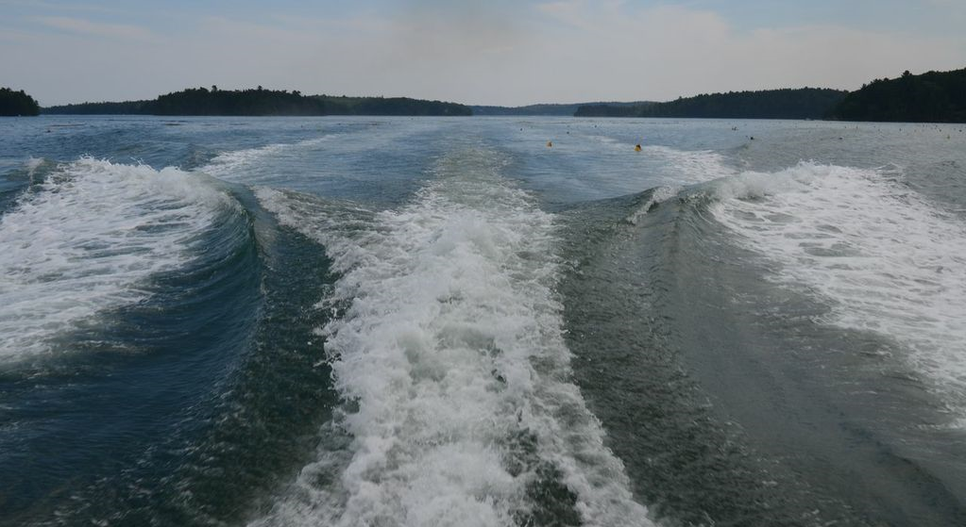
THANK
YOU!

