Slide 1
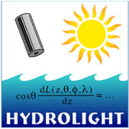
Hydrolight Lab: Part 1
July 18th, 2013

Slide 2
Exercise 1: Optical Depth
What geometric depths correspond to optical depths
Runs took a similar amount of time even though the geometric depths were different:
  Run 1 took 3.6 s, Run 2 took 3.6 s
C = a + b; Optical Depth = Geometrical Depth * C
 | a (m⁻¹) | b (m⁻¹) | Optical Depth | Geometrical Depth (m)
Run 1 | 0.1 | 0.4 | 20 | 40
Run 2 | 1 | 4 | 20 | 4

Slide 3
Exercise 1: Optical Depth
Irradiances are the same at the same optical depths
Notes:
PLOT: show irradiances are the same at the same optical depths

Slide 4
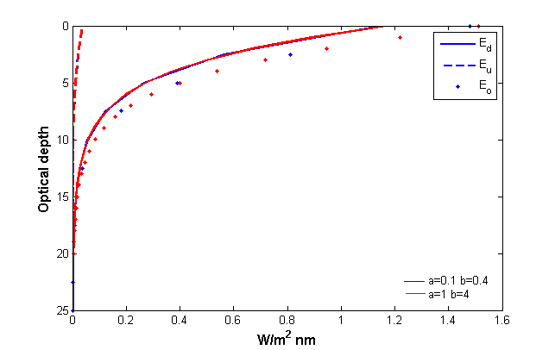

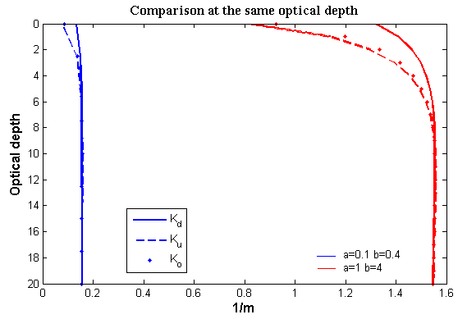
Exercise 1: Optical Depth
K functions are not constant with depth
Various K functions as a function of depth for the highly scattering water

Slide 5
Exercise 2: IOP error effects
Your AC-9 gives a=0.30 m⁻¹ +/- 20%
Three runs with a= 0.24, 0.30, 0.36 m⁻¹
b = 1.0 m⁻¹ at 440 nm

Slide 6
Exercise 2: IOP error effects
Depth | Ed | Diff.
(10 m) | (W/m^2 nm) | (%)
Run3 | 1.83E-02 | 0.00
Run4 | 3.76E-02 | 105.29
Run5 | 9.02E-03 | -50.71
Depth | Ed | Diff.
(50 m) | (W/m^2 nm) | (%)
Run3 | 3.58E-10 | 0.00
Run4 | 1.25E-08 | 3385.55
Run5 | 1.10E-11 | -96.93
Depth | Lu | Diff.
(10 m) | (W/m^2 nm) | (%)
Run3 | 9.95E-05 | 0.00
Run4 | 2.63E-04 | 164.25
Run5 | 4.00E-05 | -59.84
Depth | Lu | Diff.
(50 m) | (W/m^2 nm) | (%)
Run3 | 2.28E-11 | 0.00
Run4 | 7.95E-10 | 3385.64
Run5 | 7.00E-13 | -96.93
A small error in an IOP can make a big difference in the field at depth
 | Run 3 | Run 4 | Run 5
a (m⁻¹) | 0.3 | 0.24 | 0.36

Slide 7
Unbiased Percent Difference
Unbiased percent difference UPD (Hooker et al., 2002)
where X represents the ocean color product for λ at any discrete wavelength and t is neglected for Hydrolight
..................[1]

Slide 8
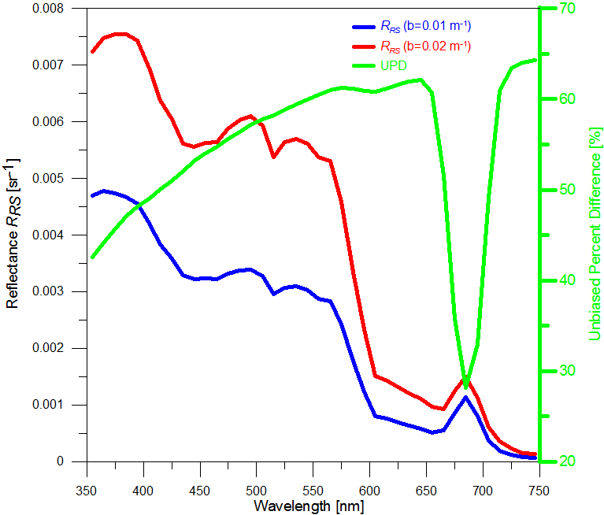
E3: R_{rs} dependence on backscatter
Particle Backscatter fraction B_{b}=b_{bp}/b_{p}
The optical depth differences cause the computer time various

Slide 9
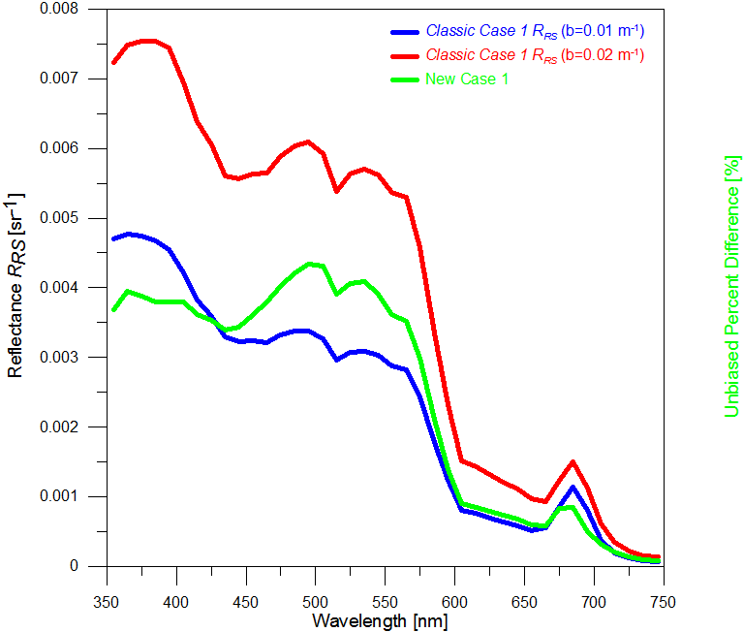
Exercise 4: Compare “CLASSIC” and “NEW” Case 1 IOP model
Chl = 2.3 mg m⁻³

Slide 10
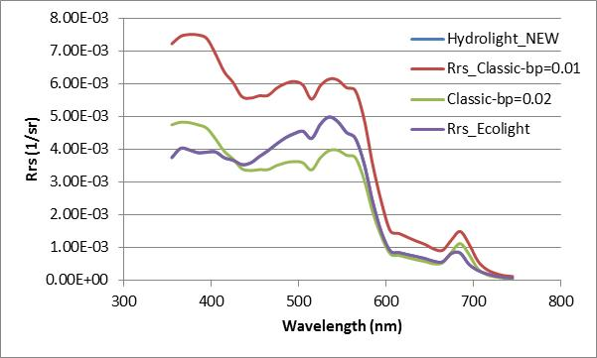
Exercise 5: Compare Hydrolight and Ecolight outputs
Ecolight computed irradiances same as Hydrolight, but it 12-20 times faster than Hydrolight

Slide 11
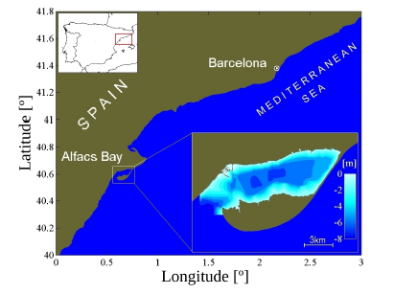
EXERCISE 6
Study area: Alfacs Bay
(Ebro Delta, NW Mediterranean)
- Case II waters
Z_{max}= 6.5 m
Hidrolight simulations:
New Case I
[Chl]= 6 mg/m3
Inelastic scattering
Finite depth (Z_{max}= 6.5 m)
Default values
Different bottom types

Slide 12
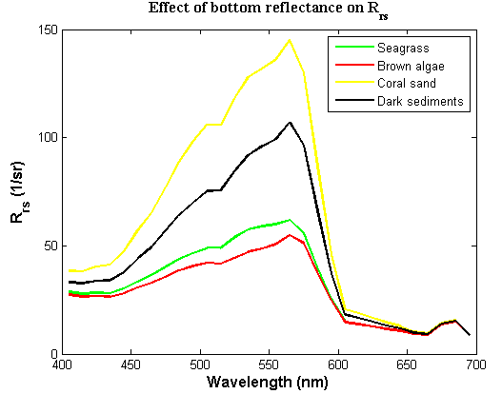
Effect of bottom reflectance on Rrs
[Chl]= 6 mg/m³

Slide 13
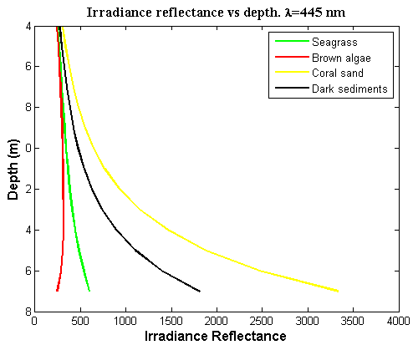
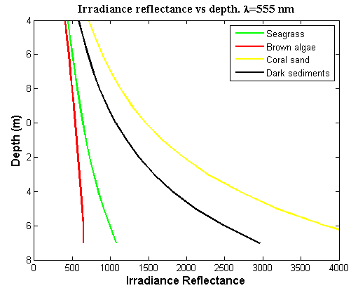
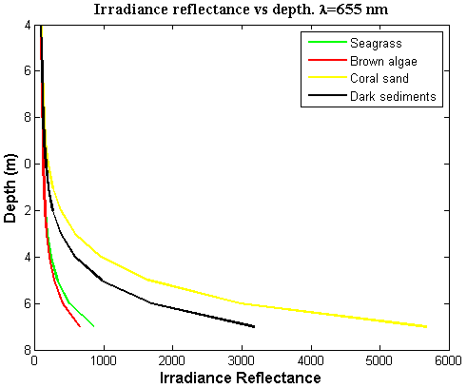
Irradiance reflectance vs depth

Slide 14
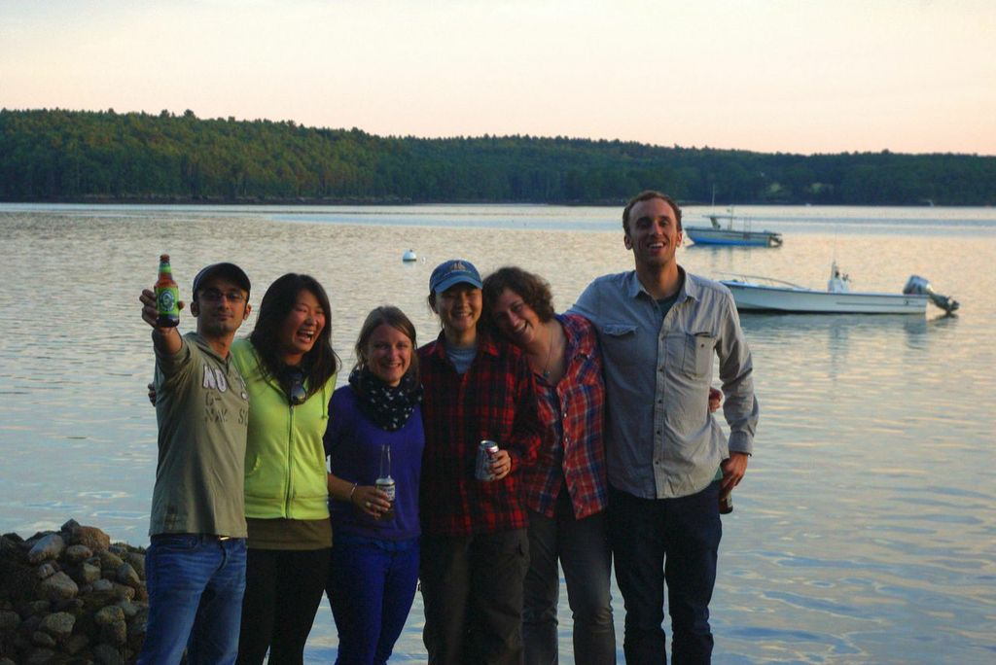
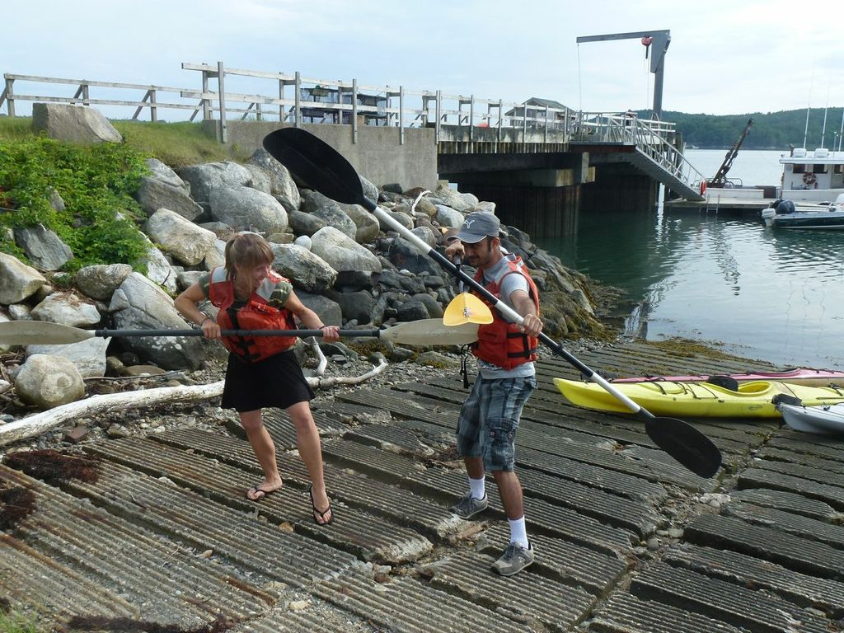
THANKS!

Slide 15
R_{rs} Dependence on Sun Zenith
Rrs as seen from 40˚, 135˚ viewing angle
Small variations in Rrs with sun zenith angle (assume Rrs is calculated exactly..?)

Slide 16
R_{rs} Dependence on Sun Zenith
The change in Rrs must be due to viewing the VSF at different angles drops off at >60˚ due to less light enter the water at high angles.

Slide 17
Rho Dependence on Sun Zenith
A rho of 0.28 appears to be a good approximation unless the sun is directly overhead. Rho also becomes spectrally dependent at small zenith angles.

Slide 18
Phase Functions
From Lab 4
Arizona Dust – 40-30 um
Platymonas – 16-30 um
Chaetoceros – 7-10 um (chains)
DRE - ????

Slide 19
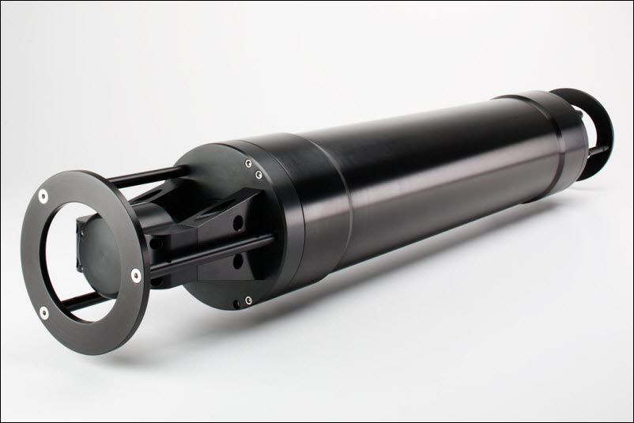
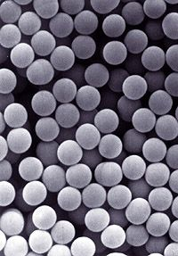
LISST, Eco VSF, Mie Theory
Fit phase function to LISST and VFS measurements of bead mixtures (and well characterized culture? Coccolithophores?).
Compare the phase function to the predicted function calculated using Mie theory.
Video for explaining the calibration, data collection, deployment, data analysis of LISST.

Slide 20
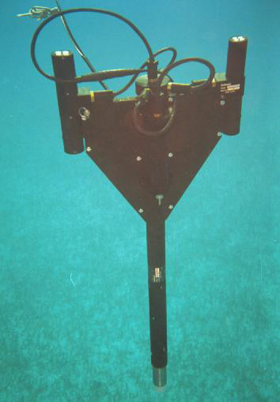
HyperPro
Ashley and Morgaine
A video!!!
View of the instrument in and out of the water.
Demonstrate (at least one) buoy-mode deployment.
Demonstrate profiling?
Demonstrate basic data processing.
Suggestions for where user can go from there.

Slide 21
Fluorometry Group:
Matt, Sophie, & Elizabeth
Fluorometer profiles, ideally in a transect (WetLabs and potentially Turner-cyclops)
  Matching Niskin bottle samples at intervals to be analyzed later in lab
  Proper lab protocols for bench-top fluorescence
Satellite image match-ups, if available
Discussing limits/pitfalls
  NP Quenching, fluor:chl:carbon, temperature/pressure effects, CDOM interference, etc
For video only: introduction to fluorescence
  Shine blue light on culture or spinach extract (if possible)
  Shine CDOM fluorometer onto white paper
  Very basic chemistry (excitation of an electron)

Slide 22
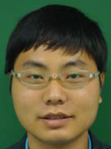



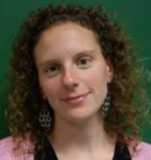
An Introduction to Radiometry:
Taking Measurements, Getting Closure, and Data Applications
Notes:
During this video you will learn the basics of radiometry and how to take proper measurements in the field and aboard ship with a variety of instruments. Using real data we’ll also show you how to process and compare results from these instruments.

Slide 23
The Plan: Dock Tests + Cruise Data
Comparison 1:
Find R_{rs} with the HyperPRO, HyperSAS, WISP
Get closure!
Comparison 2:
Measure chlorophyll with Fluorometer (CTD samples) and the WISP
Compare methodologies
Combine the results in a video introducing the basics of radiometry, instrument use, and data processing/comparison/application

Slide 24



If we have time…
We’ll make the part (or all?) of the video in Chinese and Spanish.

