Slide 1
BB9/ECOVSF

Slide 2
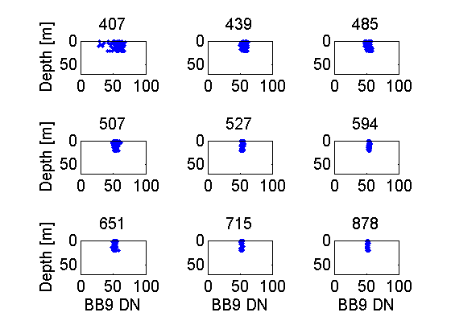
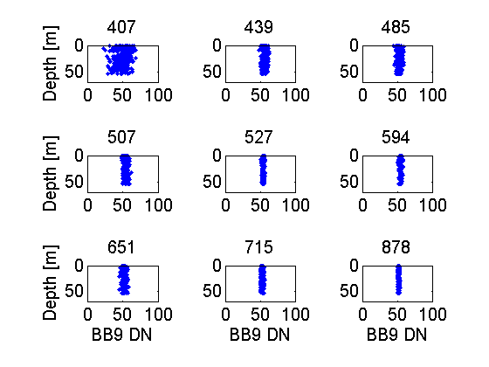
Second Day Station 1 – Cast 076
Dark Measurements
Second Day Station 2 – Cast 079
Dark Measurements

Slide 3
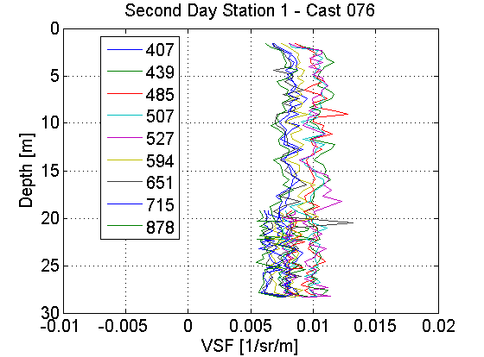
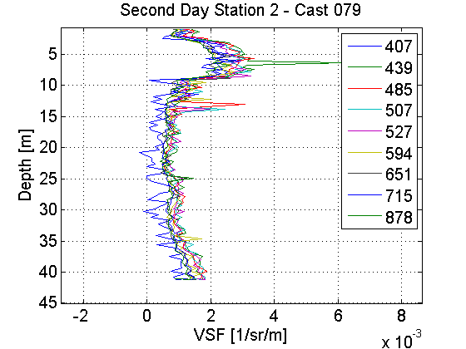

Slide 4
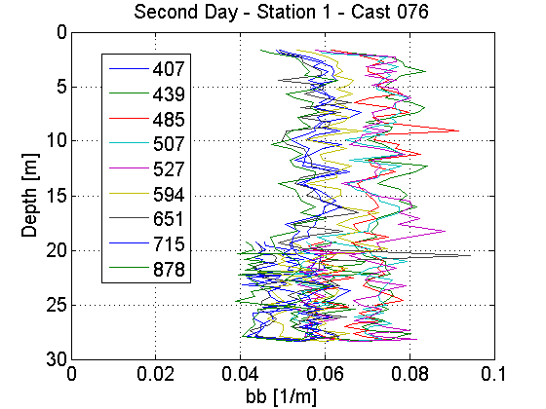
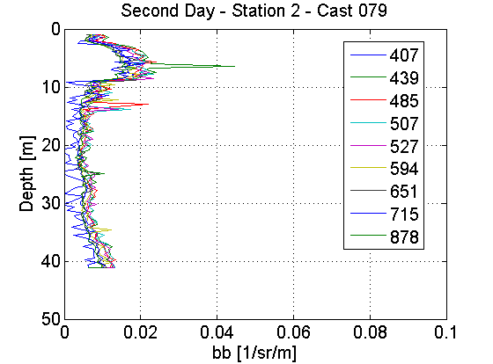

Slide 5
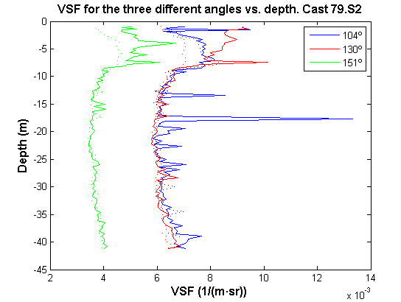
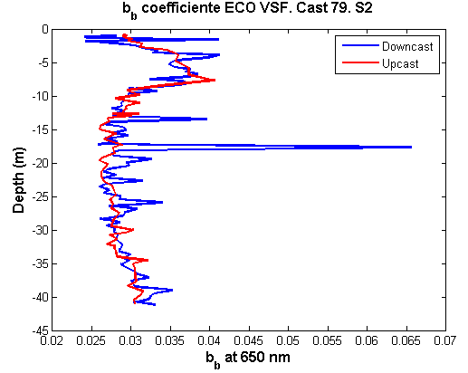
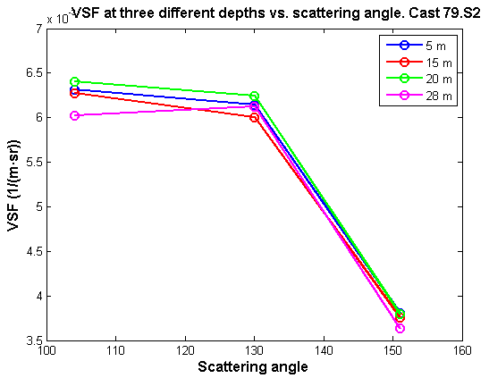
ECO VSF – Wednesday 072413 Example: Cast 79. Station 2
The upcast is less noisy than the downcast.
Between 4-8 m depth, increase the value of the backscattering coefficient → change on the particle composition/concentration. Probably, presence of a thin layer (compare with fluorescence measurements)

Slide 6
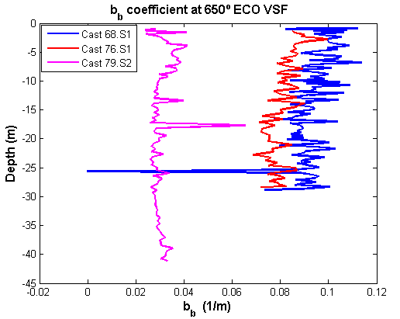
Comparison of the b_{b} coefficient for the different casts.
On the river station (blue & red), b_{b} values higher than on the ocean station (magenta), due to the higher concentration of particles.

Slide 7
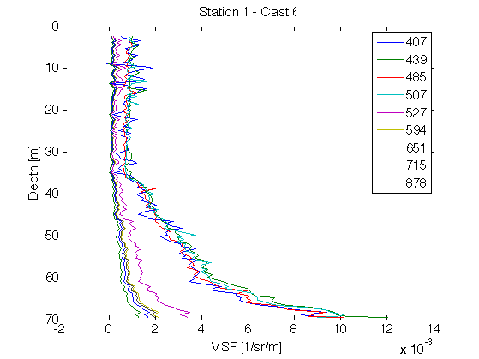
VSF(124°) – Station 1, Cast 6
WRONG!

Slide 8
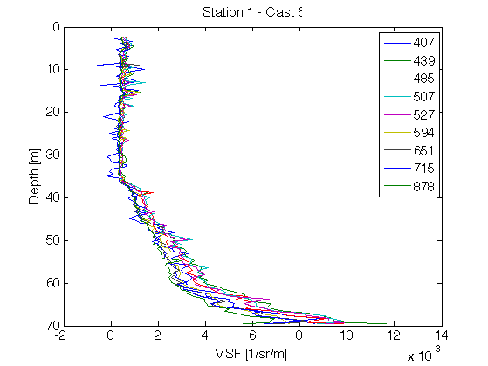

Slide 9
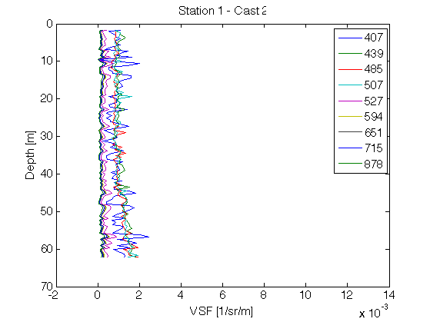
VSF(124°) - Station 1, Cast 2
WRONG!

Slide 10
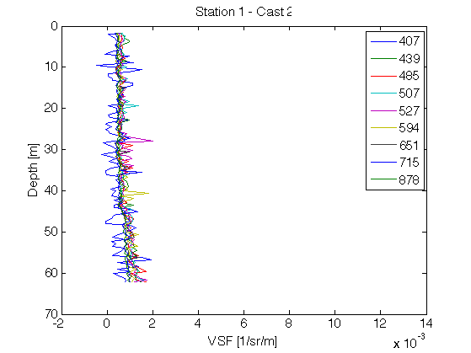
VSF(124°) - Station 1, Cast 2

Slide 11
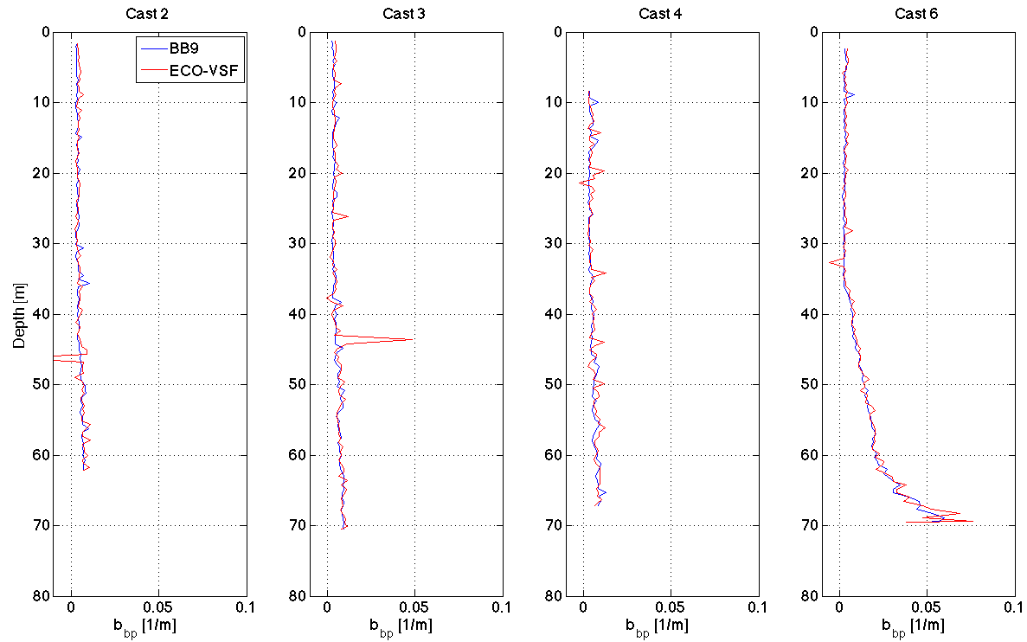
BB9-ECOVSF Closure Cruise 1 – Station 1

