Slide 1
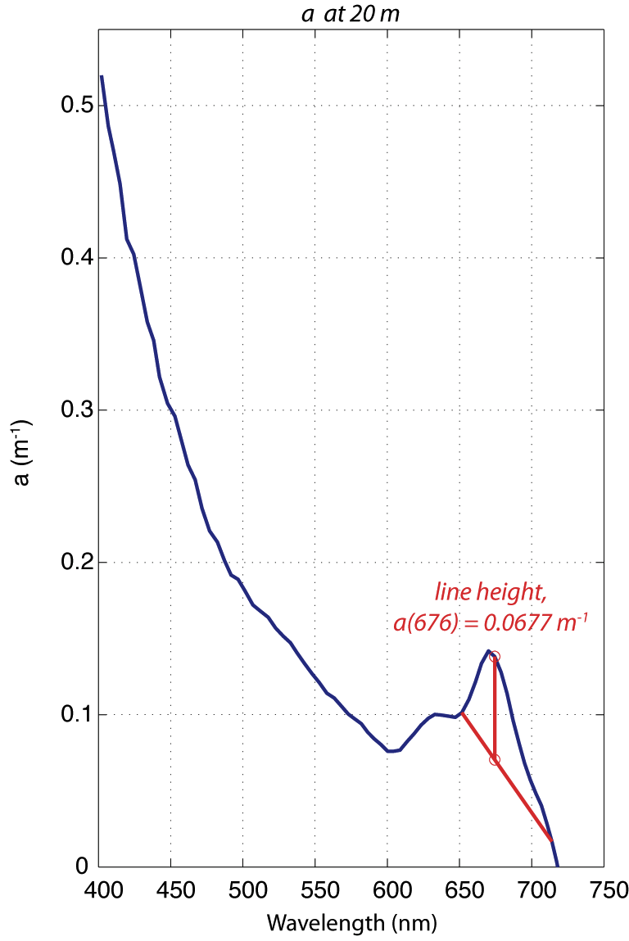
Chlorophyll Profiles from a(676)
a(676,z) = chl(z)
a*(676)

Slide 2
Chlorophyll Profiles from a(676)
a(676,z) = chl(z)
a*(676)

Slide 3
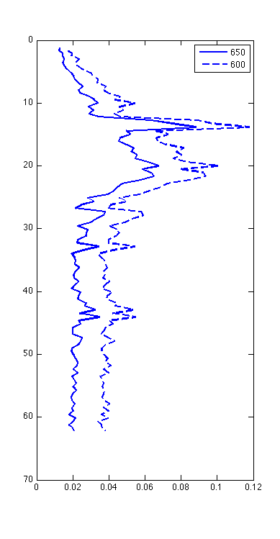
Chlorophyll Profiles from a(676)
a(676,z) = chl(z)
a*(676)
Depth (m)
Line Height, a(676) (m⁻¹)
Notes:
Note higher magnitude of 600, makes sense….

Slide 4
Chlorophyll Profiles from a(676)
a(676,z) = chl(z)
a*(676)
Depth (m)
Line Height, a(676) (m⁻¹)
Notes:
Note higher magnitude of 600, makes sense….

Slide 5
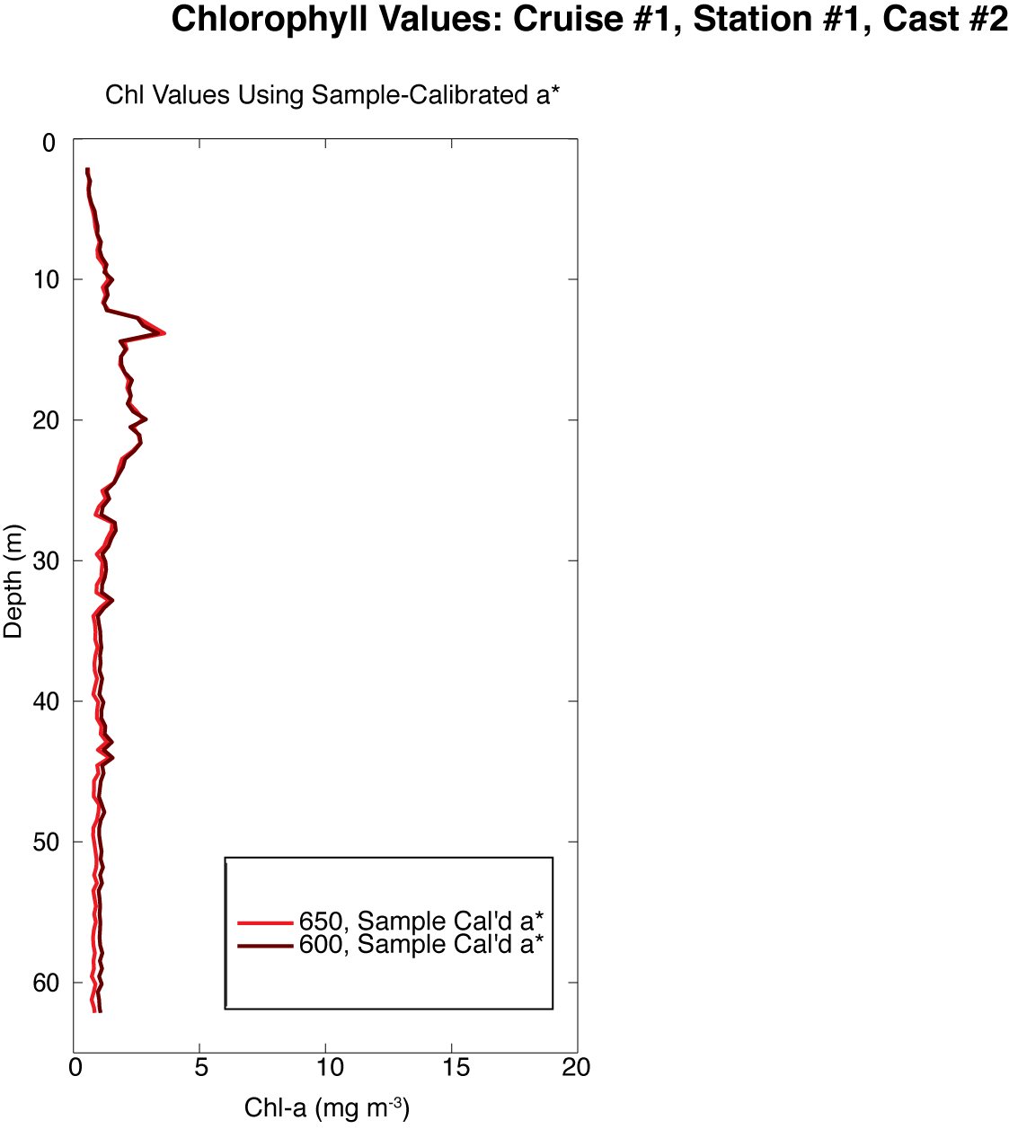
a(676,z) = chl(z)
a*(676)

Slide 6
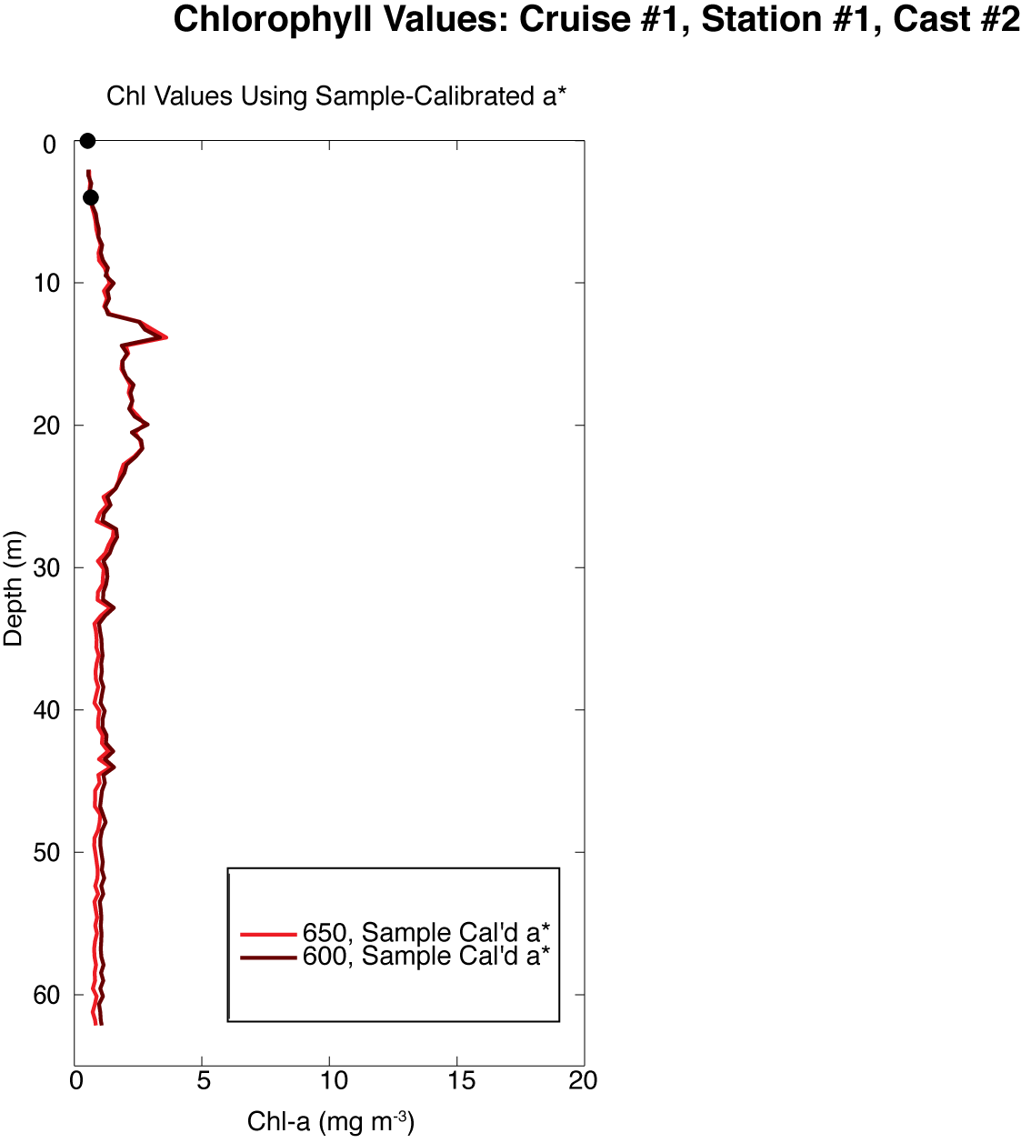
a(676,z) = chl(z)
a*(676)
a*(676)_{cal’d} = 0.022

Slide 7
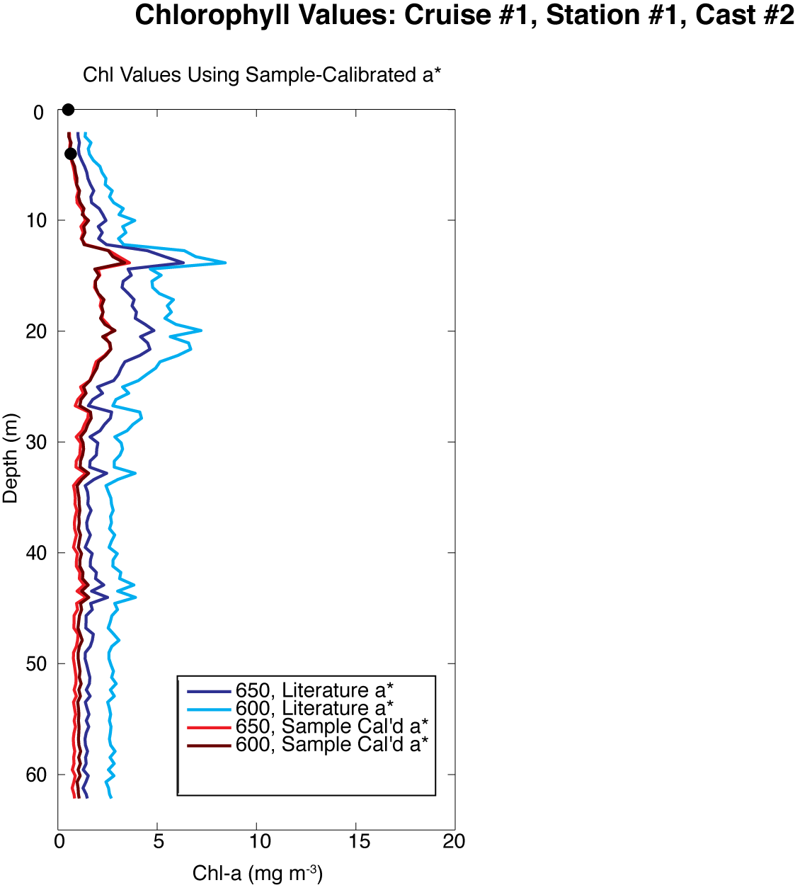
a*(676)_{lit} = 0.014

Slide 8
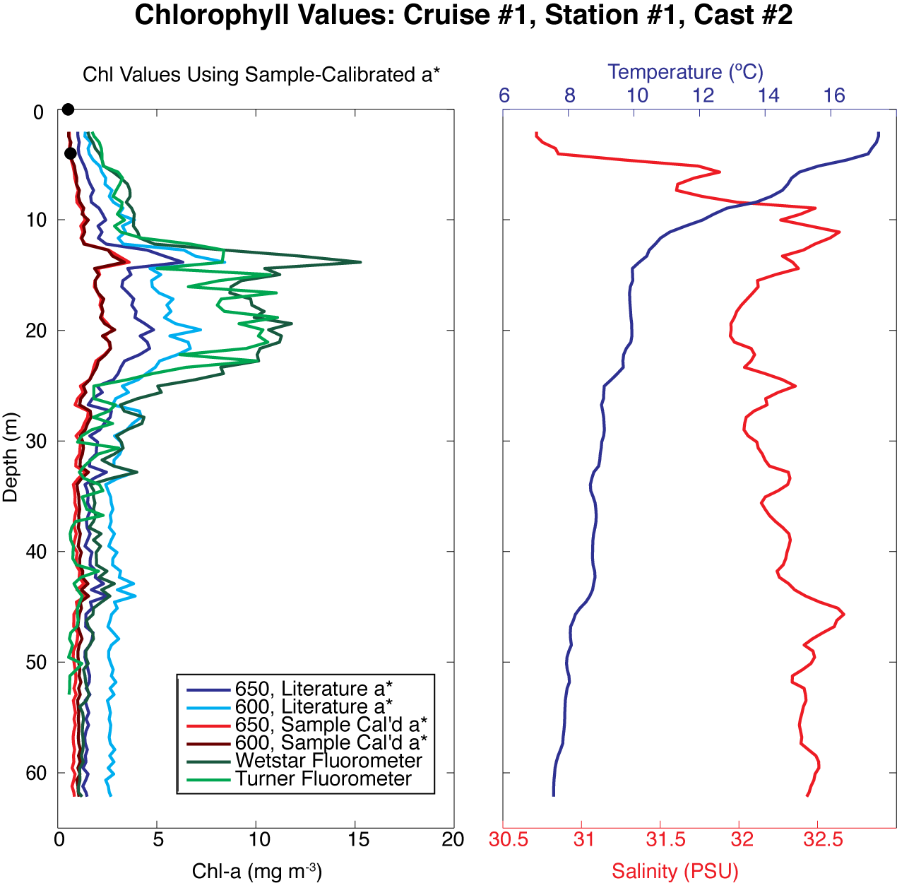

Slide 9
Notes:
Chl fluor cals??
A* to use?
600 vs 650?

Slide 10
