Slide 1
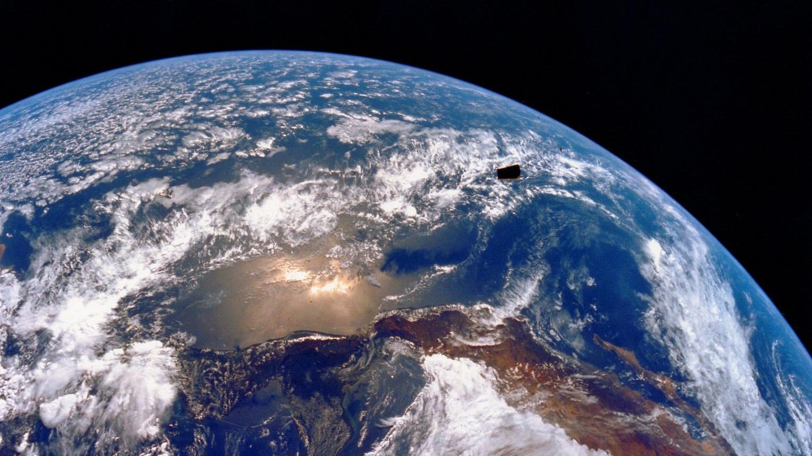
Notes:
Oceans cover approximately 72% of earth’s surface and contain over 90% of earth’s water.

Slide 2
Notes:
Scientists study the world’s oceans to learn about areas like productivity, anthropogenic impacts, and climate change. One emerging area of oceanography, ocean optics, focuses on the study of the optical properties of light and how light can change in the atmosphere and oceans. From these interactions we can learn about chlorophyll levels, particle size, and productivity in the oceans. In this video we will explain how optical oceanographers study light interactions and the common instruments that they use. We’ll also show you the best practices for calibration and field measurements, as well as what common result spectra could look like.

Slide 3
Remote Sensing Reflectance R_{rs}
Notes:
Now for an introduction into remote sensing reflectance

Slide 4
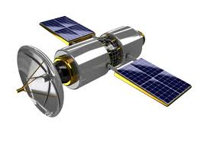
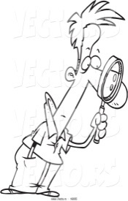
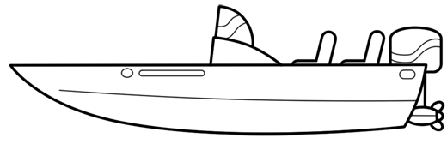
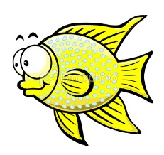
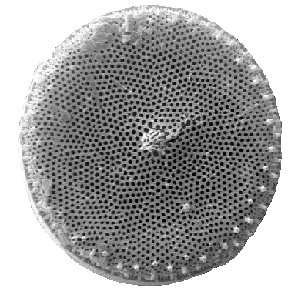
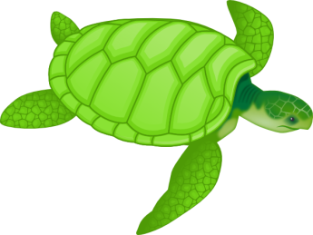
Atmospheric effects
Satellite
Skylight
L_{w}
In situ
E_{d}
L_{r}
Absorption
Downwelling irradiance E_{d}
Reflected radiance L_{r}
Water-leaving radiance L_{w}
Scattering
Transmission
Notes:
Light from the sun can be viewed as a bunch of energetic photons or waves. When this energetic light hits the water’s surface the total amount of energy per unit area received by water is the down-welling irradiance (referred to as Ed). Some of the light can be reflected back into the air and is called reflected radiance (or Lr) when viewed at a specific direction and a given solid angle. Within the water column, some of the light is further absorbed by water molecules, particles, CDOM and minerals etc; some are scattered or redirected before continuing their trips. These processes are pretty random and photons can travel in various paths. After these absorption and scattering, some are lucky enough to transmit through and travel deeper into water and some will be reflected back into air. And this part of energy at a given solid angle and a specific direction observed is the water-leaving radiance. Scientists are interested in the water-leaving radiance because it brings information of the biogeochemical state of water. Water-leaving radiance can be either collected by in-situ field work or be photographed by satellites. Clear sky is an ideal condition since when there are clouds, the particles and water molecules inside the clouds can also absorb or scatter sunlight and hence cause difficulty to calculate the actual light received by satellites. The reflected light, as well as the absorption and scattering of air molecules also contribute to the noise received by satellites.

Slide 5
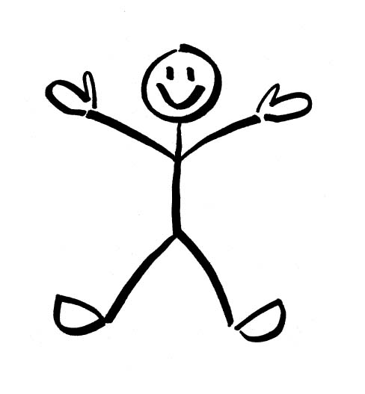
R=E_{u} /E_{d}
Air
Water
Downwelling irradiance E_{d}
Upwelling irradiance E_{u}
Notes:
As we mentioned as irrdiance and radiance, it is important to give you an overview of these two concepts. Imagine you stand on the water surface, the total energy brought by photons hitting you from all directions are the downwelling energy. And the total energy received per unit area is the downwelling irradiance. The upwelling irradiance is easy to understand and just think of the photons hitting you from below the water surface. Reflectance can be viewed as the ratio of upwelling irradiance over downwelling irradiance.

Slide 6
R_{rs}=L_{u} /E_{d}
dΩ
Air
Water
Upwelling radiance L_{u}
Notes:
The reflectance measured by satellites is a little different since satellite only measures radiance instead of irradiance. Think that you are viewing at a specific direction, the total energy per solid angle you receive is the radiance. Therefore, radiance is viewing direction and solid angle dependent. Only if the water surface is lambertian surface, the upwelling radiance at all directions are identical. Remote sensing reflectance is defined as the ration of the upwelling radiance over the downwelling irradiance.

Slide 7
Radiometers

Slide 8
Above water
In water
Skylight L_{i} ~ L_{r}
L_{w}
E_{d}
E_{d}
Air
Water
Air
L_{t} = L_{r} + L_{w}
Water
Notes:
There are mainly two types of configurations of radiometers. One is for above water measurements. This type of radiometers usually consist of a sensor measuring downwelling irradiance, a sensor pointing downward to measure the total upwelling radiance including the reflected radiance and the water-leaving radiance, and a third sensor measuring sky radiance. This third sensor is used as a reference of the reflected radiance and helps correct the total radiance in order to get the water-leaving radiance. The other type of configuration is for in-water measurements. Again, this type of radiometers include a sensor for downwelling irradiance. Instead of using a third sensor for sky radiance, they measure the water-leaving radiance directly by attach a cone to the end of the radiance sensor pointing downward. Some radiometers do not have the cone and instead they take measurements at different water depths. By multiple corrections such as depth correction and air-water interface correction, people can also get the water-leaving radiance.

Slide 9
φ =135 °
θ = 40 °
Notes:
Especially for above-water measurements, there are recommendations of measuring geometry in order to reduce the sun glinting and variability of field measurements. Think that the sun is in the grey plane. It is recommended standing ~135 degree away from the sun and holding the instrument about 40 degree downward.

Slide 10
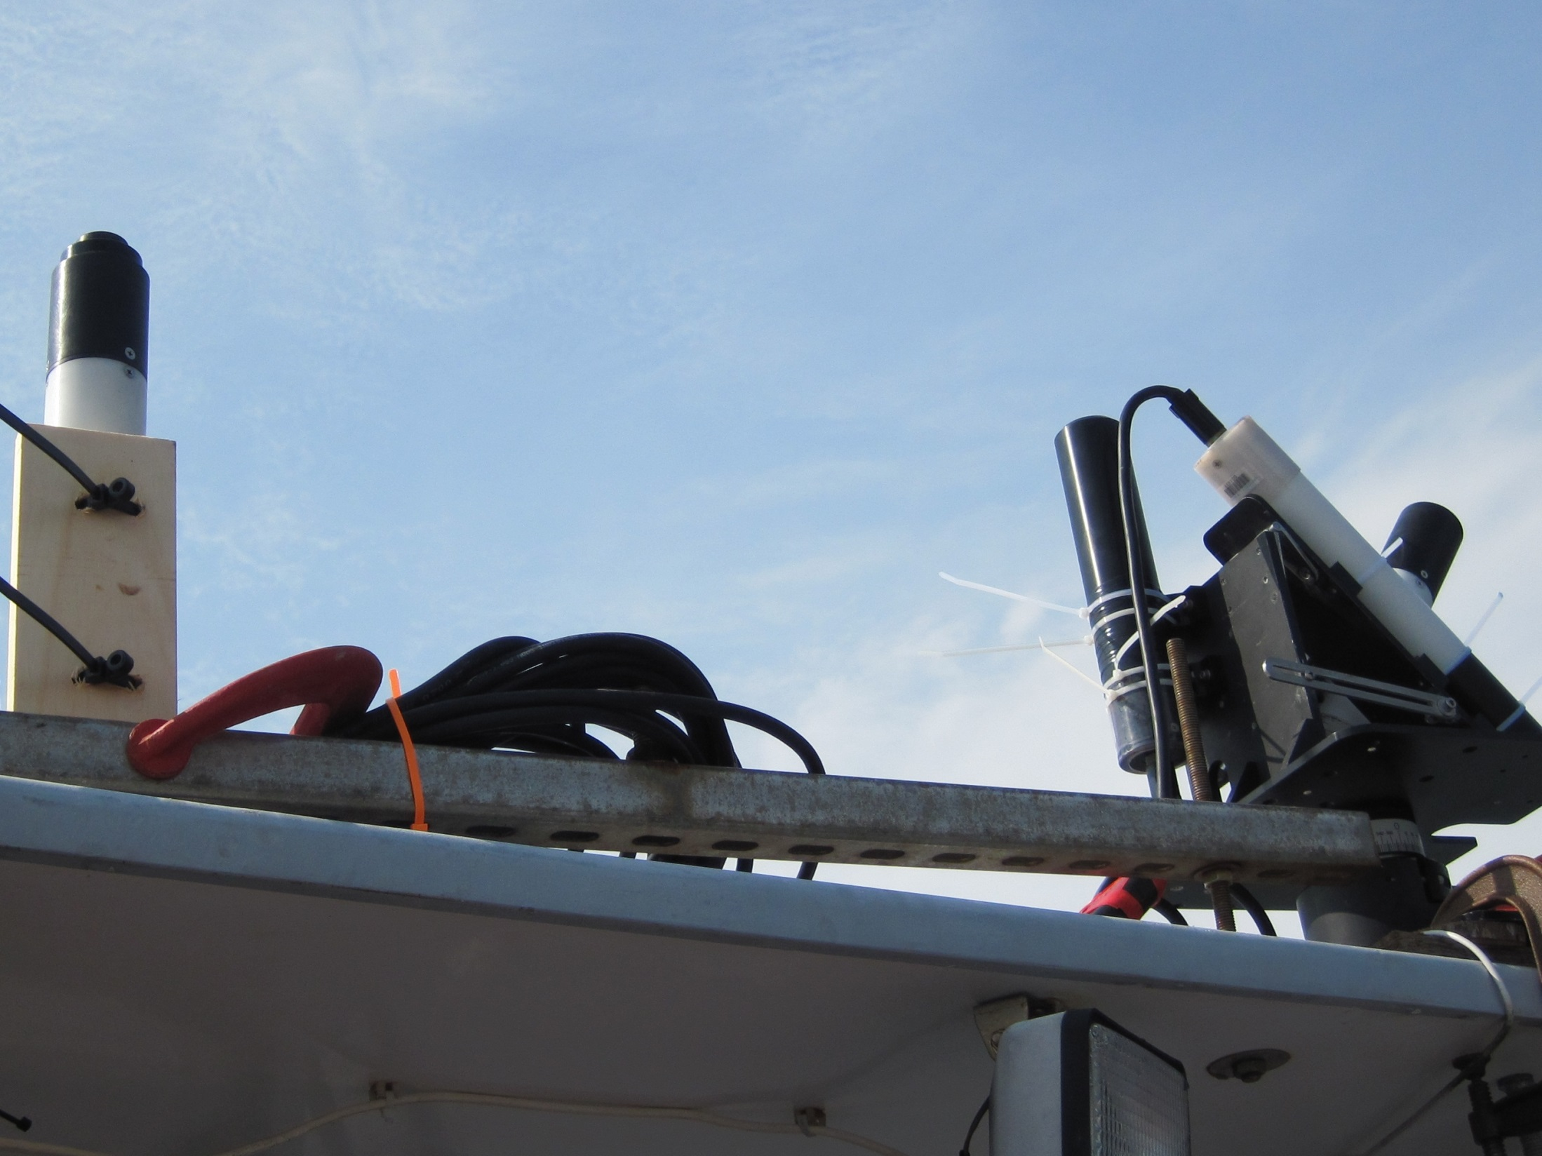
E_{d} Sensor
L_{t} Sensor
L_{i} Sensor
Tilt Heading Sensor
SECURE MOUNT
Notes:
HyperSAS mainly consists of a Ed sensor, a Lt sensor and a Li sensor.

Slide 11
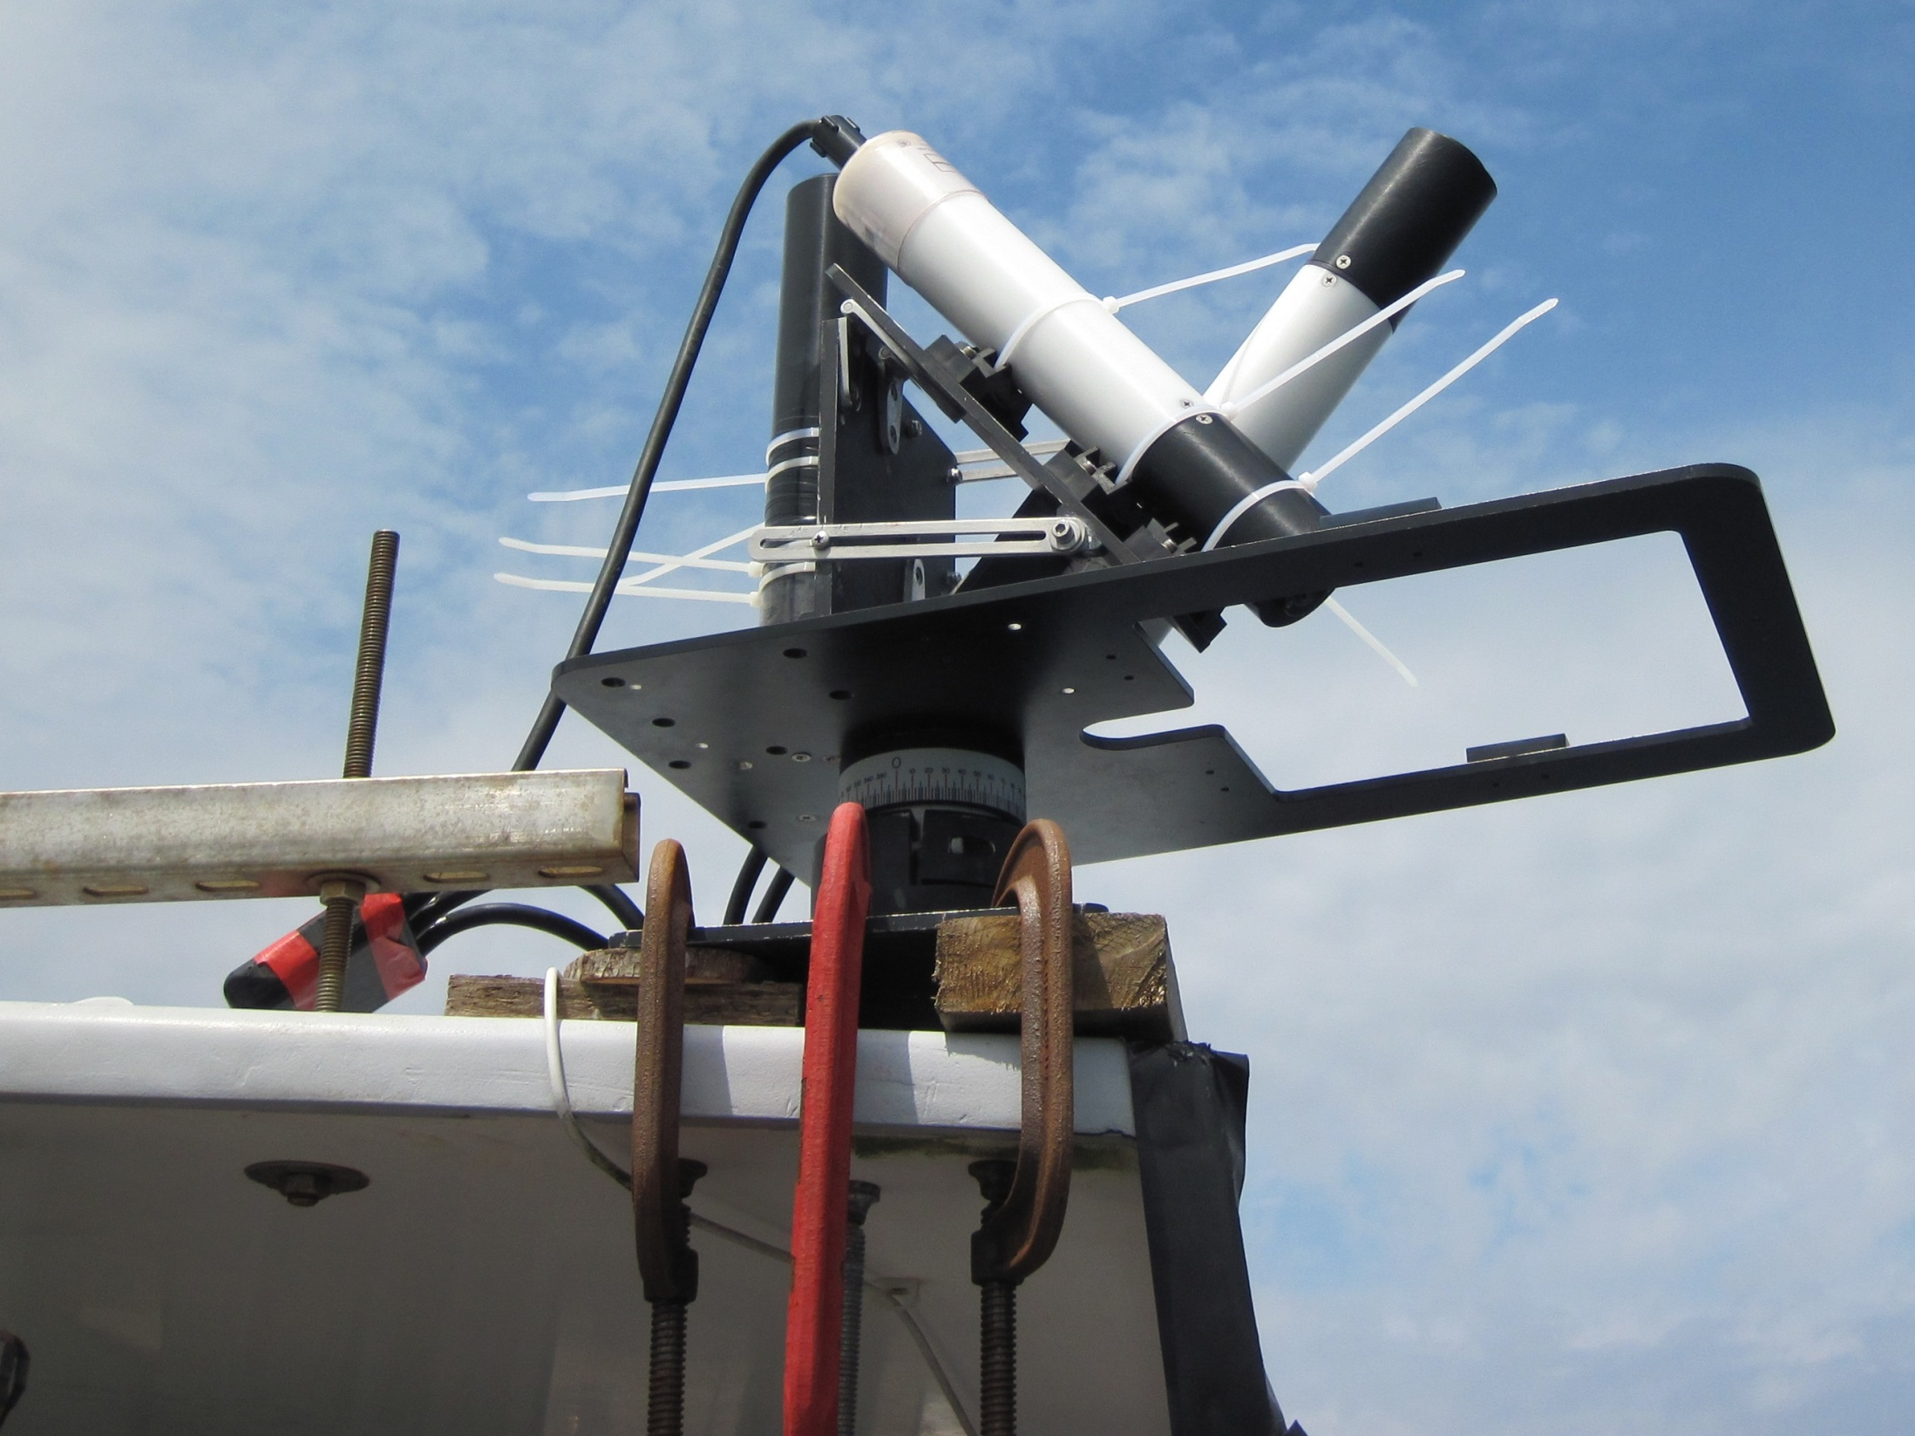
L_{i} Sensor
Tilt Heading Sensor
L_{t} Sensor
SECURE MOUNT

Slide 12
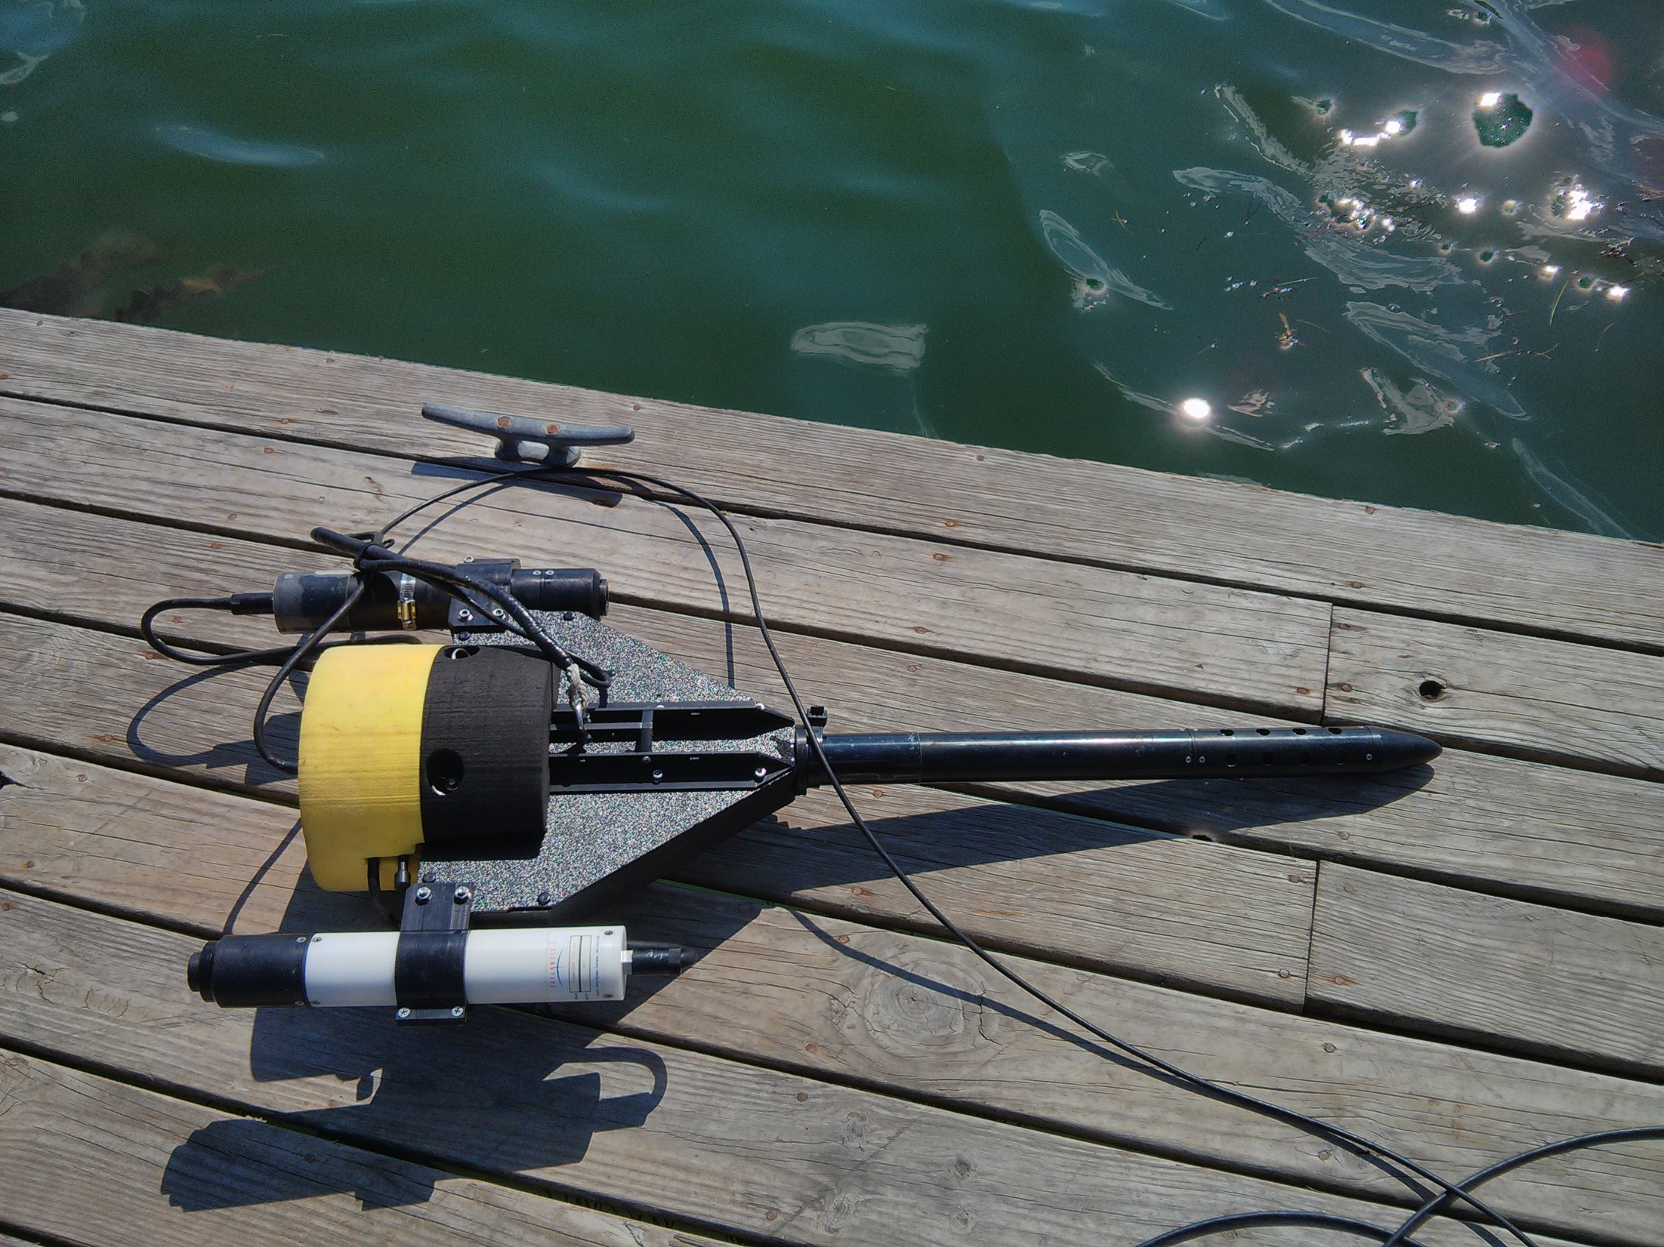
Upwelling Radiance Sensor L_{u}
Tilt sensor
Pressure sensor
Downwelling Irradiance Sensor E_{d}
Notes:
Other general recommendations include making sure that the instrument is not being shadowed by the boat and making sure that there is good communication between instrument and computer before deployment. It is important to use the lock that secures the cable to the main body of the instrument to prevent damage in the connections due to pulling. It is also helpful to take notes on wind speed and cloud cover while the instrument is recording.
Try to keep the instrument away from the boat to prevent interference with ship shadow. Additionally, try to match data collection times with casts of other radiometers and additional instruments. After data collection, make sure to look at the time series of each cast in order to check for fluctuations in the data. Make sure to note times when the instrument is too close to the boat and the sky conditions are variable. Remove any data that is compromised before processing an entire time series.

Slide 13
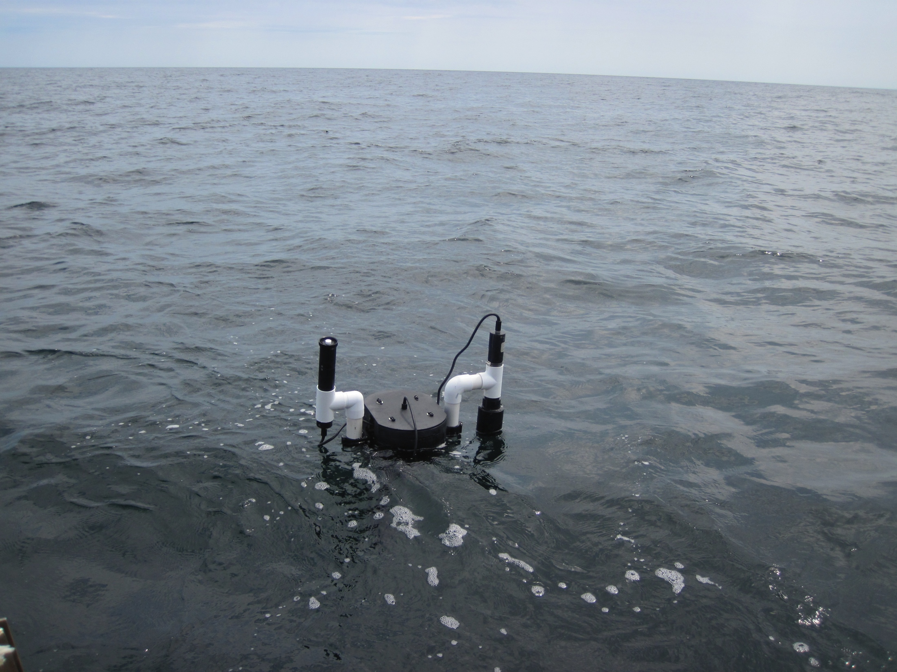
Buoy
E_{d}
L_{u}
Notes:
- You pull the buoy slowly vertically out of the water

Slide 14
Instrument Operations

