Slide 1
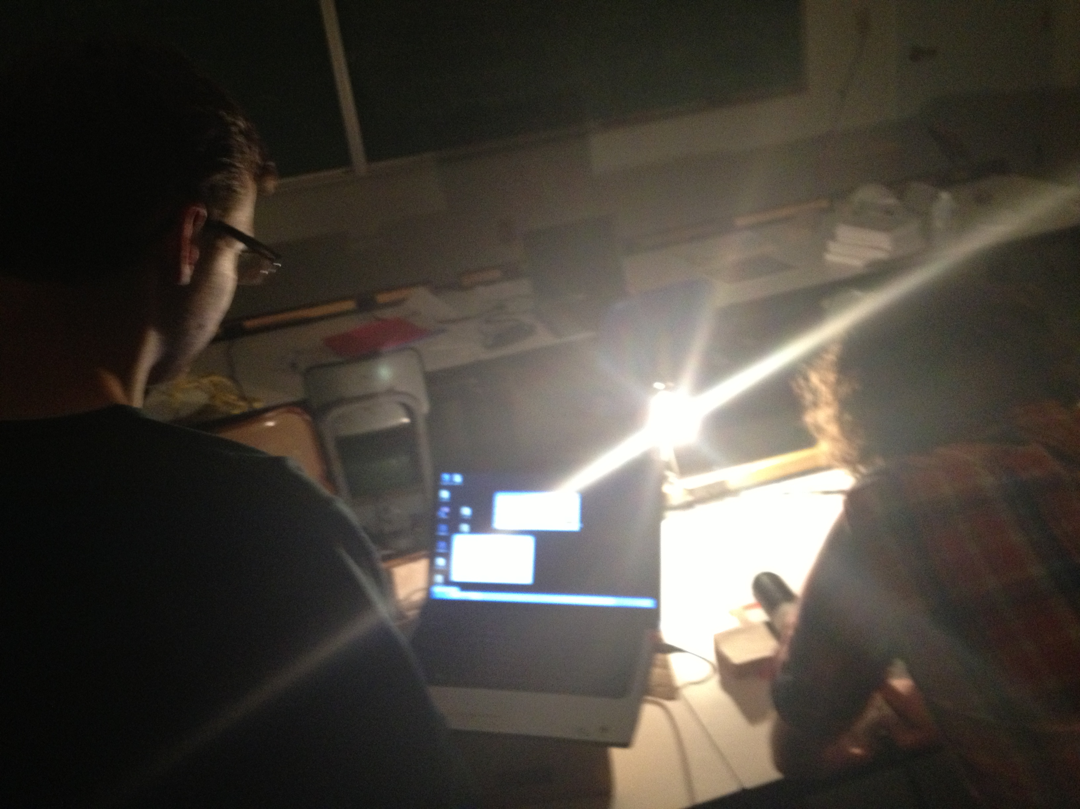
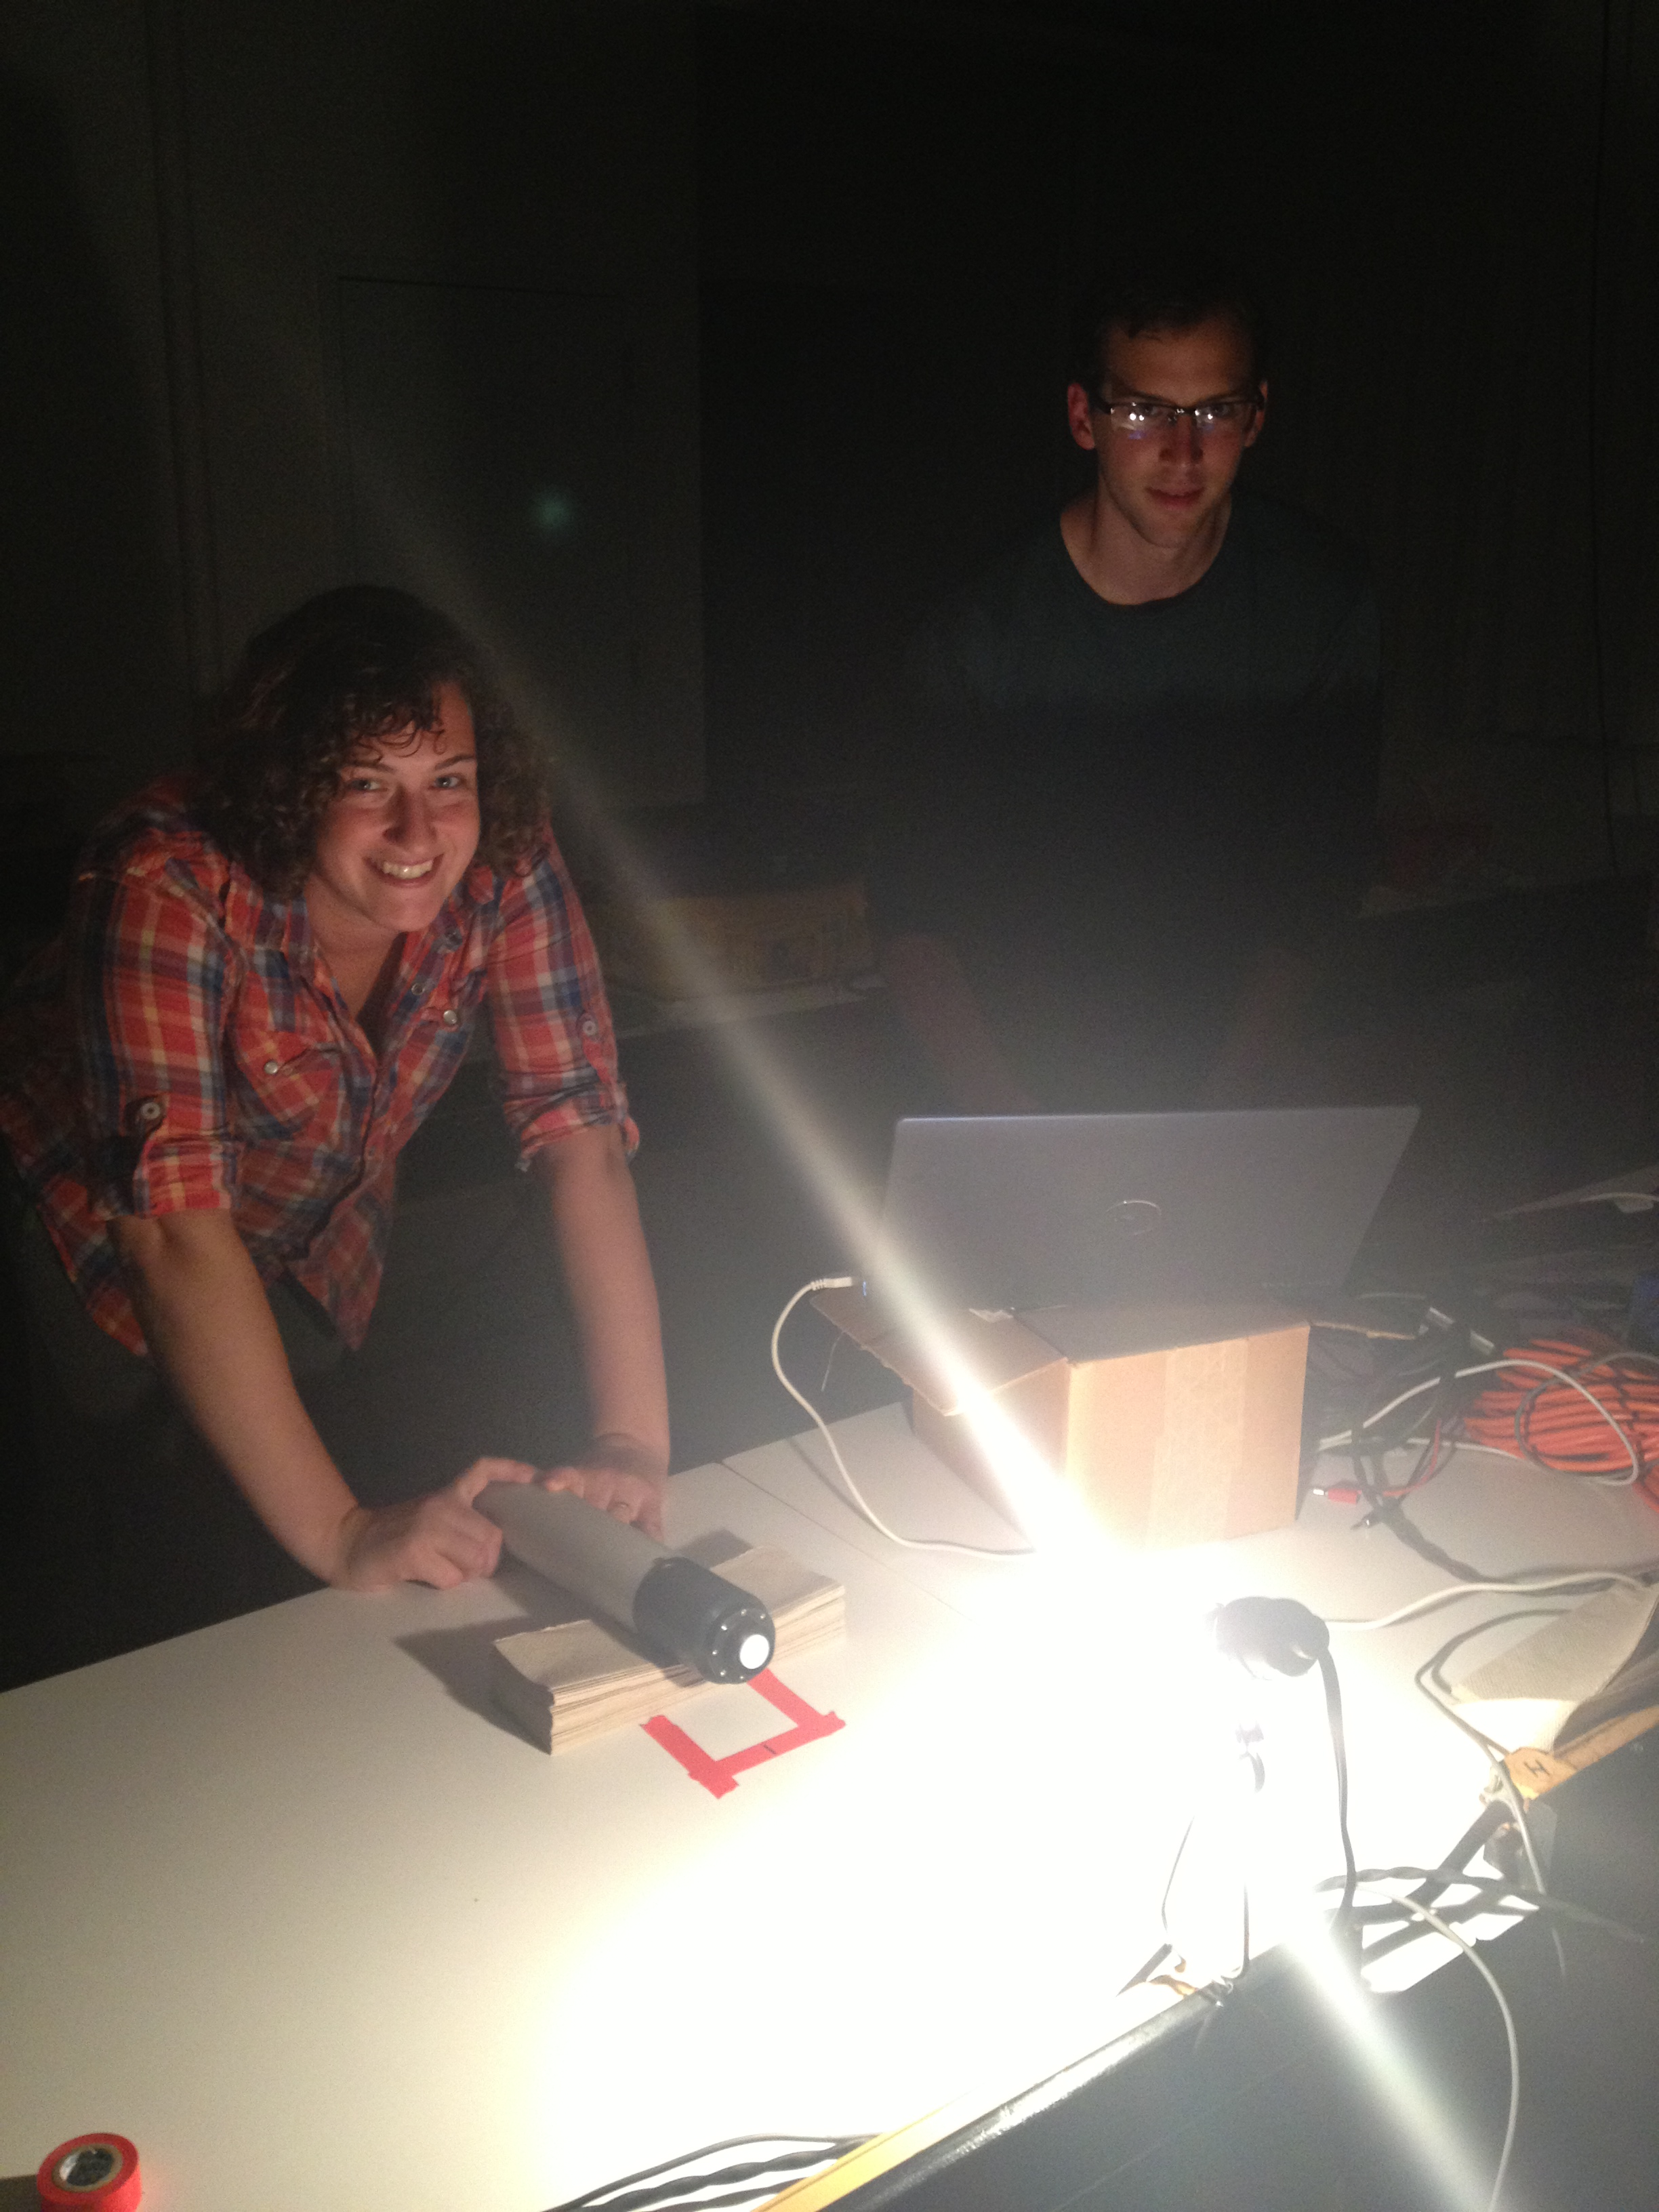
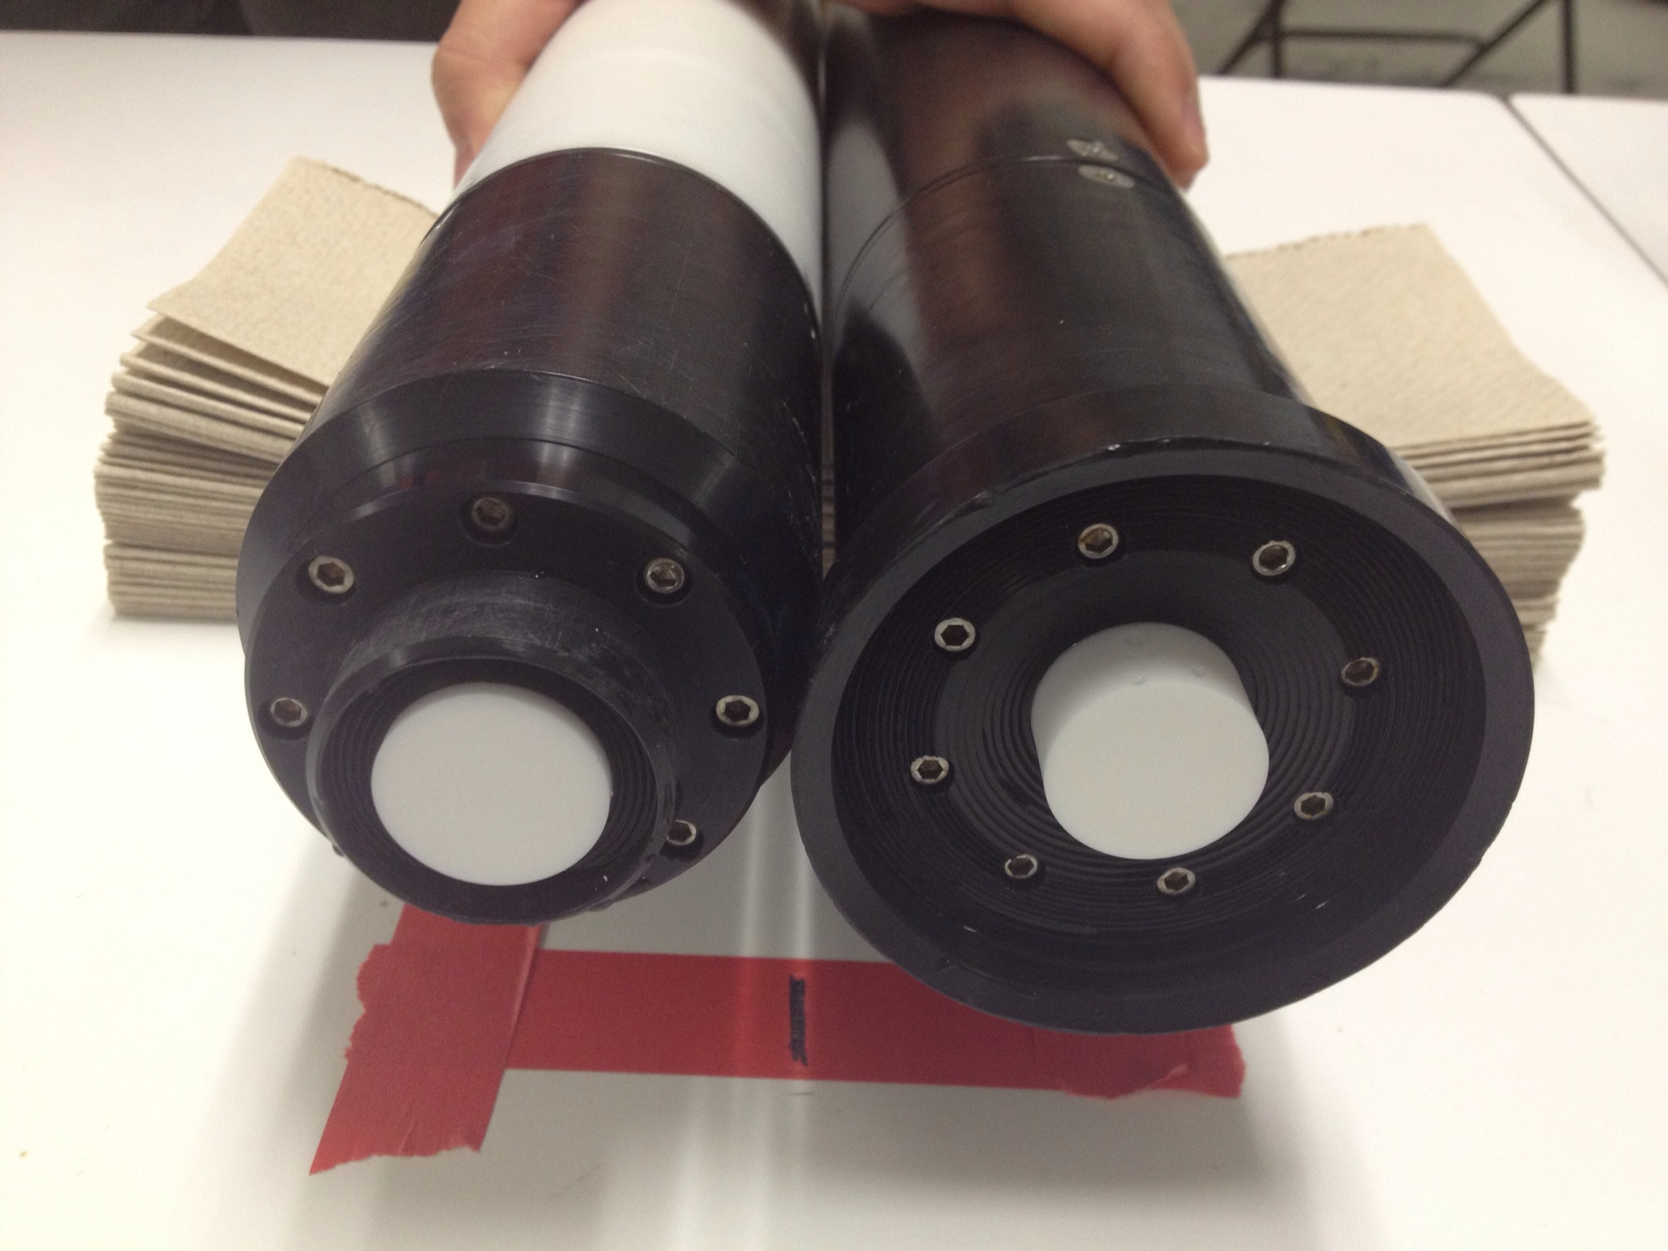
E_{d} Comparison

Slide 2
PRO and SAS Ed Measurements
Ed values were different for SAS and PRO radiometers
Examination of one set of data (Cruise 1 Station 1) show that there is a consistent difference between the sensors

Slide 3
PRO and SAS Ed Measurements
We measured irradiance of a lamp in the lab with both sensors (SAS and PRO)
There is a consistent difference between the irradiance curves returned by each instrument (max std 0.008 for both sensors, thus the difference is not explained by the uncertainty of the instrument).

Slide 4
Field
Ratio is higher for the field measurements (includes other factors: reflection off boat, water on sensor face)
Lab
The difference between sensors is real and significant, Pro irradiance is 10% higher than SAS irradiance.

